Slide 1
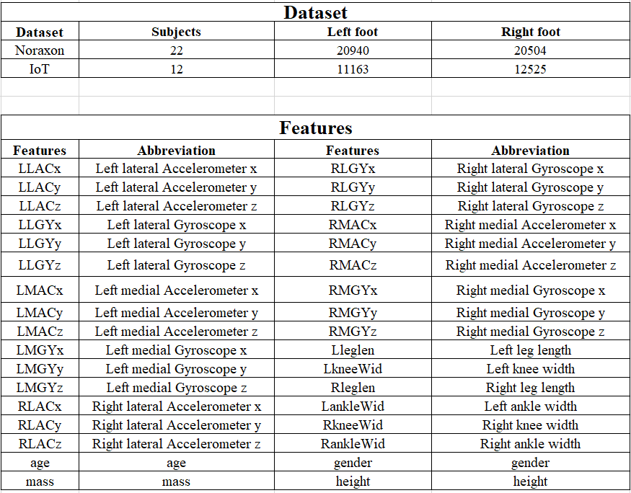
Data and features

Slide 2
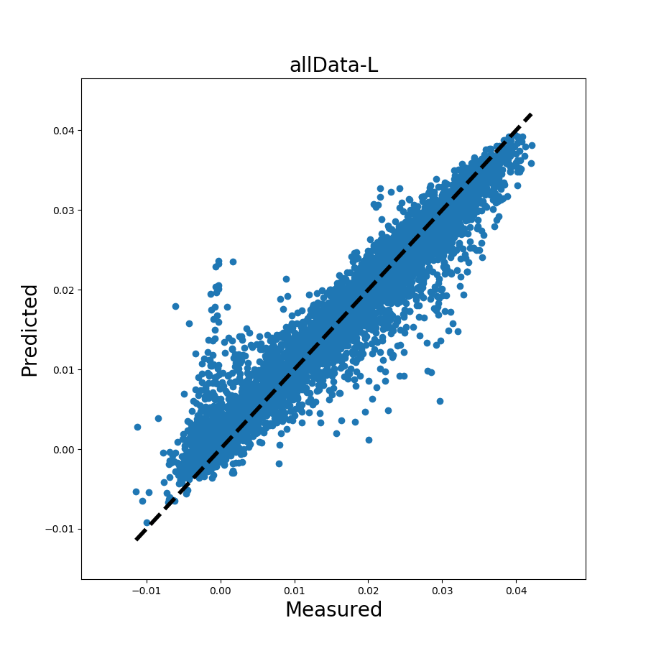
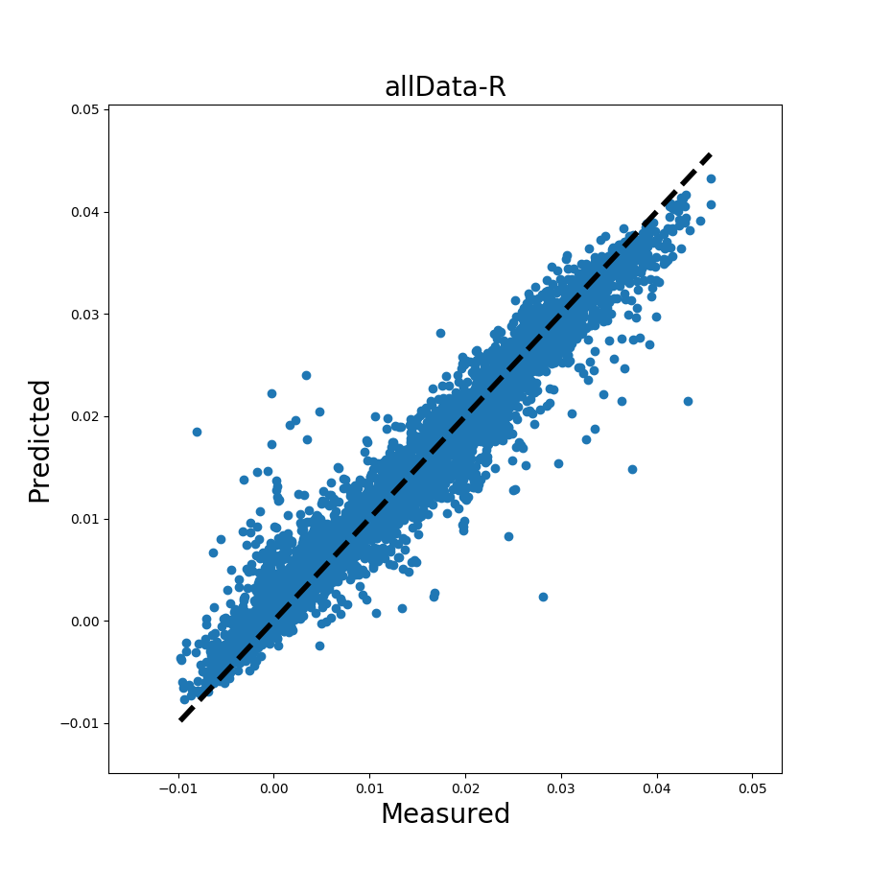
Random forest training
Training data: 70%
Testing data: 30%
Noraxon left foot model
Noraxon right foot model

Slide 3
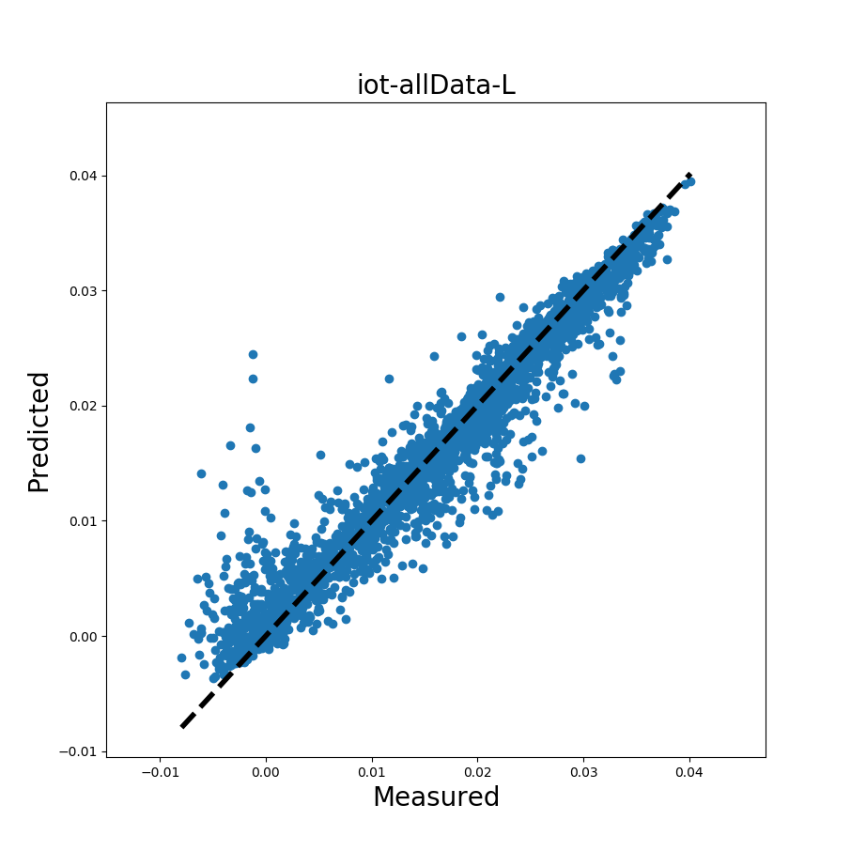
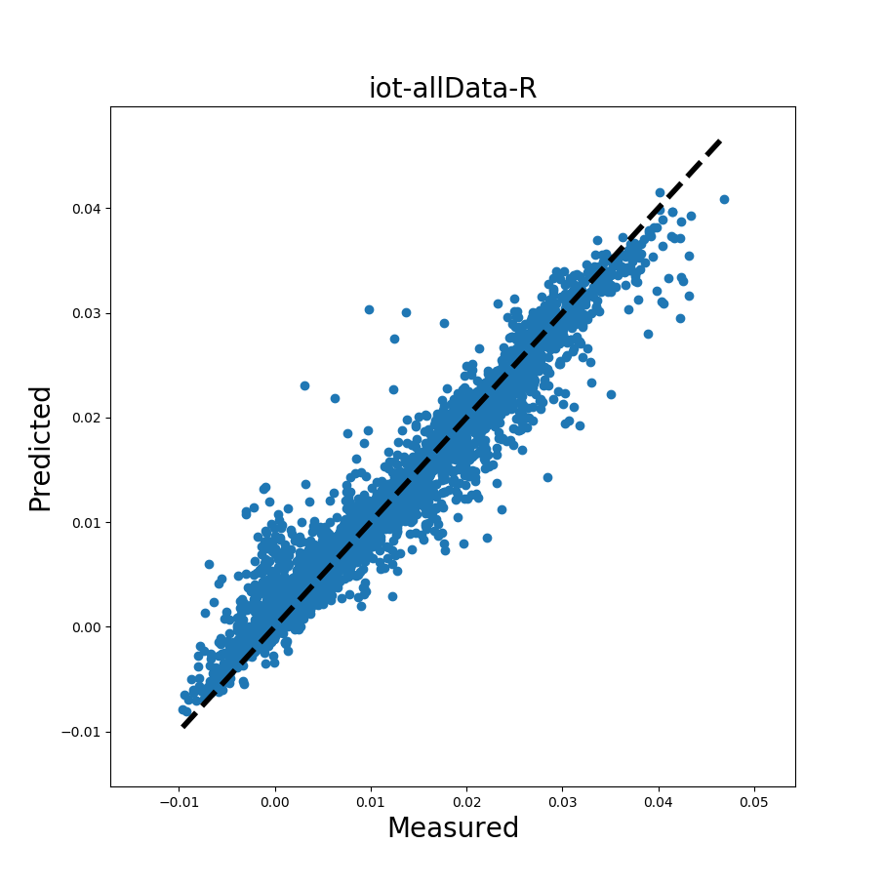
IoT left foot model
IoT right foot model

Slide 4
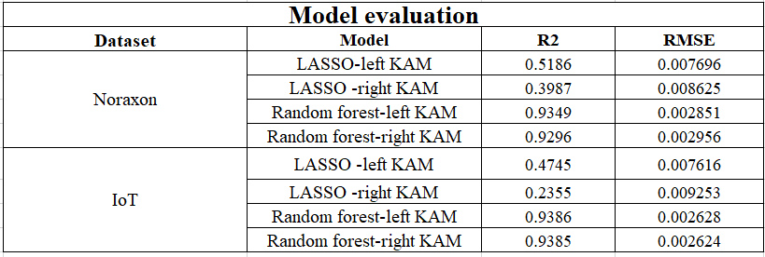
Model evaluation
R2 = 1 indicates that the fitted model explains all variability in response variable.
R2 = 0 indicates no linear relationship between the response variable and predicted values.

Slide 5
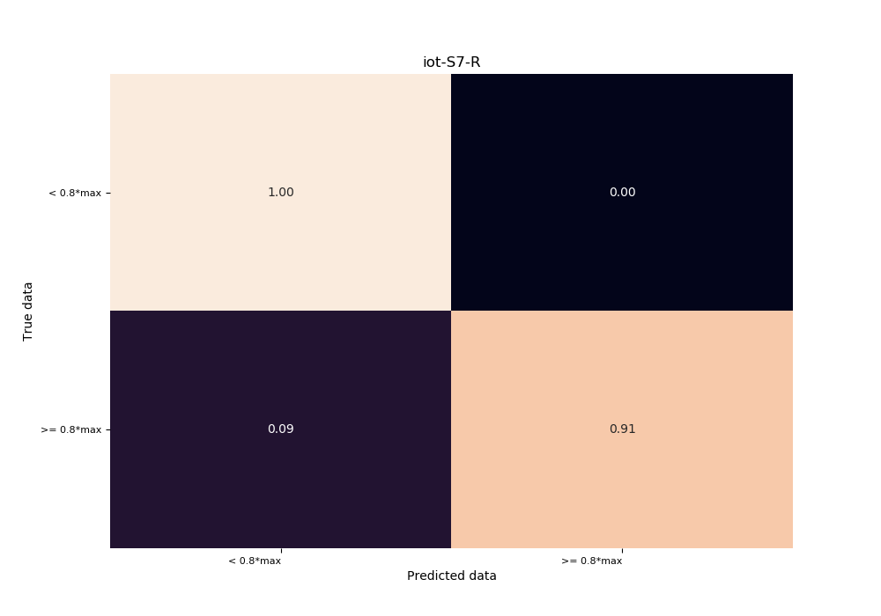
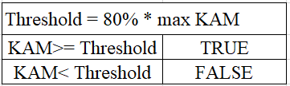
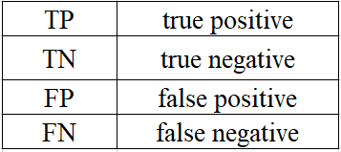
Confusion matrix

Slide 6
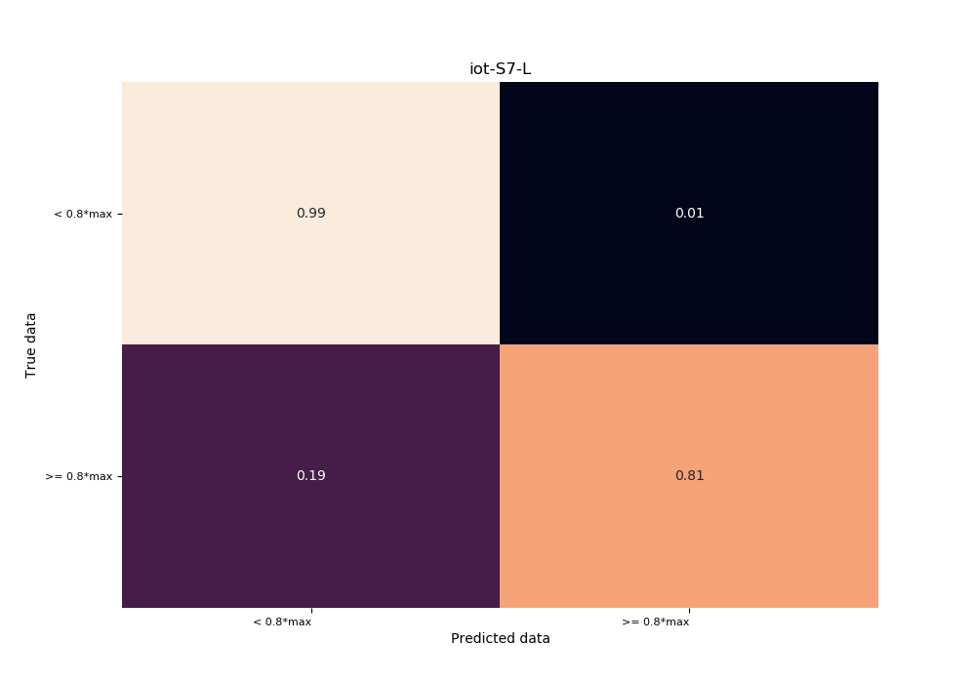
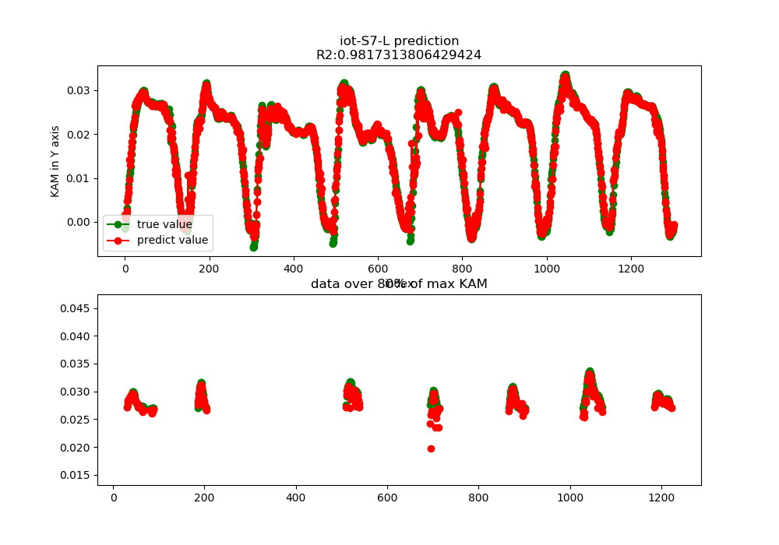
IoT-subject7-left foot

Slide 7
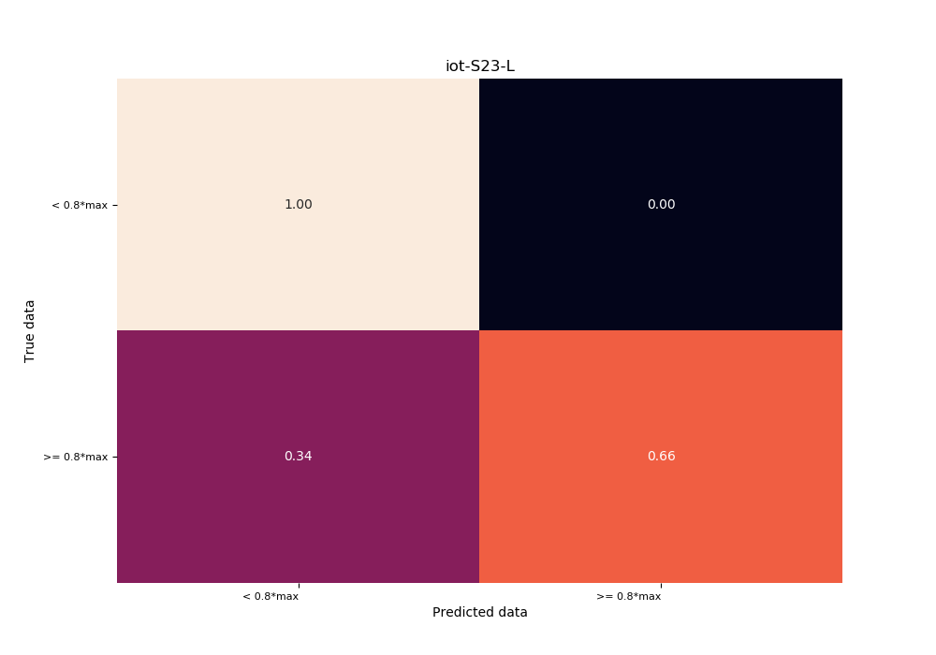
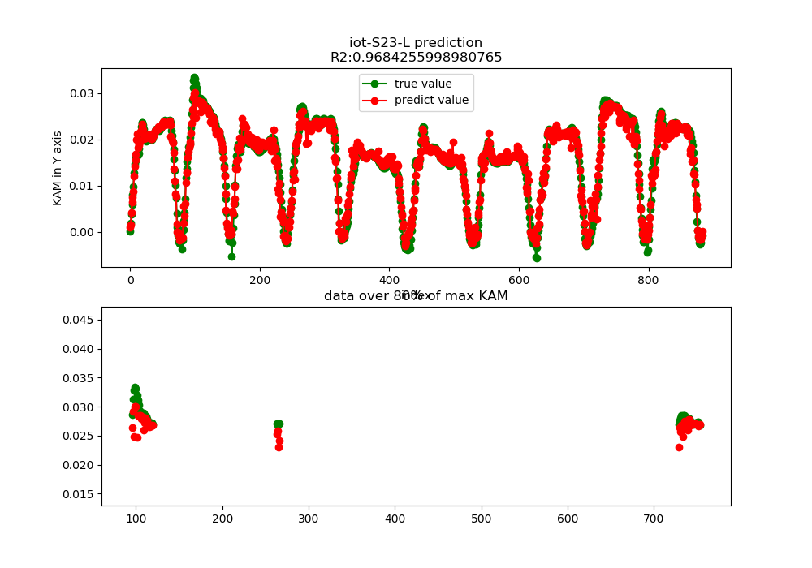
IoT-subject23-left foot

Slide 8
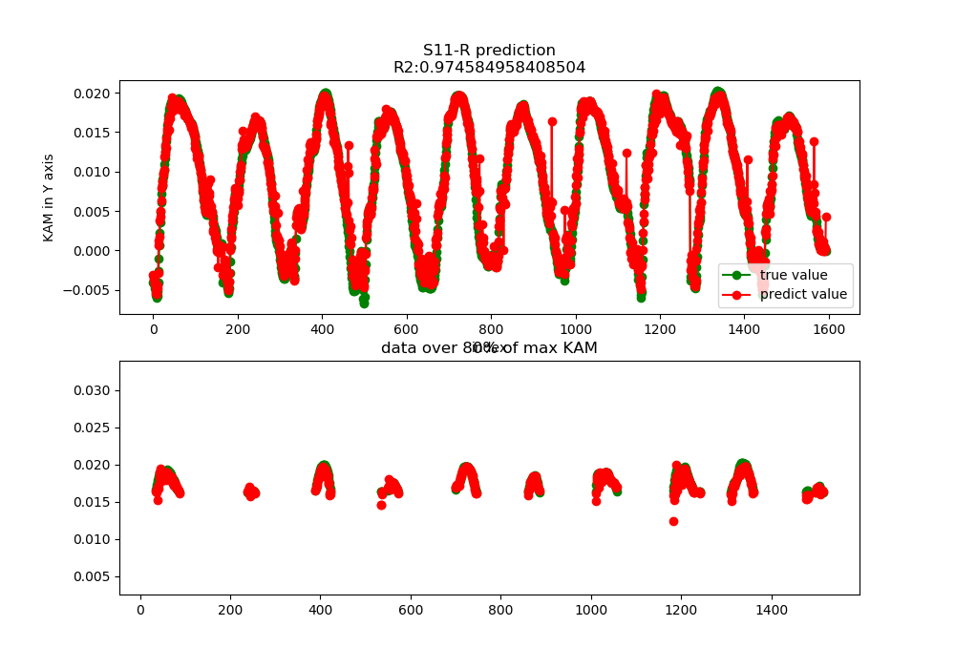

Noraxon-subject11-right foot

Slide 9
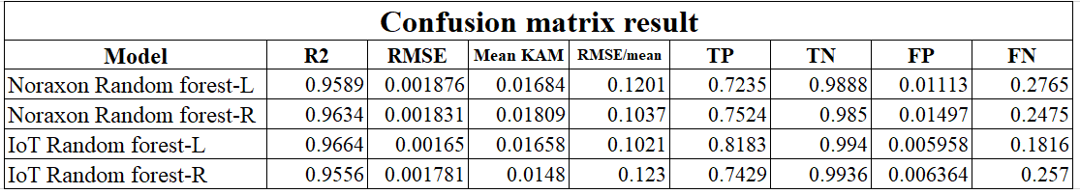
Confusion matrix

Slide 10
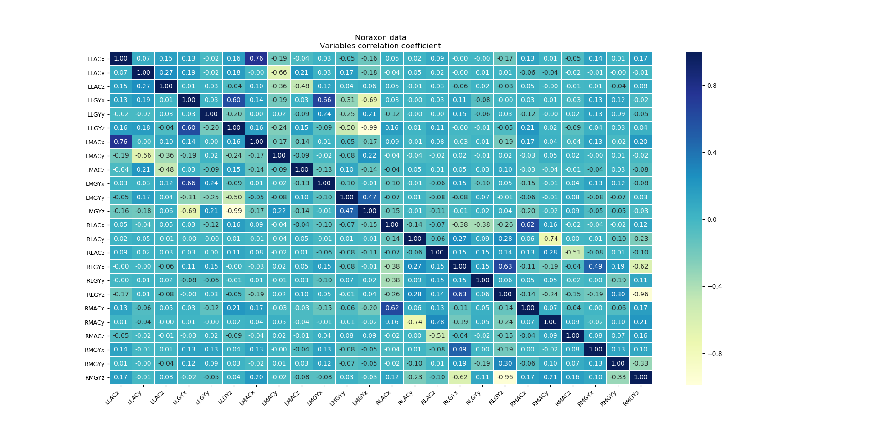
Noraxon Variables correlation coefficient

Slide 11
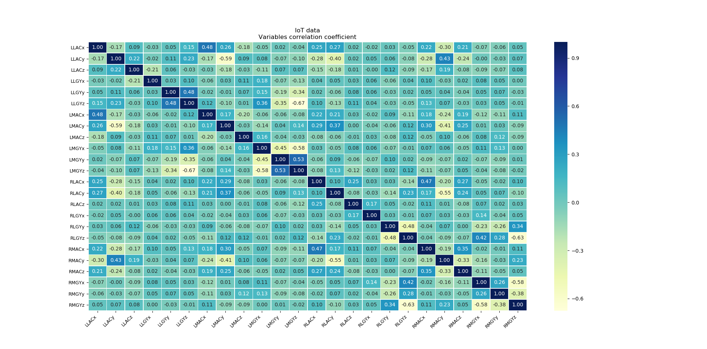
IoT Variables correlation coefficient (axis consistent with Noraxon axis)

