Slide 1
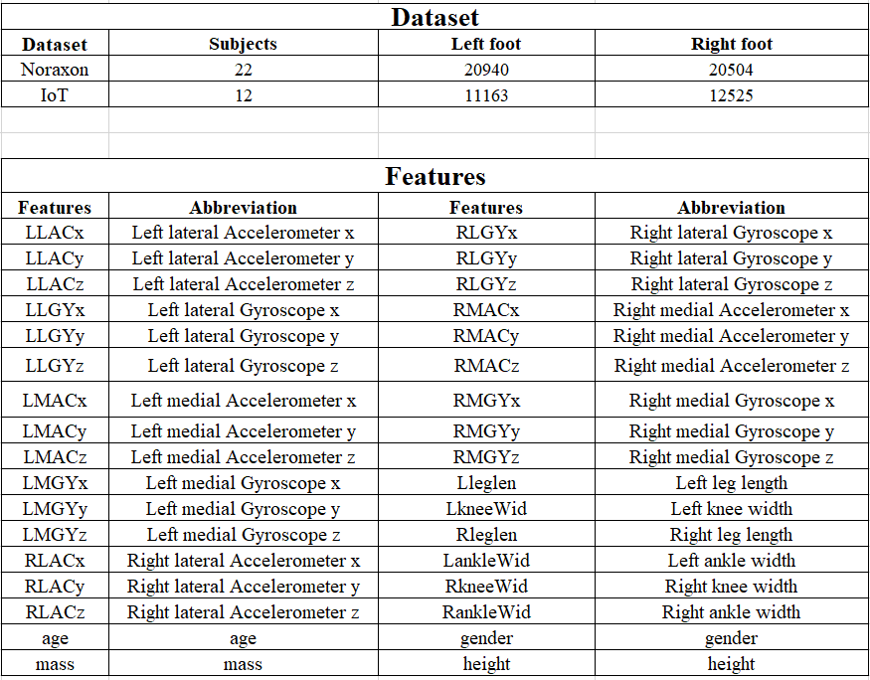
Data and features

Slide 2
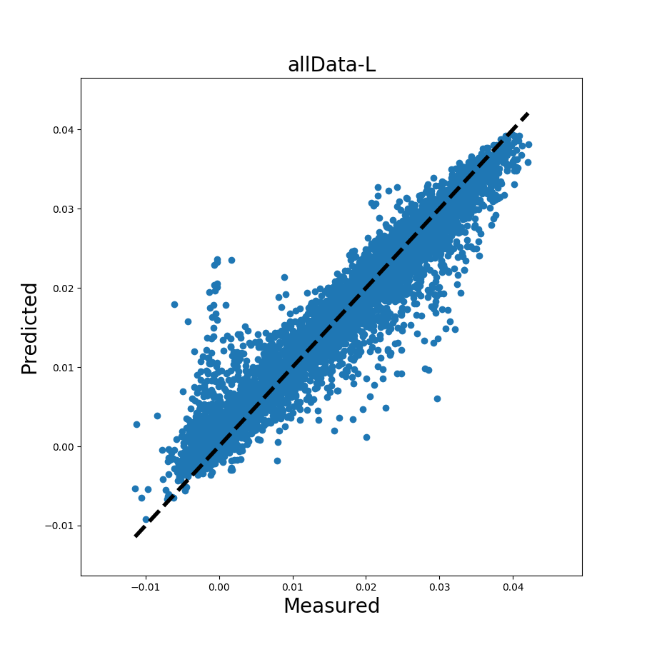
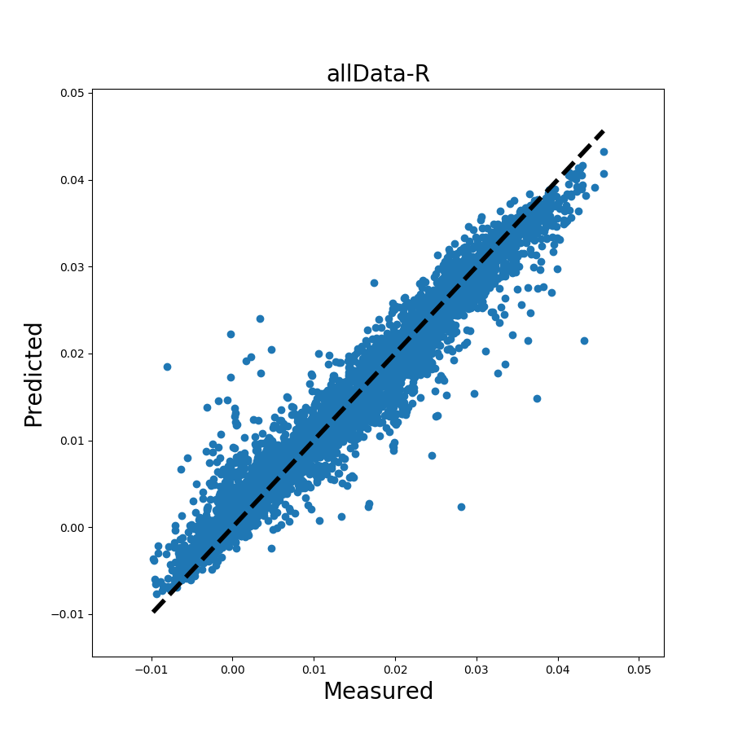
Random forest training
Training data: 70%
Testing data: 30%
Noraxon left foot model
Noraxon right foot model

Slide 3
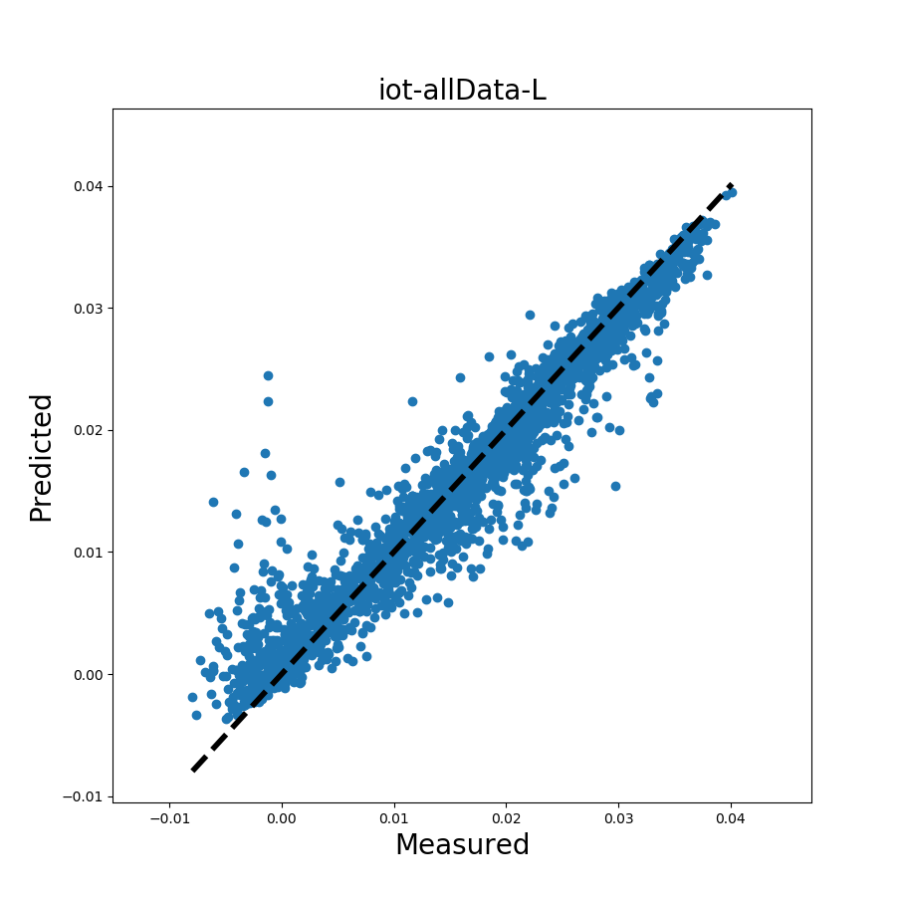
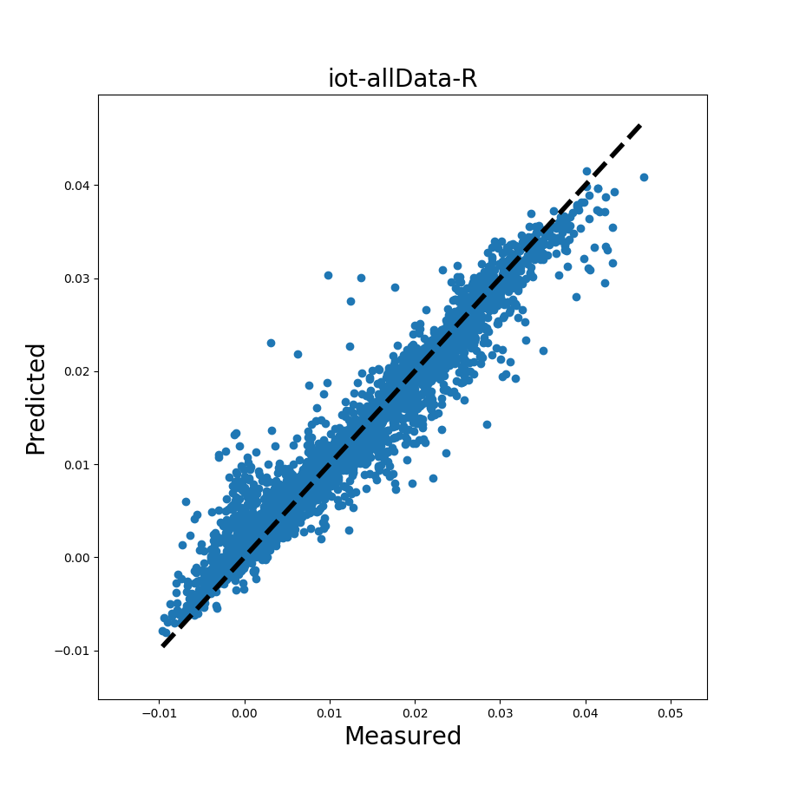
IoT left foot model
IoT right foot model

Slide 4
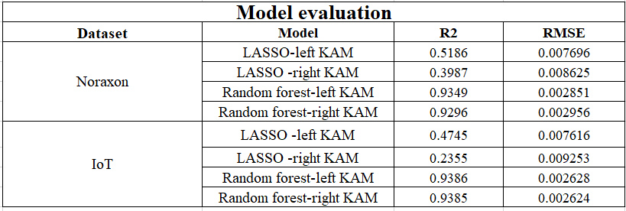
Model evaluation
R2 = 1 indicates that the fitted model explains all variability in response variable.
R2 = 0 indicates no linear relationship between the response variable and predicted values.

Slide 5
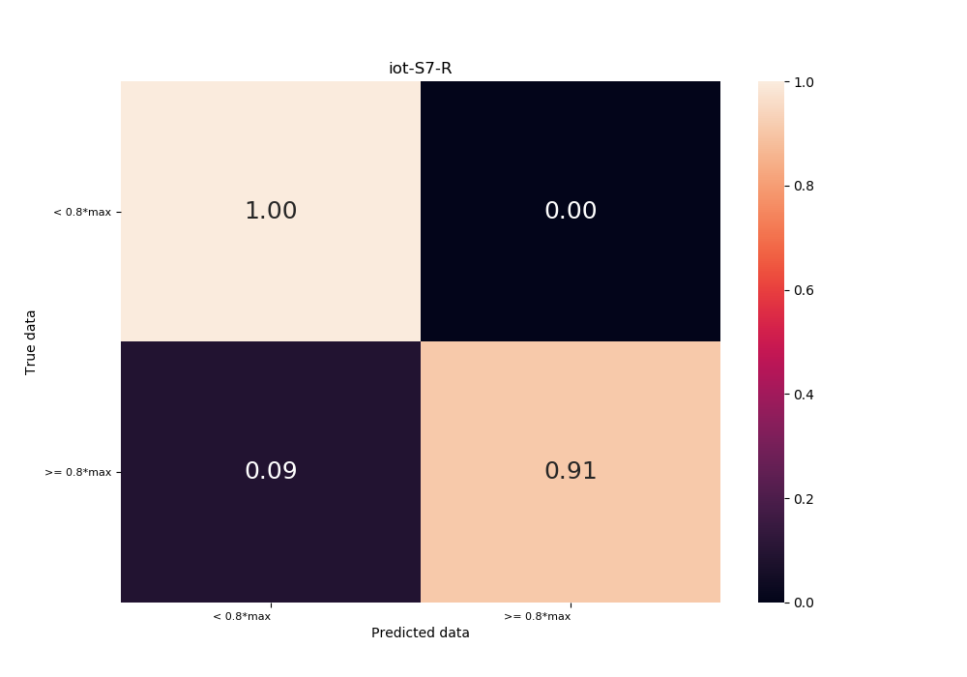
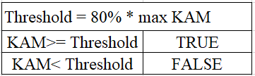
Confusion matrix

Slide 6

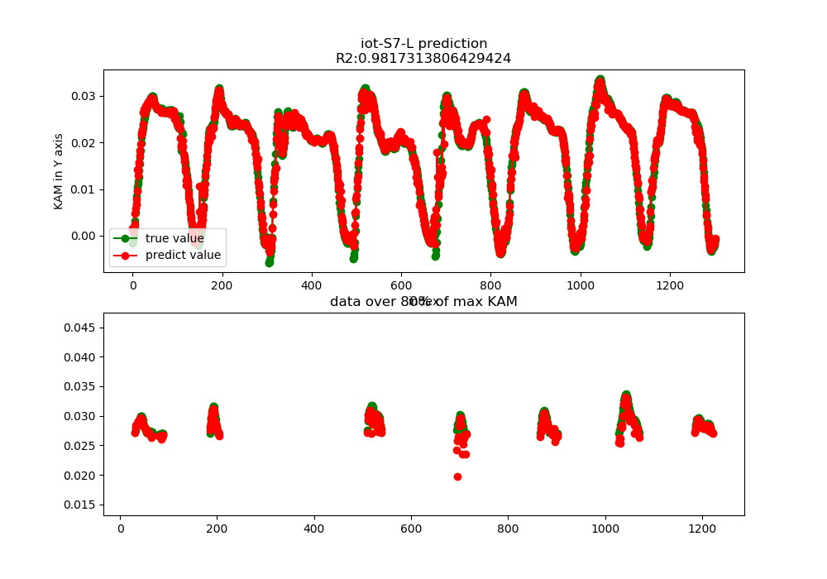
IoT-subject7-left foot

Slide 7
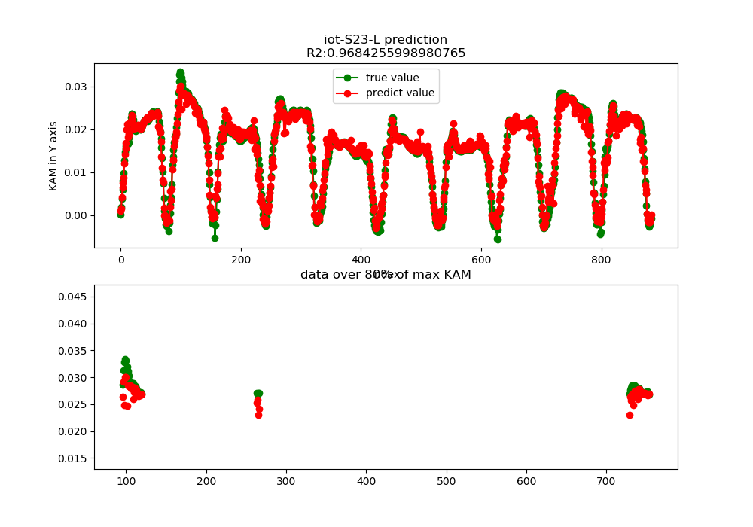
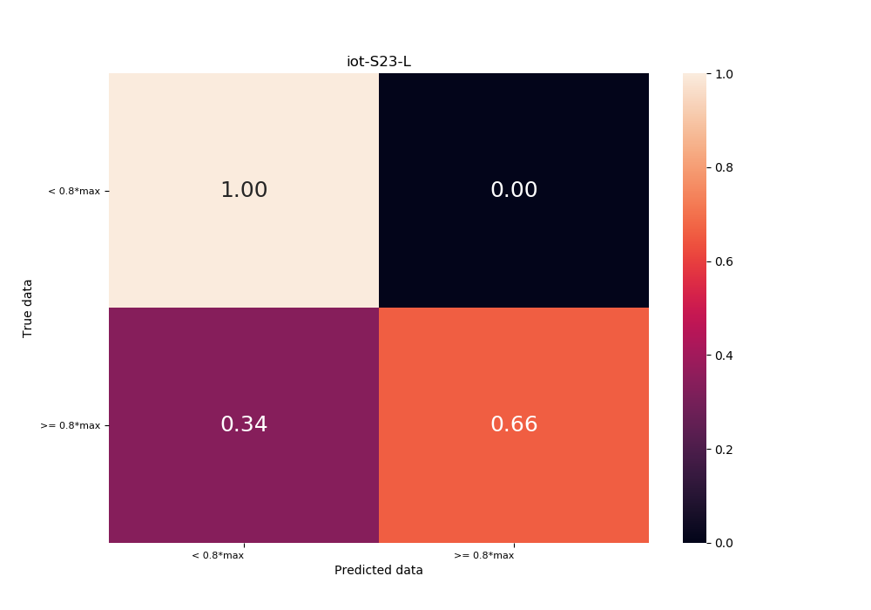
IoT-subject23-left foot

Slide 8

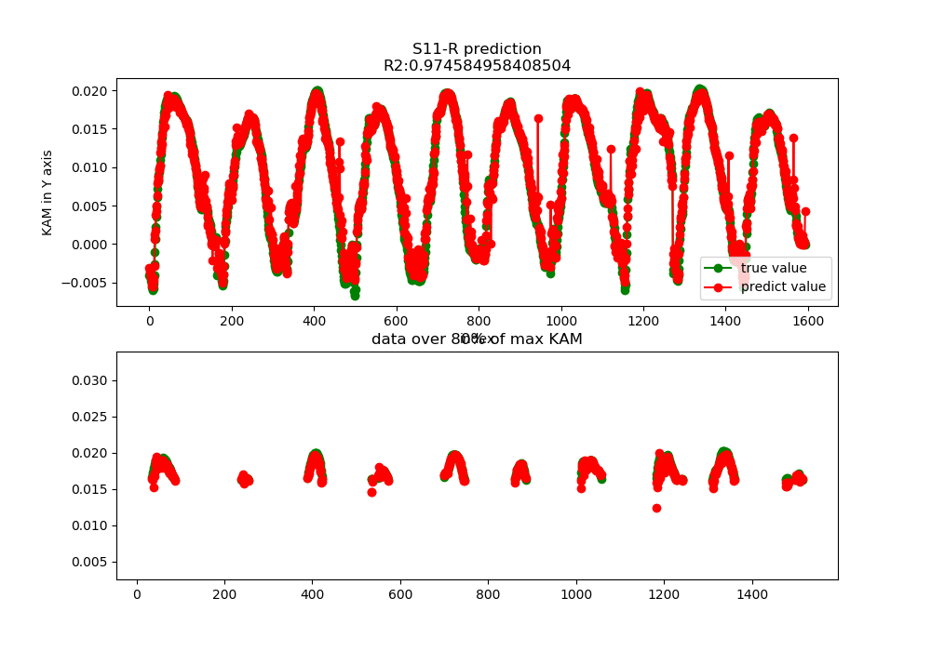
Noraxon-subject11-right foot

Slide 9
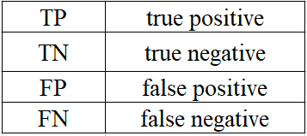
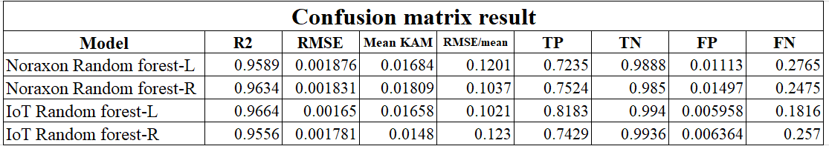
Overall confusion matrix
Mean of some parameters

Slide 10
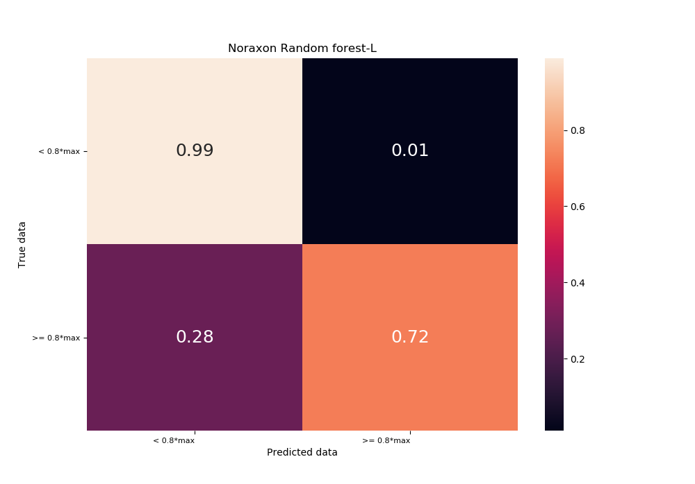
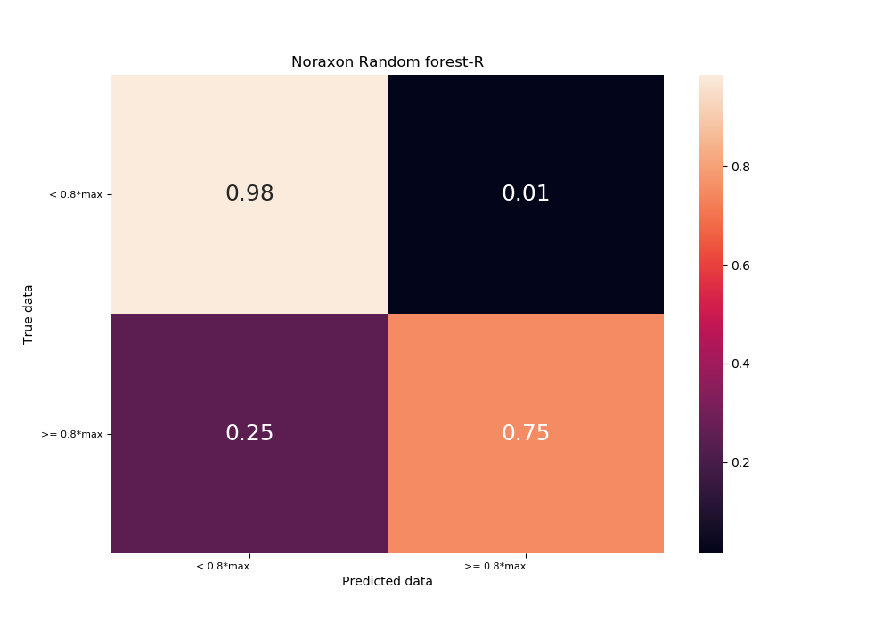
Overall confusion matrix
Overall Noraxon RF-L
Overall Noraxon RF-R

Slide 11


Overall confusion matrix
Overall IoT RF-L
Overall IoT RF-R

Slide 12
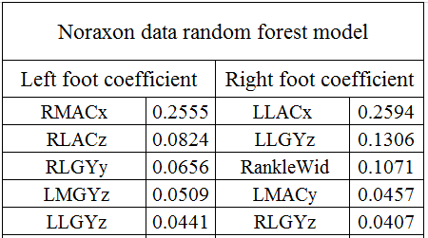
Feature importance
Noraxon RF top5 features

Slide 13
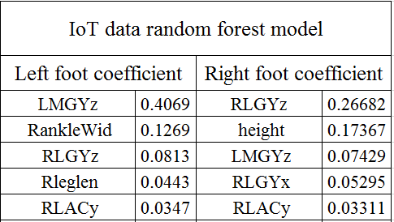
Feature importance
IoT RF top5 features

Slide 14
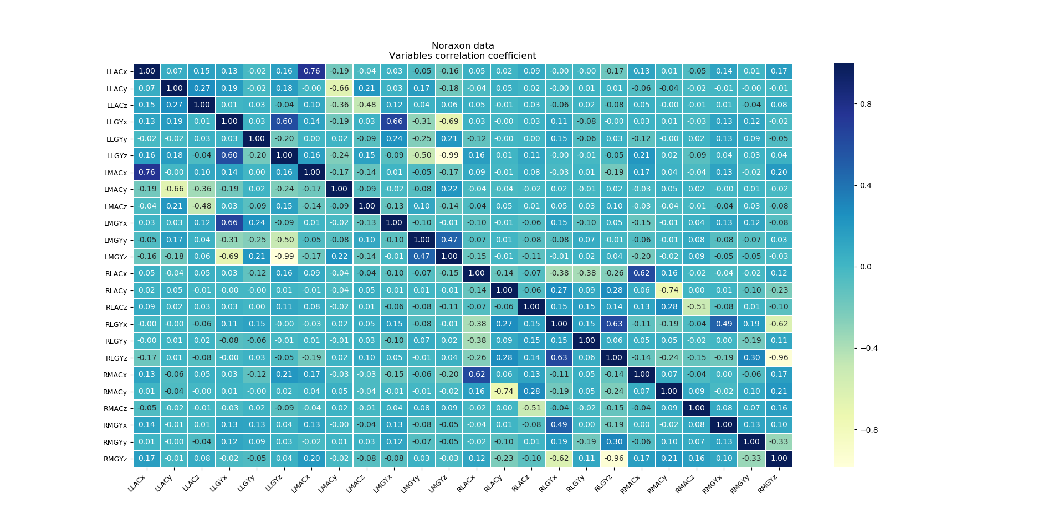
Noraxon Variables correlation coefficient

Slide 15
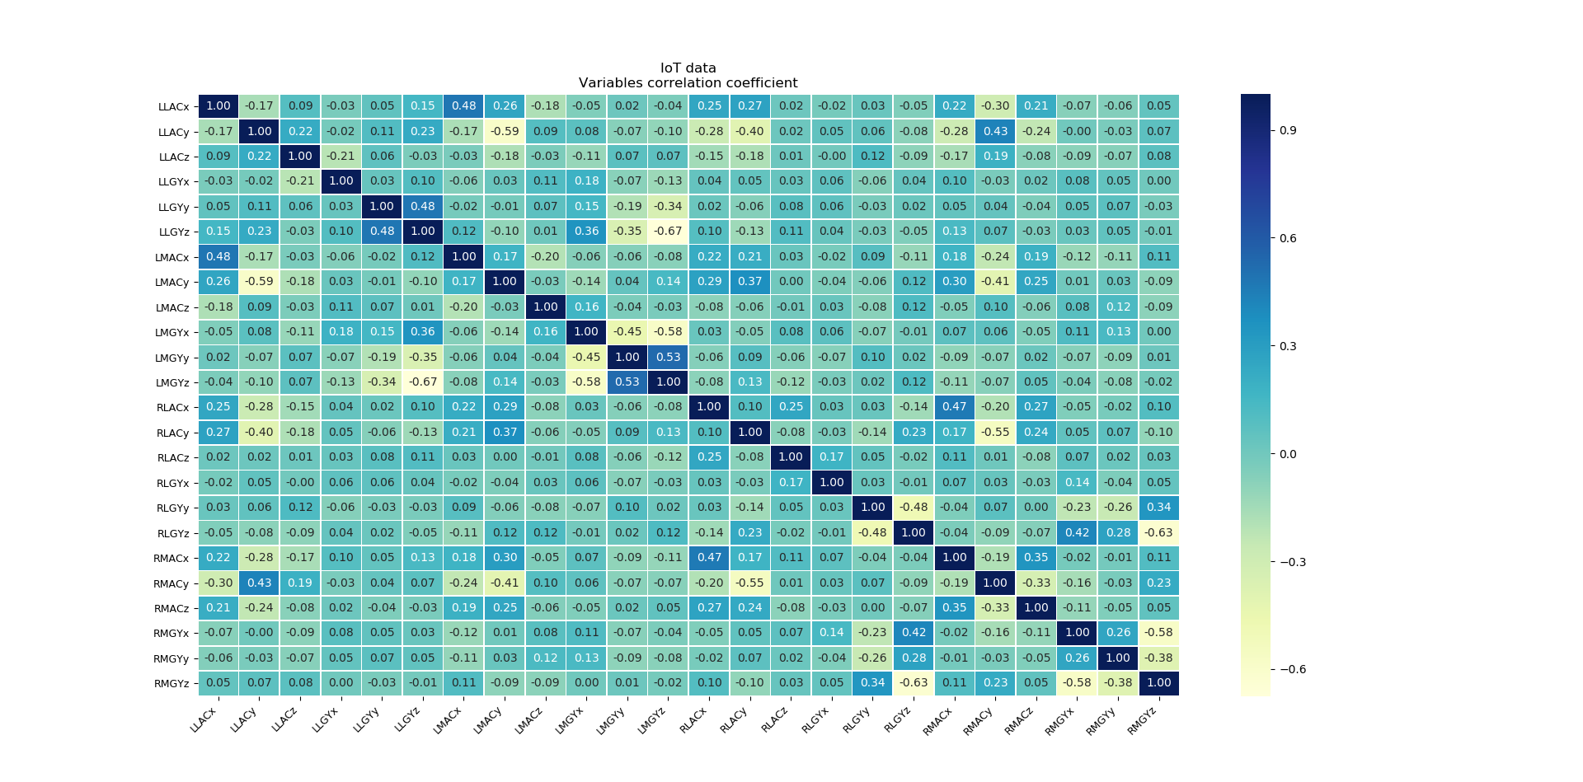
IoT Variables correlation coefficient (axis consistent with Noraxon axis)

Slide 16
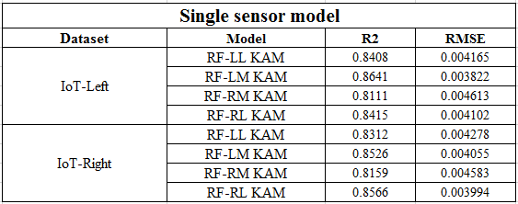
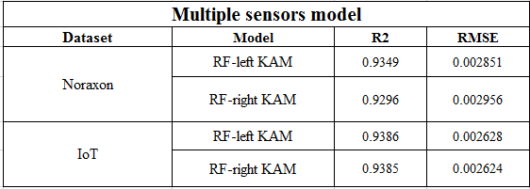
Single sensor model
All 4 sensors’ model has approximately 9% improvement of R2 coefficient

