Slide 1
Data Processing
11 subjects, 22000 data, more to process
Using static data to calibrate
All parameters are used to train
Data format:
LLACx | LLACy | LLACz
LLGYx | LLGYy | LLGYz
LMACx | LMACy | LMACz
LMGYx | LMGYy | LMGYz
RLACx | RLACy | RLACz
RLGYx | RLGYy | RLGYz
RMACx | RMACy | RMACz
RMGYx | RMGYy | RMGYz
age | mass | height
Lleglen | LkneeWid | LankleWid
Rleglen | RkneeWid | RankleWid
kamy

Slide 2
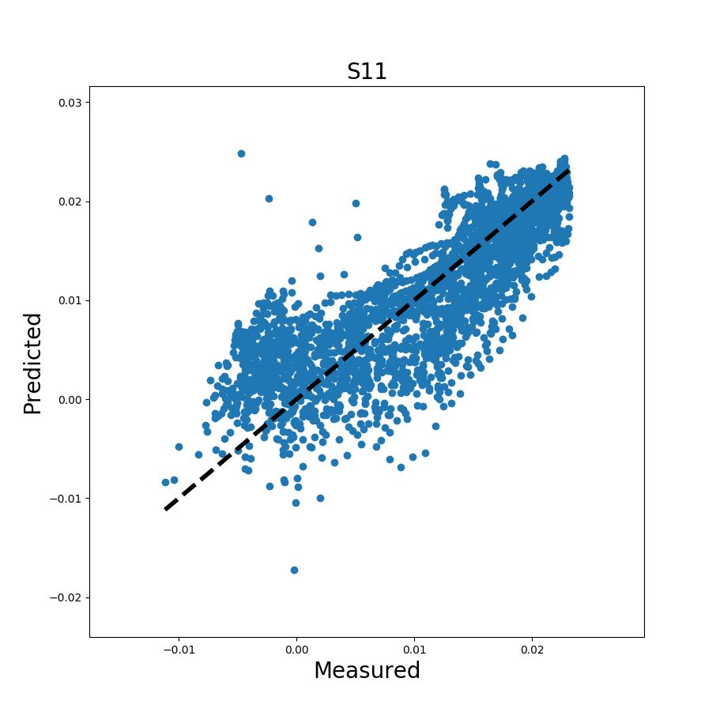
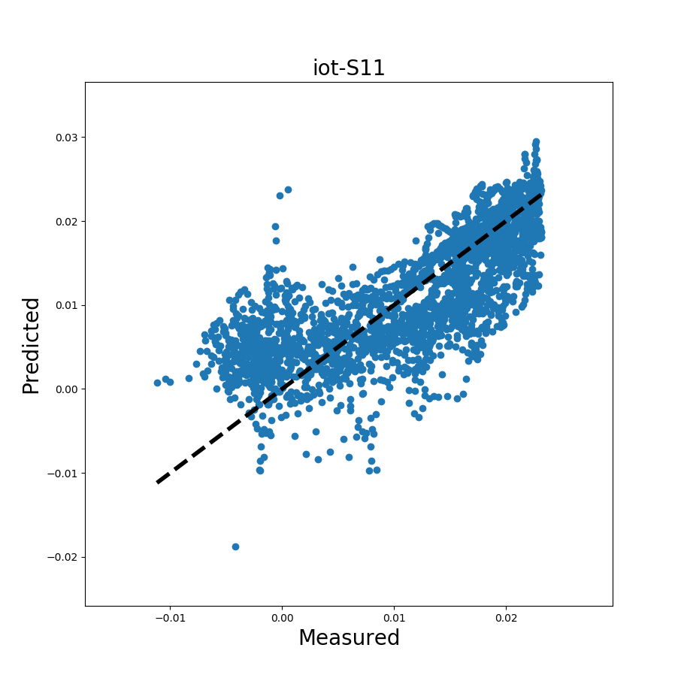
Individual Result
Alpha : 1e-8
iteration = 1e7
tolerance = 0.0001
lag = 1
Noraxon data
kam max:0.023135
RMSE:0.00447768440009271
RMSE / mean:0.39332119083506567
IoT sensor data
kam max:0.023135
RMSE:0.0052117195119275915
RMSE / mean:0.4633790066340425

Slide 3
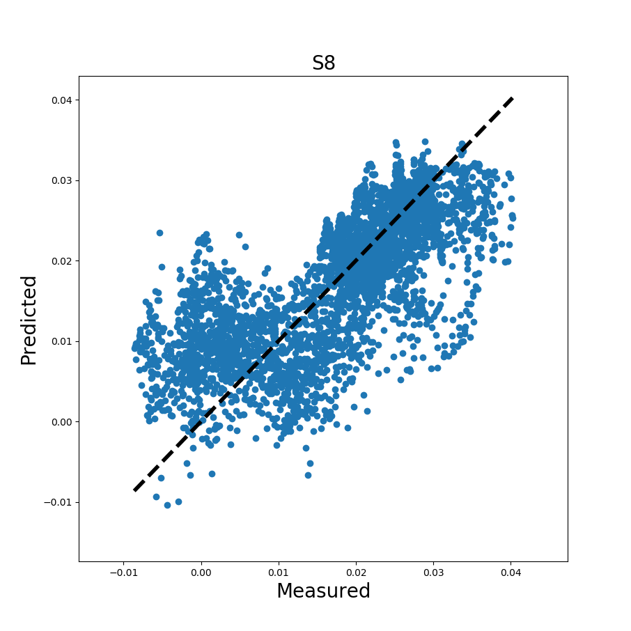
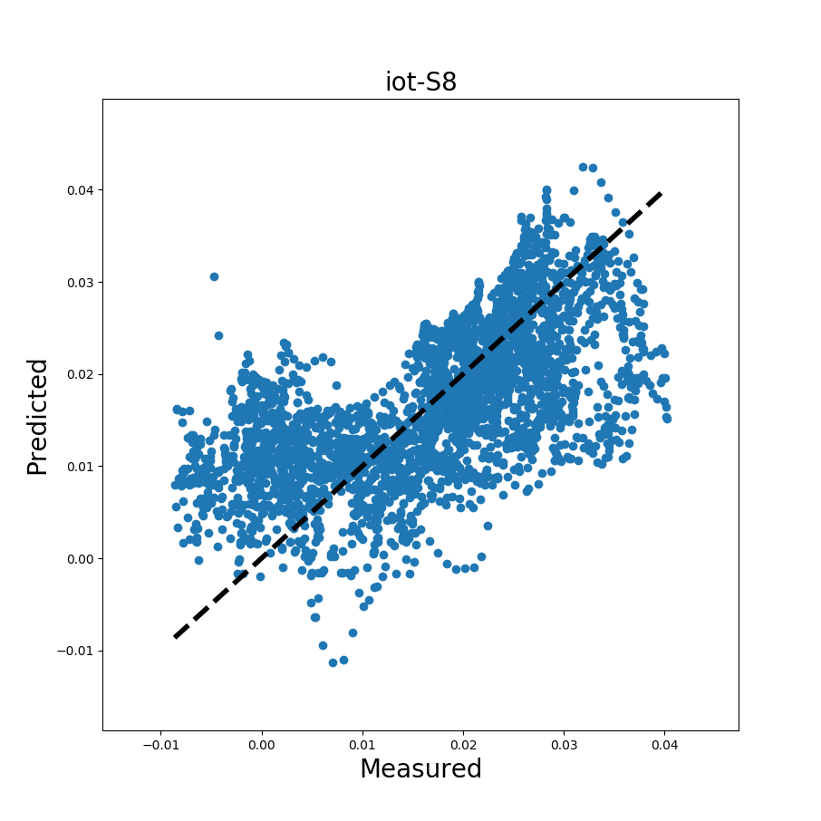
Noraxon data
kam max:0.040227
RMSE:0.0075260302881543055
RMSE / mean:0.4389400195393515
IoT sensor data
kam max:0.040227
RMSE:0.008009450076238702
RMSE / mean:0.4710097987329814

Slide 4
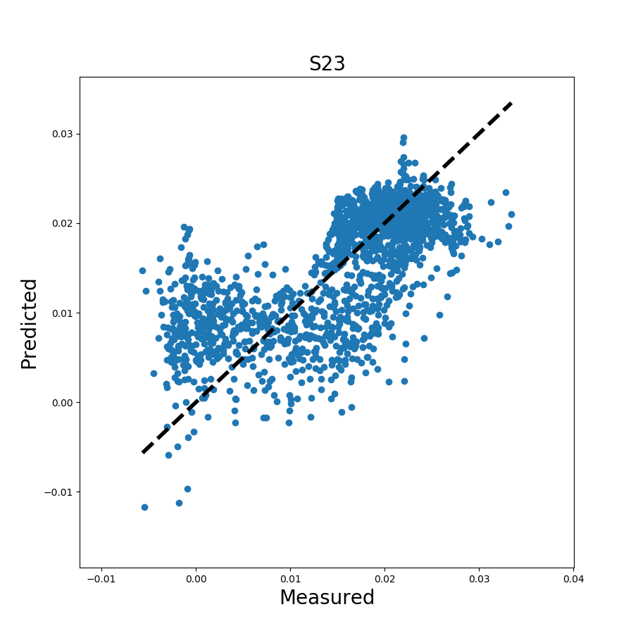
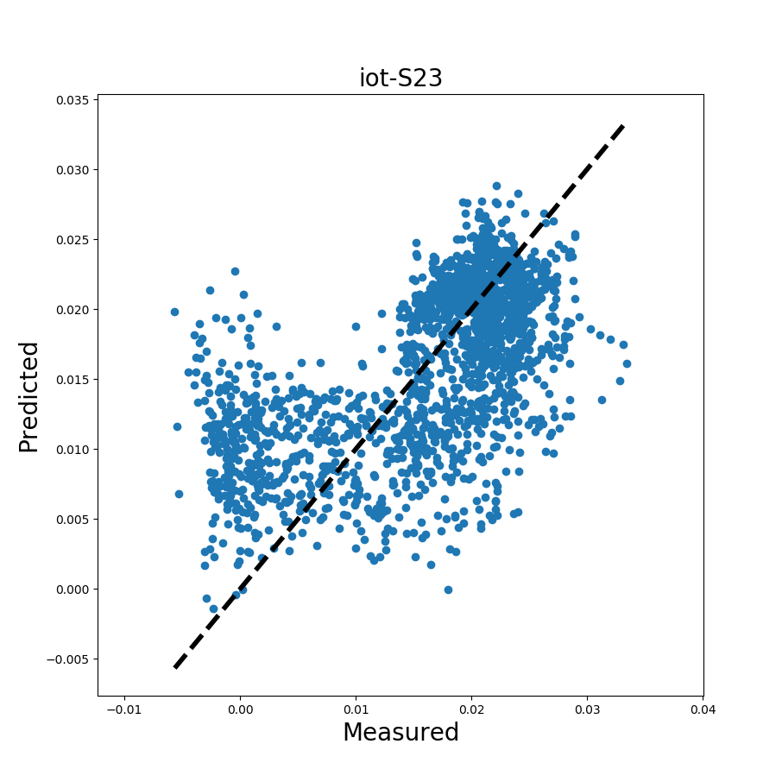
Noraxon data
kam max:0.033431999999999996
RMSE:0.005782805010717954
RMSE / mean:0.36706084598653
IoT sensor data
KAM max:0.033431999999999996
RMSE:0.006532342546258804
RMSE / mean:0.4114673222030347

Slide 5
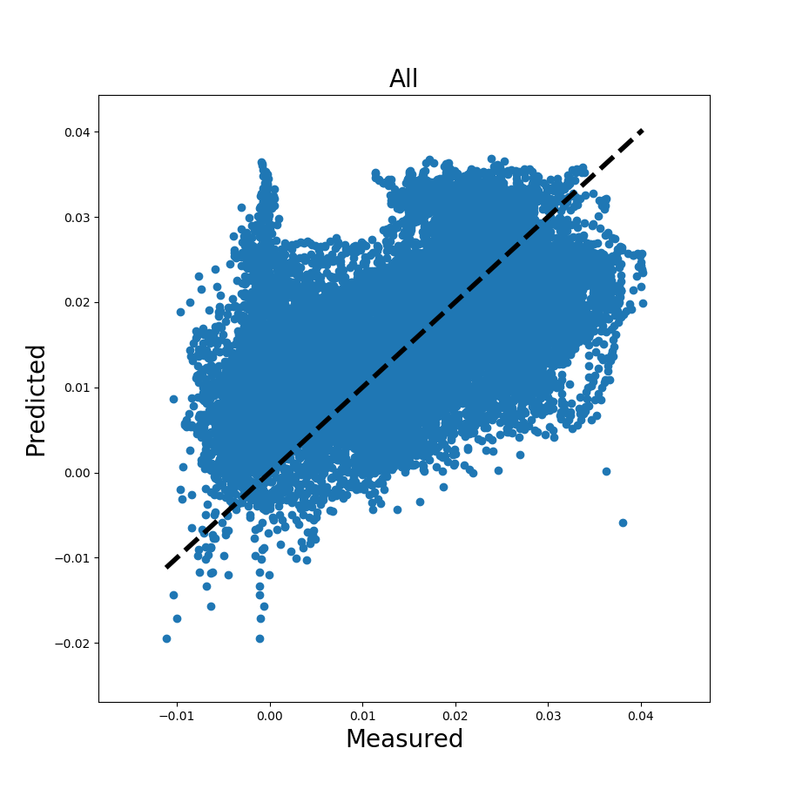
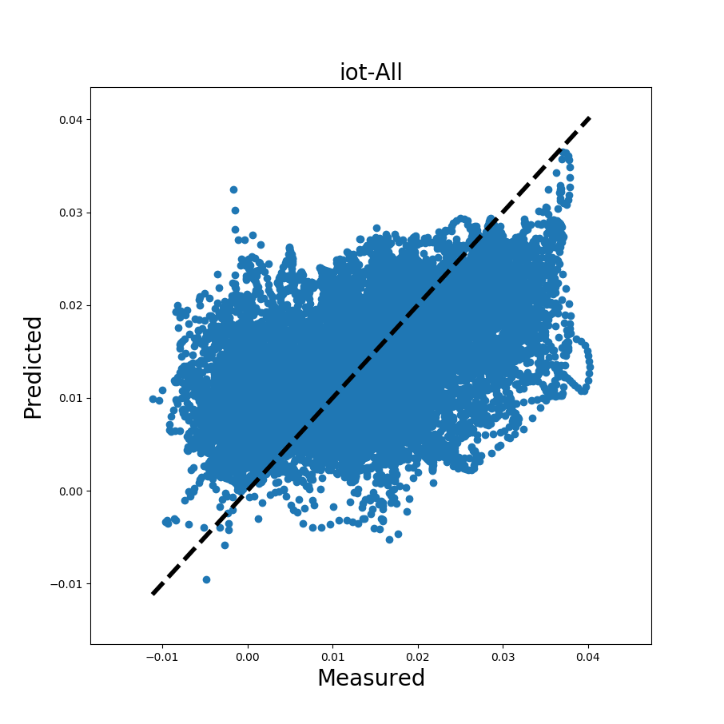
Noraxon data
kam max:0.040227
RMSE:0.007685146035657741
RMSE / mean:0.5161405012587025
IoT sensor data
kam max:0.040227
RMSE:0.008179343921095384
RMSE / mean:0.5500984402876561

Slide 6
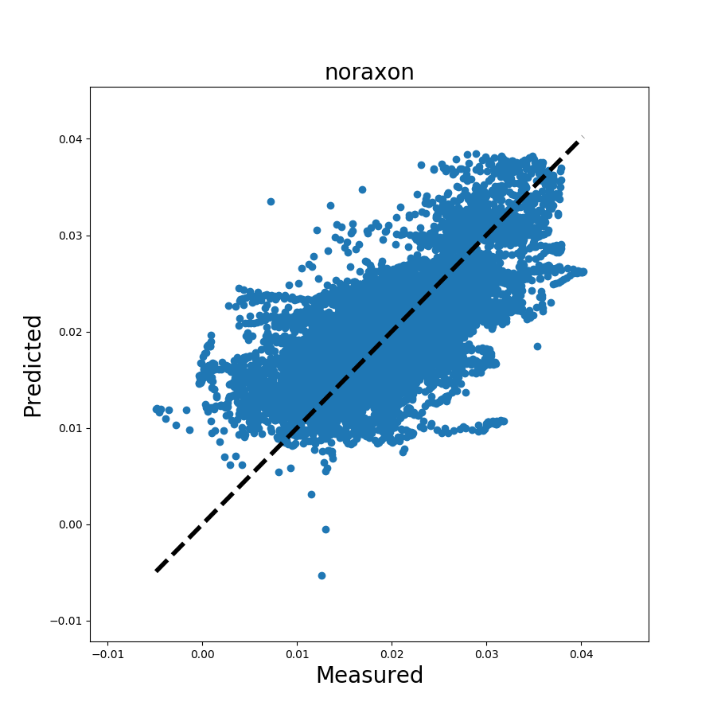
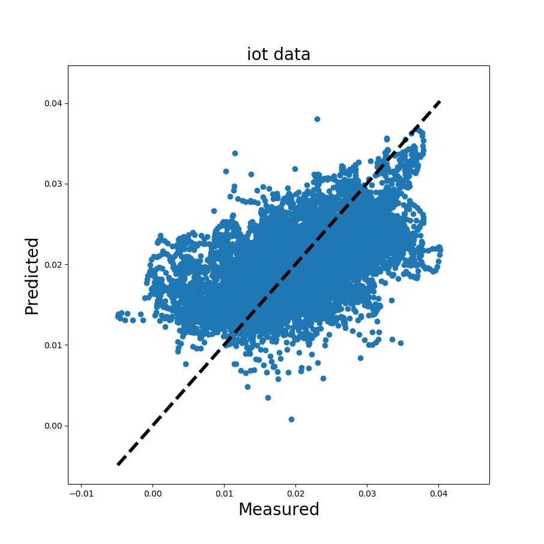
Noraxon data
kam max:0.040227
RMSE:0.004779061927682562
RMSE / mean:0.23866886523965122
IoT sensor data
kam max:0.040227
RMSE:0.005515935540994006
RMSE / mean:0.2790204886026261

