Slide 1
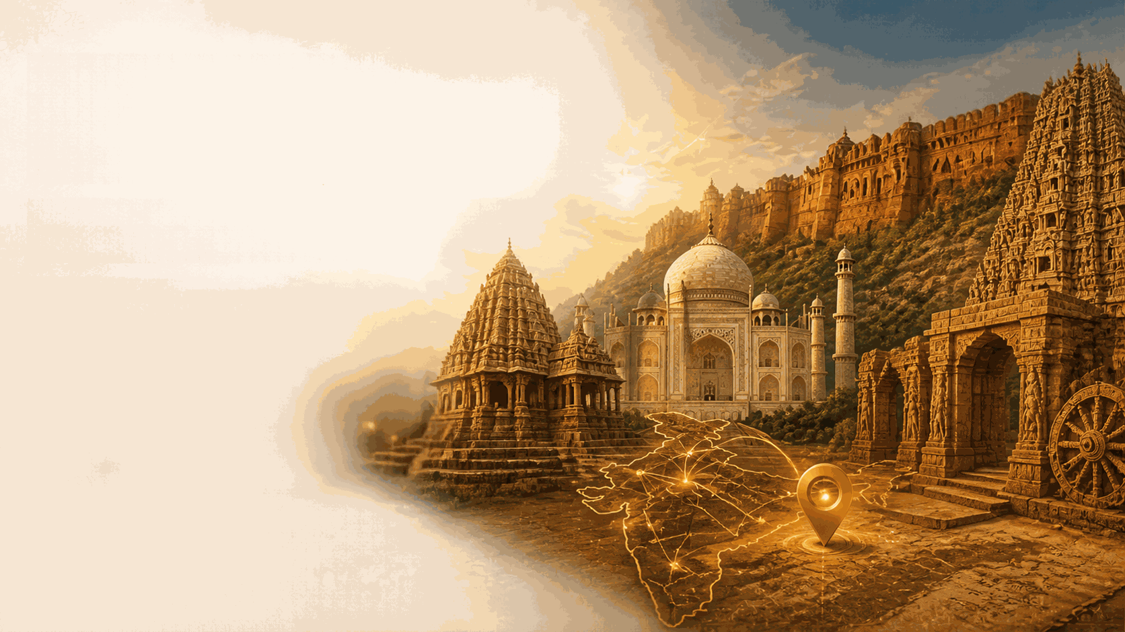


HERITAGE
QUEST
Discover India's Heritage, Explore Its History, Experience the Adventure.
An Interactive Heritage Exploration and Gamified Learning Platform.
Ch. Deekshitha
24KB1A05B1
G. Yaswini Priya
24KB1A05G2
M. Aloukitha Surin
24KB1A05Y2
Ch. Varalakshmi
25KB5A0539
III B.Tech – Computer Science and Engineering
N.B.K.R. Institute of Science and Technology (NBKRIST)

Slide 2


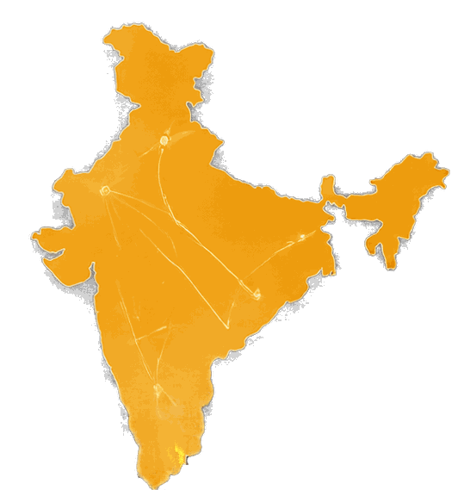



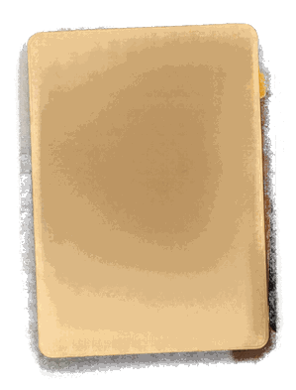

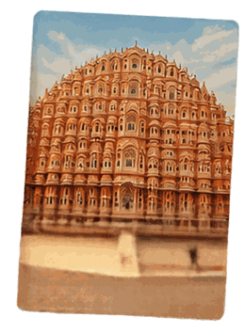




Introduction
Welcome to
HERITAGE
QUEST
Explore India's Heritage Through Interactive Adventures
Discover historical and cultural destinations
Explore places on an interactive map
Learn through adventure-based challenges and quizzes
Track your learning progress with your account
KHAJURAHO
TAJ MAHAL
Uttar Pradesh
HAWA MAHAL
Madhya Pradesh
Rajasthan

Slide 3






















Objectives
promote awareness of india's
rich cultural and historical heritage
provide an interactive platform to explore heritage destinations
make learning enjoyable through gamification
encourage users to complete destination-based challenges
track user achievements, scores, and learning progress
combine education, exploration, and technology in one platform

Slide 4
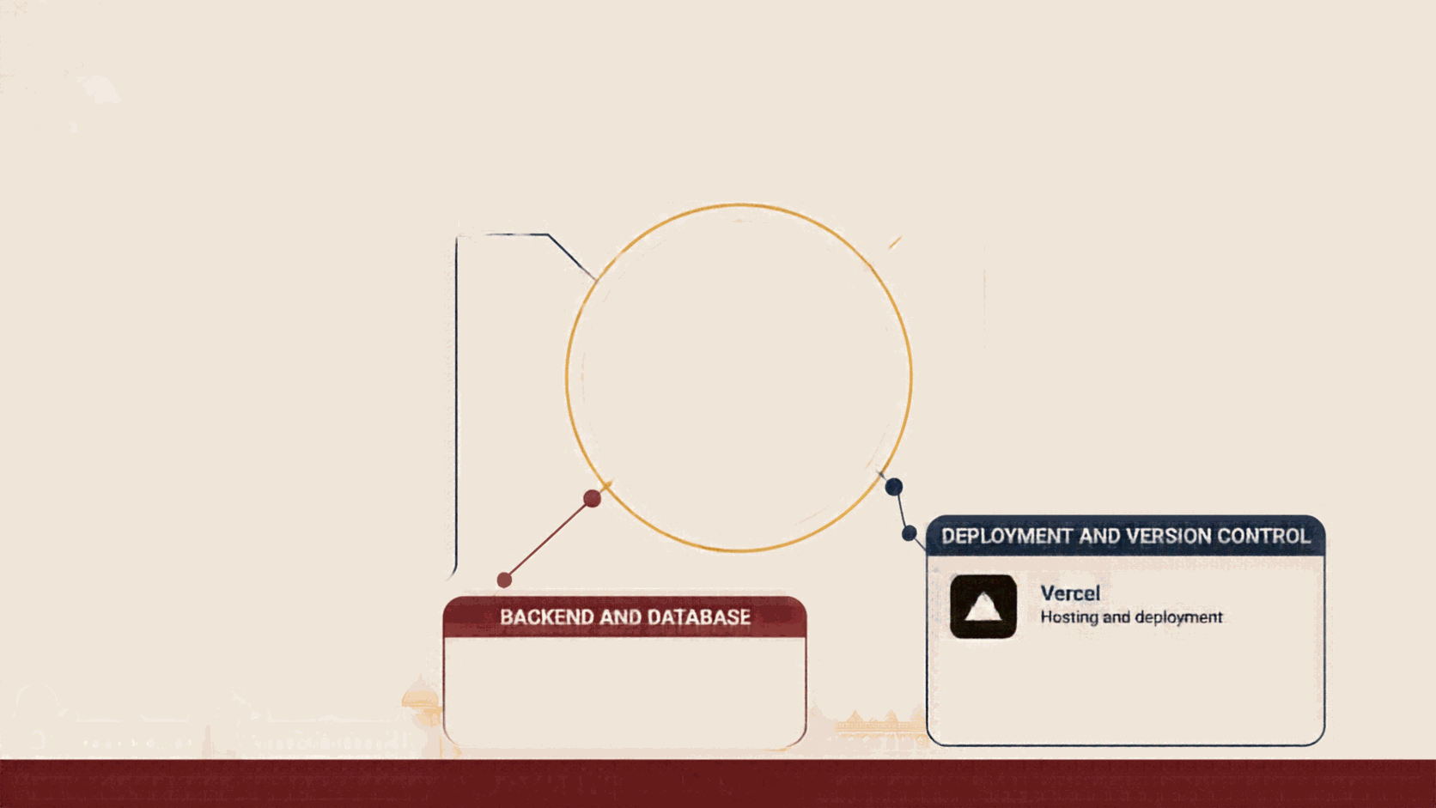






































Technologies Used
FRONTEND
MAPPING
React.js
Leaflet
Building reusable and interactive UI components
Interactive map
functionality
HERITAGE
TypeScript
QUEST
TS
Structured and
type-safe code
RL
React Leaflet
Integrating maps into
React components
Vite
Explore India's Heritage Through Interactive Adventures
Fast development
and build tool
CSS
Styling and responsive layouts
DEPLOYMENT AND VERSION CONTROL
Vercel
BACKEND AND DATABASE
Hosting and deployment
Supabase
Git and GitHub
Authentication, database services, user progress storage
Source code management and collaboration

Slide 5




































Frontend and Data Logic
How HeritageQuest delivers interactive exploration and gamified learning
1. DESTINATION DATA
2. REACT COMPONENTS
3. SEARCH & FILTERS
4. DESTINATION CARDS
& INTERACTIVE MAP
Structured TypeScript
files for each destination
React components
create the user
interface
Search bar to find destinations
Destination cards show key details and images
React Leaflet powers interactive maps
with markers
Includes name, city, state, image, difficulty, missions and more
Filters by region
help refine and
discover places
Navigation through Home, Explore and
My Progress sections
Details reveal facts, missions and more
GAME LOGIC
Manages challenges, scores, stars and level unlocking to create engaging adventure-based learning

Slide 6
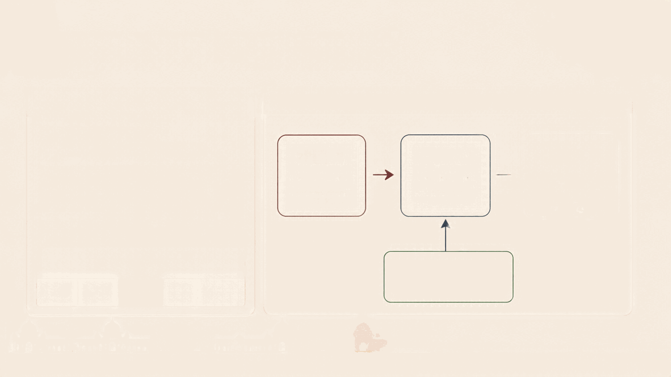

























Backend and Deployment
BACKEND SERVICES – SUPABASE
DEPLOYMENT WORKFLOW
User registration and login
Authentication and account management
GitHub
Vercel
Live Website
Stores user-specific game progress
Source code management
Hosting and deployment
Application available
publicly
Maintains completed levels, best scores, earned stars
Provides user access to progress via accounts
DATABASE TABLE: LEVEL_PROGRESS
user_id
level_id
best_score
stars
completed
Supabase
Backend services

Slide 7
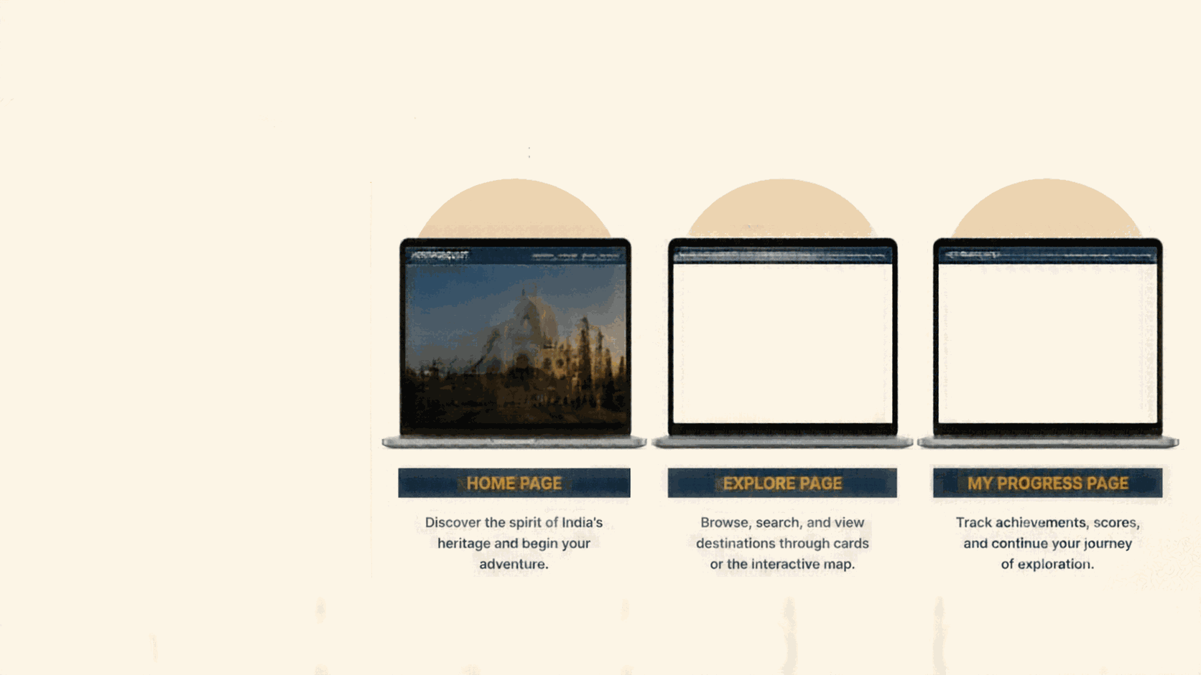


















































WORKING OF THE PROJECT
A seamless journey from exploration to achievement
1
User opens HeritageQuest website
2
Explores heritage destinations available
Sethorne Chelmsky Sams Wj Sams
Sethorne Chelmsky Sams Wj Sams
Sethorne Chelmsky Sams Wj Sams
HERITAGEQUEST
HERITAGEQUEST
HERITAGEQUEST
3
Searches or selects a region for destinations
Explore Destinations
My Progress
5. Search by region or destination
Adventures Completed
Outrings Completed
4
Views destinations via cards or interactive map
Explore India's Heritage
1200
8
24
Tand Stone
Beginn Expired
Prami @dille
5
Selects a destination to access detailed information
8
6
Discover historic places, take on challenges, and test your knowledge.
The Maksi
Aga, Ular Patek
Hangi
Karnata
Rajguru's Temple
Karnata
Achievements
Achievements
6
Starts an adventure and attempts challenges
7
Game evaluates answers and calculates scores
8
Stars and completed levels represent user achievements
HOME PAGE
EXPLORE PAGE
MY PROGRESS PAGE
9
Authenticated progress saved through Supabase
10
User views achievements and progress in My Progress

Slide 8








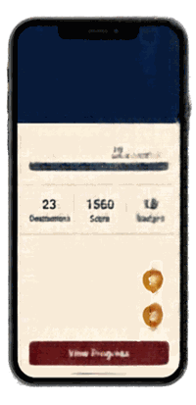




















Expected Output
HERITAGEQUEST
Home
Explore
Chalitempa
Blesstori
Ilati
An immersive platform that explores, educates and inspires
Explore India's Heritage
Discover India's heritage through interactive maps and destination stories
Embark on interactive adventures
across timeless destinations
Adventure Challenge
Level 3: Ancient Temples
Learn with adventure challenges at
every destination
Start Exploring
Popular Destinations
Adventure Back!
Earn scores, stars and levels as you explore
Ananya
Explorer
Rich dynasty built the Bhihadeeswar
Temple in Thanjavur?
Track your journey and celebrate progress
Level 12
Chola Dynasty
Build deeper connection with India's rich culture and history
Taj Mahal
Hawa Mahal
Khajuraho
Pallava Dynasty
Explore
Explore
Chalukya Dynasty
Temple Exploration
Convened 5temple challenges
Rashitaluda Dynasty
Score: 250
View Progress

Slide 9














Conclusion
Brings together India's cultural heritage and modern web technology
Future Enhancements
Transforms exploration into interactive learning
Add more heritage destinations
Maps, information, and gamified challenges encourage active engagement
Introduce multilingual support
Include virtual tours
and richer multimedia
Supabase supports authentication and progress tracking
Add more interactive quizzes and challenges
An engaging way to appreciate India's historical treasures
Preserving the Past, Exploring the Present, Inspiring the Future.

Slide 10


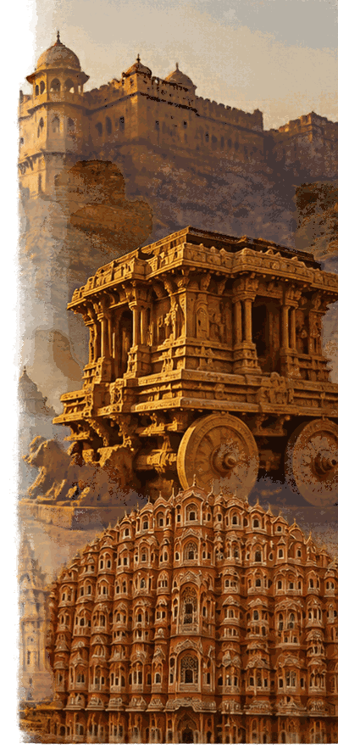



THANK YOU!
Discover. Explore. Learn. Celebrate Our Heritage.
HERITAGEQUEST
Presented by:
Ch. Deekshitha | G. Yaswini Priya | M. Aloukitha Surin | Ch. Varalakshmi
III B.Tech CSE – NBKRIST
Project website: https://heritagequest-bc271zocz-prompters3.vercel.app/

