Slide 1
Customer Shopping Behavior Analysis
Understanding customers to sell better
Python · SQL (PostgreSQL) · Power BI

Slide 2
Context and objective
Business question
1
Python
Clean and prepare the data
“How can the company use shopping data to identify trends, improve customer engagement, and optimize marketing and product strategies?”
2
SQL
10 analyses in PostgreSQL
3
Power BI
Interactive dashboard
4
Report
Recommendations for management

Slide 3
Clean data before analysis
3,900
1
Missing ratings filled with the category median
purchases analyzed
2
Columns renamed to snake_case
18
New features: age_group and purchase_frequency_days
3
variables per purchase
4
promo_code_used dropped (duplicate of discount_applied)
37
5
Cleaned data loaded into PostgreSQL
missing review ratings

Slide 4
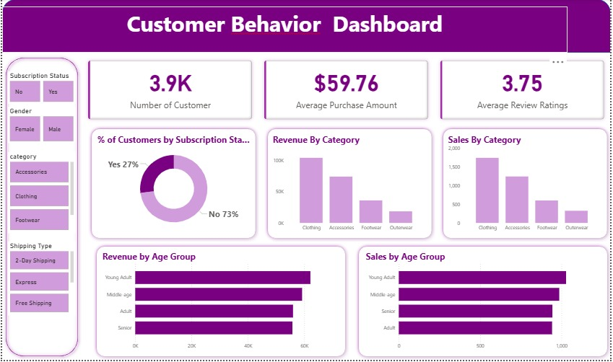
Power BI dashboard
Filters
subscription, gender, category, shipping type
KPIs
3.9K customers, $59.76 average purchase, 3.75 rating
Views
categories, age groups, subscribers

Slide 5
Key figures
$233K
$59.76
total revenue
average purchase
3.75 / 5
27%
average rating
subscribed customers
Clothing: 45% of purchases (1,737 out of 3,900)

Slide 6
Men generate 68% of revenue
≈ $60
average spend (F $60.25 · M $59.54)
2,652 vs 1,248
male vs female customers
The gap comes from the number of customers, not from how much they spend.

Slide 7
80% of customers are already loyal
3,116
loyal customers (80%)
83
new customers only (2%)
A solid base, but few new customers: acquisition is the weak point.

Slide 8
Subscription does not increase spending
$59.49
$59.87
28%
average spend of subscribers
average spend of non-subscribers
of repeat buyers (5+ purchases) are subscribed
27% of customers are subscribers, and they bring 27% of revenue.
Repeat buyers are no more likely to subscribe than others (958 out of 3,476). Subscription has no visible effect yet.

Slide 9
Young adults lead, by a small margin
27%
of revenue: Young Adult ($62,143)
+11%
between the top and bottom group
Every age group matters: no single target.

Slide 10
Products: top rated and best sellers
Top 5 by average rating
#1 seller in each category
Gloves
3.86
Accessories
Jewelry
171 orders
Sandals
3.84
Clothing
Blouse
171 orders
Boots
3.82
Footwear
Sandals
160 orders
Hat
3.80
Outerwear
Jacket
163 orders
Skirt
3.78

Slide 11
Discounts and shipping
43%
of purchases use a discount (1,677)
839
discount users spend above average
+$2
Express ($60.48) vs Standard ($58.46)

Slide 12
Our 5 recommendations
1
Boost subscriptions
2
Build loyalty
3
Review discounts
Exclusive perks (shipping, early access): today a subscriber does not spend more.
Reward regular buyers and offer a welcome deal to new customers.
Cut promotions on Hat, Sneakers and Coat to protect margin.
4
Promote key products
5
Target marketing
Campaigns on top rated (Gloves, Sandals, Boots) and best sellers.
Young adults, female customers (32% of revenue) and Express users.

Slide 13
Key takeaways
A loyal customer base, but few new customers: acquisition must improve.
1
Subscriptions and discounts do not raise spending yet: rethink them.
2
Female customers are under-represented: the biggest growth opportunity.
3
Thank you · Questions?

