Slide 1


KerjayaKu
Team Chill Chill
Your career map
for the AI era.
Explore careers. Build skills. Find your next step.

Slide 2







4
QUALITY EDUCATION
8
DECENT WORK & GROWTH
PROBLEM + USERS
One moment: a graduate asks, “What should I learn next, and why?”
Who we build for
The decision gap
Learners first, reached through the people who advise and train them.
56%
of Malaysian
professionals use AI
tools at work
Sources: Hays Asia Salary Guide 2025 (56%, 26%); MOSTI (600,000 workers)
26%
have received formal AI training
600k
workers need reskilling within3–5years
PRIMARY
Students and fresh graduates
Deciding where to go next. They get ranked roles, the exact skill gap and a free first step.
ALSO SERVED
Career switchers and working adults
At risk as AI changes their work. They see which skills transfer under two AI-adoption scenarios.
Today’s tools stop too early
01 02 03
Static lists age as jobs and skills change
Black-box matches hide which skill creates the gap No path to action a job title is not a next step
University and TVET career centres
CHANNEL
Advise many students at once with sourced, dated evidence instead of static lists.
KERJAYAKU
/
TEAM CHILL CHILL
SDC HACKATHON 2026
1

Slide 3

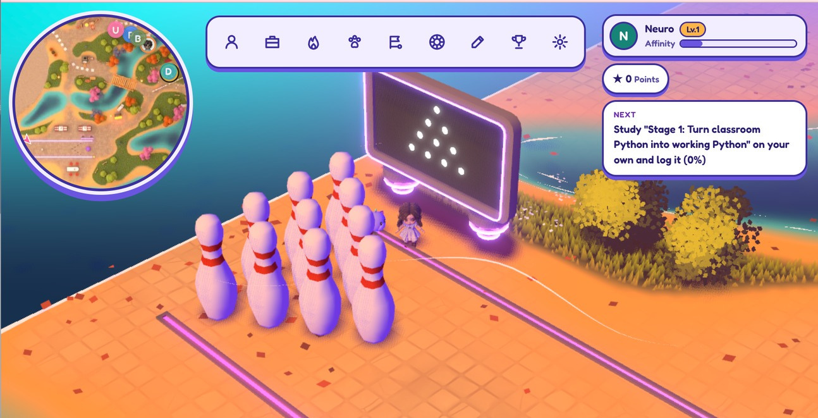
MEET KERJAYAKU
A PLAYABLE CAREER DIRECTION.
An AIcareer andlearningcompanion
for students in Malaysia.
Understand your skills. Choose a role. Build a plan you can keep returning to.
KERJAYAKU
/
TEAM CHILL CHILL
03

Slide 4


Main Formula
  Career Match
  Future Skill Value
  Career Recommendation Score
KERJAYAKU
/
TEAM CHILL CHILL
SDC HACKATHON 2026

Slide 5

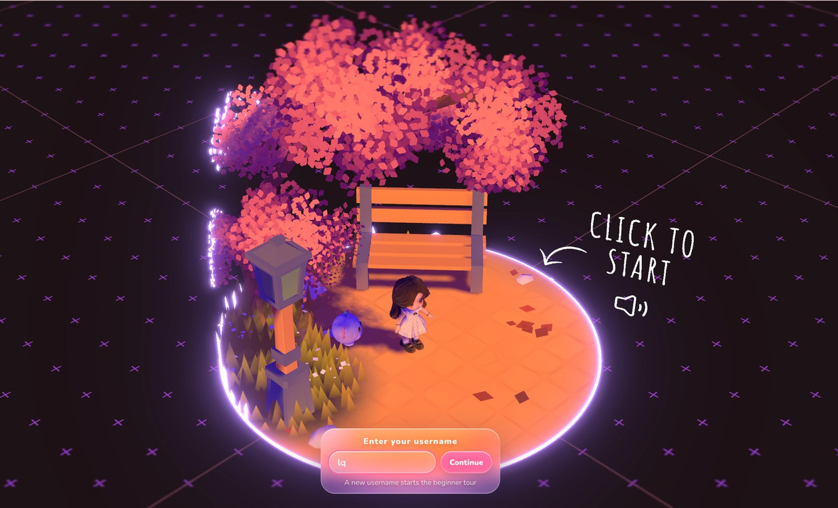
Live prototype demo
Skills profile intake
WORKING
Trend signal interface
WORKING
Explainable role matching
WORKING
Personalised pathway
WORKING
SDG target mapping
WORKING
Multiple disruption scenarios
WORKING
KERJAYAKU | CHILL CHILL
SDC HACKATHON 2026
11

Slide 6


One journey from profile to progress
Six features form one connected decision loop
01
02
03
04
05
06
PROFILE
SIGNALS
MATCH
PATHWAY
SDGs
SCENARIOS
Skills, experience and interests
Dated job-market evidence
Ranked roles and skill gaps
Ordered tasks and effort
Specific targets, not decoration
Moderate and fast disruption
KERJAYAKU
/
TEAM CHILL CHILL
SDC HACKATHON 2026
3

Slide 7
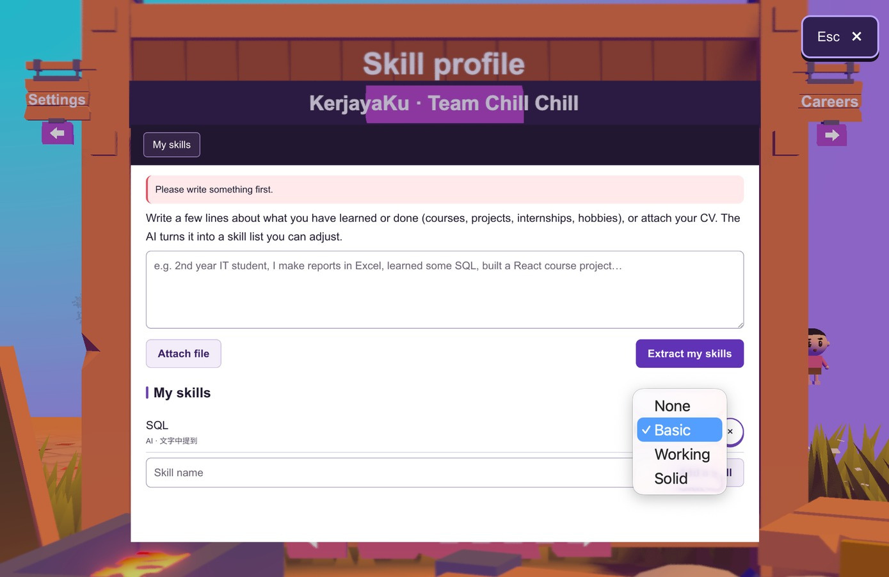
01 / SKILL PROFILE
Your skills. Your say.
AI extracts the profile.
Thestudentcancorrect it.
0–3
Reasons beside each skill
Seetheevidencebehindtheassigned level.
Four editable proficiency levels
None / Basic / Working / Solid
KERJAYAKU
/
TEAM CHILL CHILL
05

Slide 8

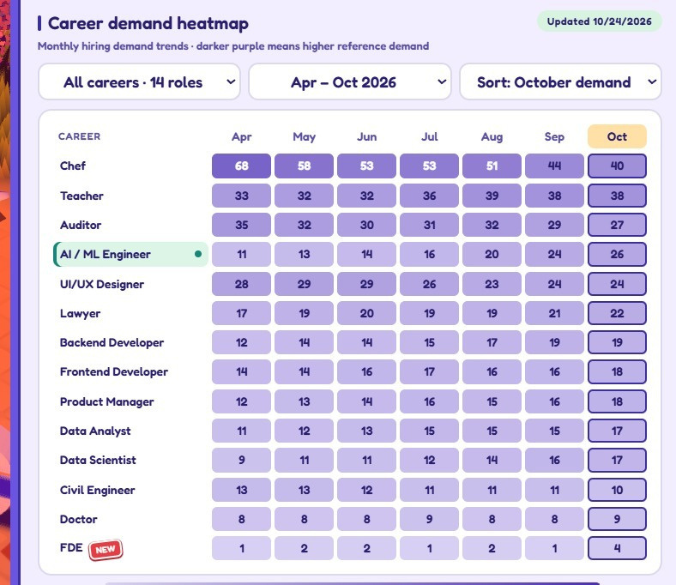
02 / MARKET SIGNALS
What is changing? Show the evidence.
Production signal pipeline
JSearch / LinkedIn/ Indeed/Ricebowl
Malaysian job samples
n8n Workflow
Filter, deduplicate, count skills
KerjayaKu
Source, date and trend shown
Uncertainty Control
Moderate and Fast-disruption scenarios recalculate role ranks from the same sourced signals
Refresh can update the evidence. A failed run retains the previous valid snapshot.
06

Slide 9



4
QUALITY EDUCATION
8
DECENT WORK & GROWTH
03 / CAREER MATCHING
Ranked roles, an explainable score, and what would raise it
One synthetic profile, two AI-adoption scenarios. Every number below is computed by our rules engine, not written by AI.
RANKED FUTURE ROLES
ESTIMATE
WHY 53 FOR DATA ANALYST
Moderate
Fast
53
= 0.6 ×
skill fit 57%
+ 0.4 ×
outlook 47%
#1
Data Analyst
53
52 #1 =
Fit:your levels vsthe role, weightedby each skill’sfuturevalue.
Outlook: those skills under AI adoption plus the hiring trend.
#2
Data Scientist
37
36 #2 =
WHAT WOULD RAISE IT
Learn SQLtothe required level
+10.1 +7.0 +5.3
#3
Auditor
35
33 #4 ▼1
Learn Statistics
#4
Product Manager
34
34 #3 ▲1
Data cleaning to the required level
SKILL GAP
SQL
Data cleaning Excel
·
YOU vs REQUIRED
#5
Forward Deployed Eng.
33
32 #5 =
1/3 2/3
✓
Statistics
Data visualisation Python
0/2 1/2
✓
Fast adoption moves Product Manager above Auditor: same data, different assumption. Confidence is low until we have 3 comparable months of postings.
KERJAYAKU | CHILL CHILL
SDC HACKATHON 2026
1

Slide 10
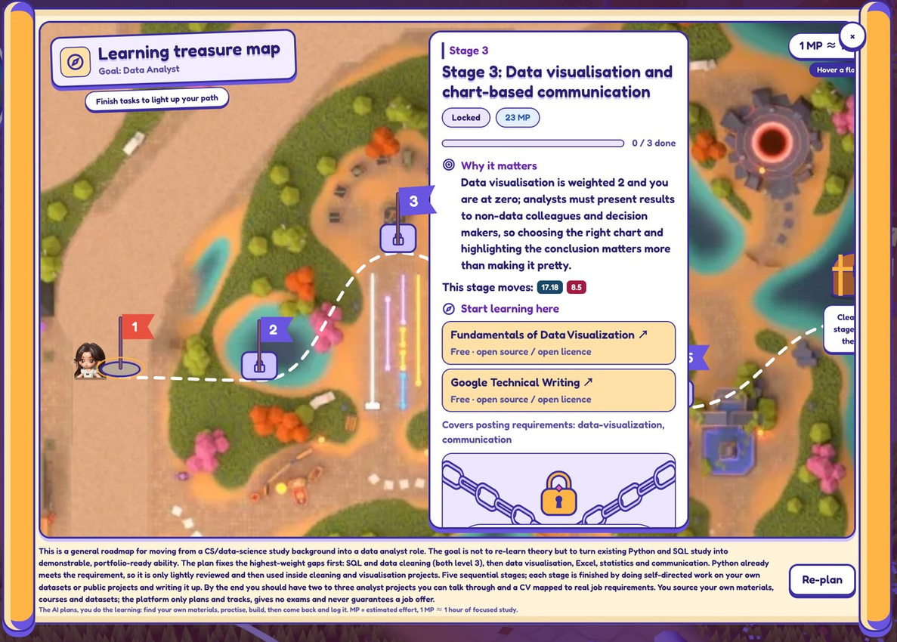





4
QUALITY EDUCATION
8
DECENT WORK & GROWTH
04 / PERSONALISED
ROADMAP
Skill gaps become an ordered plan with real, free resources
5 STAGES
·
203 HOURS
· ALL RESOURCES FREE
1
SQL: from “learned” to “can query”
50 h
FREE
Select Star SQL
2
Data cleaning you can hand over
46 h
FREE
Kaggle Learn: Data Cleaning
3
Statistics + visualisation
52 h
FREE
OpenIntroStatistics · Fundamentals of Data Visualization
4
Light check: Python + Excel
20 h
FREE
ThePythonTutorial · GCFGlobal Excel
5
End-to-end portfolio project
35 h
FREE
GoogleTechnicalWriting+allof the above
Stages unlock in order; finish all five to open the chest.
KERJAYAKU
/
TEAM CHILL CHILL
SDC HACKATHON 2026
2

Slide 11
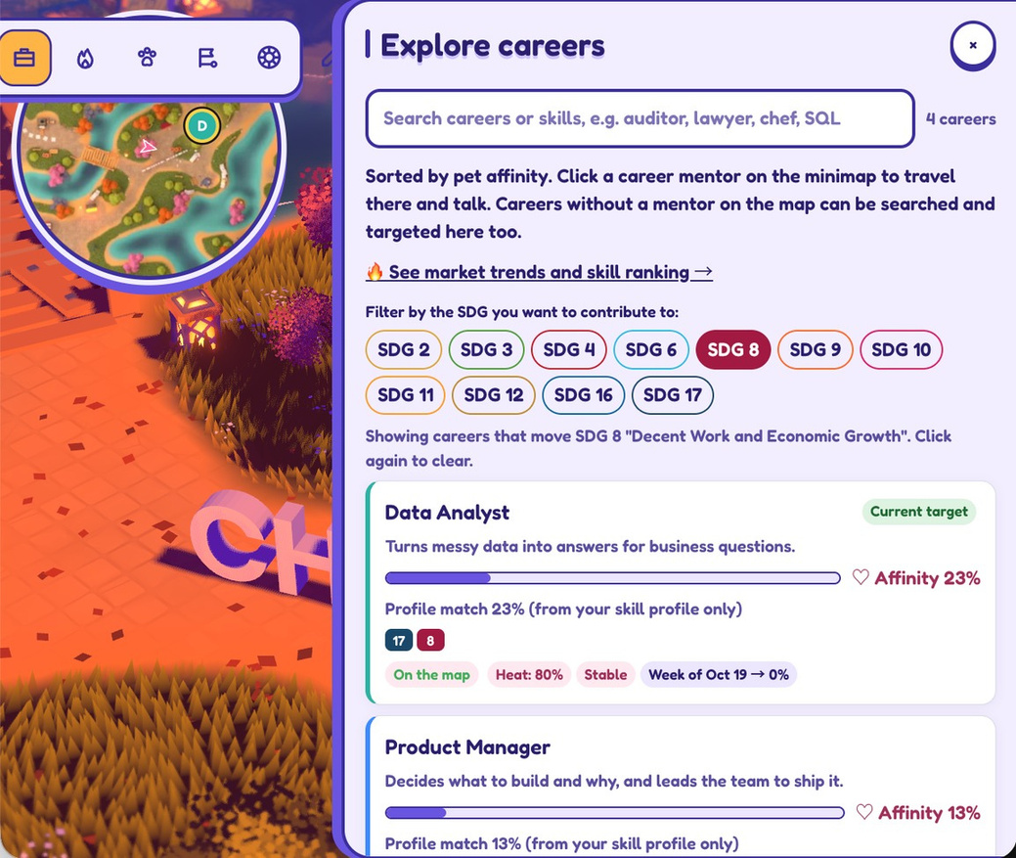


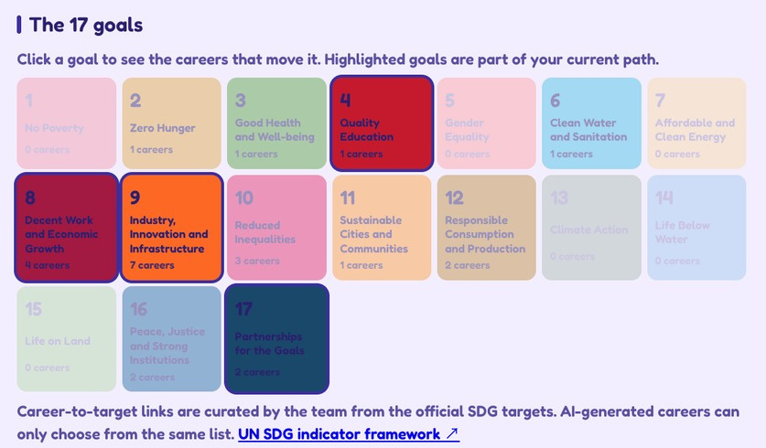
05 / SDG ALIGNMENT
SDG Progress stays meaningful
Career preparation connects to exact SDG targets and a visible habit loop
Profile + pathway tasks + learning reports
SDG 4.4
Relevant technical skills for
SDG 8.5
Full and productive employment
KERJAYAKU | CHILL CHILL
SDC HACKATHON 2026
7

Slide 12
06 / HANDLING UNCERTAINTY
Same profile.
Two possible AI futures.
MODERATE
EXTREME
VS
Three-year comparison using explicit assumptions. Scenario scores are estimates, not predictions.
KERJAYAKU
/
TEAM CHILL CHILL
10

Slide 13




























KerjayaKu
Technical Architecture:
Evidence in, Rules decide
4
QUALITY EDUCATION
8
DECENT WORK & ECONOMIC GROWTH
DATA
ENGINE
(BUILD
& COLLECT)
PRODUCT
Open Data
TalentCorp MyCOL / JobStreet 2025 / Anthropic Economic Index
Data Scripts
Python · re-runnable import + page checks
Human Review
Learner
laptop or phone EN · BM · 中⽂
Telegram Bot
FastAPI / DeepSeek Flash learning logs
42 skills mapped
O*NET task → skill
build
approved map
explores
/api/integrations
Dated Datasets
JSON · source + date as of 30 Oct 2026
load JSON
KerjayaKu App
Three.js · WebGPU Rapier · Vite
Game API
Node.js / Render
AI Layer
DeepSeek v4.1 Flash/
JSON schema
score · rank
Weekly Schedule
payload
Scenario Engine
Job Data
LinkedIn / JSearch new postings only
Normalise
title + skill rules dedupe · SQLite
PostgreSQL
player saves + 30-day market window
Rules Engine
Score = 50% skill fit + 50% career outlook
n8n · Monday MYT 08:00
Moderate vs Extreme
+ player Refresh
AI adoption · ranks
Weekly job-market collection → game. Every Monday 08:00 MYT, or by hand: n8n asks the game server for an incremental collection, then checks every 10 s until the new data is published (max 75 checks ≈ 12 min). Only new or changed postings are fetched; a failed run never replaces the last good data.
Technical Architecture
·
Team Chill Chill

Slide 14
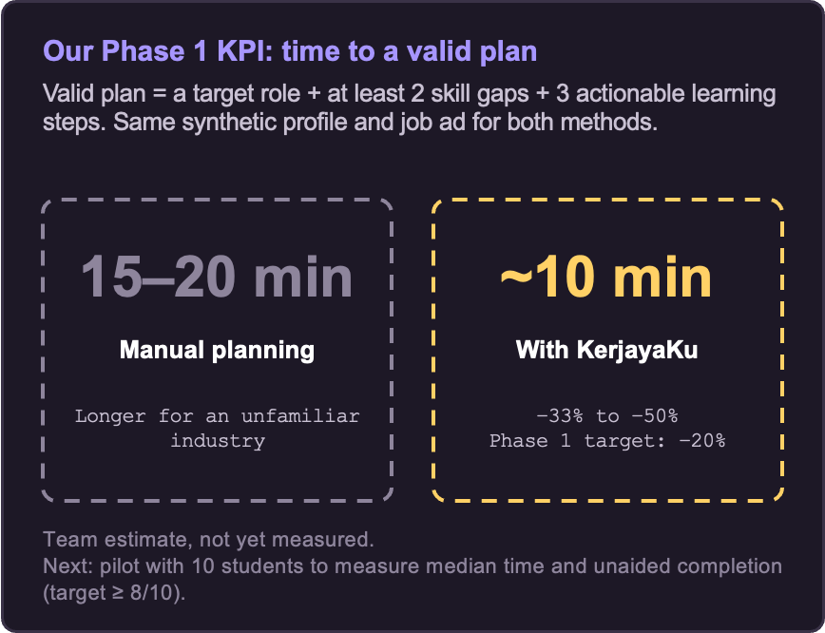



4
QUALITY EDUCATION
8
DECENT WORK & GROWTH
/
IMPACT
Who we reach, and how we prove it.
Learning stays free
67 / 67
All 67 starting resources are free.
HRD Corp-claimable courses are next.
SDG targets, not badges
4.4 · 8.5
Every role links to a UN target with a
reason. Every skill is tagged to a target.
Reach through partners
10 → 1
Pilot 10 students → one university career
centre cohort → TVET providers and HR teams. EN · BM · 中⽂.
KERJAYAKU
/
TEAM CHILL CHILL
1

Slide 15



4
QUALITY EDUCATION
8
DECENT WORK & GROWTH
/
FEASIBILITY
Small pilot. Clear operating model.
Monthly cost : fixed + per user
US$20 / RM81
Hosting + data (fixed)
$0 FoC
Learning content
< RM 1
Total AI per user
≈ US$0.03–0.05
AI (per user)
Replit Core: app, DB
DeepSeek Flash (game +bot),
67 of 67 resources free
even at 4× our estimate
~80k input + 25k output tokens per active user per month
Per user = US$20 fixed ÷ 100 users + US$0.03–0.05 AI ≈ US$0.23–0.25, falling as users grow.
Fixed: Replit Core plan (its usage credits cover hosting, database and weekly collection); JSearch free tier.
AI: DeepSeek Flash list price (US$0.15–0.30 / 0.60–1.20 per 1M input / output tokens, off-peak–peak) × assumed 80k + 25k tokens per user.
Freshness
Privacy + fairness
Deployment
Weekly collection Mon 08:00 MYT Refresh: 30-min cooldown 30-day rolling window Failure keeps last good data
Demo uses synthetic profiles Scores read skill levels only No age or gender input
Keys stay on the server
PostgreSQL
DeepSeek
440+ automated tests Labelled demo mode fallback
Aligned with Malaysia’s PDPA
KERJAYAKU
/
TEAM CHILL CHILL
2

Slide 16

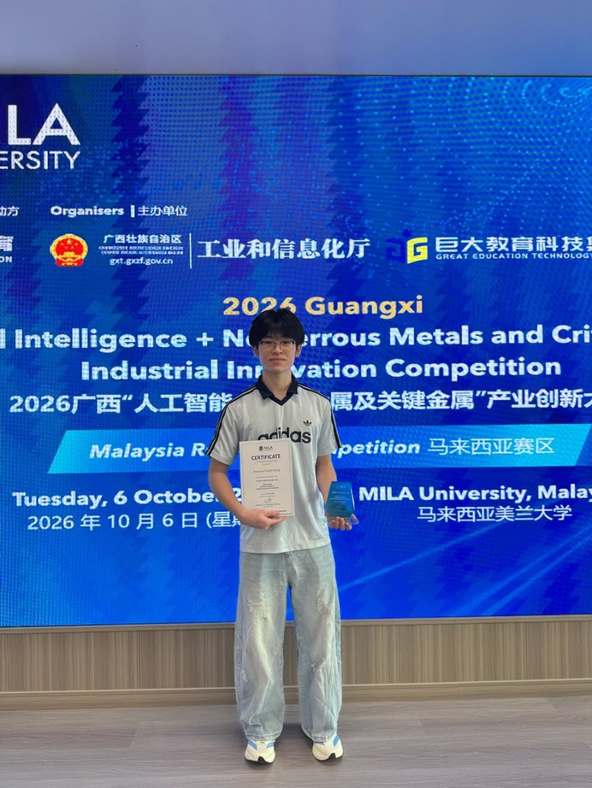







Meet Our Team
Edixon Teo Zan Wei
Aloysius Ting
Ngan Kin Sing
Chong Lee Khim
Khor Qi Xuan

Slide 17


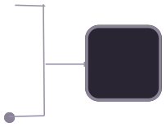












4
QUALITY EDUCATION
8
DECENT WORK & GROWTH
/ APPENDIX 1: WORKFLOW
Fresh market data every week, checked before it shows.
N8N
yes: check again (max 75×)
⚡
Every day 08:00
no
⚡
Start collection
Wait 10 s
Check status
Verify publication
failed → error
Still working?
pending?
Published
POST /crawl/schedule
GET …/schedule/:runId
new data on screen
Run now (demo)
starts run
GAME SERVER
·
RENDER
no
yes
no → keep last good data
nothing replaced, error logged
Last state
Collect postings
LinkedIn · JSearch
Normalise
Publishable?
Merge 30-day window
PostgreSQL
Trends panel
heatmap · skills · log
since + known
IDs
title + skillrules
complete or capped
KERJAYAKU
/
TEAM CHILL CHILL
1

