Slide 1
CostMatrix
One costing system for electrical panel boards — from enquiry to quotation, with every view we are building
735
components in the master library
296
standard kits in 17 groups
2 tracks
basic app live · advanced app on staging
Nationwide Electrical Industries Ltd · Operations · 12 September 2026 · internal

Slide 2




Why we are replacing the Excel costing
What one real project workbook (NPP-192) showed us
3 prices
25 %
0
10+
for the same 800/5 A CT in one sheet
flat labour uplift, whatever the work
link between costing and quotation — prices pasted as a picture
hidden sheets copied forward from old projects
Price drift
Labour guessed, not measured
Every workbook is a copy of the last; old prices and even old dates travel with it. No price history, no approval step.
Labour is 25 % of material regardless of hours. A busbar-heavy board and a wiring-heavy board cost the same to build on paper.
Retyping
No view across panels
The quotation is edited by hand from the sheet: quantities in the technical offer already differ from the costing.
Options and similar boards live on separate sheets; nobody sees the whole project at once.
CostMatrix · internal · September 2026 · 2

Slide 3









What CostMatrix does
Kits are the unit of costing; prices freeze the moment they are used; labour is hours × rate
Library
Costing
Approval
Quotation
BOMs
CRM
735 components, 296 kits; EUR purchase price × landed factor → KES
Panels built from kits; labour per kit group in 3 process types
Draft → submitted → approved; revisions keep history
PDF with 4 annexures, technical offer generated from the kits
Switchgear, busbar, accessories, enclosure — by panel and by costing
Customers, enquiries, follow-ups, won/lost
Frozen prices
Multi-company
Safe to grow
A master price change never alters an existing costing; the KES price and the factor used are stored on every line.
In-house engineers and external contractors or consultants, each with their own discount, labour rates and margins.
Two tracks: the basic app stays live as our back-up while the advanced app is built and proven on staging.
CostMatrix · internal · September 2026 · 3

Slide 4
Where we are — two tracks
Basic app in production, advanced app on its own staging environment
Basic app · live
Advanced app · staging
Library, kits, costing engine, approval, quotation PDF, BOMs, CRM
Master library seeded: 735 components, 296 kits
NPP-192 acceptance figure reproduced from the seed: KES 3,622,781.80 material
Still owed by us: labour hours for 17 kit groups, 8 part prices, the Form 3B/4B enclosure uplift rule
Next: the NPP-192 end-to-end trial on production
Foundations F1–F12 built: part attributes, kit versions, labour actuals, documents with text extraction, activity log, approval rules, import framework, physical dimensions
AI assistant core and screens built (propose-only; live test pending)
Supplier price-list import built; BOM import in progress
Own staging database and preview site; nothing reaches production until tested and behind a per-company switch
CostMatrix · internal · September 2026 · 4

Slide 5
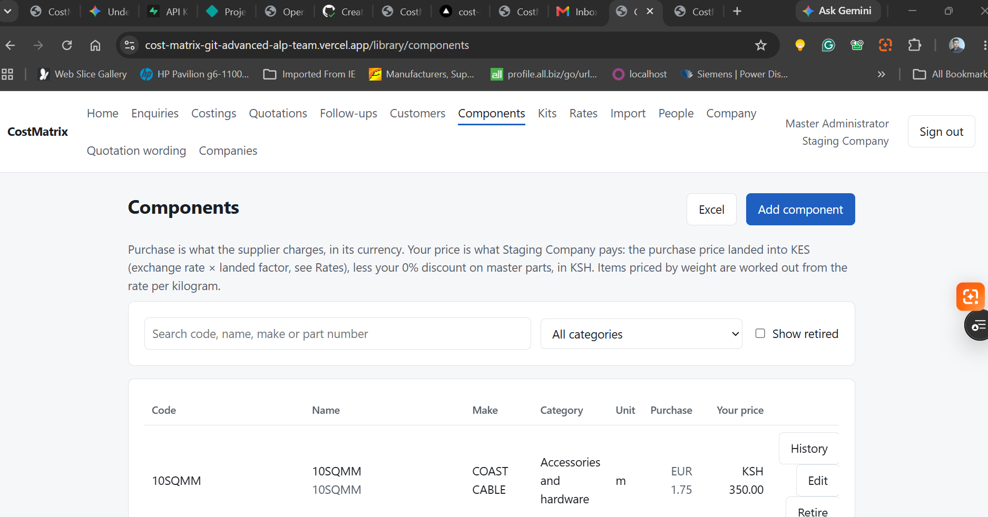
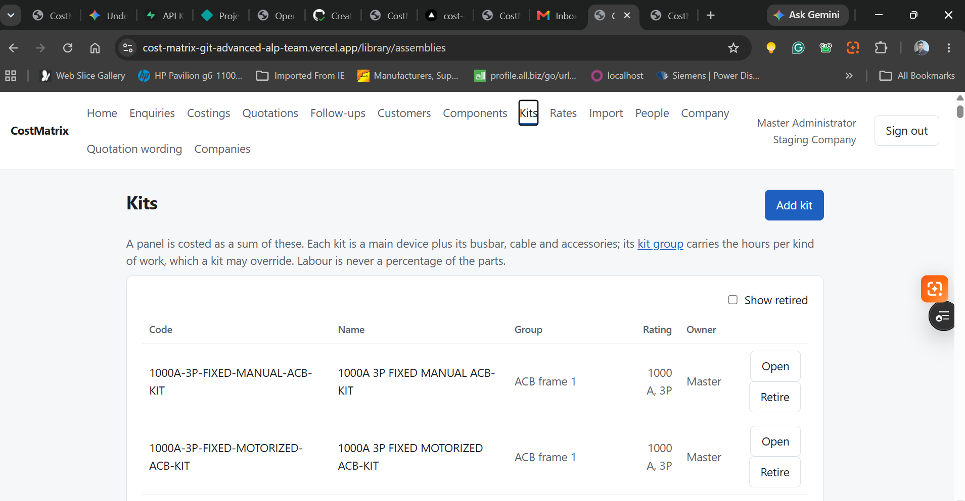
The library — components and kits
Live screens from the staging app
Components: purchase price in EUR, landed KES price, category, unit, history per part
Kits: a main device plus its busbar, cable and accessories; the kit group carries labour hours
CostMatrix · internal · September 2026 · 5

Slide 6
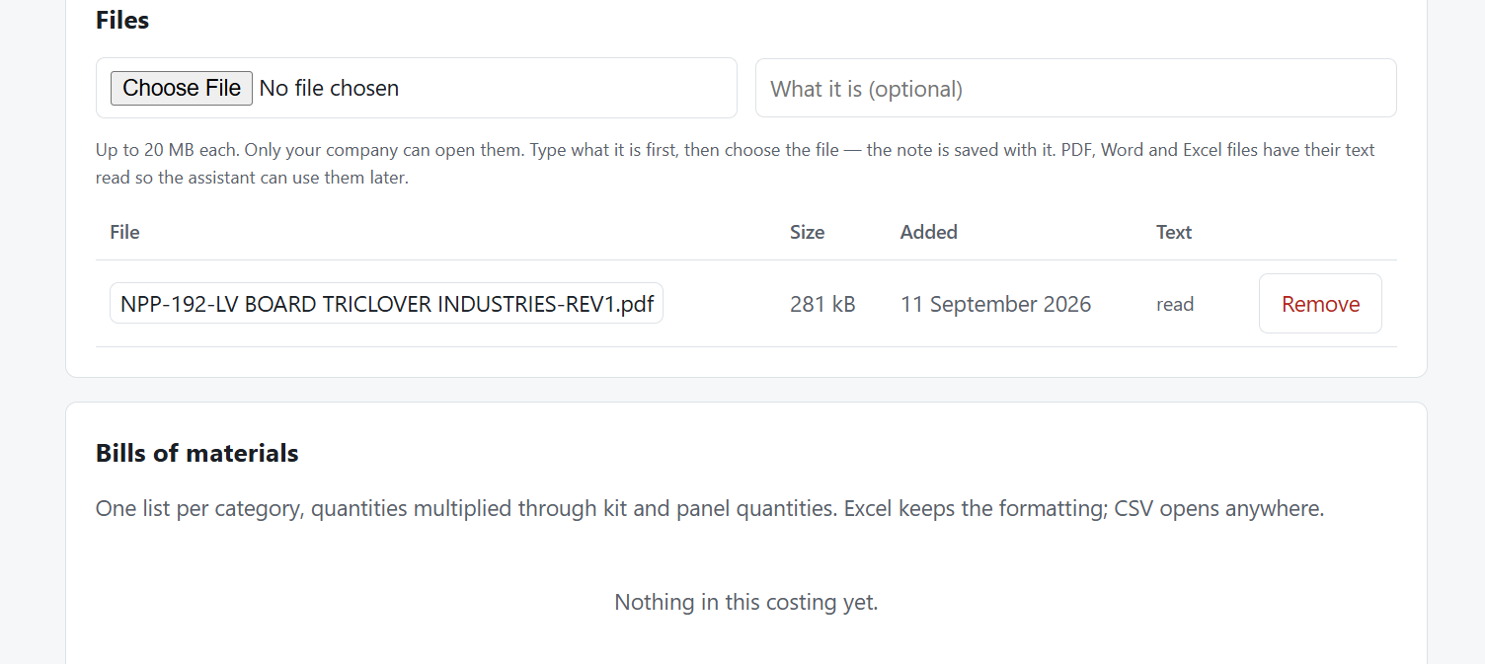




Costing, documents and outputs
Files attached to a costing are read automatically so the assistant can use them
Quotation PDF
Cover letter, notes, price schedule, terms, technical offer — generated from the costing, letterhead per company.
Four BOMs
Switchgear · busbar (size, metres, kg) · accessories & hardware · fabricated enclosure parts.
Revisions
Changes after approval create Rev 1, Rev 2… the old revision stays read-only.
The NPP-192 quotation PDF attached to a costing on staging — text extracted ("read") within a minute
Documents
Enquiry specs, single-line diagrams, tender schedules, supplier price lists — stored per company, text read for search and AI.
CostMatrix · internal · September 2026 · 6

Slide 7





The AI assistant — proposes, never decides
Built and switched on for staging; first live run pending a small Anthropic credit
1 · Attach the enquiry
2 · Draft this costing
Spec, single-line diagram or tender schedule on the enquiry or costing.
The assistant reads the documents and proposes panels, kits and quantities from our own library — with the sentence and page that justified each line, and a confidence.
3 · Engineer reviews
4 · Apply
Accept, change or reject line by line; unresolved items are listed, never invented; low-confidence lines start rejected.
Only accepted lines are written, through the same engine as the kit picker; prices frozen, lines marked as the assistant's, who applied them recorded.
Before approval
Guard rails
Never invents a price or a part number · acts as the signed-in user, so it sees only what they see · off for every company until the master administrator switches it on · usage and budget per company · key stored on the server, never in the browser
A review card: missing items, placeholder parts, prices older than 90 days, margin below policy, mismatches with the spec.
CostMatrix · internal · September 2026 · 7

Slide 8
Bringing data in — price lists and BOMs
Nothing in the catalogue or a costing changes until a person accepts each row
Supplier price lists · built
BOM import · in progress
Upload CSV, Excel or PDF; map the columns once
Rows matched to the catalogue four ways; ambiguity reported, not guessed
Old price → new price with % change, per row
Accept per row or all; every accepted price keeps its source and date in the history
This is also where the 8 unpriced parts go in
A parts list from EPLAN, a consultant or a customer
Part numbers and manufacturer numbers matched; where a device is a kit's main device, the kit is proposed
Unmatched rows: manual choice or a placeholder part
Lands as a draft panel through the same review screen
CostMatrix · internal · September 2026 · 8

Slide 9
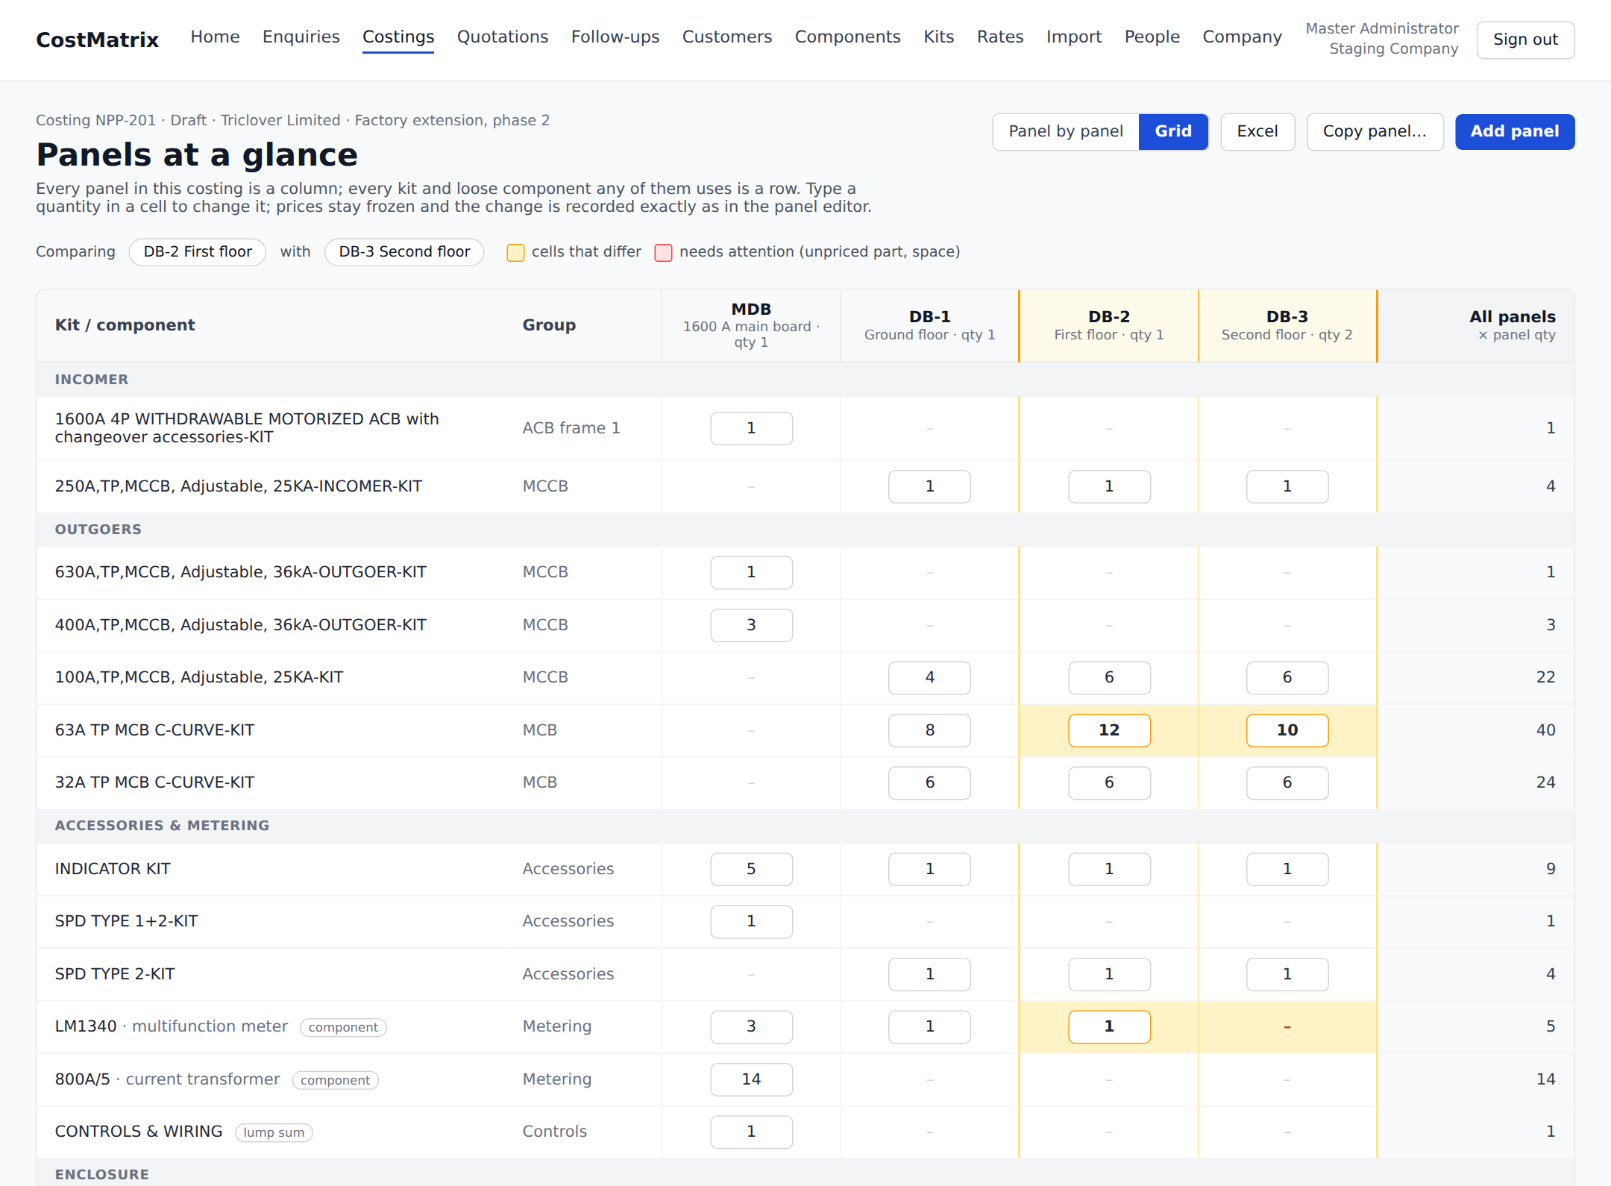




New view · panels at a glance
Confirmed design — panels as columns, kits and components as rows, editable in place
Compare
Pick two panels; differing quantities light up in amber.
Copy a panel
A schedule of similar boards starts from one column.
Totals per panel
Material, labour, selling and rounded price; all panels × quantity at the right.
Excel
The same layout exported for the team or the customer.
CostMatrix · internal · September 2026 · 9

Slide 10
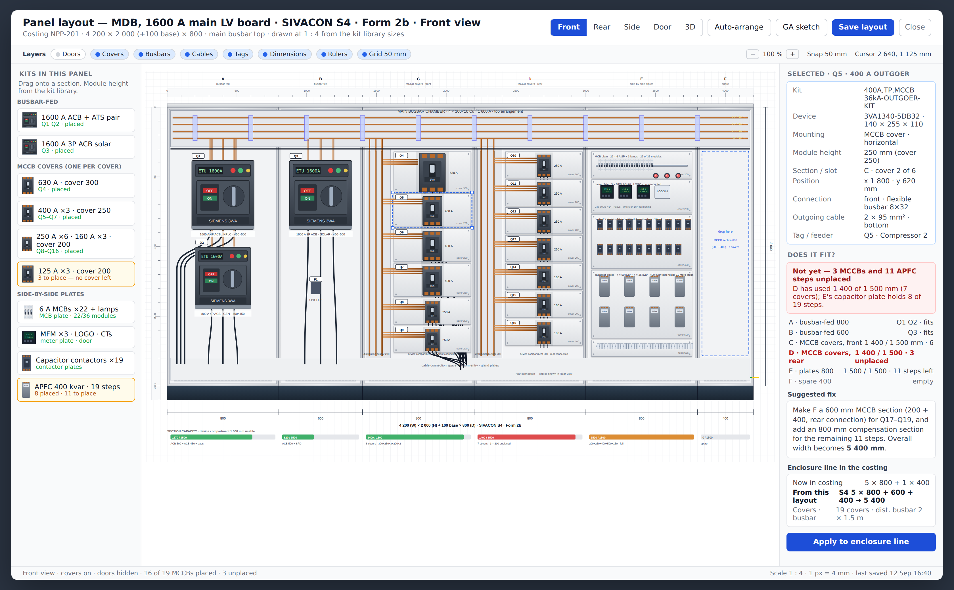



New view · panel layout at true scale
SIVACON S4 sections drawn at EPLAN Pro Panel level: real device faces, busbars, covers, cables, tags and dimensions — the fit verdict counts module heights, not guesses
Plate rules
Side by side (MCB, contactor, meter, terminal) · one MCCB per cover, horizontal · ACB, ATS, changeover, isolator fed from the main busbar.
Drag and drop
A kit dropped on a section lands on the right cover or plate; the app says when a section is full and suggests the fix.
Enclosure line
The layout proposes the cubicles; one click writes them into the costing.
CostMatrix · internal · September 2026 · 10

Slide 11
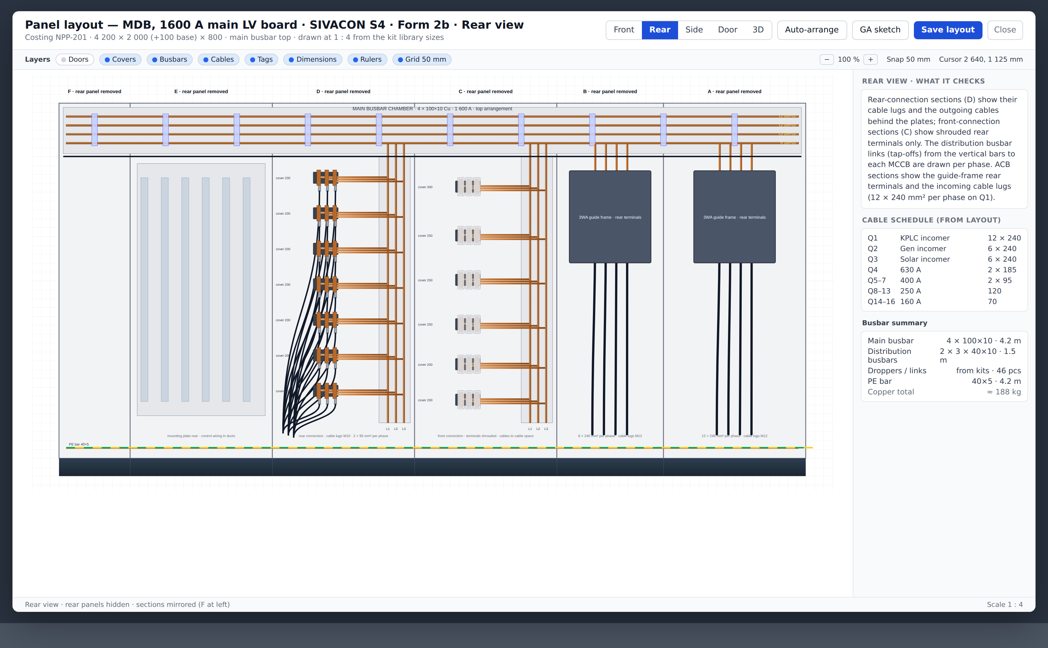
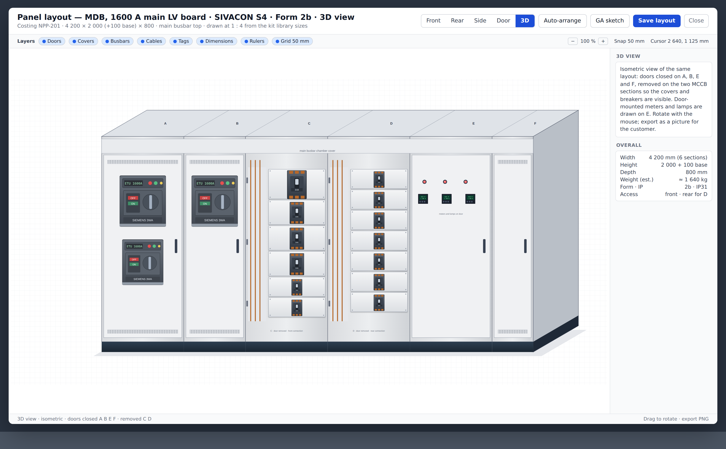
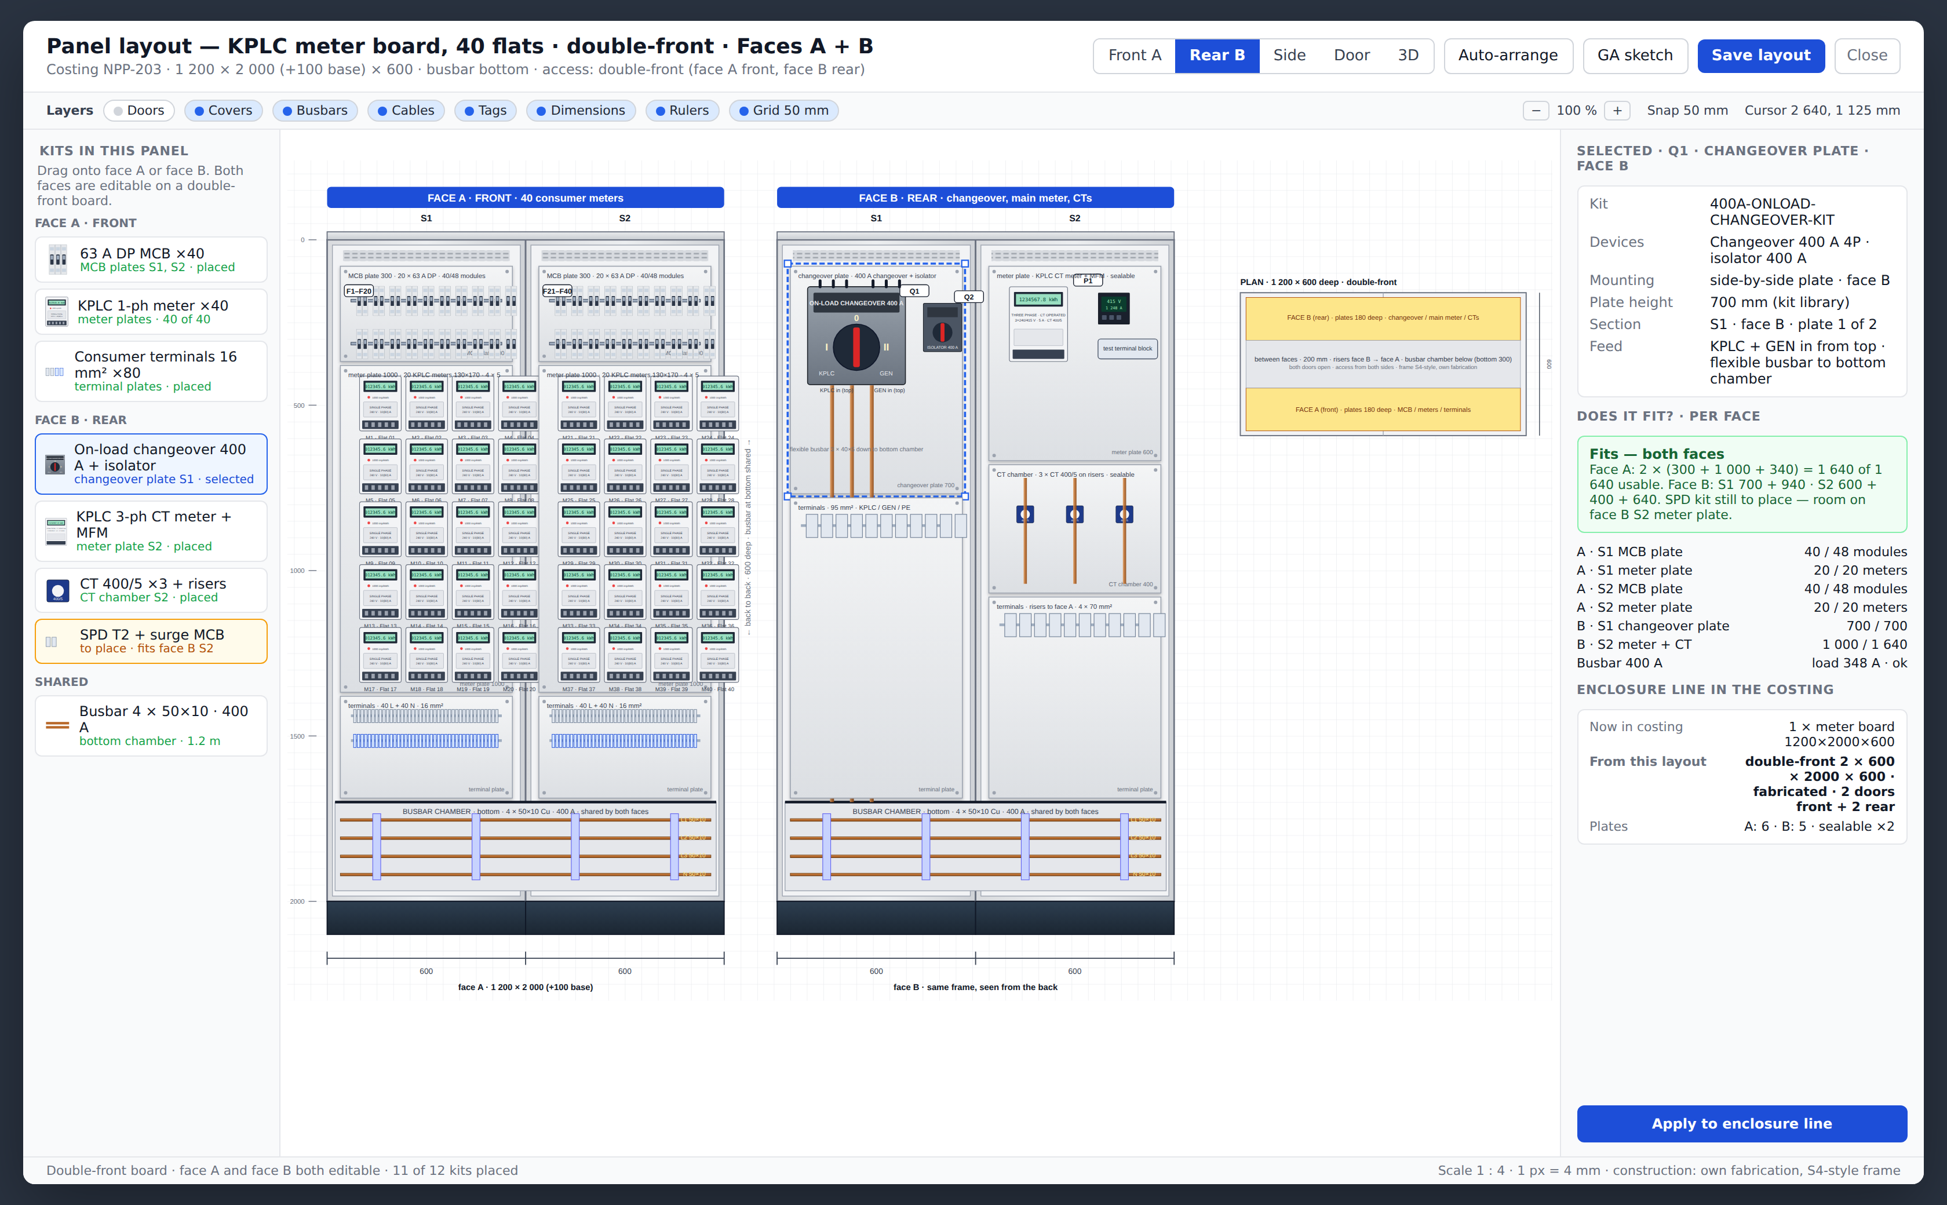

Panel layout · rear view, 3D view and double-front boards
Rear connection, customer picture, and both faces editable on our own double-front fabrication
Rear view: lugs and cables on rear-connection sections, cable schedule, copper summary
3D view: isometric picture for the offer, doors closed or removed per section
Double-front KPLC meter board: face A and face B, shared bottom busbar, fit per face
Double-front is standard for us
Fit per face
Own fabrication on an S4-style frame, busbar between the faces; used mainly for KPLC meter boards — MCB, meter and terminal plates on one face, changeover and terminals on the other.
A double-front section fits only when both faces fit; the GA sketch prints a front and a rear elevation.
CostMatrix · internal · September 2026 · 11

Slide 12
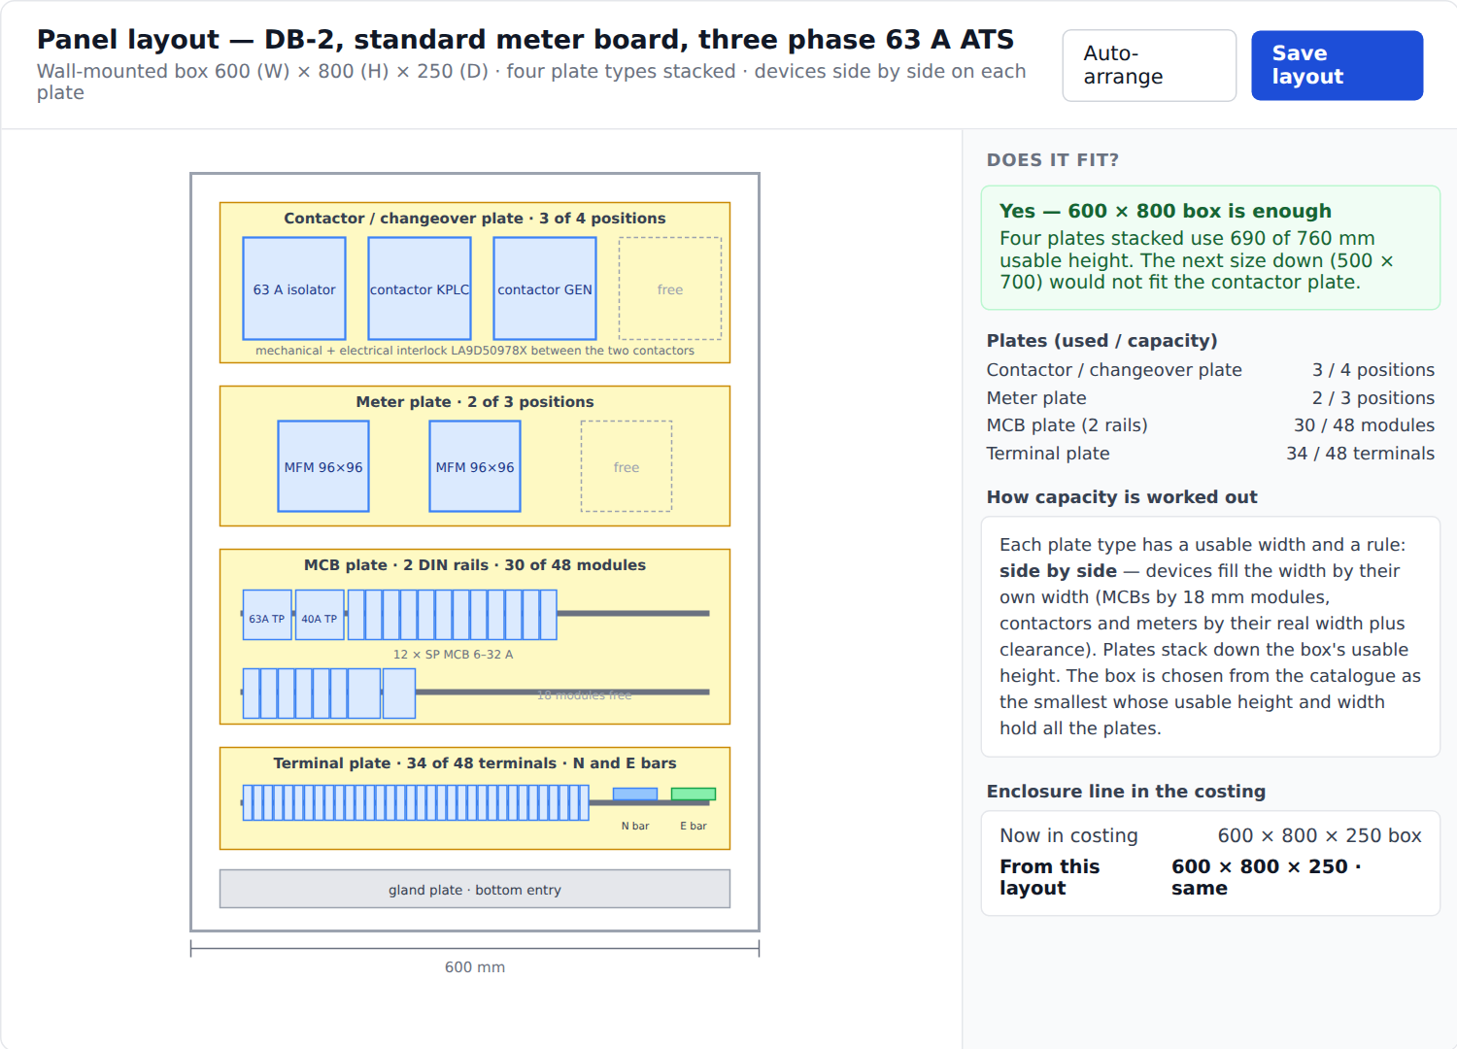
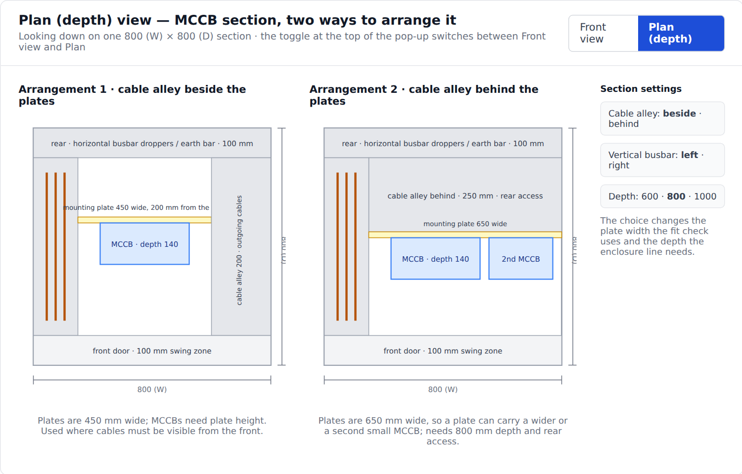
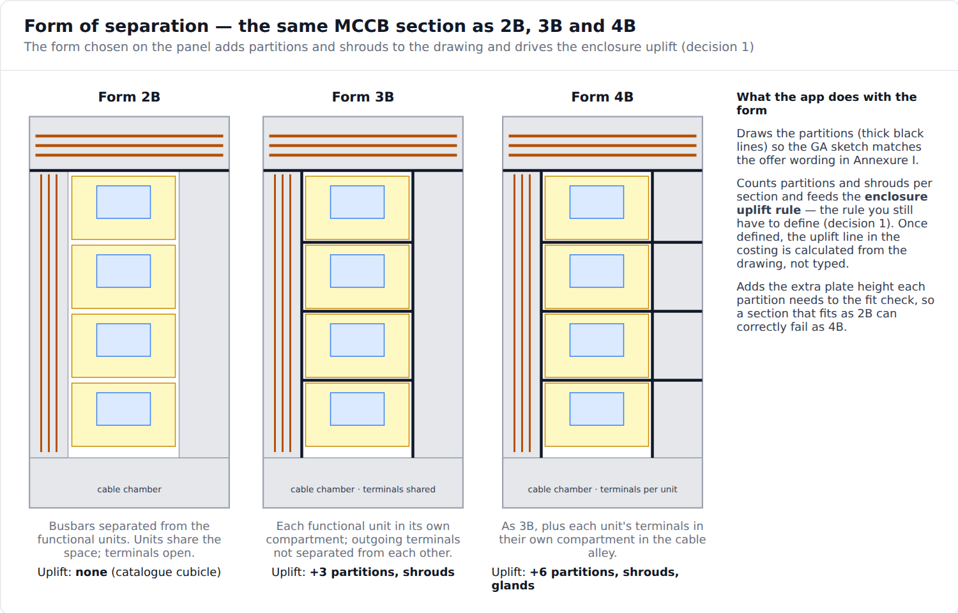


Panel layout · meter board, depth and form of separation
Same tool, three more views
Plan view: cable alley beside or behind the plates
Form 2B / 3B / 4B partitions feed the enclosure uplift
Meter board: four plate types stacked in the smallest box that fits
Section settings
Uplift from the drawing
Cable alley beside or behind, vertical busbar left or right, depth 600 / 800 / 1000 — each changes plate width and the enclosure the costing needs.
Partitions and shrouds are counted per section, so the Form 3B/4B uplift is calculated, not typed — once the rule is defined.
CostMatrix · internal · September 2026 · 12

Slide 13
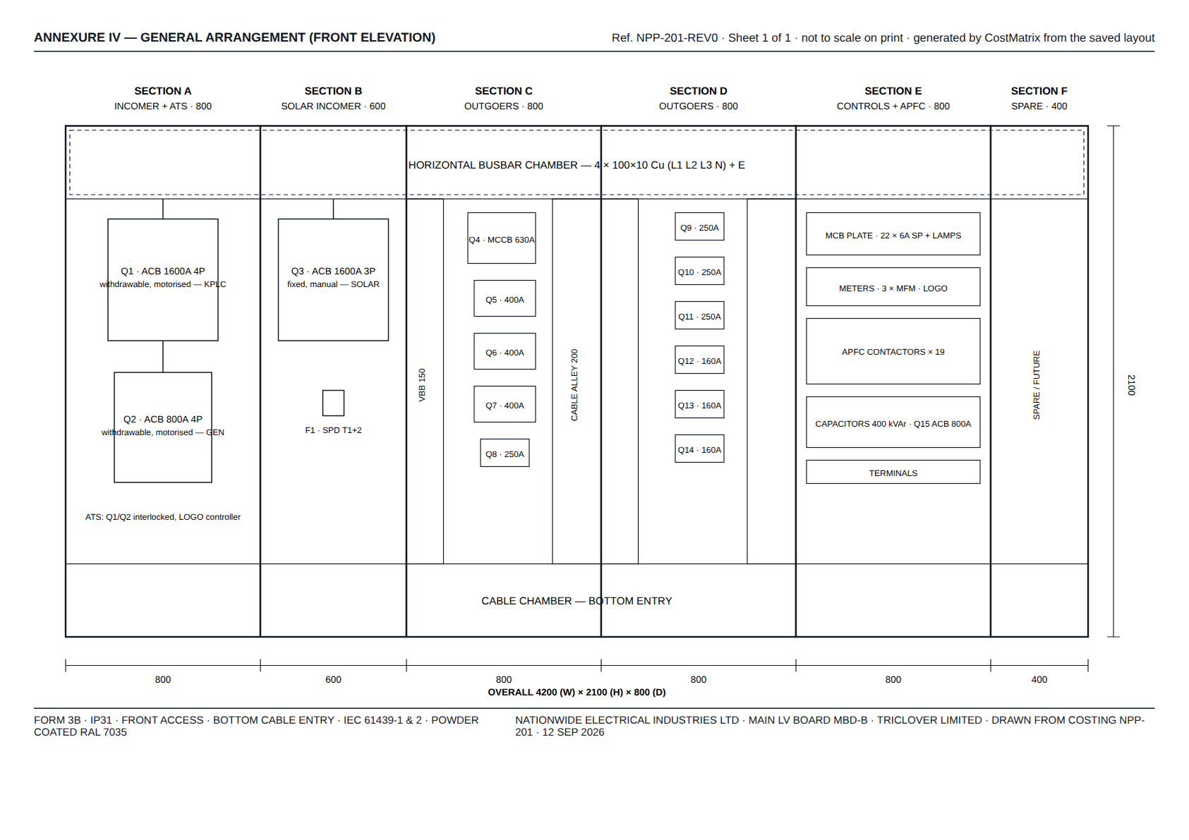



Panel layout · the GA sketch in Annexure IV
The saved layout printed as a general-arrangement drawing with device tags and dimensions
Generated, not drawn twice
The same layout that sized the enclosure becomes the drawing the customer sees — quantities cannot drift between costing, offer and drawing.
Device tags
Q1, Q2… follow the kits; the technical offer bullets and the drawing use the same list.
A4 PDF
Exported with the quotation; also usable by the workshop as a build reference.
CostMatrix · internal · September 2026 · 13

Slide 14
Roadmap
Borrowed from EPLAN, the switchgear makers' configurators, estimating tools and CPQ systems
1
2
3
4
Now
Phase 2
Phase 3
Phase 4
Foundations F1–F12 · AI assistant · supplier price lists
BOM import · grid view · approval rules · quotation validity and follow-ups · options and alternatives · estimate vs actual labour
Guided board configurator · APFC configurator · parameterised kits · compatibility checks · labour standards from actual hours · sales analytics · panel layout canvas
Busbar run calculator · enclosure fill check from dimensions · Word/EPLAN exports · e-signature and customer portal · supplier price feeds
CostMatrix · internal · September 2026 · 14

Slide 15

What the team needs to supply
The software is ahead of the data — these four inputs unlock real costings
Labour hours
Eight prices
Hours per kit group for assembly, wiring and busbar fabrication — 17 groups. Without them labour shows as zero.
The unpriced parts used by the APFC breaker kits and the meterboard kits, plus the 200 A MCCB part number.
Dimensions
Enclosure uplift rule
Width, height, depth and mounting type per device from the Siemens and C&S catalogues — the layout canvas depends on them.
How Form 3B/4B, partitions and extras add to the catalogue cubicle price.
Then: the NPP-192 trial on production, the first live AI draft, and the grid and layout builds in the order shown.

