Slide 1




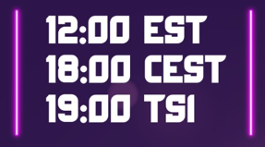

18 October 2022

Slide 2
We would like to see you among us for the interview preparations in English every Tuesday and Thursday.
Today we will discuss these questions;
More about SQL

Slide 3
Those keys are used to modify the Database
Create
Select
Drop

Slide 4
Insert
Add
Those keys are used to do changes on the table
Select
Rename
Update
Alias
Delete
Alter

Slide 5
smallint
Stores whole numbers from -32768 to +32767
integer
Stores whole numbers from -2147483648 to +2147483647
bigint
Stores whole numbers from -9223372036854775808 to 9223372036854775807
decimal
Up to 131072 digits before the decimal point, up to 16383 digits after the decimal point
serial
Auto incrementing integer

Slide 6
bigserial
Large auto incrementing integer
char()
Stores specified number of characters
varchar()
Stores specified number of characters
date
Date value
money
Currency amount

Slide 7
boolean
true or false

Slide 8
Where
Used to describe a condition while getting data from table
Order by
Used to sort the result set in ascending or descending order
Group by
Used to group the result set
Having
Used to specify a search condition for a group or an aggregation
Distinct
Used to delete duplicate rows or data from a table

Slide 9
Limit
Used to limit the result
Fetch
Used to limit the result

Slide 10
And
Between
Used to return more detailed output from the database.
Or
Using
Not
Like
In

Slide 11


