Slide 1
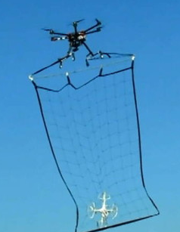

Replace the with actual photo of setup
Panel 3
Panel 2
Panel 1

