Slide 1
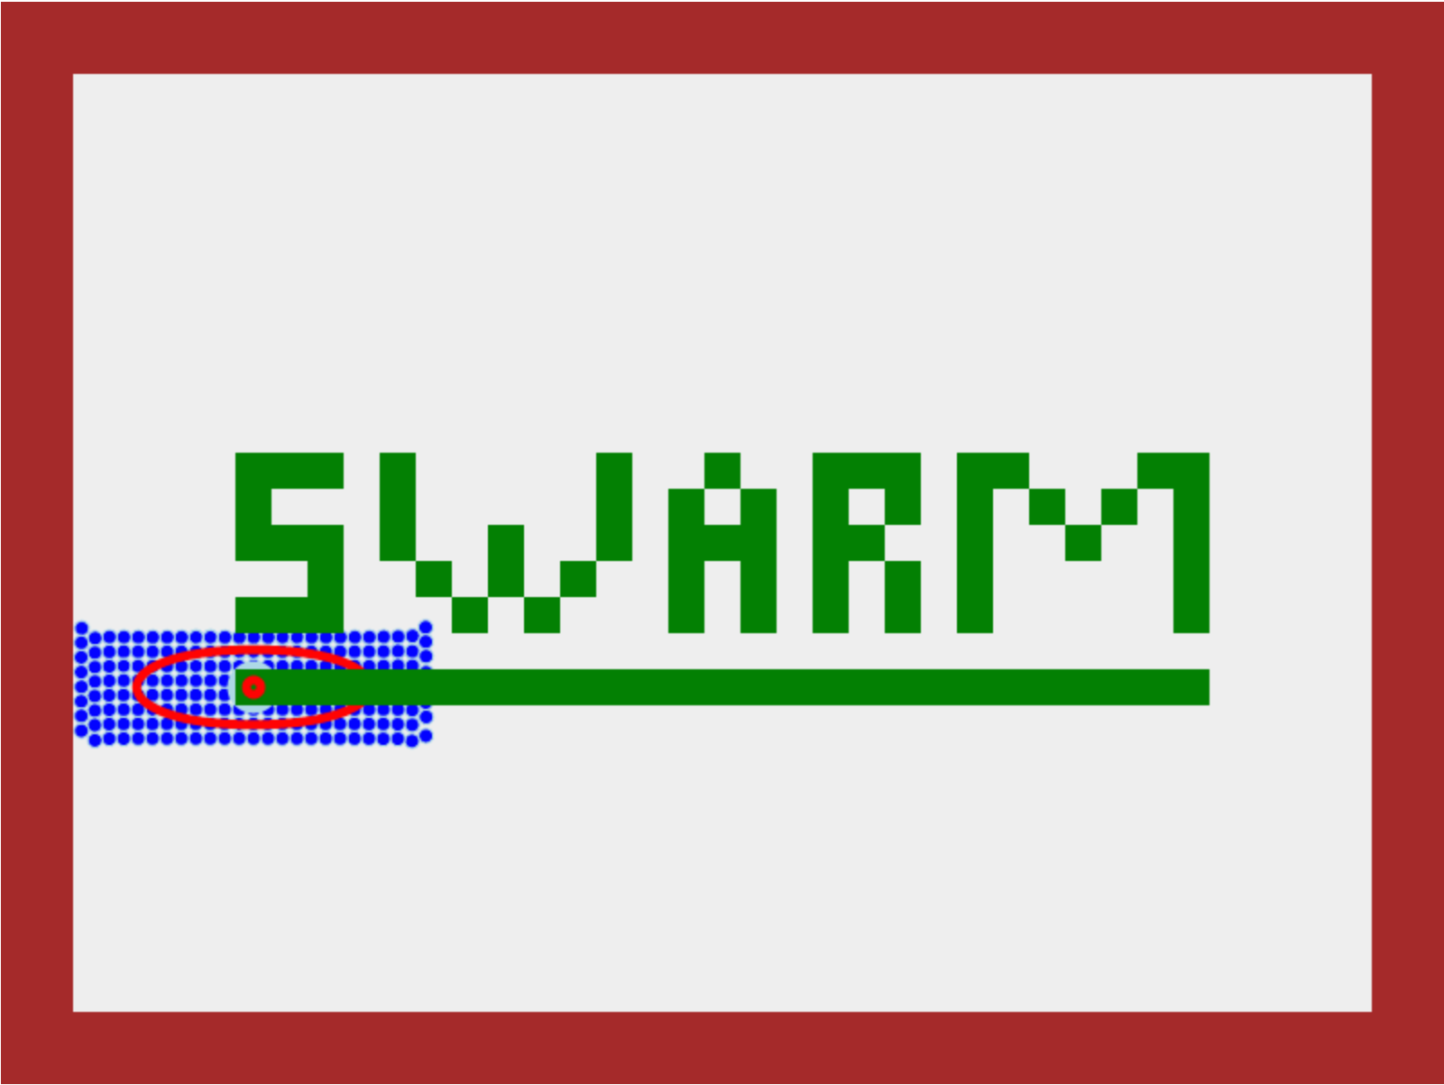
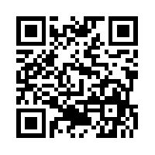

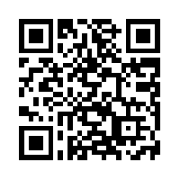
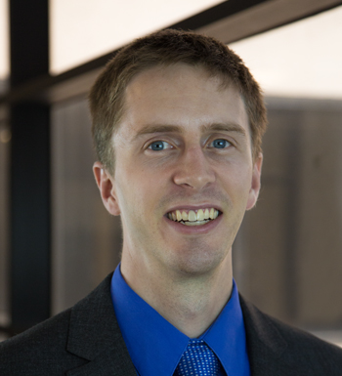
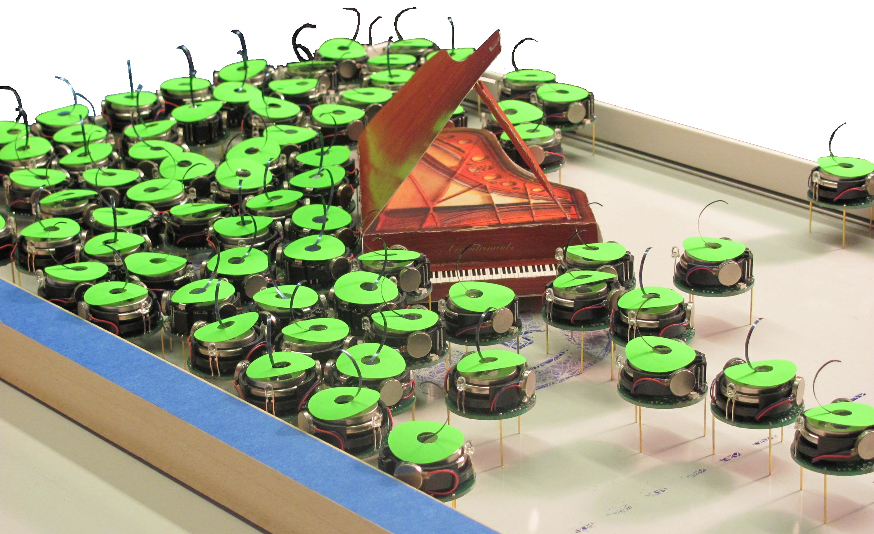

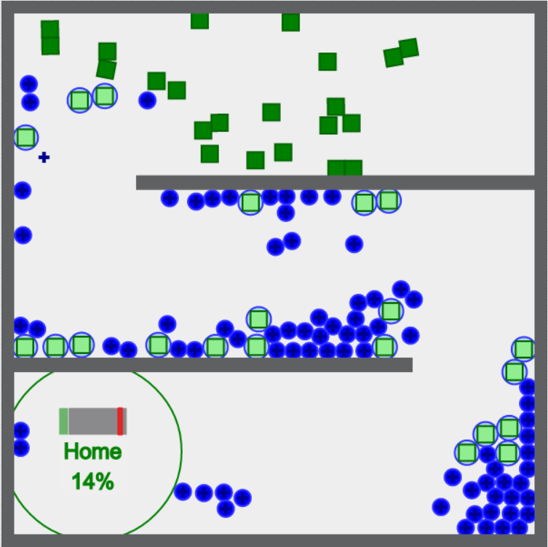
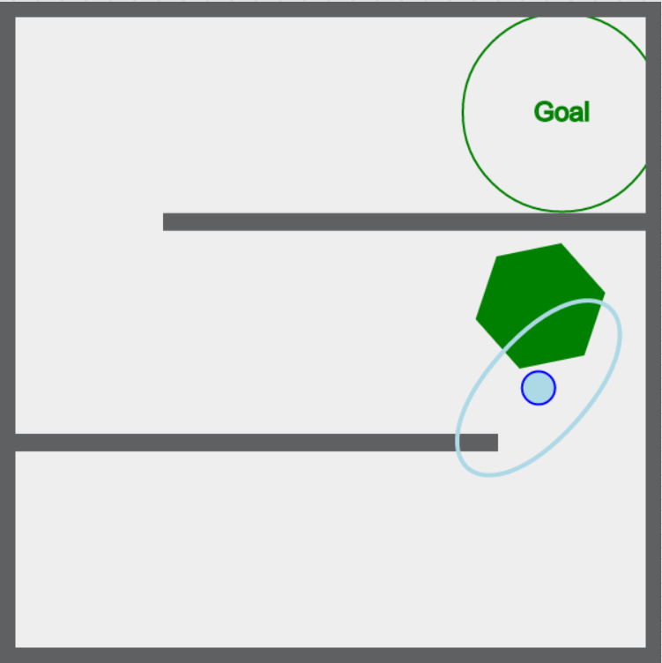
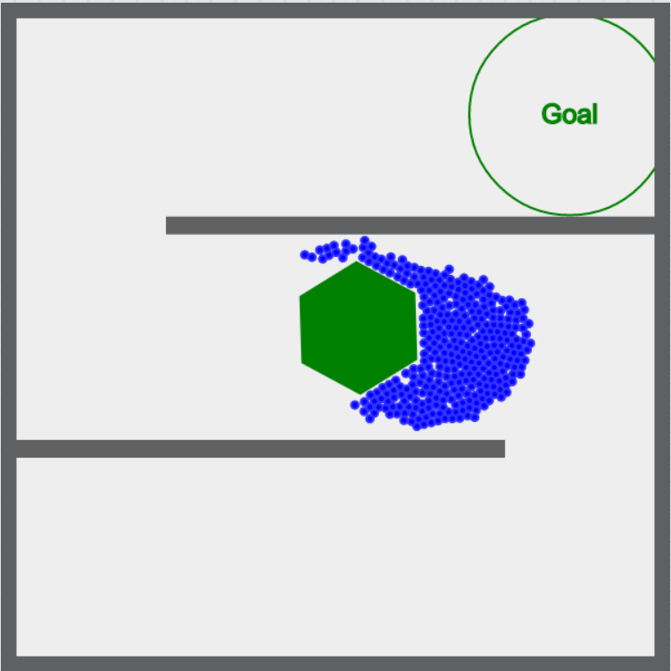
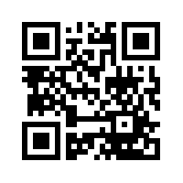
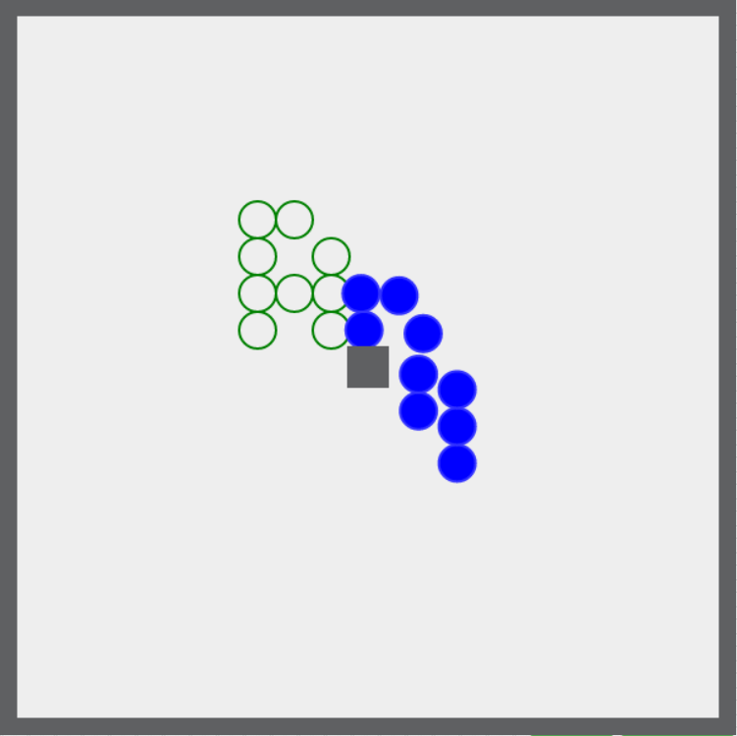
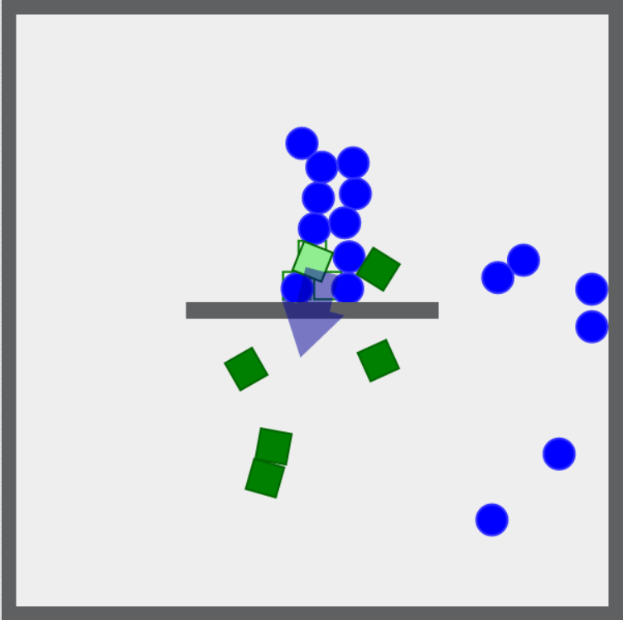

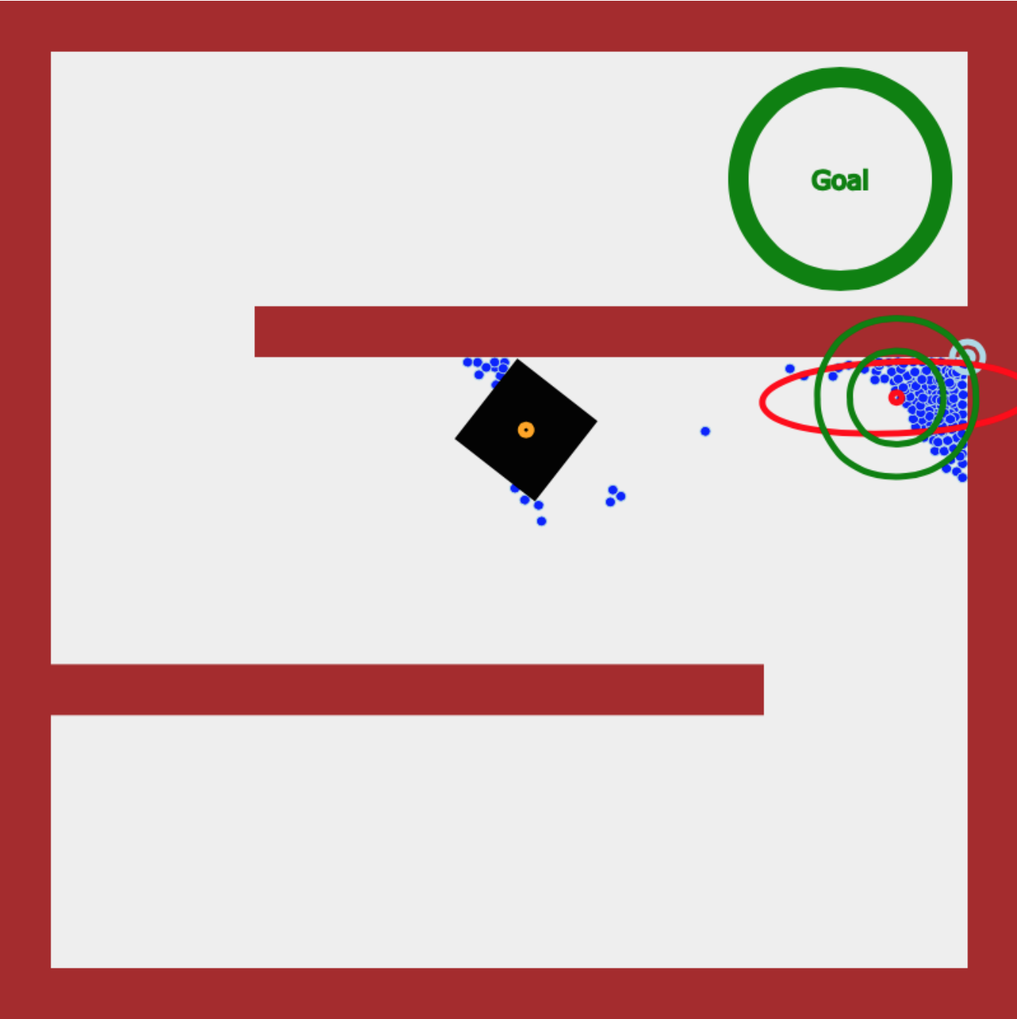
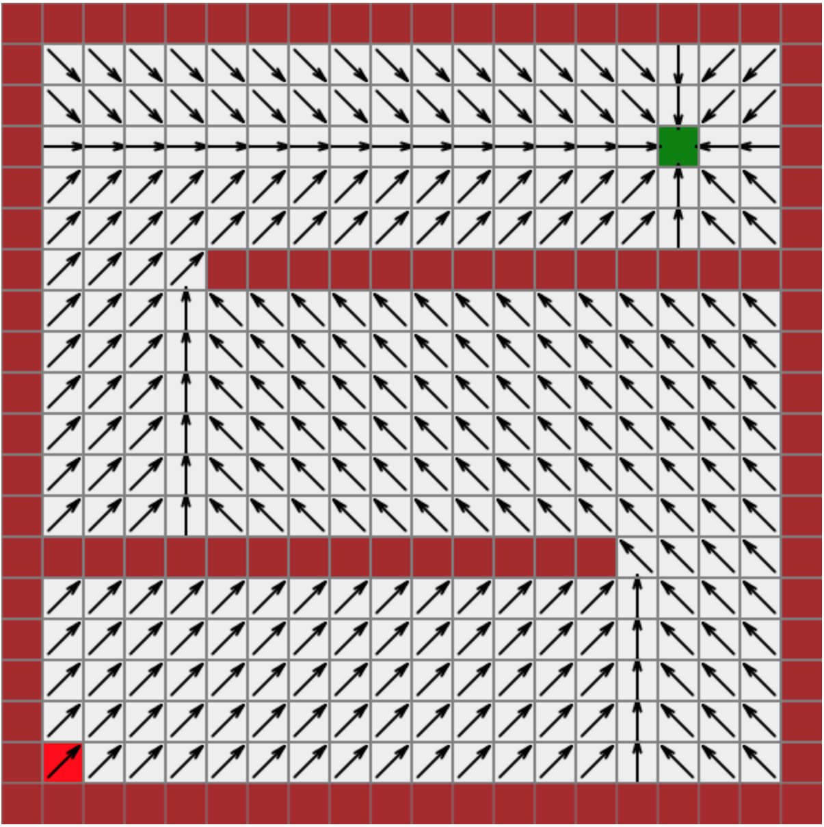
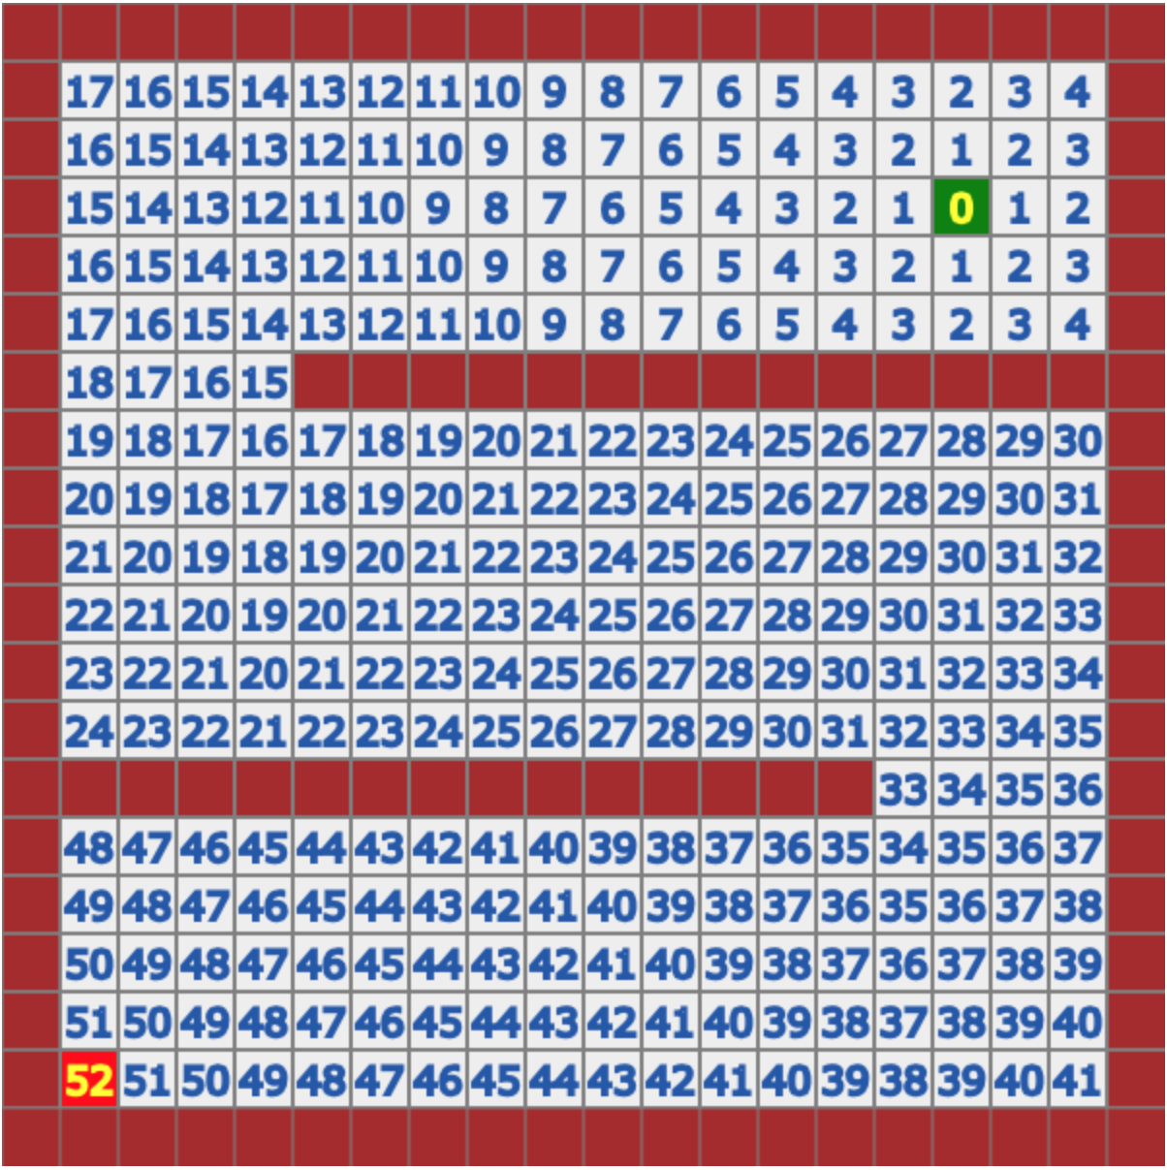
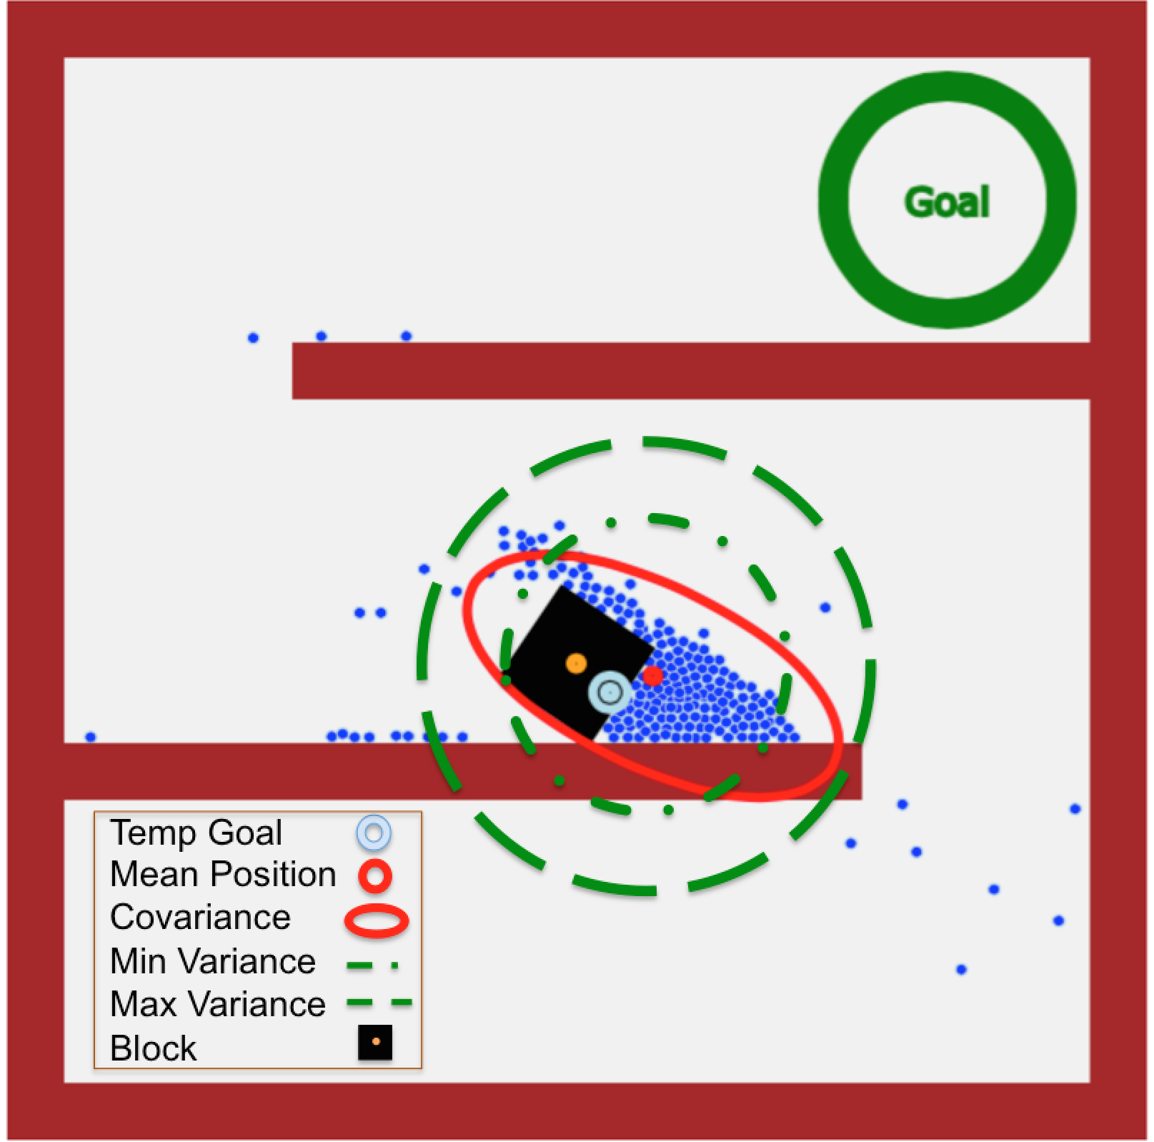




Controlling the Shape of 1,000 Robots with Just Two Inputs
Shiva Shahrokhi, Aaron T. Becker
sshahrokhi2@uh.edu, atbecker@uh.edu .
Department of Electrical and Computer Engineering,
University of Houston
Robots
Mean Position
Covariance
Website, C.V.
YouTube channel
Why a Swarm?
Three Controllers
Opportunities
Swarm robots:
Can pass through constrictions
Can bend around obstacles
Can be simple:
Easy to design, build, test
Disposable/ replaceable
Small, tiny, nano/micro robots
How could the swarm be optimally partitioned using the same input? What is the ideal obstacle shape?
What if we do not know the environment? How can the swarm learn the environment?
What is the advantage of heterogeneity? Could a leader robot increase performance by measuring a stochastic environment?
What obstacle shapes are ideal for controlling a given moment?
Swarm Piano Mover’s video
How Do Humans Control Swarms?
(1) Controlling mean position of
200 robots with different gain settings
Proportional gains, K_{p}, increase the response,
but also increase overshoot
Derivative gains, K_{d}, reduce overshoot,
but slow the response
Humans can control swarms. Our gamification research
with SwarmControl.net has run 10,000s of experiments.
Can machines learn how to control a swarm?
Rules: Inputs are simple & global: all robots receive exactly the same commands
Result 1: Without any obstacles and noise, the robots cannot be steered to arbitrary positions. Adding obstacles and/or noise breaks symmetry and enables controlling the position of every robot.
Results
Block Pushing
with 200 robots
Problem: push a block through a maze using a swarm of robots with global inputs
All robots get the same global input and use hybrid hysteresis mean-variance control to reach the goal
We choose local goals to steer the swarm: aggregate behind the block to push the block forward
Block-pushing video
(2) Controlling variance by
exploiting Brownian noise
Robots wait to increase variance
and go to corners to decrease variance
SwarmControl.net
Block Pushing
If variance is larger than desired maximum, we direct swarm to nearest corner to gather robots
(3) Hybrid hysteresis mean-variance control
Robots go to corners if variance is bigger than max
Mean Control if variance is less than min
Flip
Gradient
BFS
Block Pushing
We use BFS values to find local goals and direction that we should go from starting point to goal
Bread-first search (BFS) to find the shortest path from starting point to the goal
In this experiment, 200 robots push the black block in the maze to the goal, by controlling the swarm mean and variance
Flip
Flip
Flip

