Slide 1

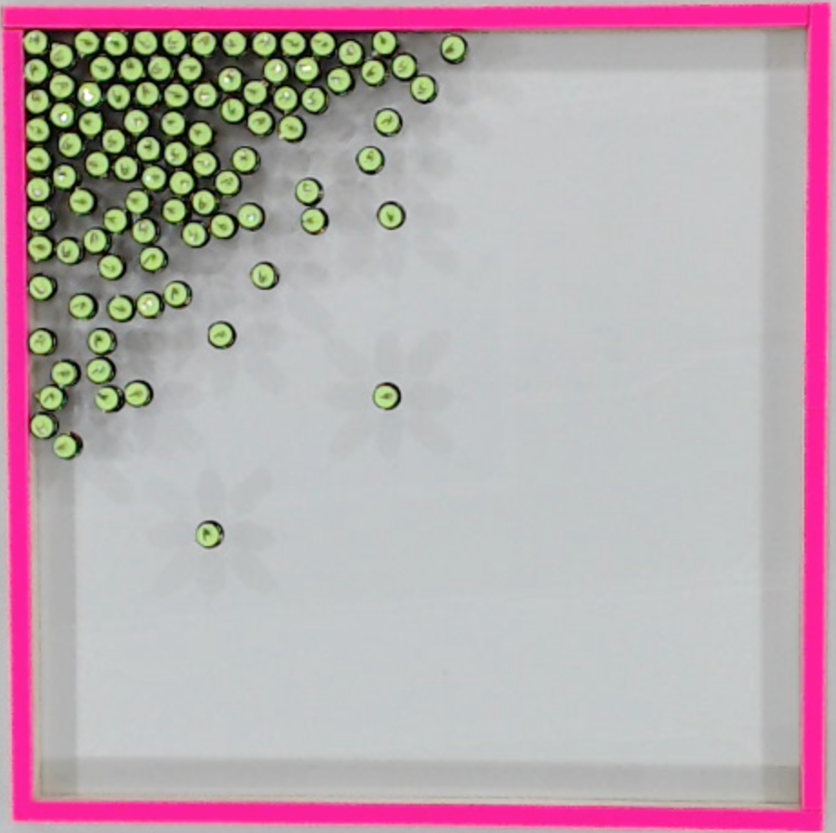
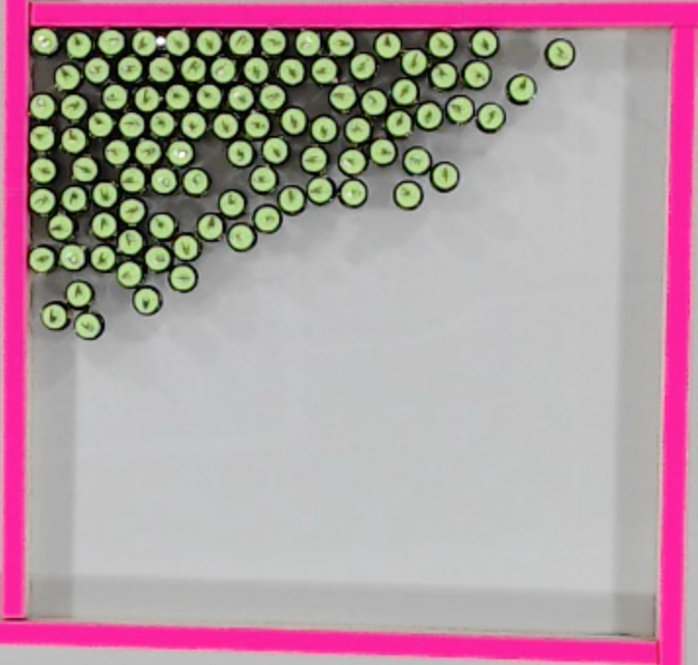
_
x
Light direction
β
A=3/4
1/2
1/4
1/8
1/16
Light direction

