Slide 1
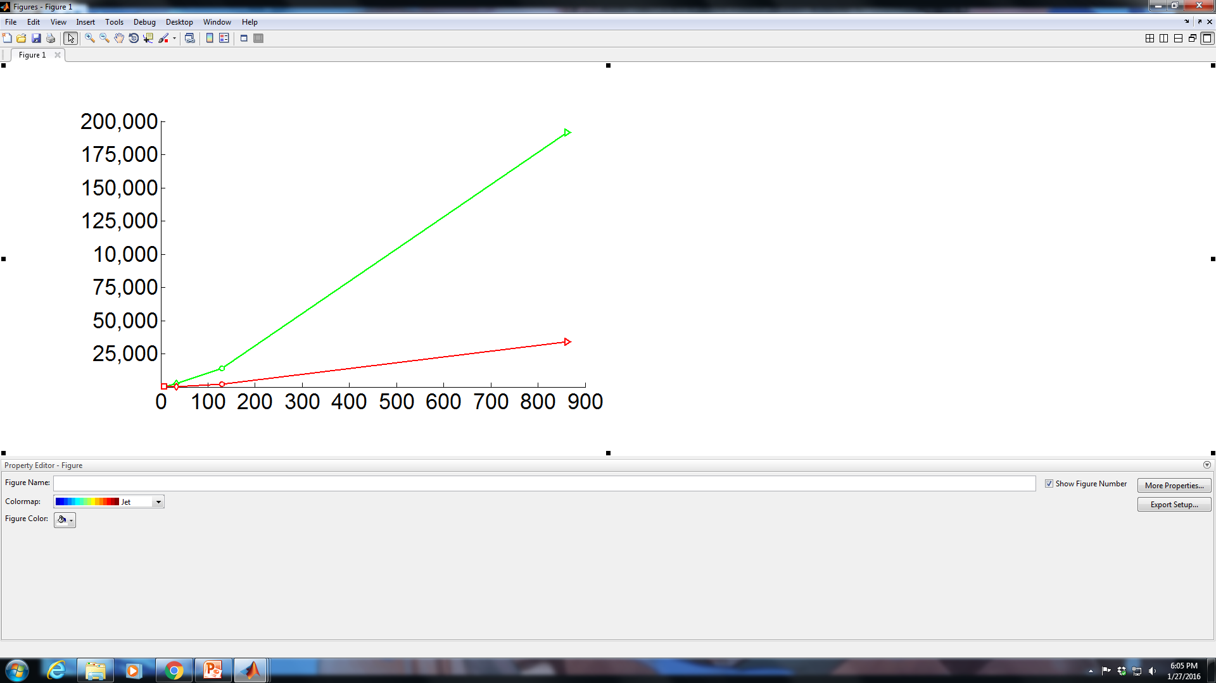

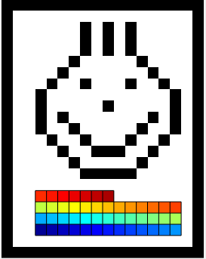
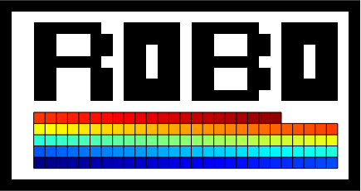
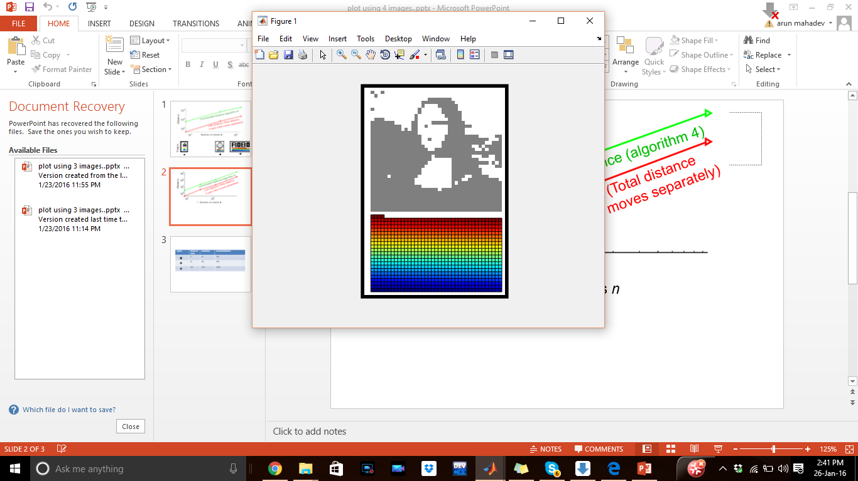
Commanded distance – y = 0.15x² + 90x-500
Total distance (robot diameter)
LAP distance (total distance
if each robot moves separately)
Number of robots n
Shapes

