Slide 1
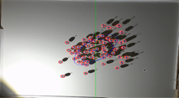
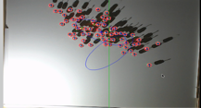
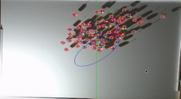
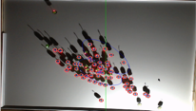
t = 30 s
t = 400 s
t = 550 s
t = 750 s
15,000
10,000
5,000
0
-5,000
Covariance (px²)
0 100 200 300 400 500 600 700 800
Time (s)

