Slide 1
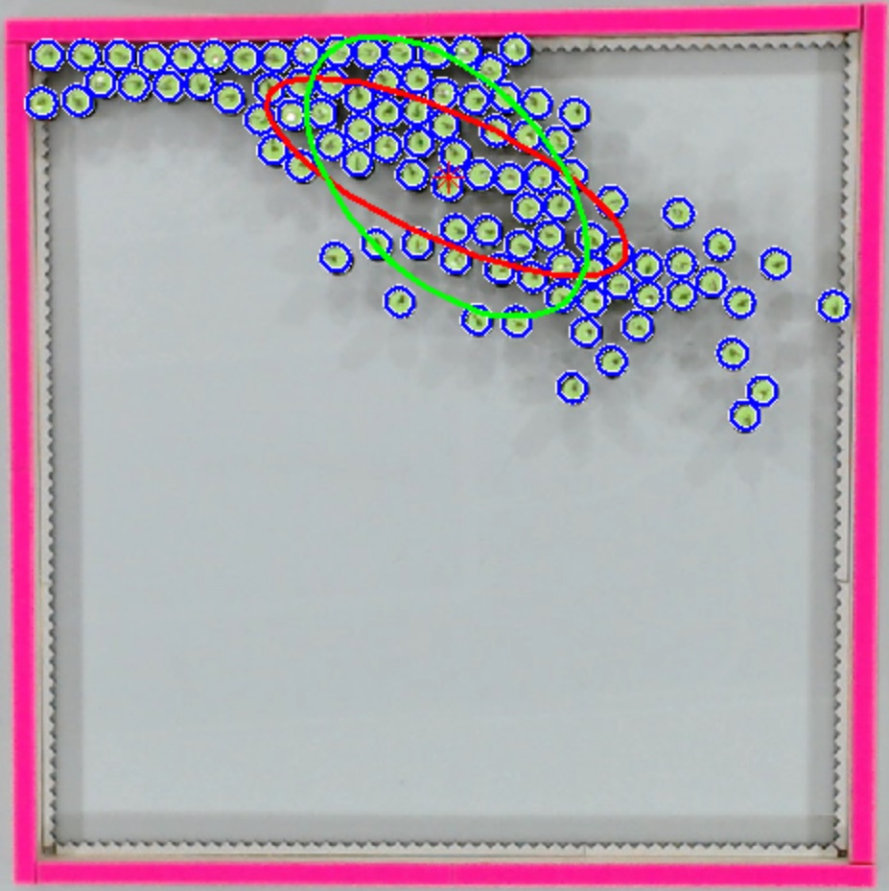
Distant light source
Kilobots with photophile behavior

