Slide 1
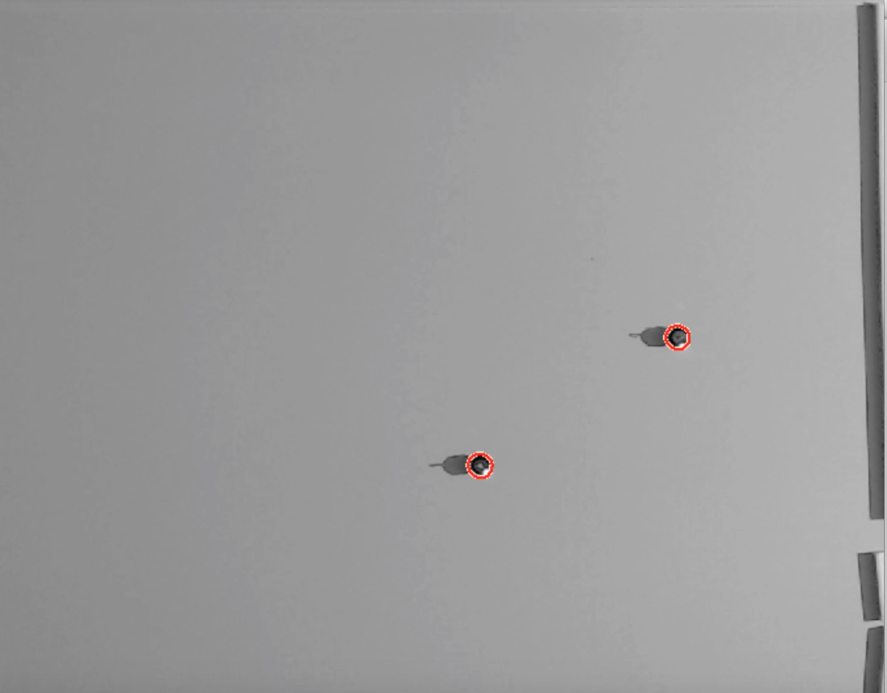
Robots
Top path
Bottom path
Goal positions

