Slide 1
F
N
F_{f}
Fsinθ
Fcosθ
θ
F

Slide 2
α
Robots
Mean Position
Covariance
Desired Cov A
Desired Cov B
Goal Regions
Goal 1
B
A
Goal 2

Slide 4
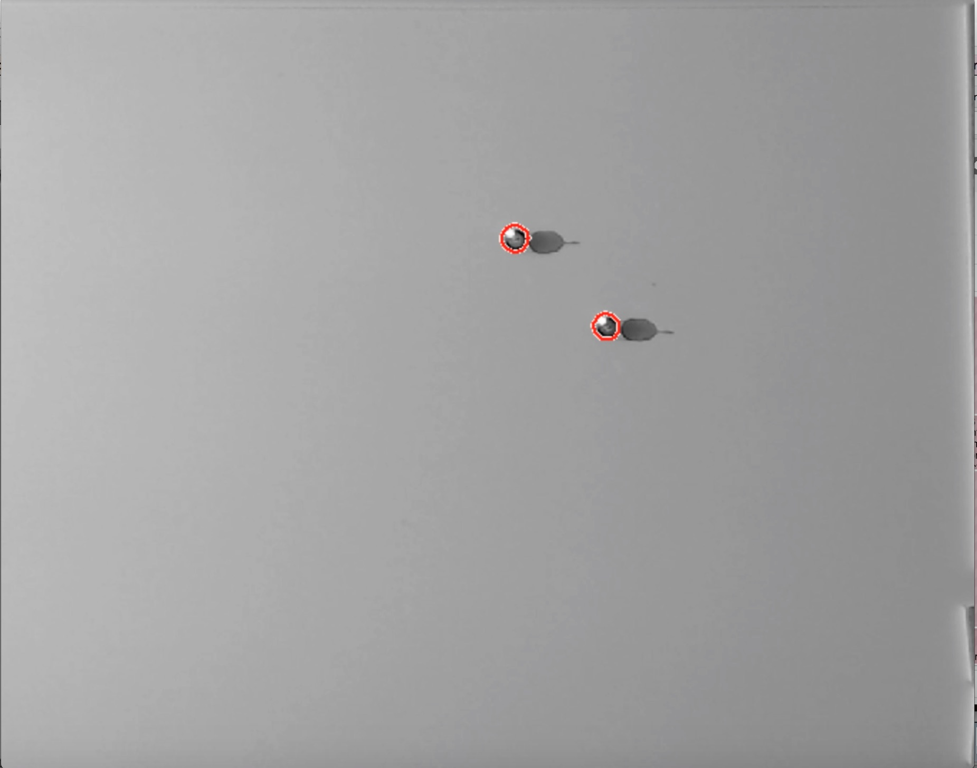

Slide 5
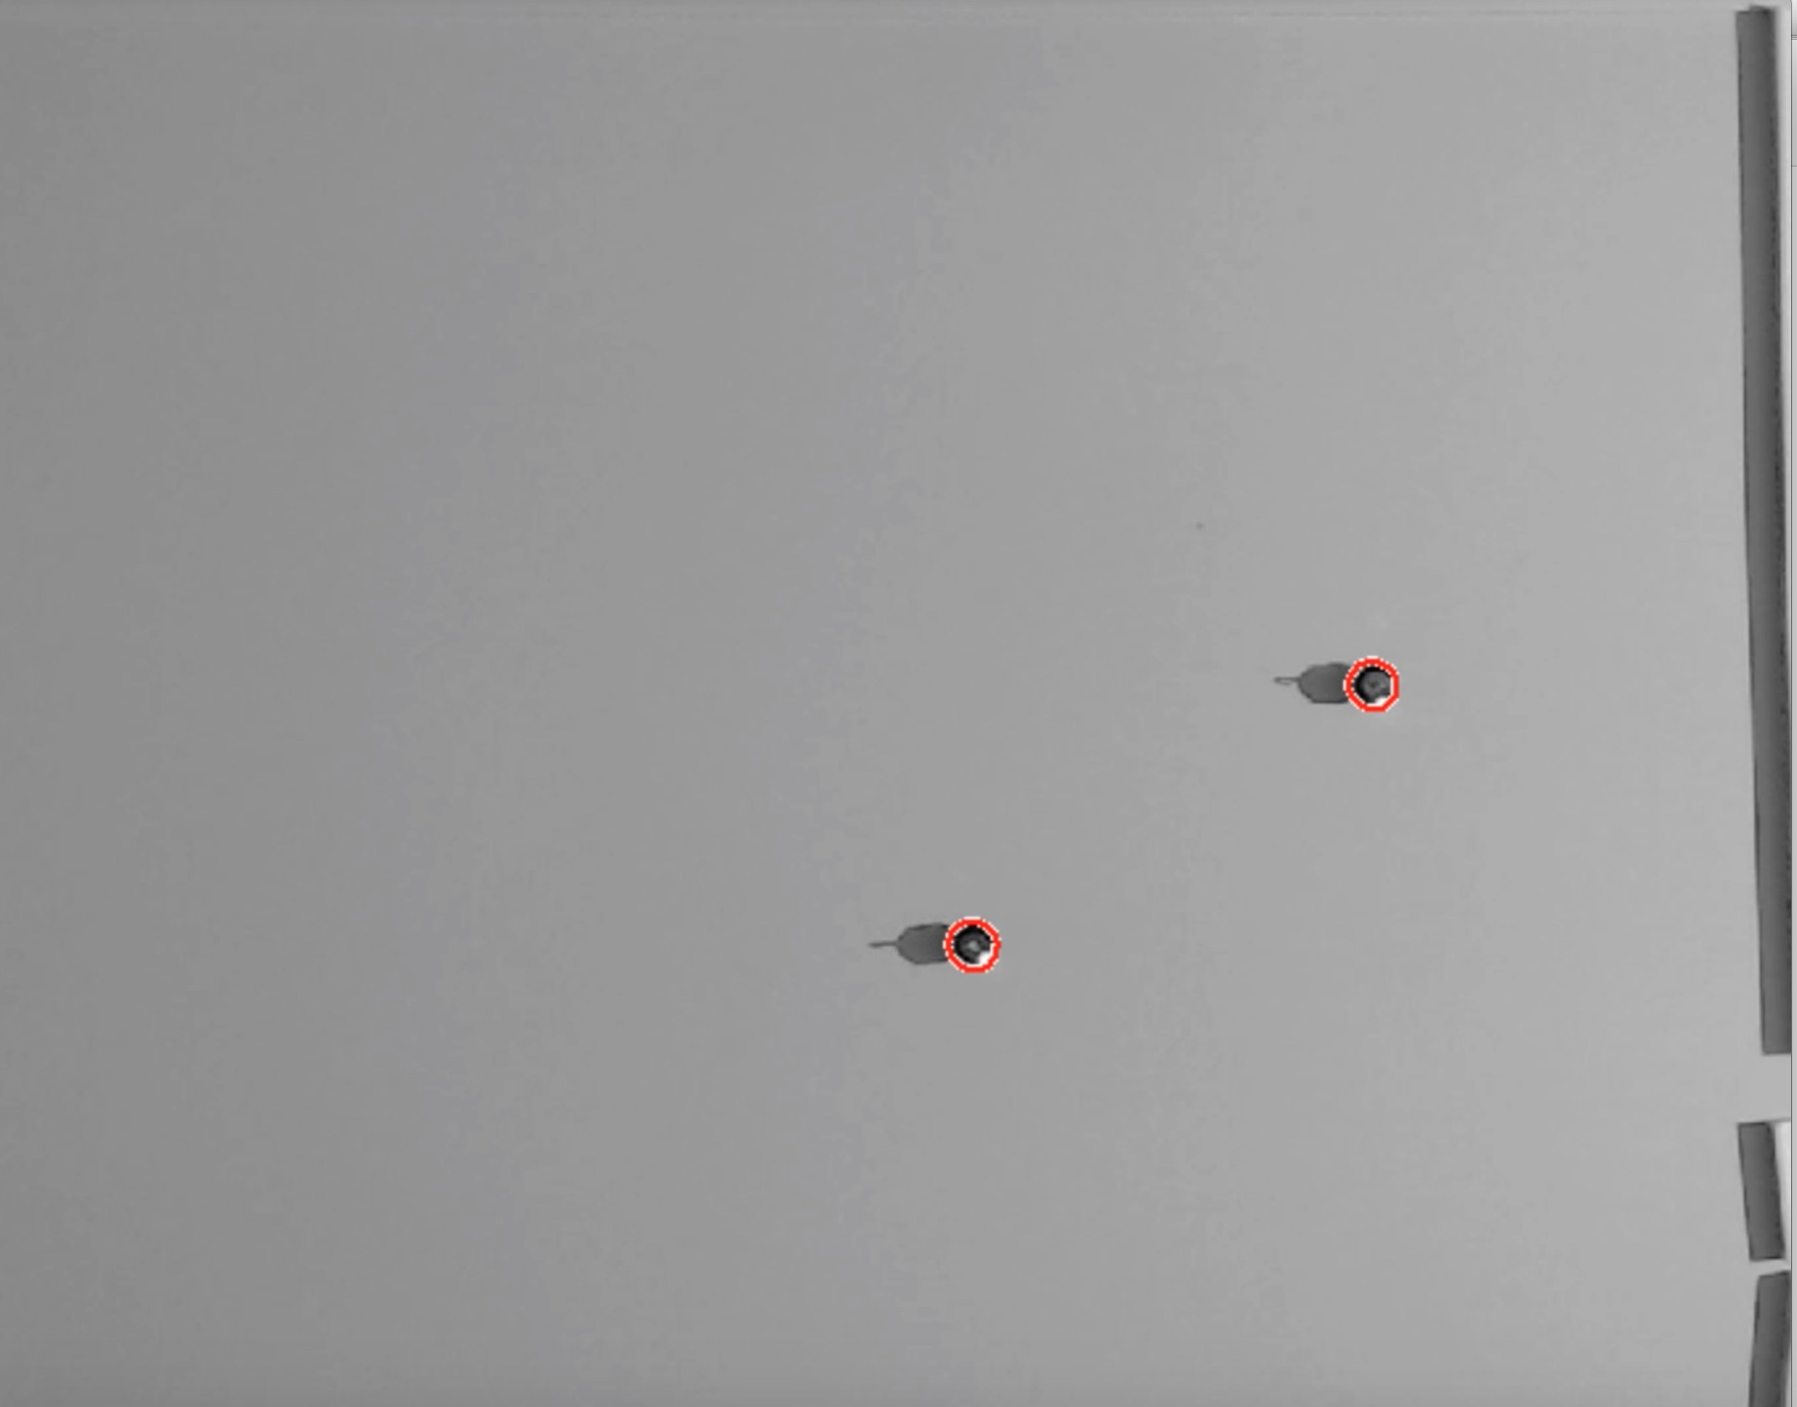
Robot
Bottom Path
Top Path
Goal Positions

Slide 6

Robot
Bottom Path
Top Path
Goal Positions

Slide 7

Robot
Bottom Path
Top Path
Goal Positions

Slide 8

Robot
Bottom Path
Top Path
Goal Positions

Slide 9
Robot
Bottom Path
Top Path
Goal Positions

