Slide 1
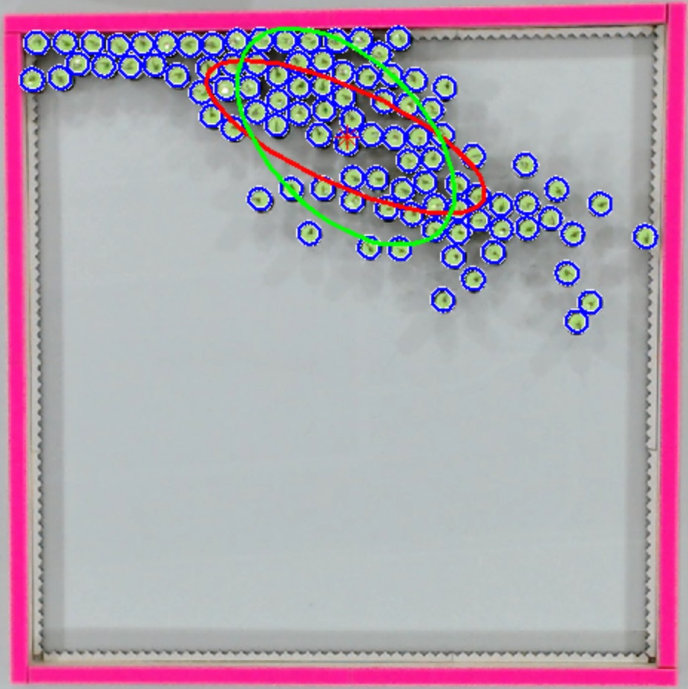
Distant light sources
Kilobots with photophile behavior

