Slide 1
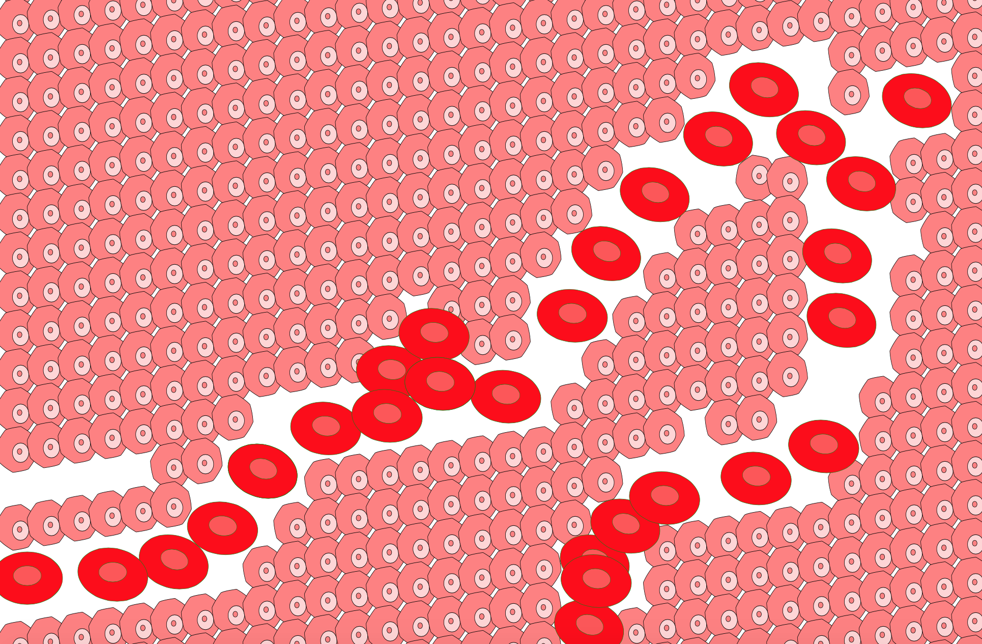
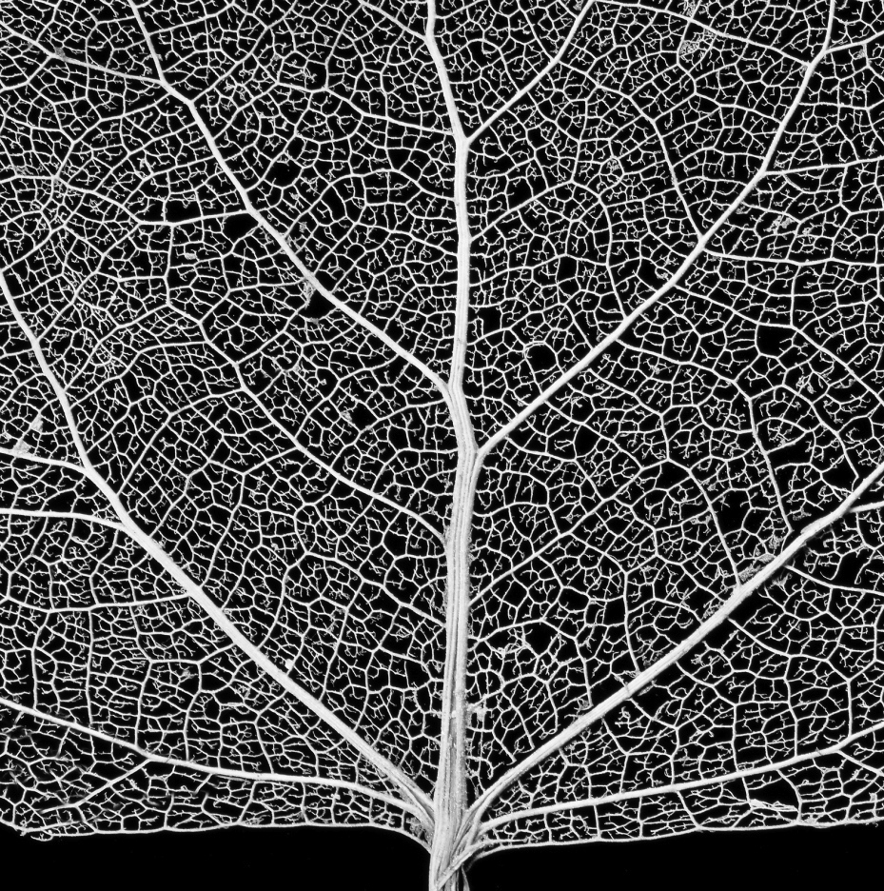
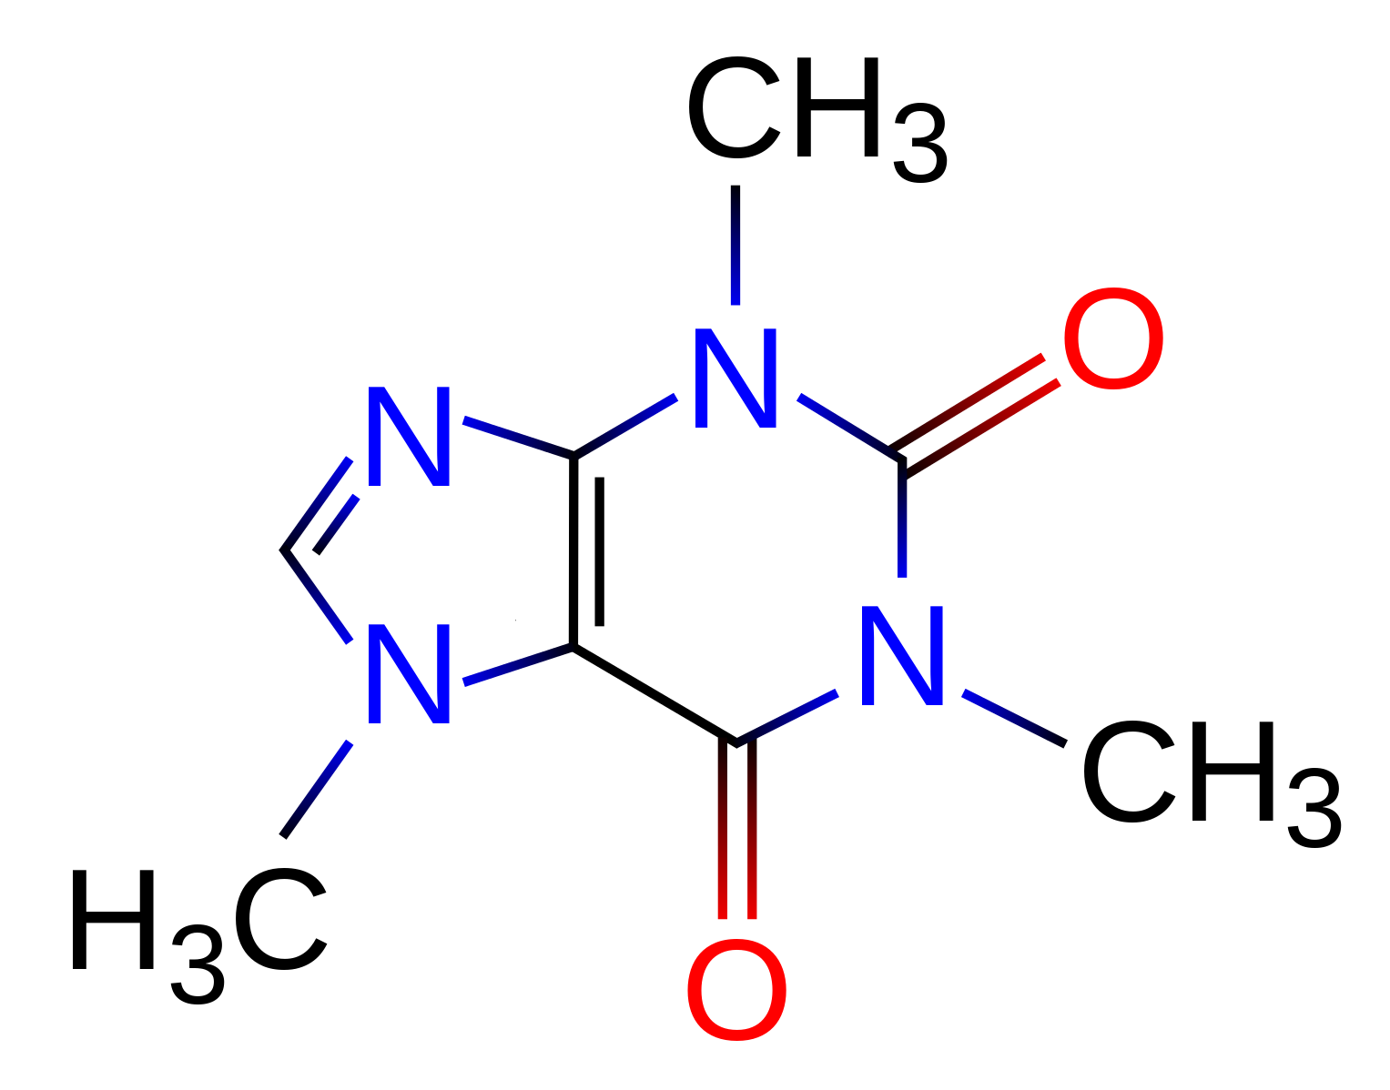
Be a nano robot! Kill cancer cells, not healthy cells.
Neuron is damages, be an artificial wire for it.
Damaged blood vessel, Patch the leaks.
Colored cells need key nutrients.

