Slide 1
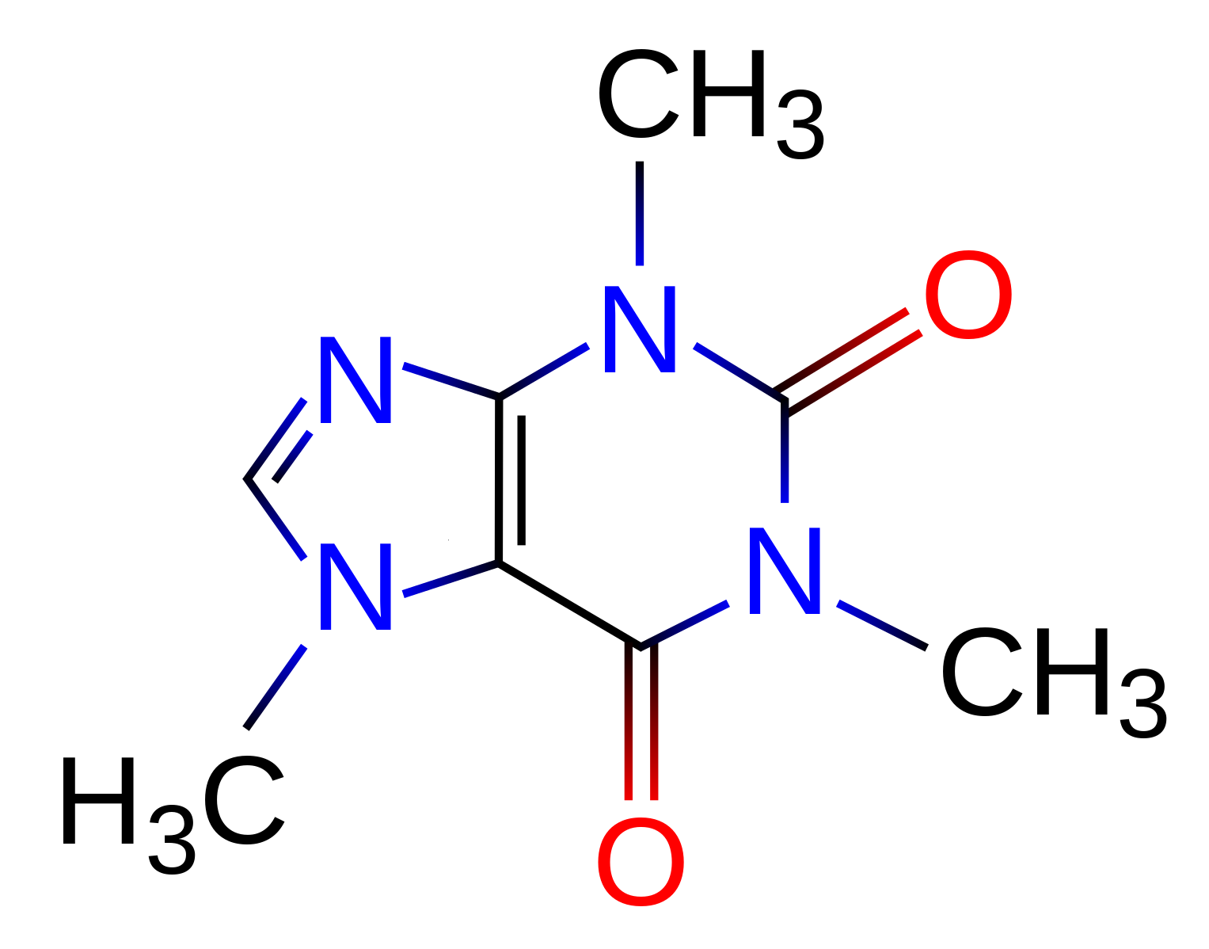
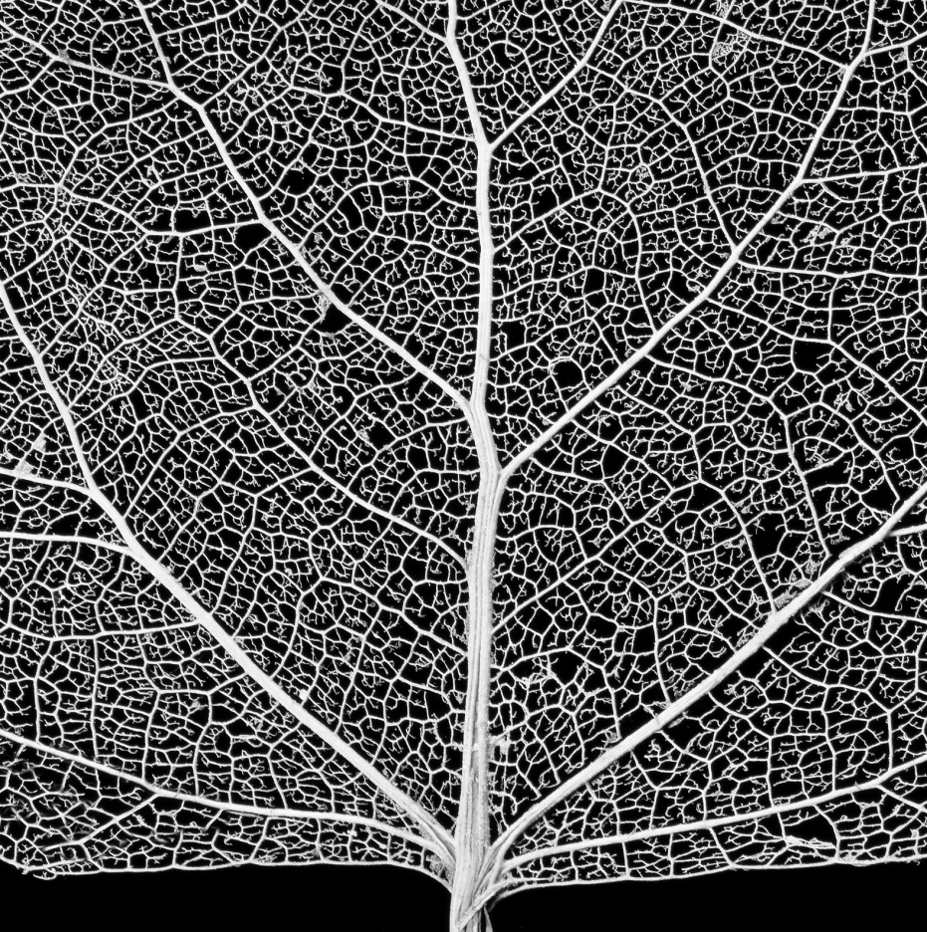
Patch damaged blood vessels
Reconnect a severed neuron
Targeted drug delivery:
cover cancer cells ,
not healthy cells
Deliver key nutrients:

