Slide 1
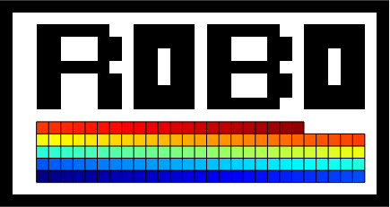
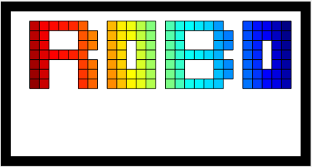
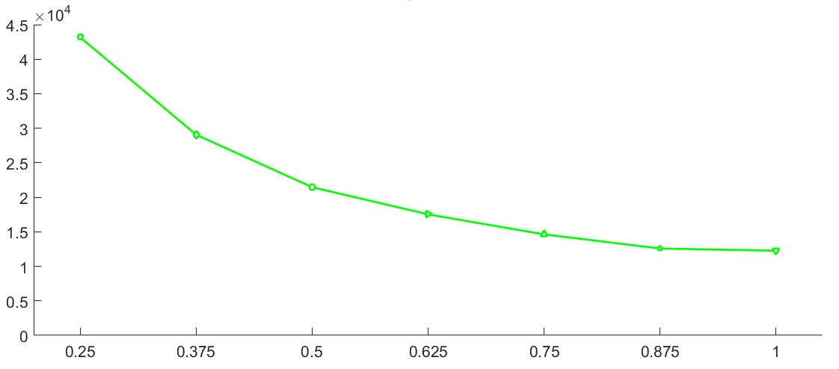
start
finish
Total distance (robot length)
y =10⁵( 2.5x⁴ – 7.3x³ + 8.3x² – 4.4x + 1.1)
ε, Minimum Clearance

