Slide 1
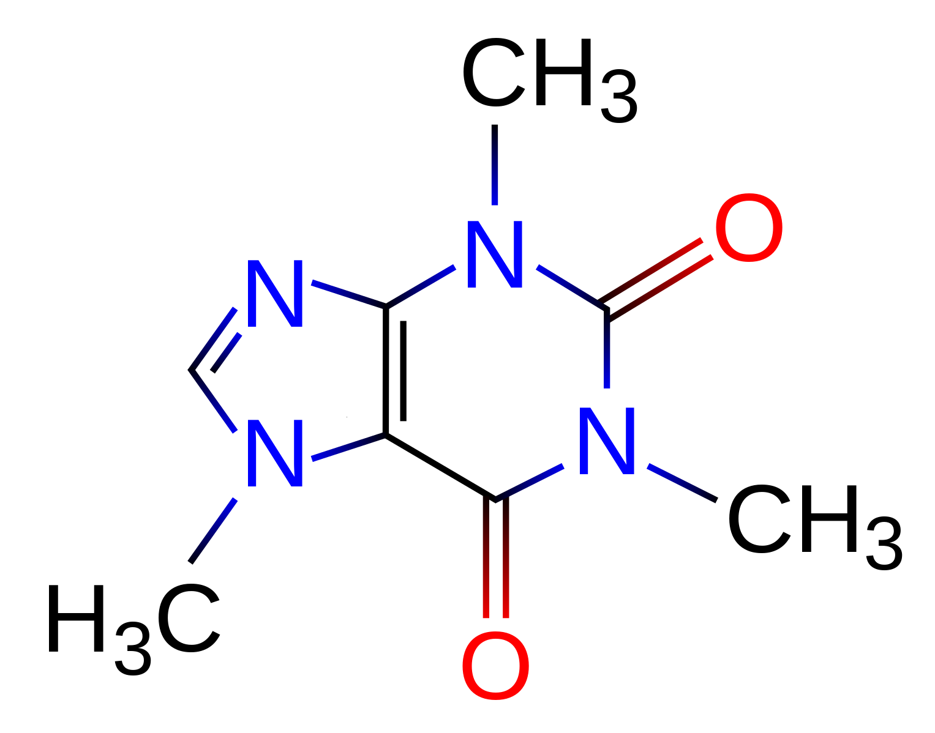
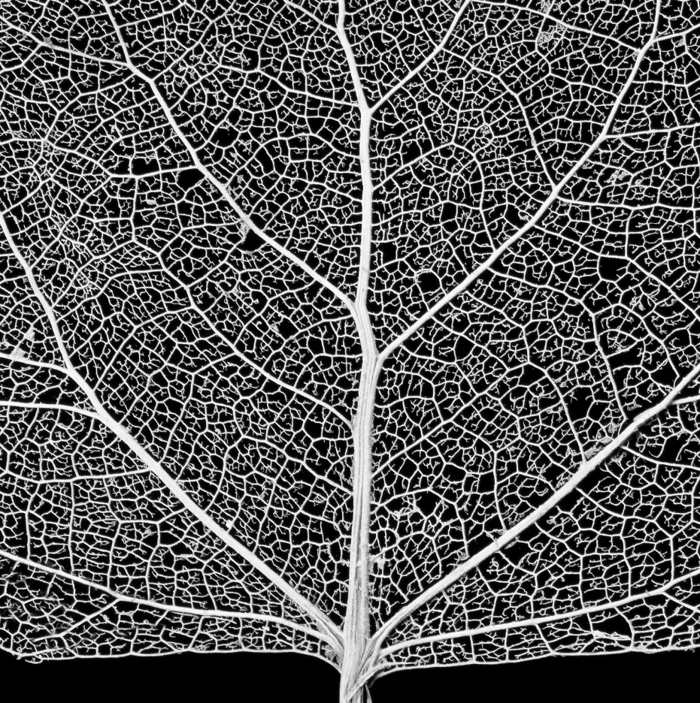
Patch damaged blood vessels!
Reconnect severed neuron
Deliver key nutrients:
Targeted drug delivery:
cover cancer cells ,
not healthy cells

