Slide 1
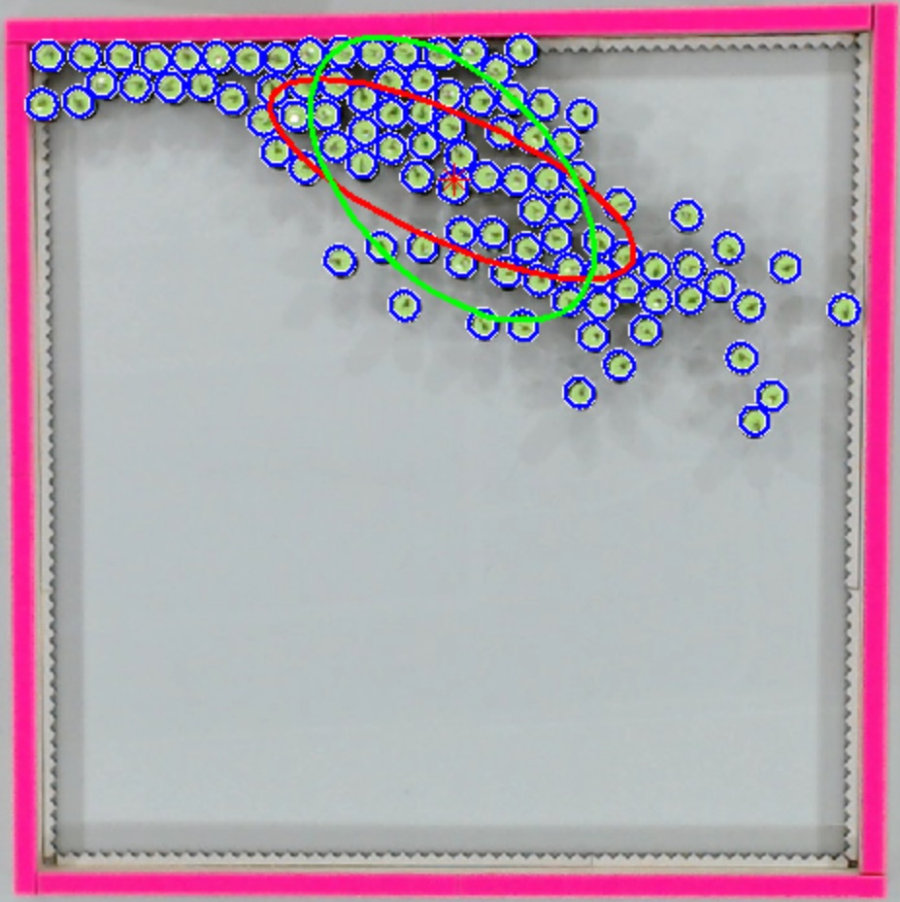
Distant light
sources
(global control input)
Kilobots with photophile behavior

