Slide 1
AI-Based Traffic Sign Detection, Localization and Map Dashboard System
Final Project Presentation
Notes:
Good [morning/afternoon]. I built a web platform that turns noisy AI traffic-sign detections into a clean, mapped, verified sign inventory. The detection model is an external service — my contribution is everything around it: capturing frames with GPS, integrating the model safely, removing duplicates, mapping the result, and giving administrators tools to review and operate the system. Let me walk you through it.

Slide 2
Problem Statement
• Manual sign surveying is slow and error-prone
• raw per-frame detections are duplicated and noisy
• GPS and confidence vary.
Notes:
Detection ≠ inventory; the same physical sign is seen many times.

Slide 3
Project Goal
• Deduplicated, location-refined, reviewable inventory
• secure media
• observability
• reproducible demo.
Notes:
The detector is external; the platform is the contribution.

Slide 4
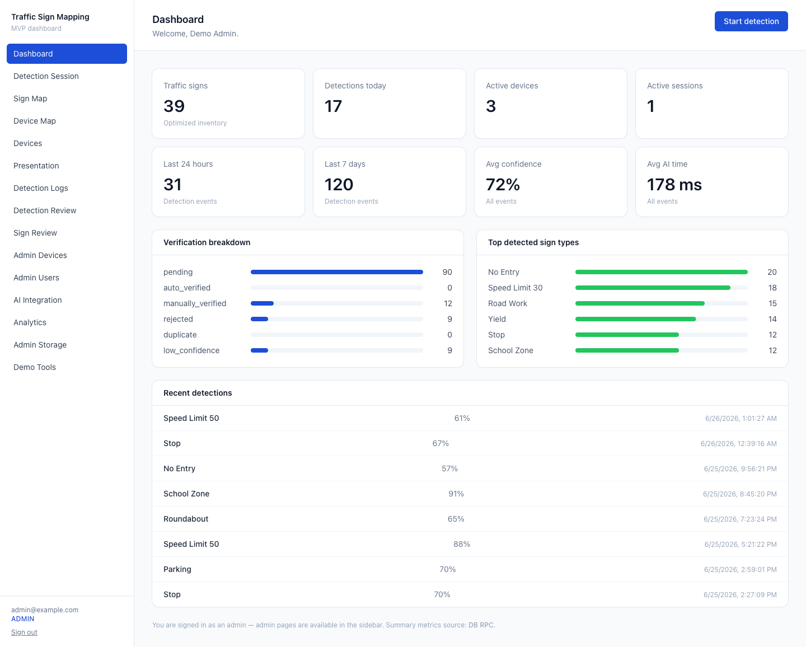
System Overview
• Next.js 14 + TypeScript + Tailwind
• Supabase (Auth, Postgres, Storage, RLS)
• Leaflet/OpenStreetMap
• Playwright tests.
Notes:
Two server trust tiers — RLS client for user reads, service-role for trusted writes/RPCs.

Slide 5
End-to-End Data Flow
• Frame + GPS → upload → sign URL → AI → validate → save events → group signs → logs → dashboards.
Notes:
Walk the seven steps of the frame endpoint.

Slide 6
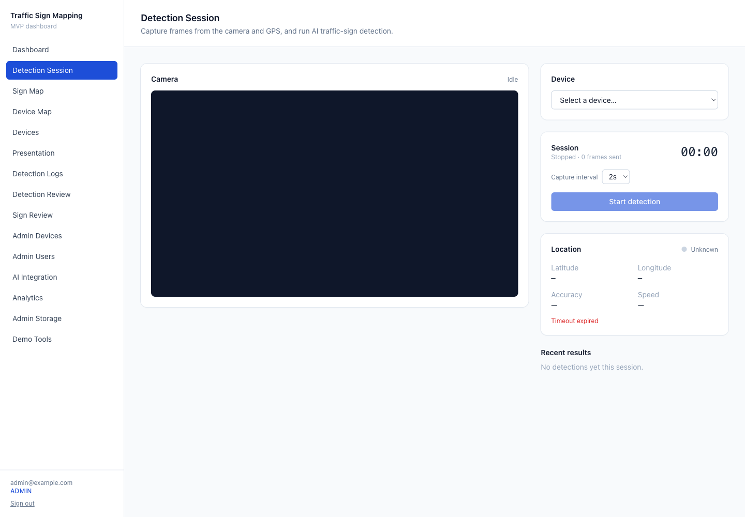
Detection Session Workflow
• Select device → start session → periodic capture → results stream → counters update.
Notes:
Camera + geolocation in the browser; a device must be selected before Start.

Slide 7
AI Model API Contract
• Modes mock/external/auto
• signed image URL in request
• validated/normalised response
• timeout + retry.
Notes:
Mock mode runs the whole pipeline with no external server — used for this demo.

Slide 8
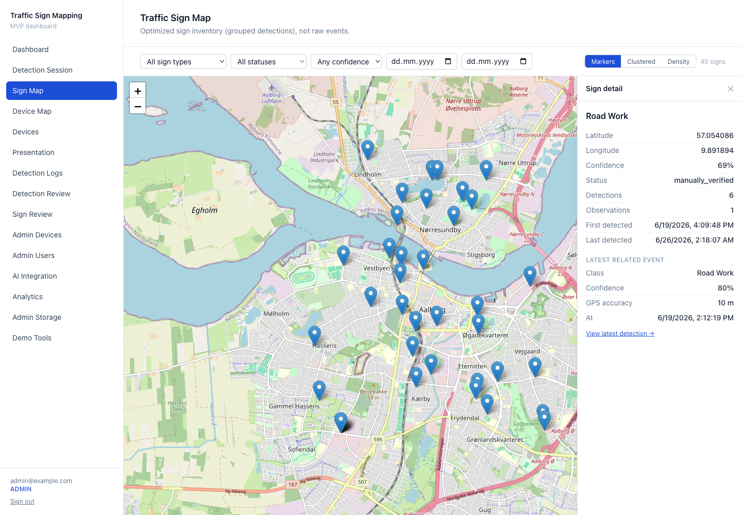
Location Fusion & Duplicate Filtering
• Same type + Haversine within 25 m → observation; else new sign
• weighted average confidence / max(gps_accuracy, 1)
• auto-verify ≥3 obs & avg conf > 0.75.
Notes:
Core algorithmic contribution; cite Haversine and density-based clustering as background.

Slide 9
Database Design
• 11 tables; UUID PKs, timestamptz, jsonb
• RLS on all
• migrations 0001–0006.
Notes:
Maintenance/analytics tables are service-role-only; raw + optimized data both retained.

Slide 10
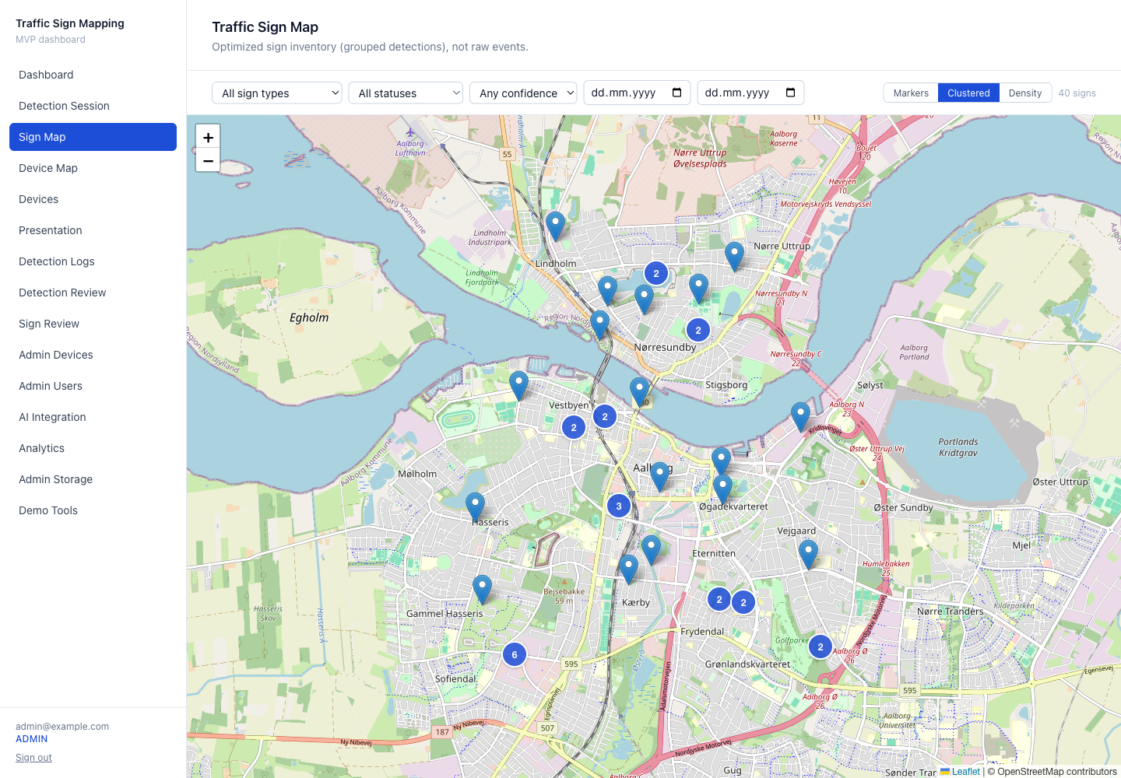
Map Dashboard
• Markers / clustering / density
• filters
• sign detail panel
• live device map.
Notes:
The inventory map shows optimized signs, not raw detections.

Slide 11
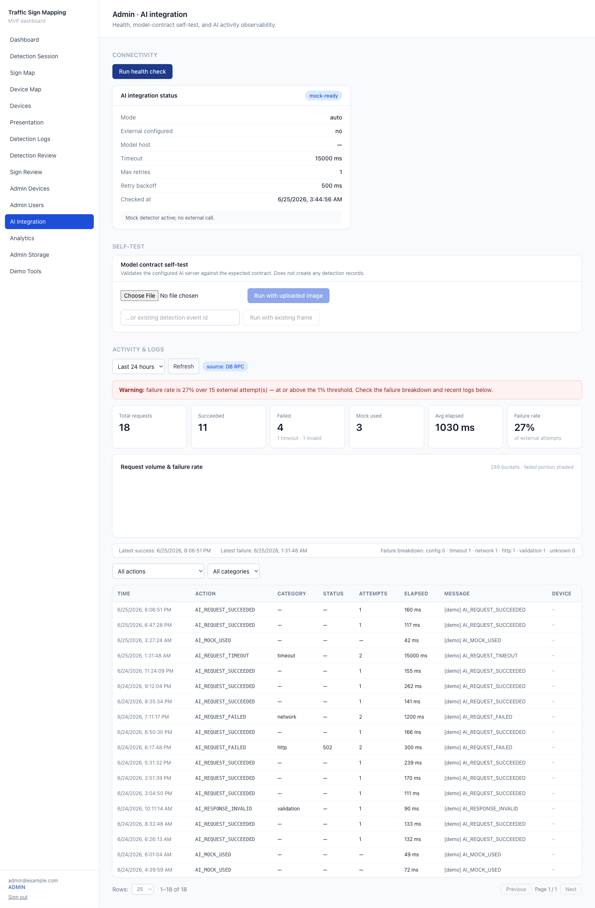
Admin & Observability
• Users/devices/review
• AI health + self-test + failure analytics
• daily snapshots + gap detection.
Notes:
Human-in-the-loop review improves operational data quality (doesn't guarantee correctness).

Slide 12
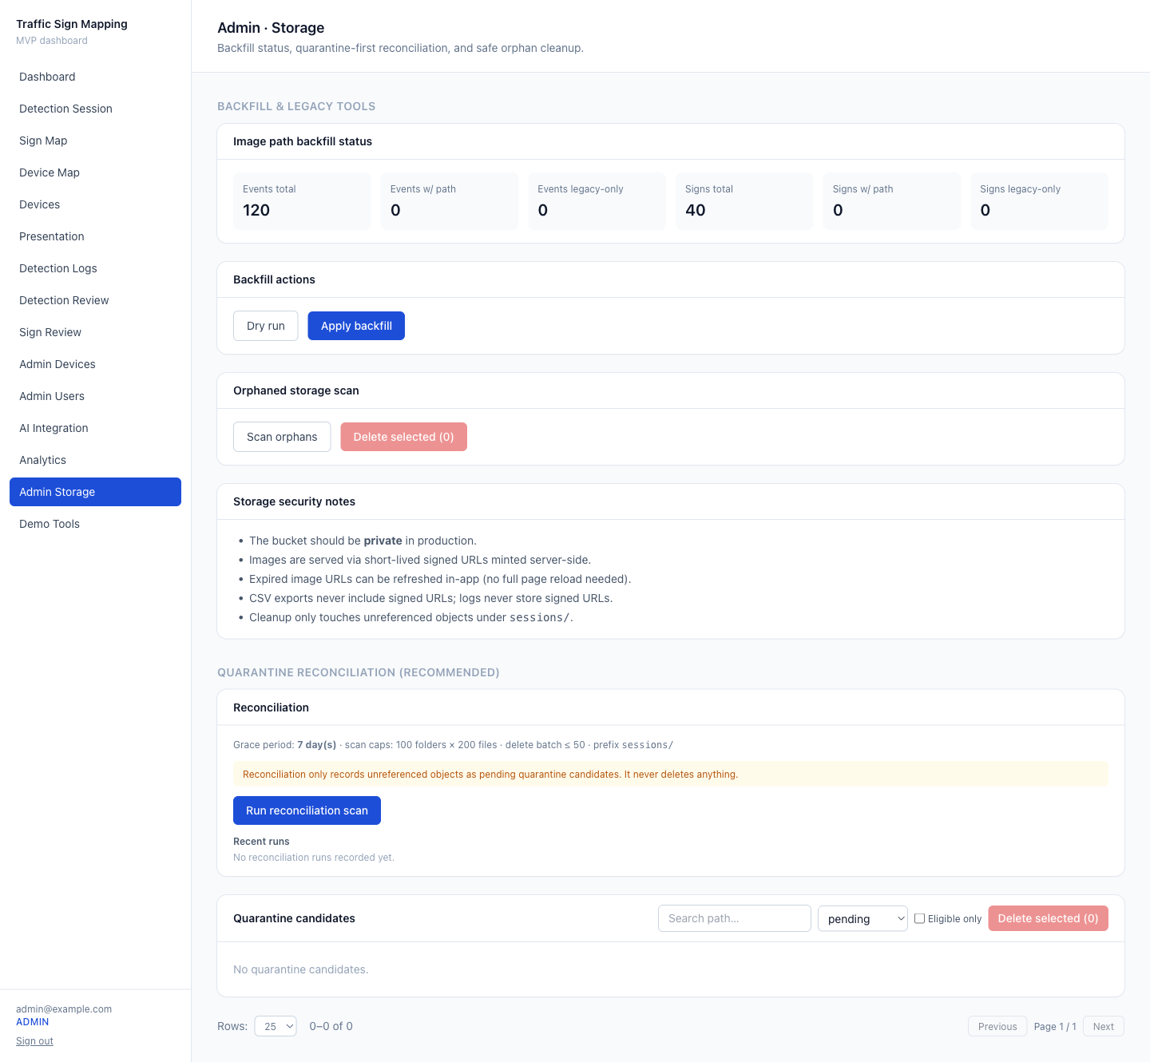
Security & Storage Design
• Private bucket + signed URLs (server-only, after auth)
• RLS
• secrets server-only
• cron bearer secret
• quarantine-first cleanup.
Notes:
Images are never public; nothing is auto-deleted; secrets never reach the client.

Slide 13
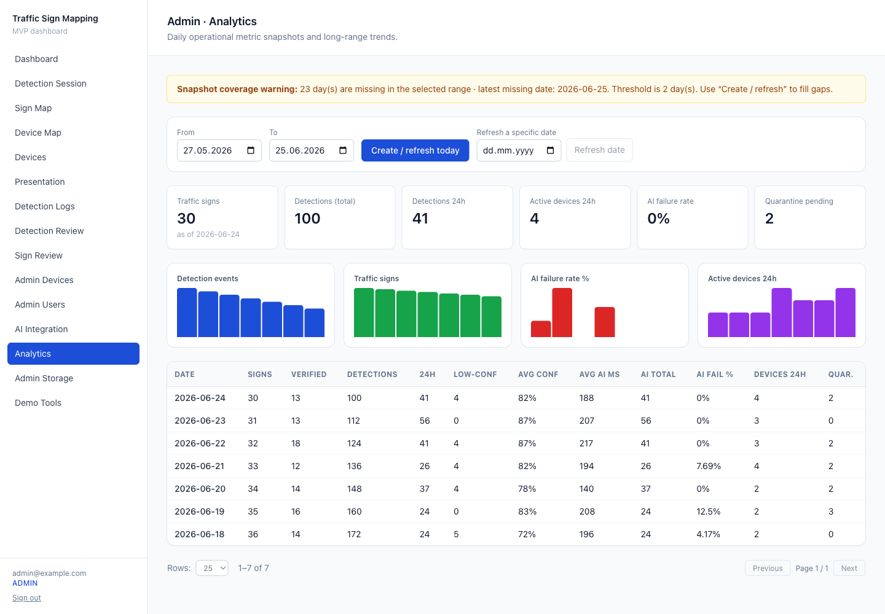
Testing & Validation
• Real Supabase backend
• migrations applied
• private bucket
• demo seeded
• Playwright 24/24
• lint/typecheck/build clean (54 routes).
Notes:
Verified end-to-end, not just locally mocked. Demo counts are seeded data, not metrics.

Slide 14
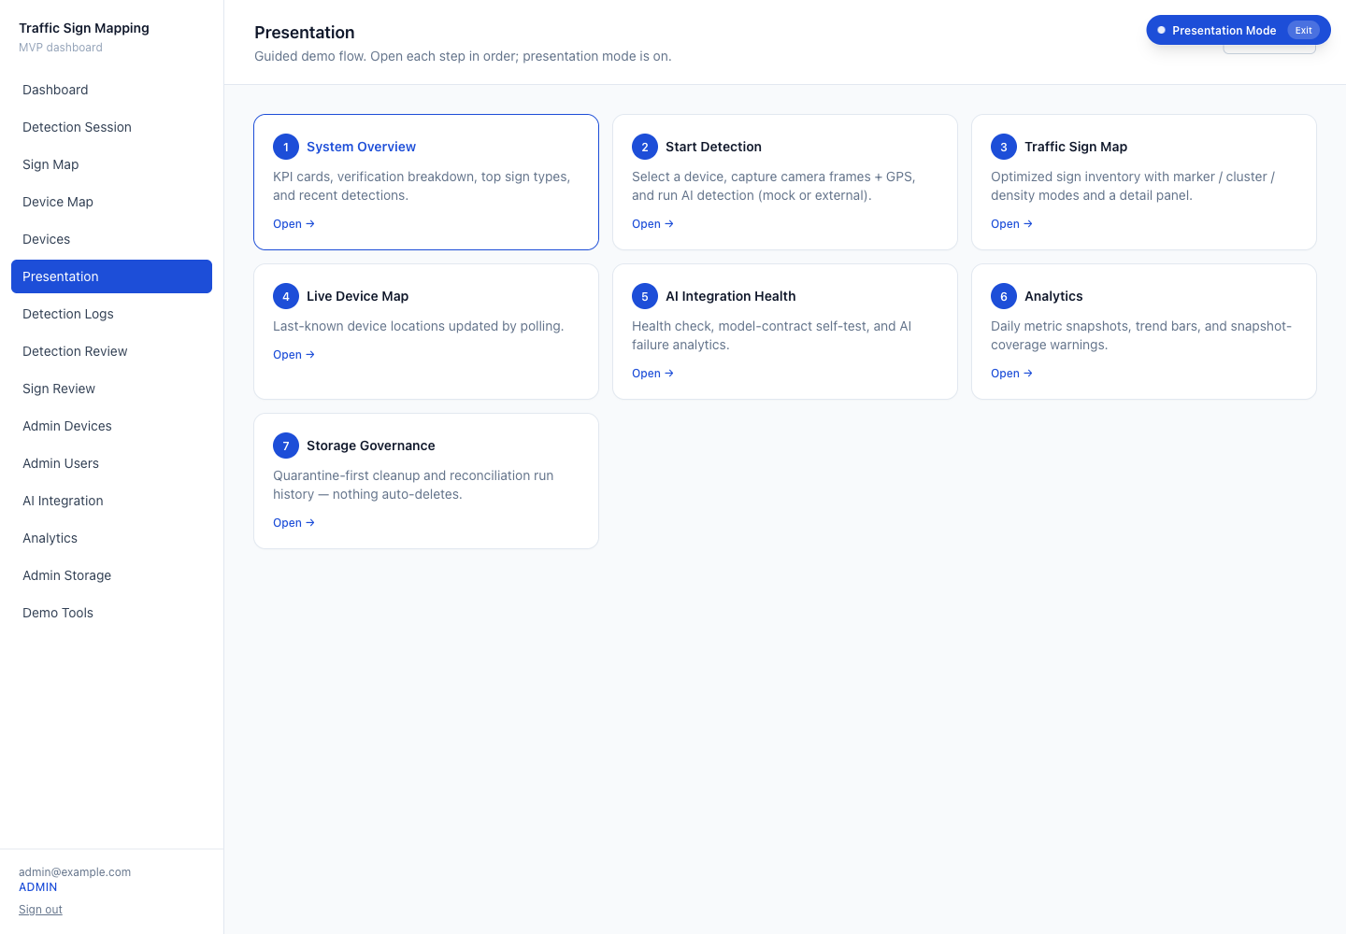
Limitations, Future Work & Conclusion
• Limitations (no spatial index, no model-accuracy benchmark, capped scans)
• future work (PostGIS, labelled evaluation, alerting)
• conclusion: the platform is the contribution.
Notes:
Be honest about scope; transition into the live demo.
Closing: To summarise: the system turns raw, duplicated detections into a deduplicated, location-refined, reviewable, and securely served sign inventory, with administrative observability and a reproducible demo. It was validated against a real Supabase backend with the full end-to-end test suite passing. Thank you — I'm happy to take questions.

