Slide 1
m4U-260917-v01-01-02-01
17-Sep-2026 17:06:42
Linear retuning of v01_01_01_01 to reach the TDR-1 tunes

Slide 2
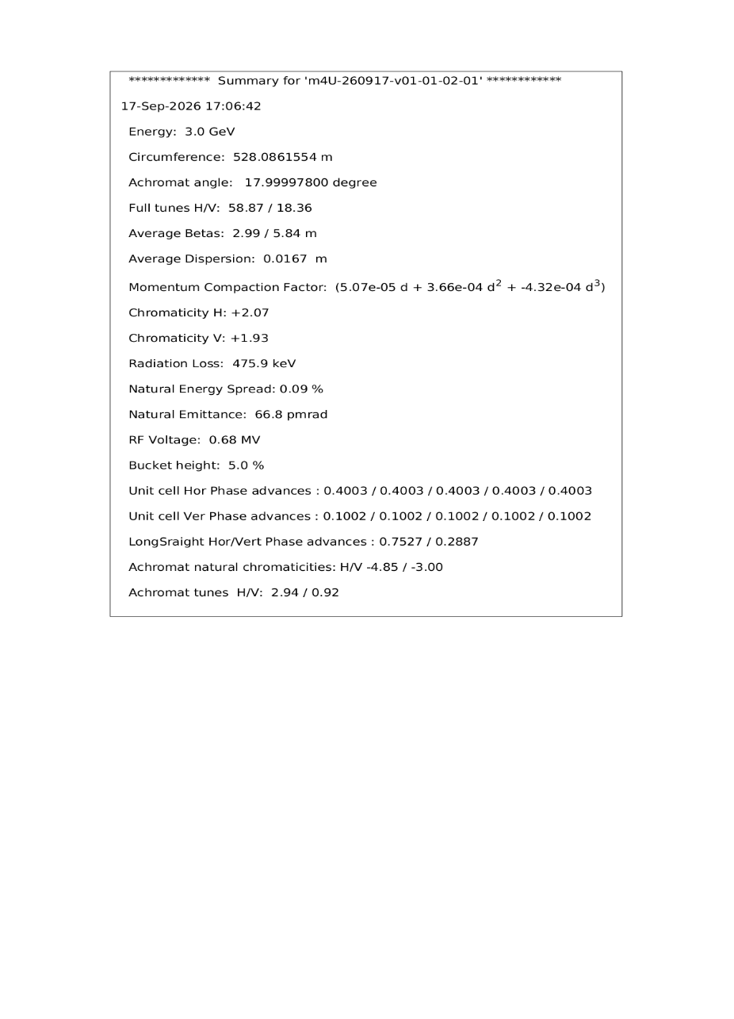
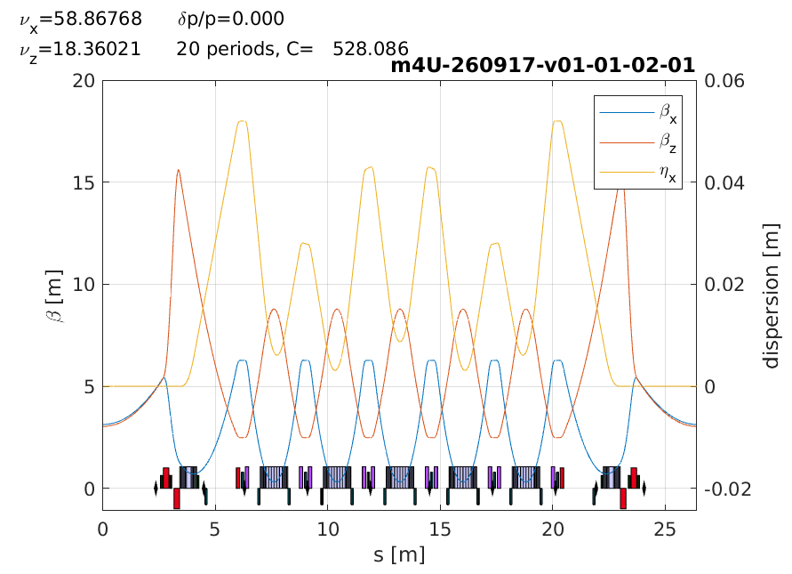
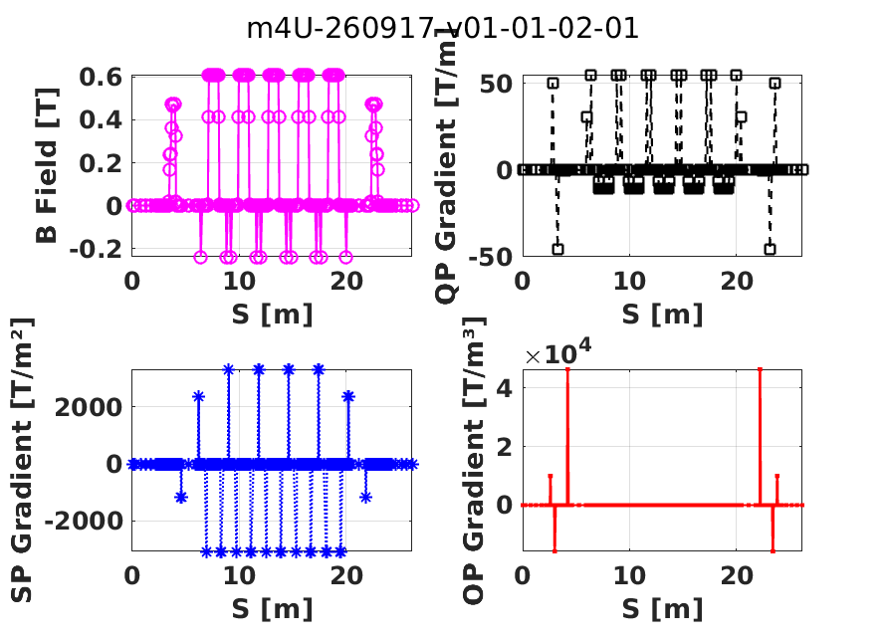
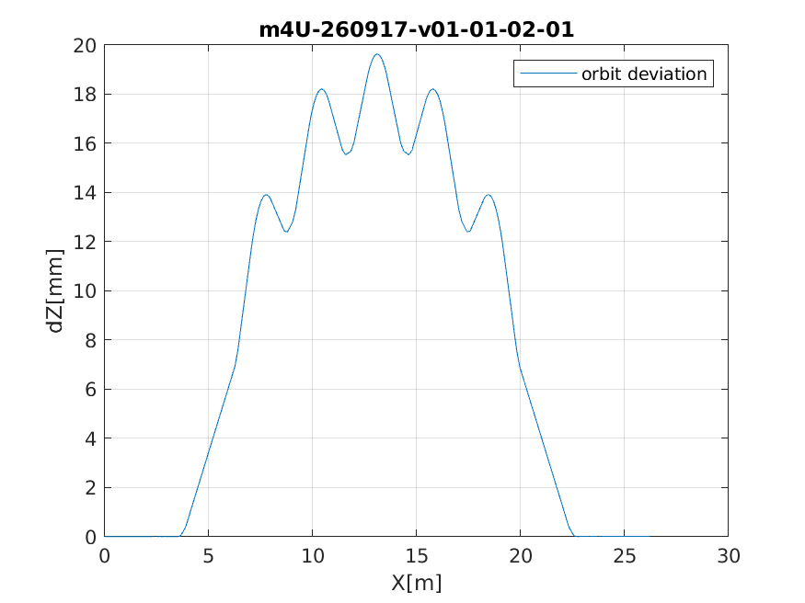
m4U-260917-v01-01-02-01

Slide 3
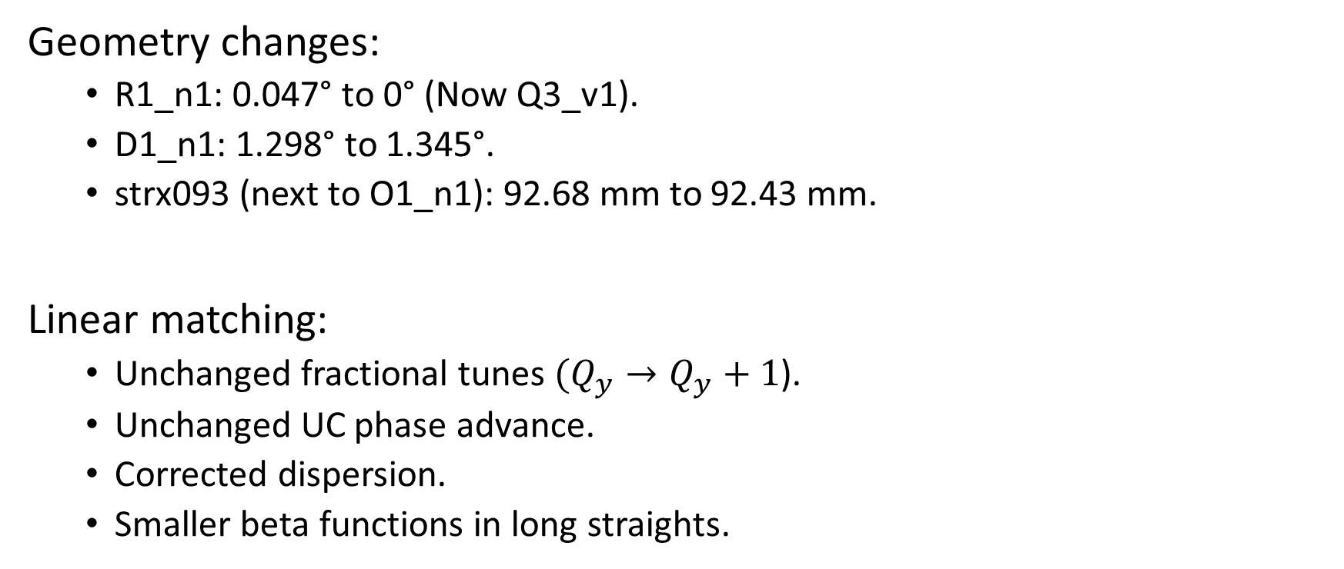
Minimal changes from TDR-1
Geometry changes:
  R1_n1: 0.047° to 0° (Now Q3_v1).
  D1_n1: 1.298° to 1.345°.
  strx093 (next to O1_n1): 92.68 mm to 92.43 mm.
Linear matching:
  Unchanged fractional tunes $(Q_{y}→Q_{y}+1$).
  Unchanged UC phase advance.
  Corrected dispersion.
  Smaller beta functions in long straights.

Slide 4
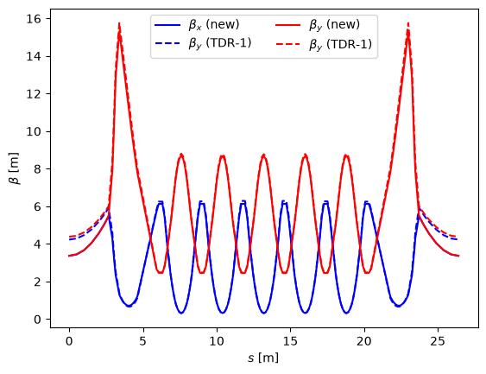
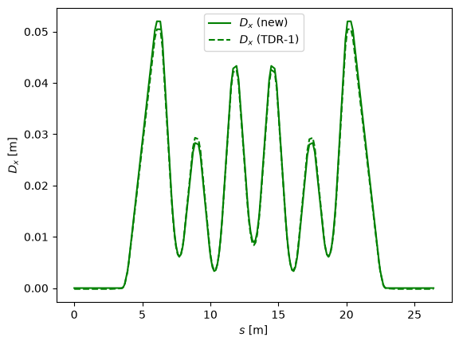
Comparison with TDR-1

