Slide 1
DIGITAL PAYMENTS
STEP BY STEP INSTRUCTIONS FOR VARIOUS MODES OF PAYMENT:
UPI, Wallets, PoS, and SMS banking (USSD)

Slide 2
POINTS OF SALE (POS)

Slide 3
Types of POS
Physical POS
V-POS
MPOS
Phone connected with external POS device through jack / Bluetooth
Virtual E-payment Gateway
Physical Card Swiping – PTSN with landline / GPRS enabled

Slide 4
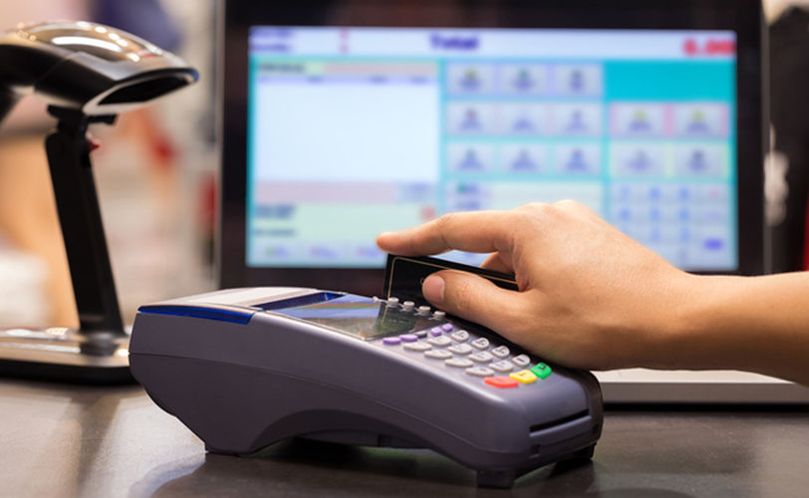
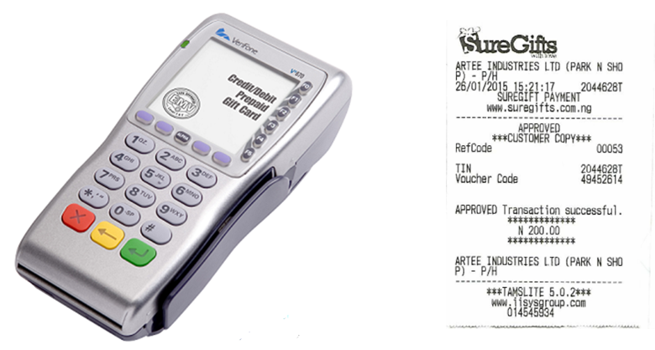
Physical POS
Step 1: Swipe a debit/credit card on the POS machine
Step 2: Enter Amount to be paid and PIN
Step 3: Generate receipt

Slide 5
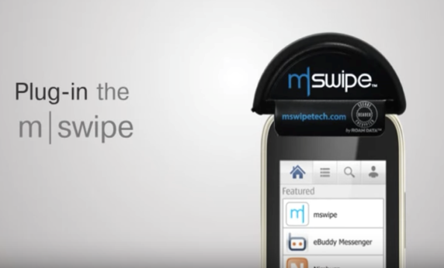
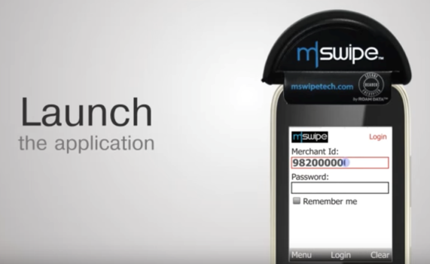
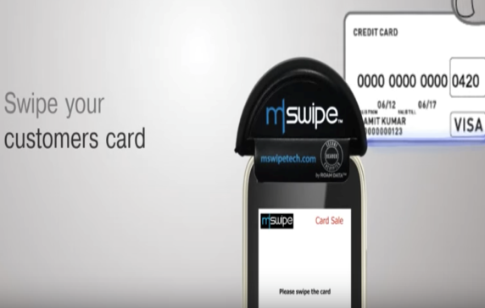
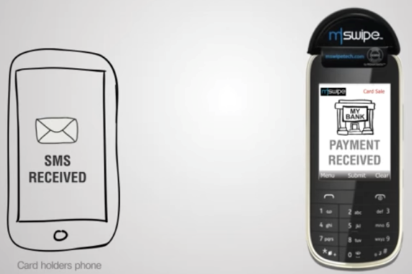
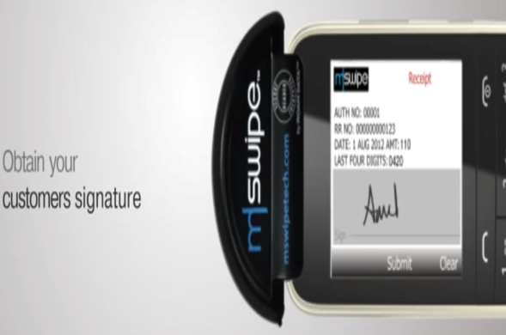
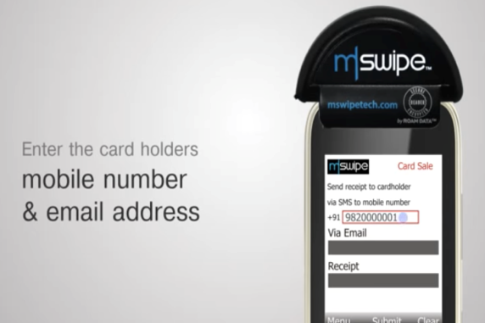
Mobile POS
Note: mSwipe is used as an example of MPOS here

Slide 6
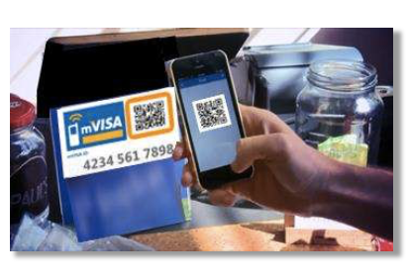
Virtual-POS
No machine required
Customers can scan QR code of the merchant for instant payment

Slide 7
Installation of POS Terminal
Open / identify current account for transactions
Fill in the application form (online / at the branch)
Identify type of POS required (landline / GPRS)
Submit following documents:
Proof of business
Shop & establishment registration certificate
VAT certificate
Sales tax…..
Proof of address
Photo identity proof of proprietor / partner
Financial details
Bank statement
Income tax return
Acceptance of MDR by merchant
Execution of Merchant Establishment Agreement

Slide 8
Unstructured Supplementary Service Data (USSD) based mobile banking
National Unified USSD Platform (NUUP)

Slide 9
Required for activation
Works on every mobile phone on GSM network
Simple SMS-type system
Visit your branch or ATM to link mobile number and bank account
Details can be updated online or on SMS
Can be used for payments upto Rs 5000 per day, per user

Slide 10
Simple fund transfer system
You will get your Mobile Money Identifier (MMID) and Mobile PIN (MPIN) upon registration
Remember your MMID and MPIN
Make payments in few steps (*99#)
To make the system more user friendly, several new features are proposed to be introduced

Slide 11
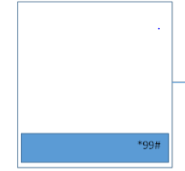
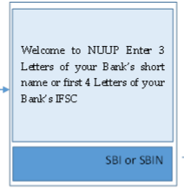
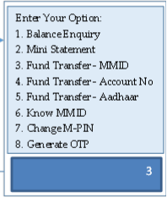
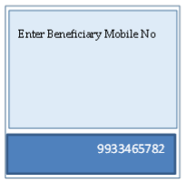
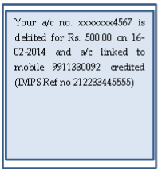
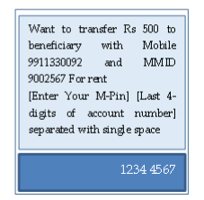
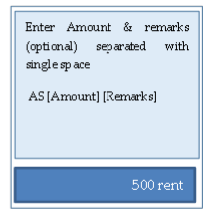
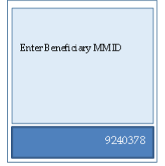
Transfer Funds to another Bank Account
Dial *99# from your phone

Slide 12
Proposed new USSD features
Using account number instead of MMID
Can work with only Aadhar number also

Slide 13
UPI
Unified Payment Interface

Slide 14
Requirements for registration on UPI
Requirements
Smartphone with internet facility
Bank Account details (only for registration)
Available apps
SBI app, PNB UPI, UPI Collect (ICICI), Axis Pay, Canara Bank UPI, UCO UPI, Union Bank UPI, OBC UPI and 20 other banks
3rd party apps – Trupay, Phonepe, UPI pay, Mypoolin etc

Slide 15
UPI Registration Process
Download any bank’s app or 3rd party app
Choose your unique ID (Aadhar, Mobile No.) as Virtual Payment Address (VPA)
Select your bank
Give account details for first time
Registration Completed
Set M-PIN for validating transactions

Slide 16
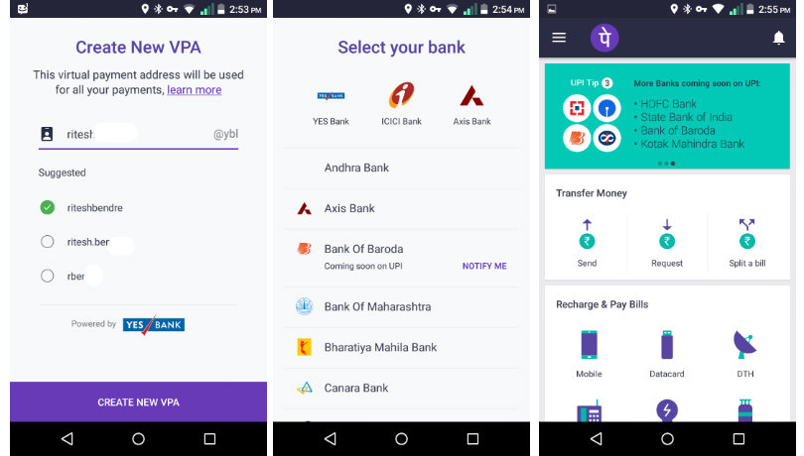
Sample Screenshots (PhonePe app)
Screenshot taken from http://www.bgr.in/news/unified-payments-interface-heres-how-to-register-send-and-receive-money-using-upi-apps/

Slide 17
Sending Money on UPI
Choose “Send Money”
Enter payee’s Virtual Payment Address
Enter amount
Write remarks for transaction
Hit “Send”
Confirm the details

Slide 18
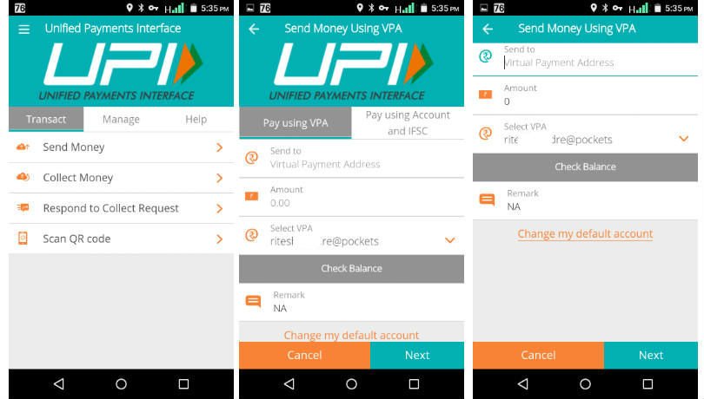
Sending Money
Screenshot taken from http://www.bgr.in/news/unified-payments-interface-heres-how-to-register-send-and-receive-money-using-upi-apps/

Slide 19
Collecting Money (raise a demand) on UPI
Choose “Collect Money”
Enter payer’s Virtual Payment Address
Enter amount
Write remarks for transaction
Hit “Confirm”
Enter when do you want to collect

Slide 20
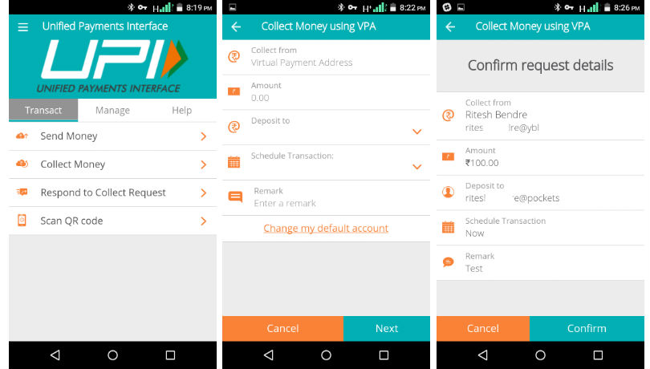
Collecting Money
Screenshot taken from http://www.bgr.in/news/unified-payments-interface-heres-how-to-register-send-and-receive-money-using-upi-apps/

Slide 21
WALLETS

Slide 22
What are e-wallets
Electronic pre-paid payment system, mobile-first
Used in purchasing items on-line with a computer or a smartphone at a store.
An individual's account is required to be linked to the digital wallet to load money in it.
Provided by many banks and private companies

Slide 23
Using Wallets
Consumer Downloads the App on smartphone
Sign Up Using Mobile
Load Money Using Debit Card/Credit Card of NetBanking
Start using wallet to make payments
Consumer Wallet Limits: Rs.20,000/month for all. Rs.1 lakh/month with KYC
Shopkeeper/Service Provider Downloads the App
Sign up using Paytm
Self Declare itself as a Merchant
Start Accepting Payment
Merchant Wallet Limits: Rs.50,000/month with Self Declaration. Rs.1 lakh/month with KYC
Basic Requirements to Start Using a Wallet: Bank Account, Smartphone, 2G/3G Connection & A Free Wallet App

Slide 24
Aadhar enabled payment system (AEPS)

Slide 25
Aadhaar Enabled Payment System (AEPS)
AEPS allows bank-to-bank transaction at PoS (MicroATM) with the help of BC
Only Aadhar needed
Aadhar enabled Services
Balance Enquiry
Cash Withdrawal
Cash Deposit
Aadhaar to Aadhaar Funds Transfer

Slide 26
Key Steps for AEPS Transaction
Go to a MicroATM or Banking Correspondent
Provide your bank name and Aadhaar
Choose which transaction to do
Provide Finger print on scanner
Process Completed
On successful transaction, take the print slip

Slide 27
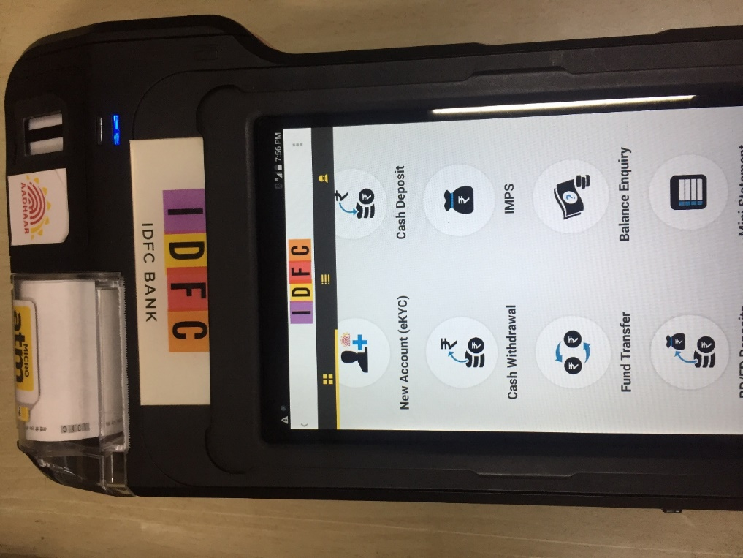
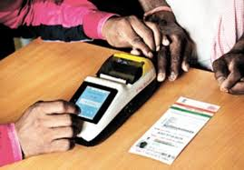
Screen Shots

Slide 28
Thank you

