Slide 1



PROJECT/1
WTWY SUMMER GALA 2024 PARTICIPATION AND DONATION MAXIMIZATION
ALPER KORKMAZ, GÖKHAN KAYA, KEREM DEMIRCI

Slide 2

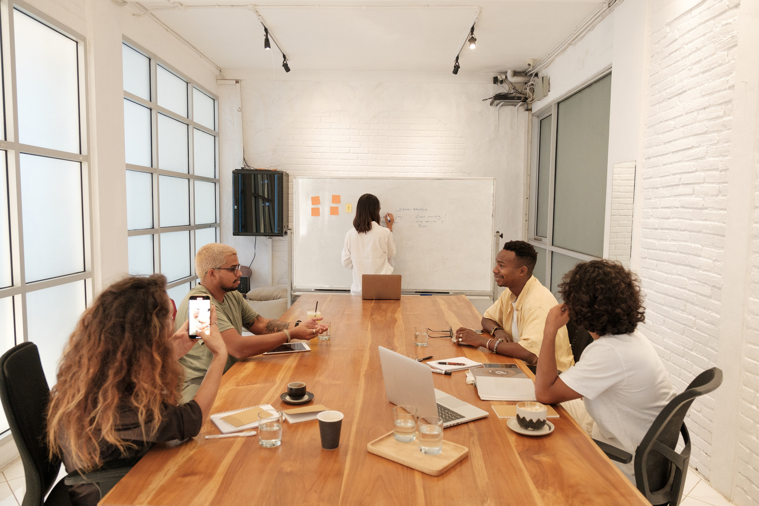
Sevgili Vinny & Julia,
Yeni tanıştığımız ve güzel sohbet ettiğimiz etkinlikte sizlerle tanışmak ve sohbet etmek çok güzeldi. Birlikte çalışmanın her iki taraf için de anlamlı olup olmadığını görmek için sonraki adımları beraber atmayı çok isteriz.
Bahsettiğimiz gibi, bağış toplama çabalarımızın önemli bir bölümünü oluşturan sokak ekip çalışmasının etkinliğini optimize etmek için veri ve analitiklerin gücünden yararlanmak istiyoruz.
WomenTechWomenYes (WTWY) derneğimiz her yıl yaz mevsiminin başında yıllık bir gala düzenliyor. Yeni ve kapsayıcı bir kuruluş olduğumuz için gala ile hem etkinlik alanımızı kadınların teknolojiye katılımını artırma konusunda tutkulu bireylerle doldurmak hem de aynı anda farkındalık ve erişim oluşturmak için gala ile çifte görev yapmaya çalışıyoruz.
Bu amaçla metro istasyonlarının girişlerine sokak ekipleri yerleştiriyoruz. Sokak ekipleri ulaşabildikleri kişilerin e-posta adreslerini topluyor ve kayıt olanlara galamıza ücretsiz bilet gönderiyor.
Sizden yardım talep etmek istediğimiz yer ise, sokak ekiplerimizin yerleşimini optimize etmemize yardımcı olması için, şehirden ücretsiz olarak temin edilebildiğini bildiğinizden emin olduğum MTA metro verilerini kullanmak, böylece galaya katılabilecek ve amacımıza katkıda bulunabilecek en fazla kişiye ulaşabiliriz.
Top şimdi sizin sahanızda, en yakın zamanda yapacağınız çalışmanın sonuçlarını merakla bekliyor olacağız.

Slide 3



CONTENT
GOAL
This is the first project for the Data Science Bootcamp, where we perform Exploratory Data Analysis (EDA) on the MTA turnstiles data.
WomenTechWomenYes (WTWY) hosts an annual gala during the summer. To drive attendance, their Street team goes to subway stations in NYC to attract people to sign up for the gala.
Optimize the placement of street team that collect email address for free tickets of WomenTechWomenYes(WTWY) annual gala.
Finding the overall busiest stations.
Finding the busiest day of the week and the time period of a day with highest traffic per station.
Determining what demographics would be more interested in such event.
Determining which boroughs have the stations with highest traffic.
Determining the percentage of drivers in these boroughs.

Slide 4
Ideas
1) Determining total traffic to/fro station entrance/exits will be beneficial.
2) Women and white collar workers in the area of stations are more likely to be interested.
3) People with higher purchasing power would donate more money.
4) Driver/non-driver ratio of different areas of NYC could also be a good indicator as drivers don't tend to be around subway stations

Slide 5
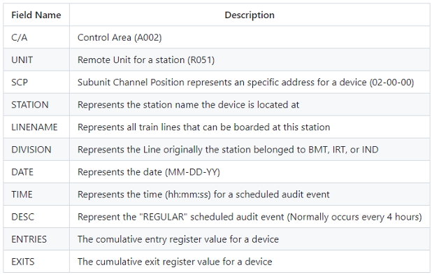
Field Description

Slide 6


Libraries
Numpy
Matplotlib
Pandas
Seaborn
Matpltlib.Colors

Slide 7
Datasets (.csv)
1.Turnstile_Usage_Data__2022_20240118
2.nyc_census_tracts
3.MTA_Subway_Stations

Slide 8
Purpose & Workflow
• Understanding the dataset
• Cleaning the dataset and getting rid of the unnecessary columns
• Checking data integrity
• Scanning the web for additional datasets to help our case
• Finding ways to demonstrate different criteria in an attempt to maximize donation and attendance to WTWY

Slide 9
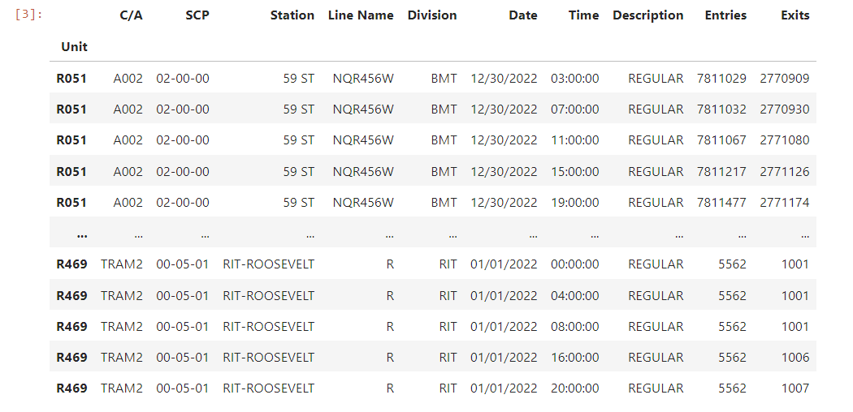
Implementation
• Importing the dataset
• Examining the datatypes and data integrity

Slide 10
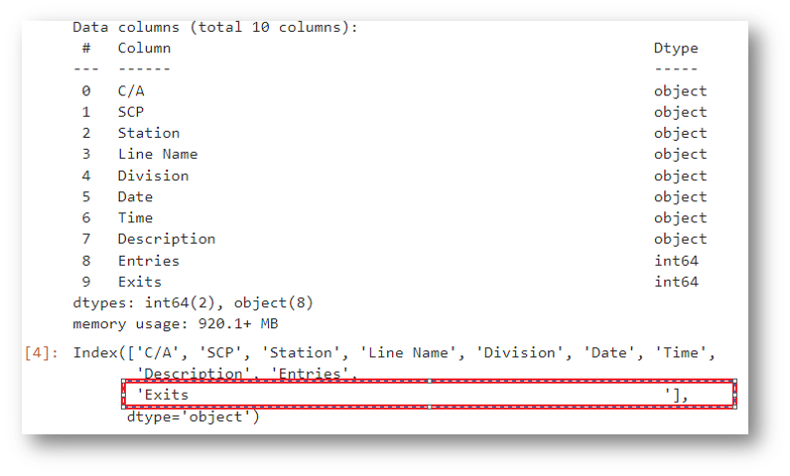
Implementation
• Date and Time Columns are Strings
• “Exits” column as a typo
• There are no columns with null values
• Hour information has been extracted from
time column and added as a new column
to the dataset
• Confirmed that there is no duplicate data

Slide 11
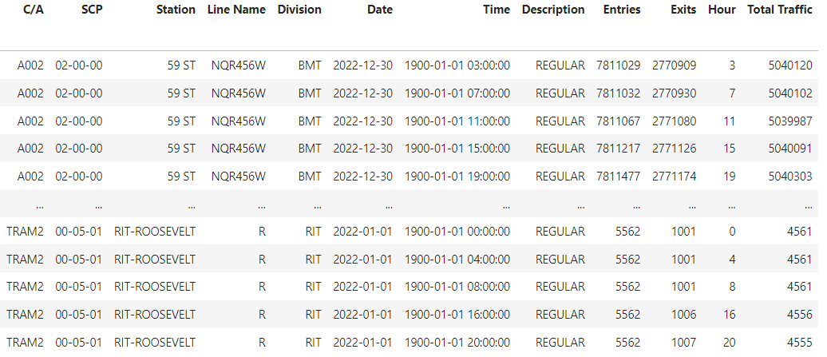
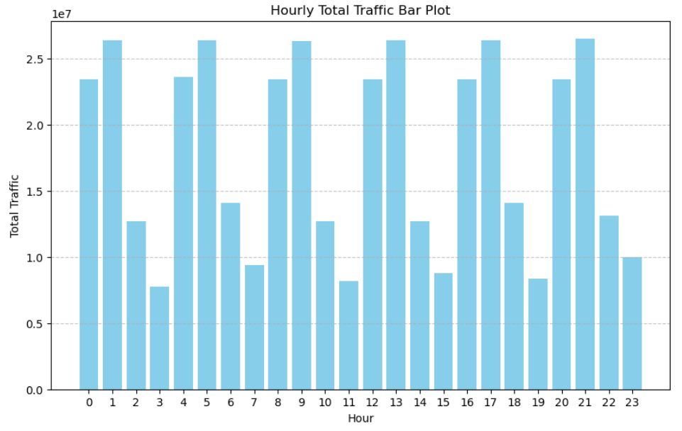
Implementation
We have substracted "Entries" and "Exits" columns, took the absolute value of the result and moved the value as a new column called "Total Traffic"
We have also grouped the total traffic by "Hour" to see if there is any pattern of traffic increase in specific hours such as rush hours

Slide 12
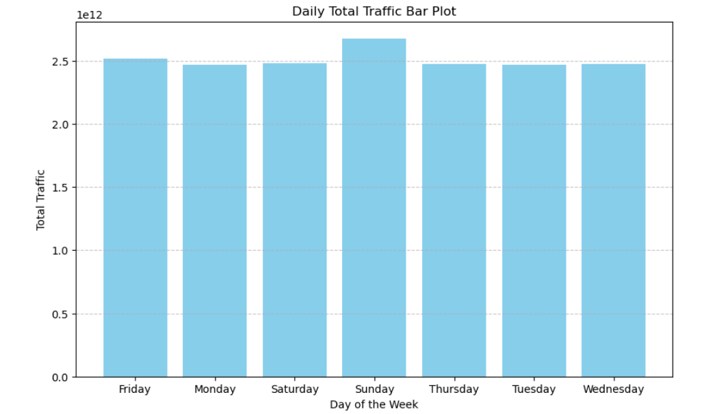
Implementation
We have used Python’s day_name function to get the “day of the week” information from datetimestamp.
We have grouped the remaining dataset by the day and summed the total traffic to see which day was busier. Sunday turned out to be busier than other days.

Slide 13
Implementation
We have checked how many different "description " values are there
Description
REGULAR --> 10905897
RECOVR AUD --> 57354
Recovr Aud is not a regular line and therefore is not relevant. We clean our dataset from these values
Since the gala is planned to be in the beginning of Summer (beginning of June), we take May-June-July data only as data from other seasons might be misleading

Slide 14
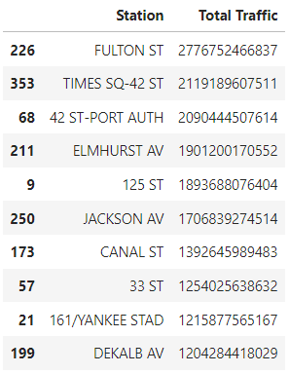
Implementation
We have grouped station information with the sum of all traffic for that station and printed the top 10 busiest stations.

Slide 15
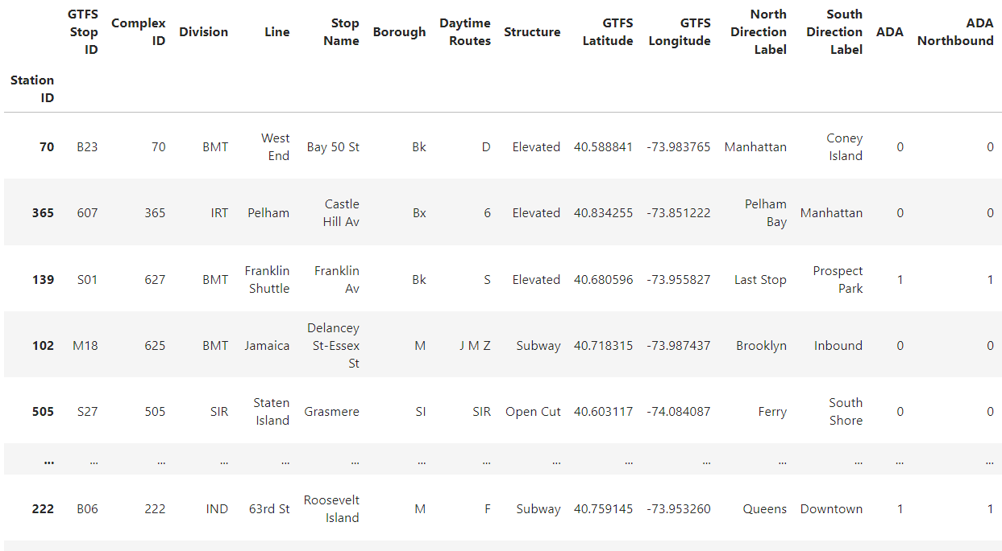
Implementation
To be able to map these stations with their respective boroughs of NYC, we have imported and cleaned yet another dataset called: "MTA_Subway_Stations.csv"

Slide 16
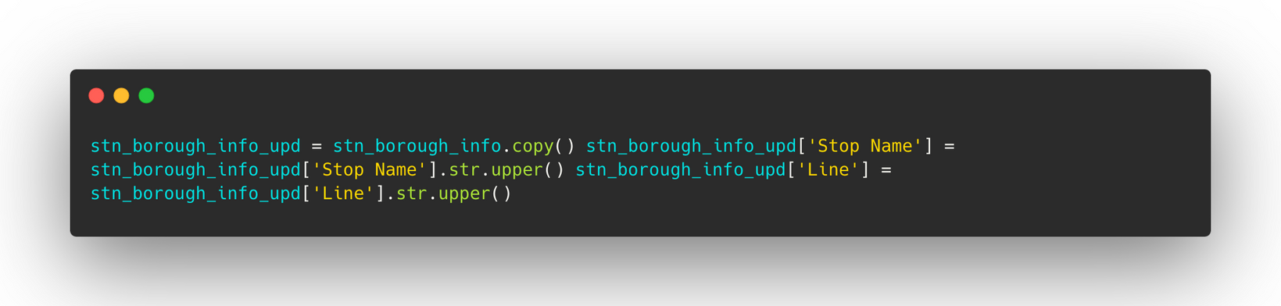
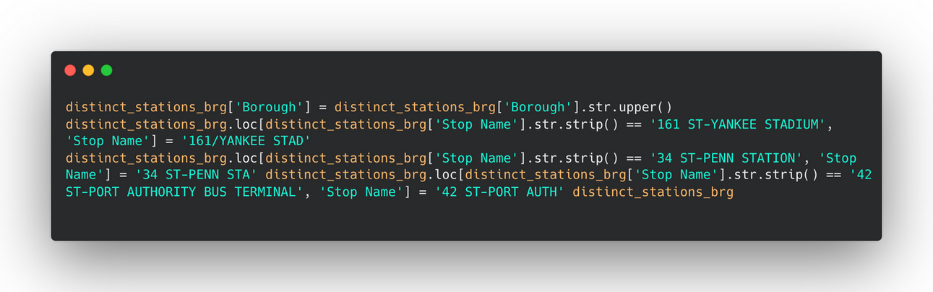
Implementation
We have cleaned this dataset from unnecessary columns and duplicates. We have also changed column values to be able to map them with our original dataset.
We have joined the two datasets from the "Station" and "Stop Name" columns to map each station with corresponding NYC borough

Slide 17
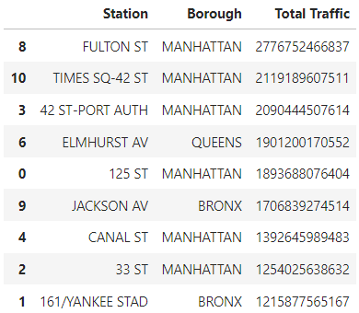
Implementation

Slide 18
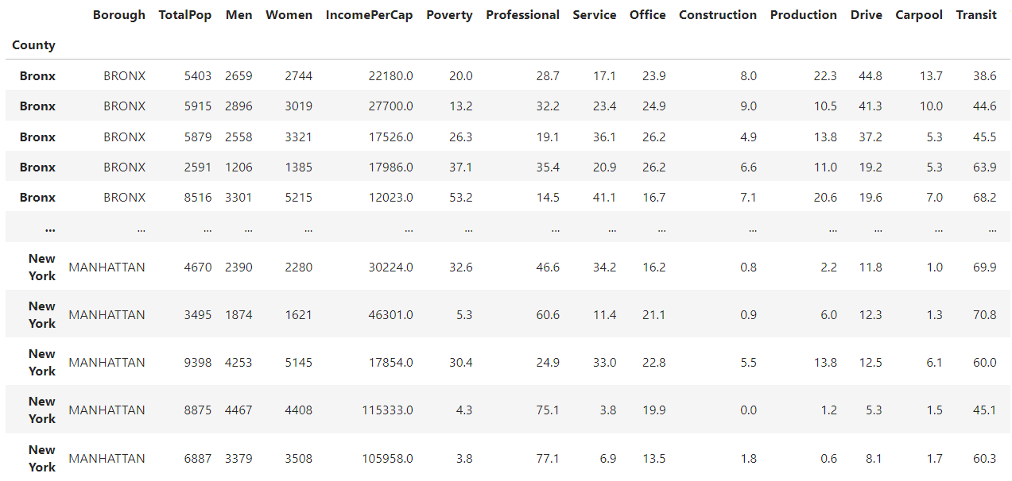
Implementation
Now, we want to make use of another dataset called "nyc_census_tracts.csv" to be able to better grasp the demographic distribution of different boroughs of NYC
Unrelated columns have been dropped and the dataset is checked for data integrity and duplicate data
We have filtered our dataset to only include data from Manhattan, Brooklyn and Bronx as all top ten most crowded stations are located in these boroughs
Finally, we have grouped this dataset by Borough information and we took the mean and the sum of other columns.

Slide 19
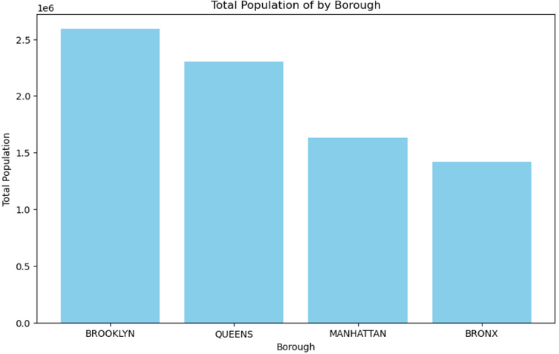
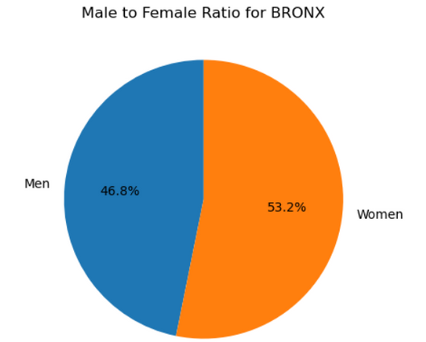
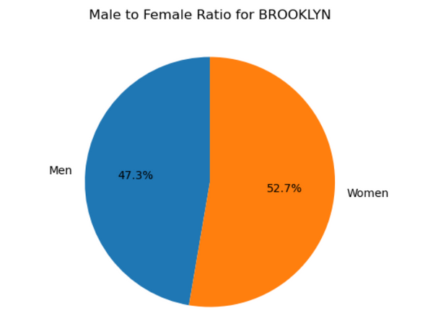
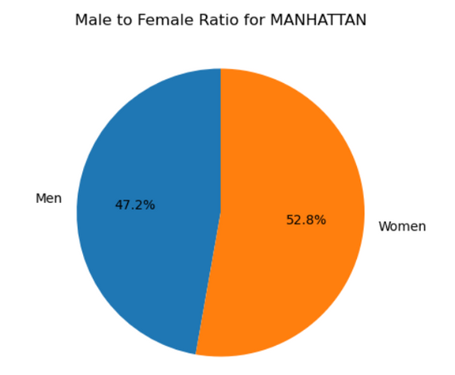
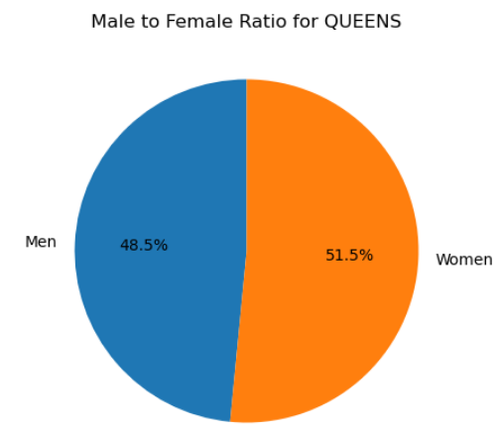
Implementation
Total population between boroughs and the percentage of women in each borough is as can be seen. Brooklyn and Queens have the most population.

Slide 20
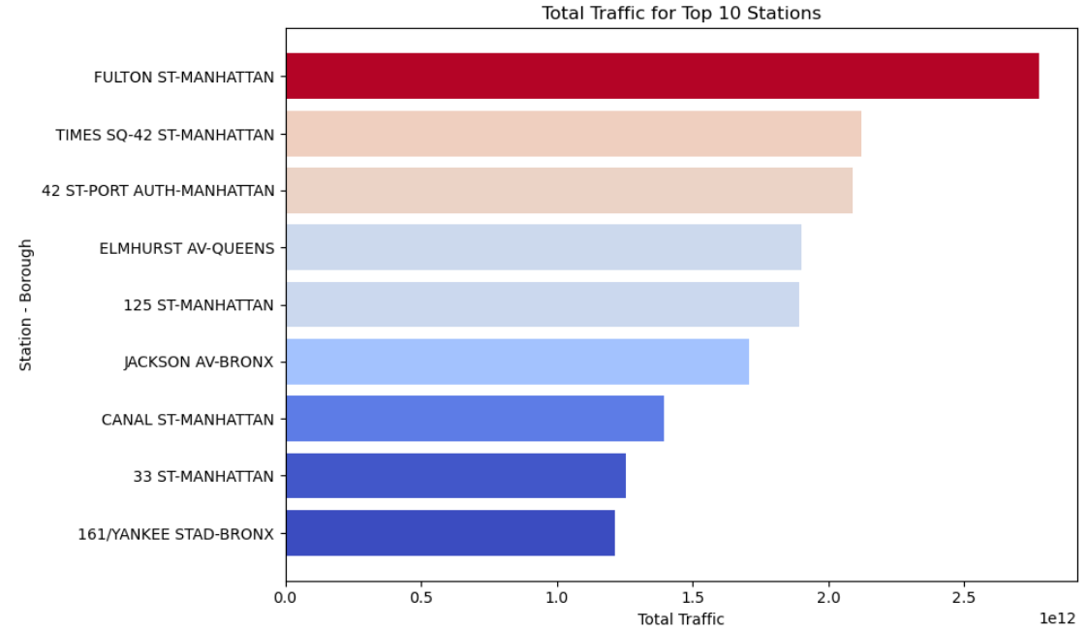
Implementation
6 of 10 stations with most traffic are located in Manhattan area.
4 out of top 5 stations with most traffic

Slide 21
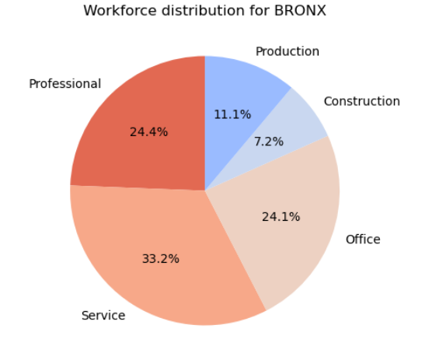
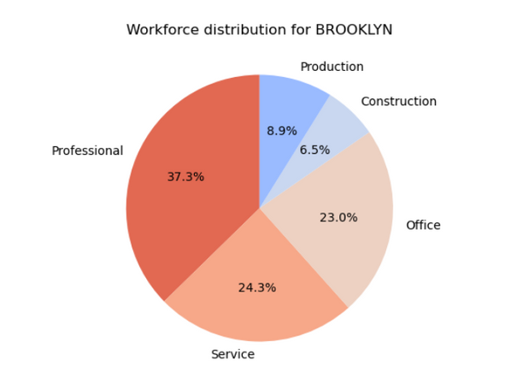
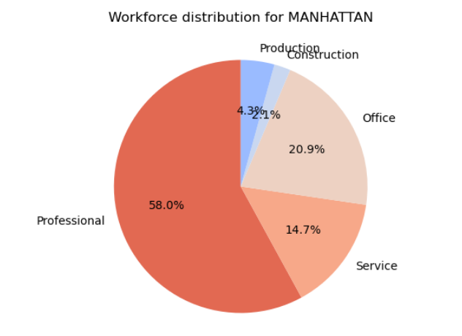
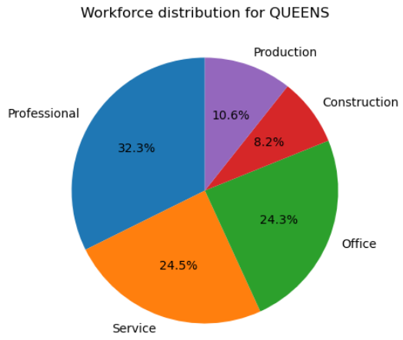
Implementation
When we check working sector distributions of these boroughs, we can observe that close to 80% of Manhattan's population is working in professional or office jobs.

Slide 22
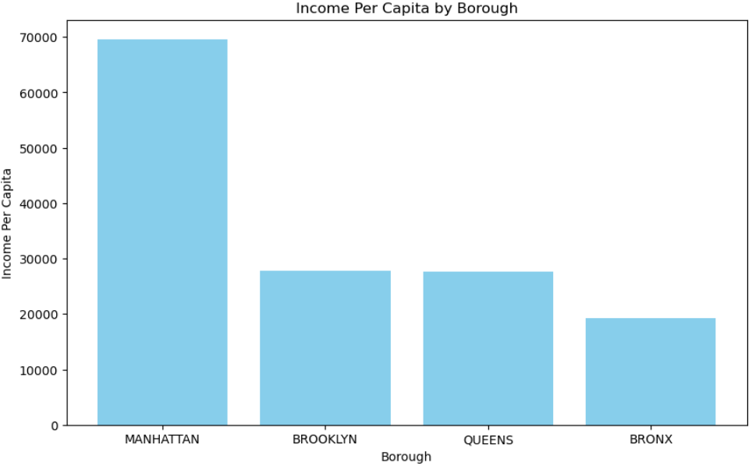
Implementation
When we check the boroughs by the average household income, we can see that Manhattan's average income is drastically higher than other boroughs

Slide 23
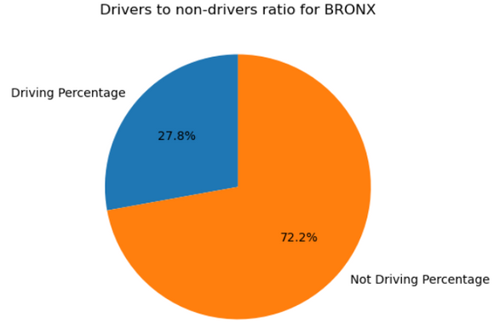
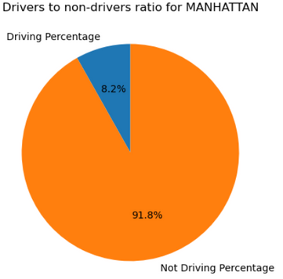
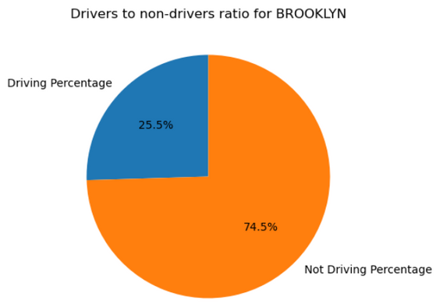
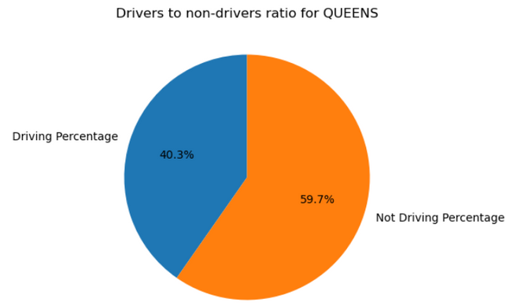
Implementation
We decided to take the drivers out of equation by generating a driver-nondriver ratio for these boroughs
For this, we have calculated the mean percentage of population in every borough that uses different commutes to go to work. Carpool and Car columns are counted as Drivers. Later on two new columns are added to dataset by multiplying this percentage with total population and finding driver/non driver ratio.

Slide 24


Summary & Results
All 10 of the busiest stations are in Manhattan, Brooklyn, Bronx and Queens
6 of those 10 busiest stations are located in Manhattan.
All boroughs have roughly same percentage of women.
Brooklyn has the highest population with Queens being a close second.
White collar workers and people with significantly higher income live in Manhattan.
There doesn't seem to be a significant traffic increase in rush hours but the traffic at 16:00-18:00 and 20:00-22:00 can be utilized to maximize donations and participation.
There is a traffic increase on Sunday, since people will be more eager to be informed about an event during Friday night and weekend, Friday, Saturday and Sunday should be utilized.
People will be less interested in listening about the gala early in the morning.
People from boroughs with high percentage of drivers are less likely to use other way of commute such as subways therefore making half of the population of Queens not beneficial to use for our purpose.

Slide 25

Summary & Results
Based on these findings, we suggest that placing staff members in these 5 stations in related boroughs, at Friday to Sunday between 16:00-18:00 and 20:00-22:00 will most likely maximize registration and the amount of collected donations.
FULTON ST-MANHATTAN
TIMES SQ-42 ST-MANHATTAN
42 ST-PORT AUTH-MANHATTAN
ELMHURST AV-QUEENS
125 ST-MANHATTAN

Slide 26
Future Works
1) Taking into consideration the tourists that are using the stations as they might be less likely to donate for a cause in a country foreign to them.
2) Taking the latitude and longitude information for stations with the most traffic and demonstrating these exact locations on a Google Map using API call.
3) Taking into consideration the percentage of population working from home per each borough.

Slide 27
THANKS FOR LISTENING
ALPER KORKMAZ, GÖKHAN KAYA, KEREM DEMIRCI

