Slide 1
Exploring Emotions Towards Covid-19 Vaccines
AIN423 Data Intensive Applications
Data Science Capstone Project
Alper Mert, Muhammet Batuhan Doğan

Slide 2
Problem
Context: Why vaccine sentiment analysis is important?
Problem: Real-time, large-scale sentiment analysis is difficult with traditional methods. Social media platforms, with their vast amount of user-generated data, offer an alternative means to analyze public opinion.
Objective: Analyze vaccine-related sentiments using NLP and statistical methods.

Slide 3
Data Understanding
We used "vaccination_all_tweets.csv"[1] dataset from kaggle.
This dataset contains 228208 rows and 16 columns. This dataset includes features such as user information, tweet content, hashtags, and engagement metrics. These features provide comprehensive details for conducting sentiment analysis, exploring temporal trends, and performing regional comparisons.
The most important feature of our data is "text" obviously. Date feature is also important to do time serial analysis.

Slide 4
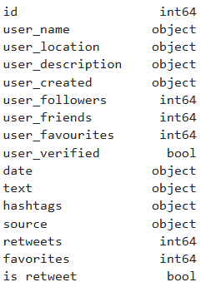
Our dataset’s features

Slide 5
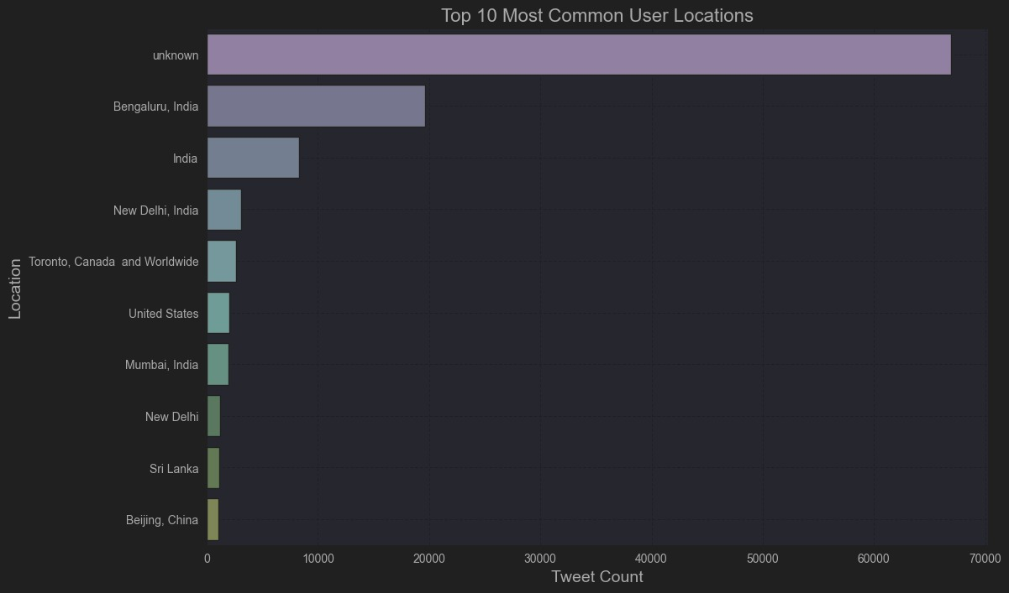
Data Understanding

Slide 6
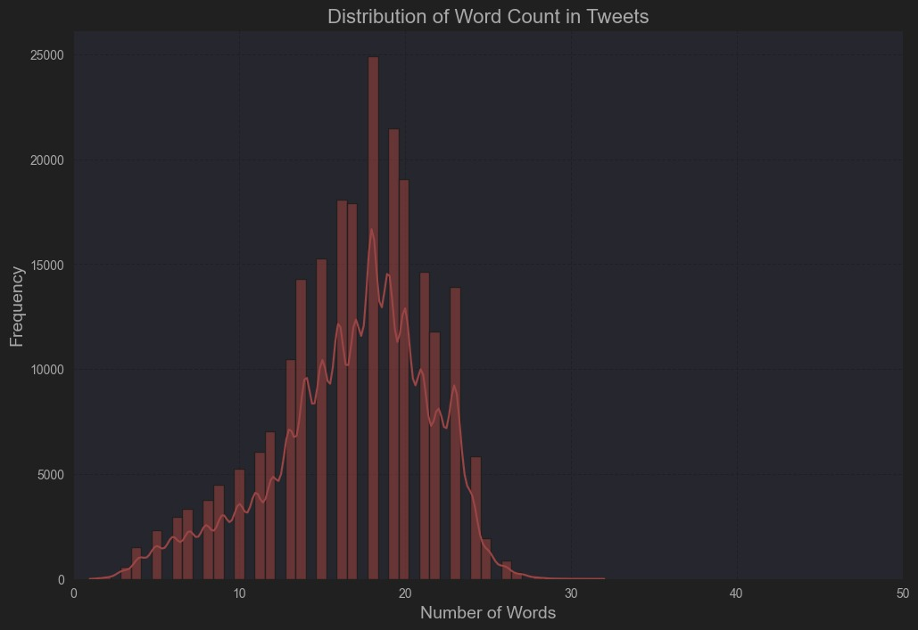
Data Understanding

Slide 7
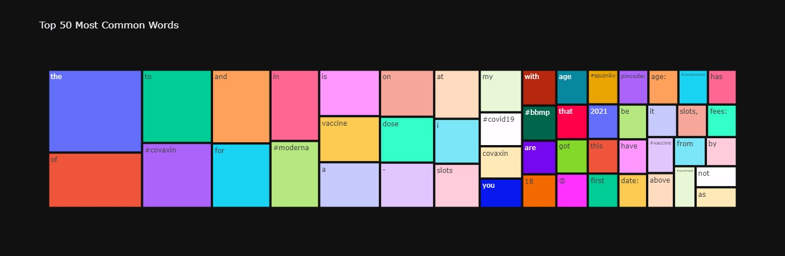
Data Understanding

Slide 8
Data Preparation
Exploratory data analysis will help uncover trends and anomalies, while visualization techniques will provide insights into the distribution and patterns within the data.
Preprocessing steps include cleaning the dataset by removing irrelevant information, handling missing values, and preparing the text for analysis through tokenization and the removal of stop words.

Slide 9
Data Preparation
We transformed the tweets lowercase to get rid of meanings of uppercase.
Then we transformed the date features into datetime format to do time serial analysis.
We filled the empty data in "hashtag", "user_location" features.
Then we dropped the features "user_name", "source", "user_description", "user_friends" features since we thought those are irrelevant.
As nlp preprocessing techniques, we removed stop words from tweets. We used predefined stop word list to get rid of all such words. We also preprocessed the tweets to eliminate url, emoji.

Slide 10
Modeling
We used VADER to do sentiment analysis. VADER is effective on sentiment classification.
We calculated "positive", "negative" and "neutral" probabilities for each tweets by analyzing the words in tweets. Then we calculated compound scores for each tweet.
We classified sentiments as "Positive", "Negative" and "Neutral" by using compound scores. We decreased the threshold from 0.05 to 0.03 to decrease the count of Neutral tweets.

Slide 11
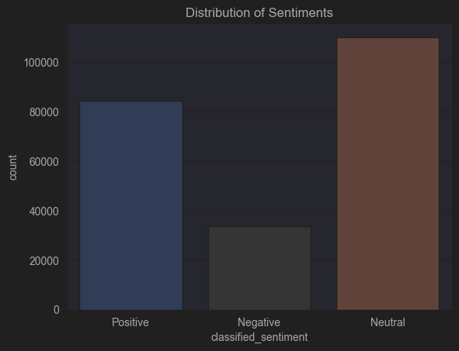
Distribution of 3 sentiments after Classification process with VADER

Slide 12
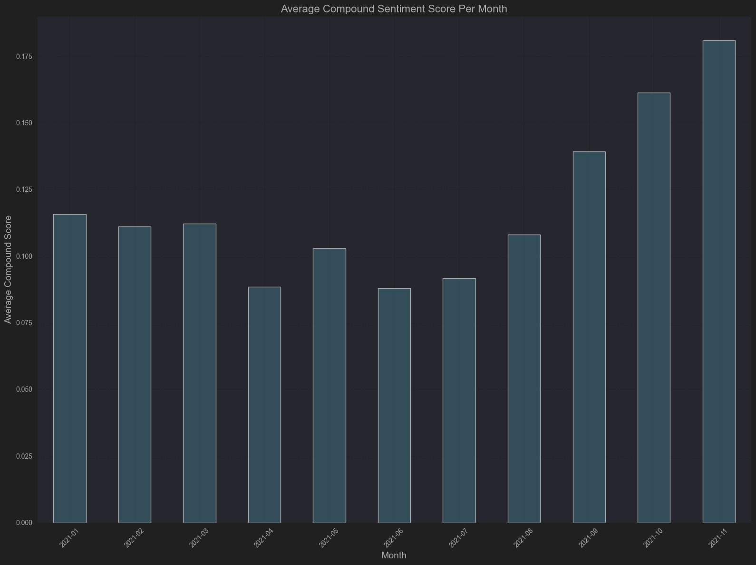
Average Compound Score Per Month

Slide 13
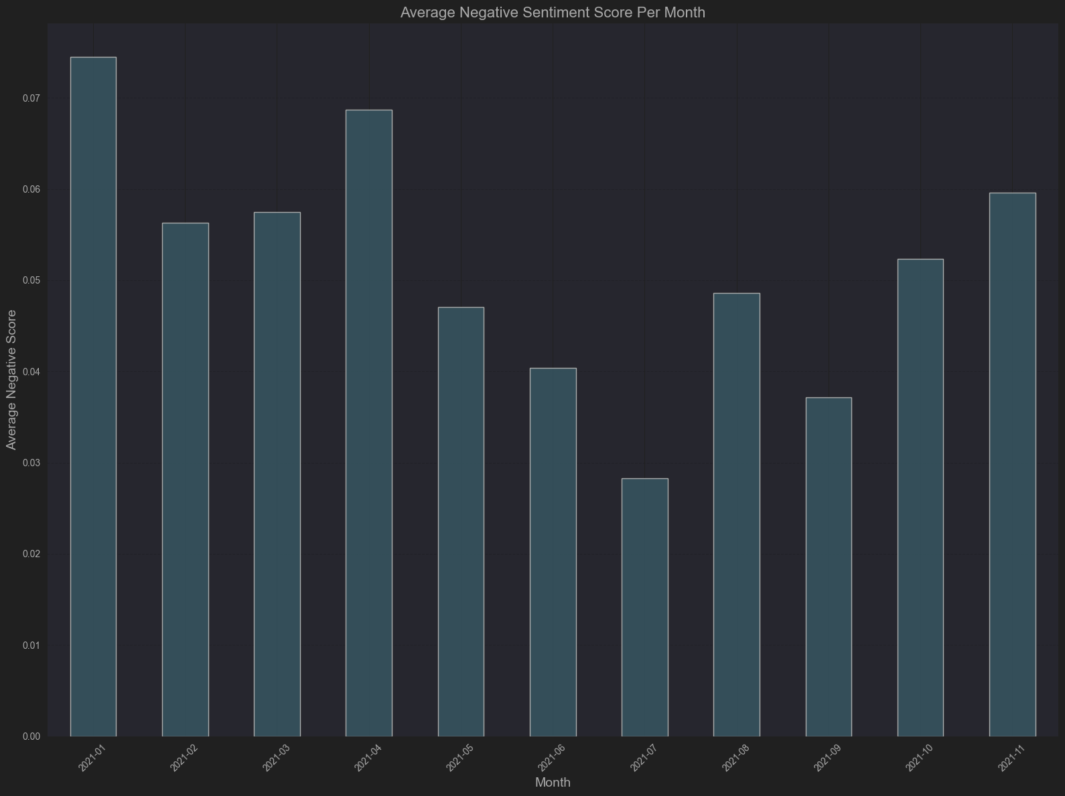
Average Negative Sentiment Score Per Month

Slide 14
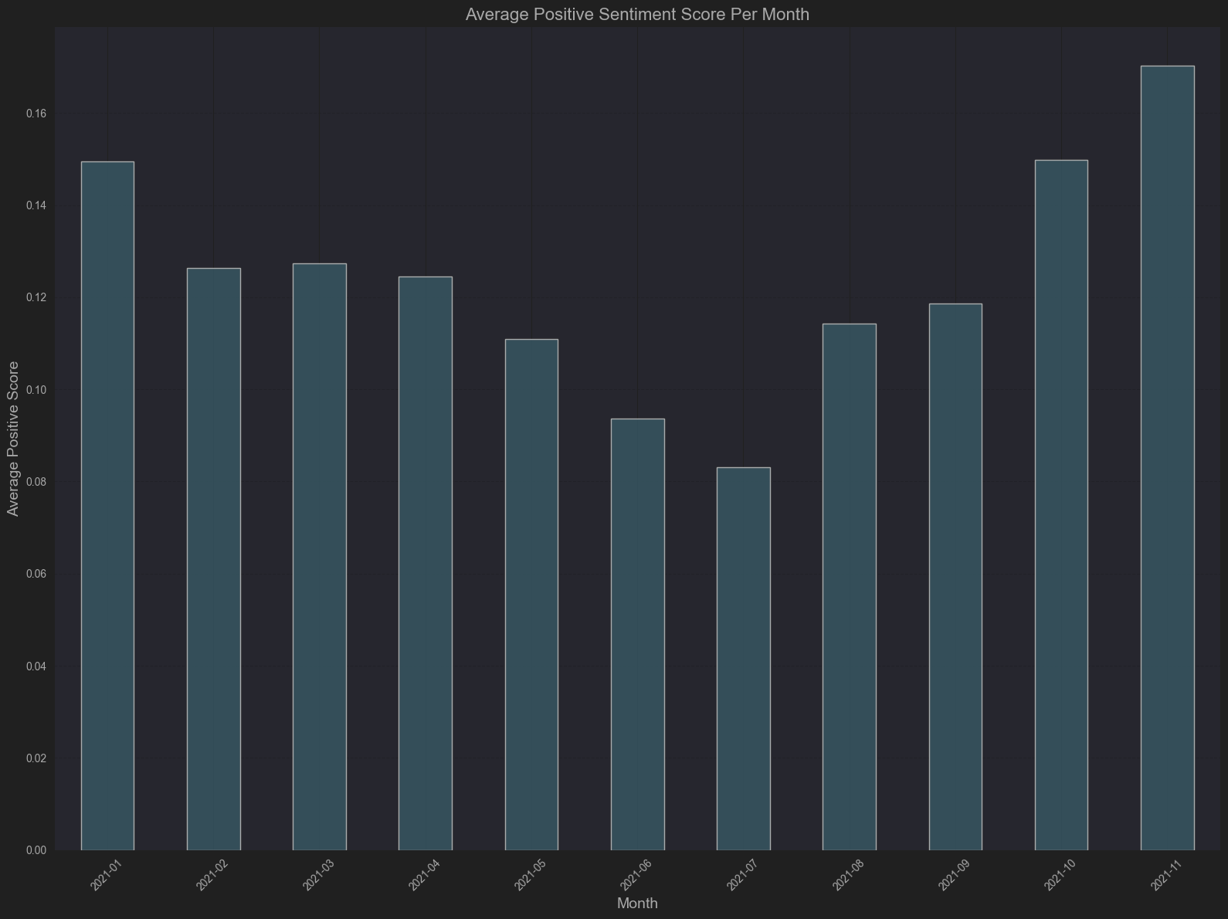
Average Positive Sentiment Score Per Month

Slide 15
Modeling
After made the visualizations, we implemented Logistic Regression model. We chose logistic regression for this project due to the following reasons:
- Simplicity and Interpretability
- Efficiency for High-Dimensional Data
- Good Baseline Model
- Compatibility with TF-IDF Features
- Probabilistic Outputs

Slide 16
Modeling
Training, Evaluation, and Fine-tuning
We splitted our data as training(60%), validation(20%) and test(20%).
We evaluated the model’s performance with validation set to ensure the generalization and avoid overfitting. We used predefined key evaluation metrics to evaluate our models.
We did grid search operation to find optimal parameters for Logistic Regression in our task. We then defined the C parameter as 10 and penalty parameters as l2. Then we did the same process to test our parameter changed model.

Slide 17
Evaluation
We used predefined evaluation metrics to evaluate the success of our models.
We calculated ‘classification report’ for both models.

Slide 18
Default Model’s Validation Set Classification Report
Validation Set Classification Report:
precision recall f1-score support
Negative 0.91 0.76 0.83 6726
Neutral 0.92 0.98 0.95 22023
Positive 0.95 0.93 0.94 16892
accuracy 0.93 45641
macro avg 0.93 0.89 0.91 45641
weighted avg 0.93 0.93 0.93 45641

Slide 19
Default Model’s Test Set Classification Report
Test Set Classification Report:
precision recall f1-score support
Negative 0.91 0.77 0.83 6725
Neutral 0.92 0.98 0.95 22024
Positive 0.95 0.93 0.94 16893
accuracy 0.93 45642
macro avg 0.93 0.89 0.91 45642
weighted avg 0.93 0.93 0.93 45642

Slide 20
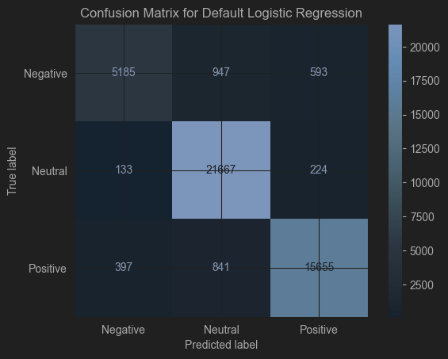
Confusion Matrix For Default Model

Slide 21
Parameter Changed Model’s Validation Set Classification Report
Validation Set Classification Report:
precision recall f1-score support
Negative 0.89 0.80 0.85 6726
Neutral 0.94 0.98 0.96 22023
Positive 0.95 0.94 0.94 16892
accuracy 0.94 45641
macro avg 0.93 0.91 0.92 45641
weighted avg 0.94 0.94 0.94 45641

Slide 22
Parameter Changed Model’s Test Set Classification Report
Test Set Classification Report:
precision recall f1-score support
Negative 0.89 0.81 0.85 6725
Neutral 0.94 0.98 0.96 22024
Positive 0.95 0.93 0.94 16893
accuracy 0.94 45642
macro avg 0.93 0.91 0.92 45642
weighted avg 0.94 0.94 0.94 45642

Slide 23
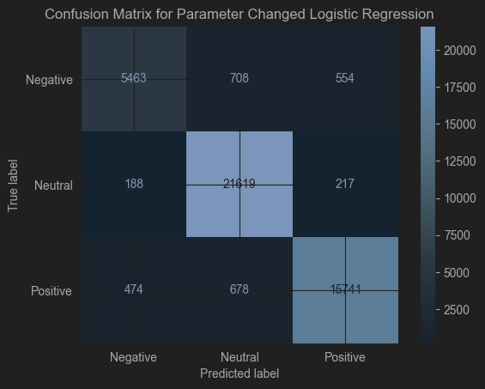
Confusion Matrix For Parameter Changed Model

Slide 24
Comment On Results
Both model’s performances are very good, maybe too good. Tweets may be easy classifiable according to sentimens.
VADER contains only 3 labels as Positive, Negative and Neutral. Using more advanced sentiment classifier and adding more emotions may change the results.
Even we decreased the threshold, the count of Neutral tweets are too many. Again adding more emotions may solve this problem
Our dataset contains the tweets in limited timeline. Adding last 2 years’ tweets may change the results.

Slide 25
References
[1]: https://www.kaggle.com/datasets/gpreda/all-covid19-vaccines-tweets
Github Link: https://github.com/AlperMRT/Data-Intensive-Applications-Project-COVID-19-Vaccines-Sentiment-Analysis
Report Link : https://docs.google.com/document/d/1F-80b11HEh9XjQd0cUR1wLLysrYKhsne/edit

