Slide 1
COVID-19 IMPACT ON VIOLENCE AGAINST WOMEN

Slide 2
ALPER DOĞUKAN NİZAMOĞLU 17030411050 MIS

Slide 3
Covid-19 has been under the influence of the world for 2 years, 3.7 million people lost their lives in this period, and 172 million people caught this disease. It has undoubtedly changed our lives irrevocably. Even if we say that these 2 years caused a social and economic collapse, we would not be wrong, many workplaces went bankrupt or came to the point of bankruptcy, there were layoffs at great rates regardless of the size of the companies, and many other negative things happened.

Slide 4
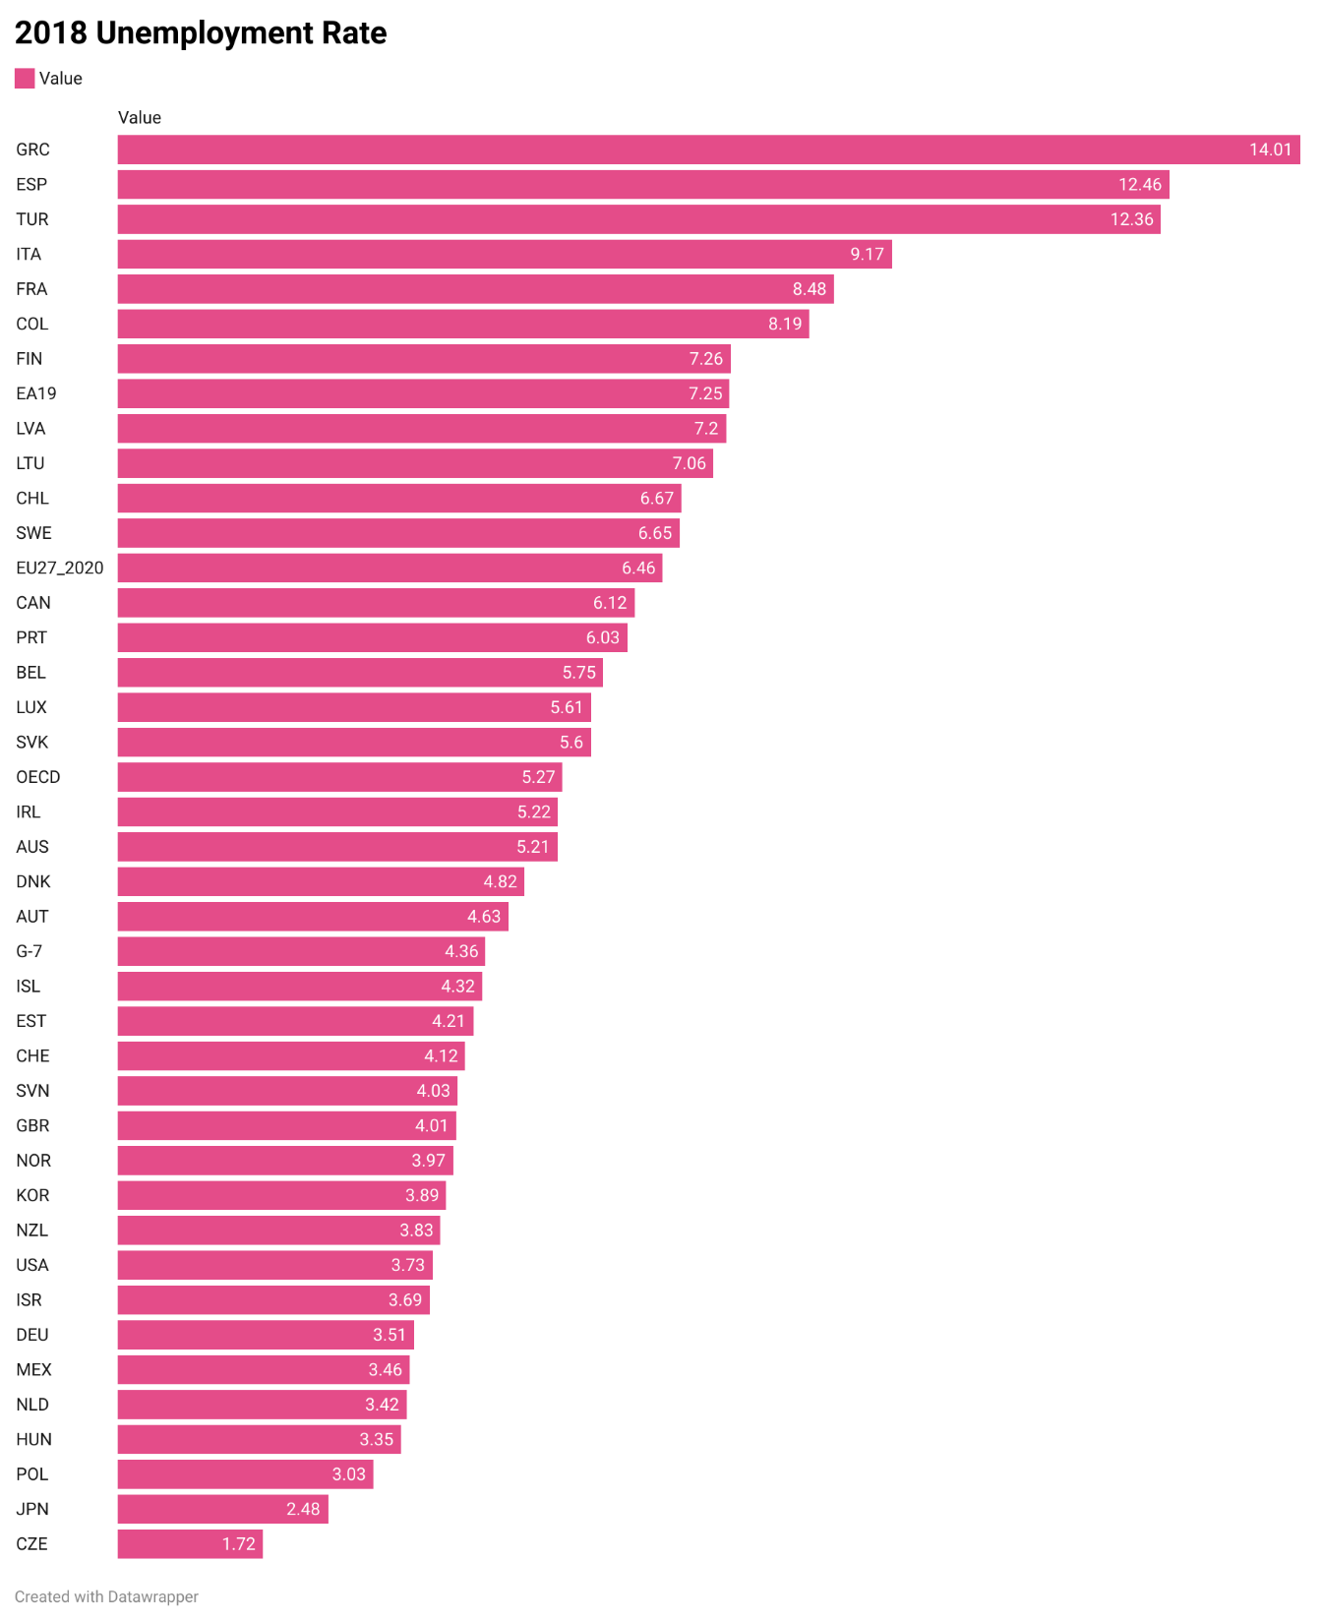
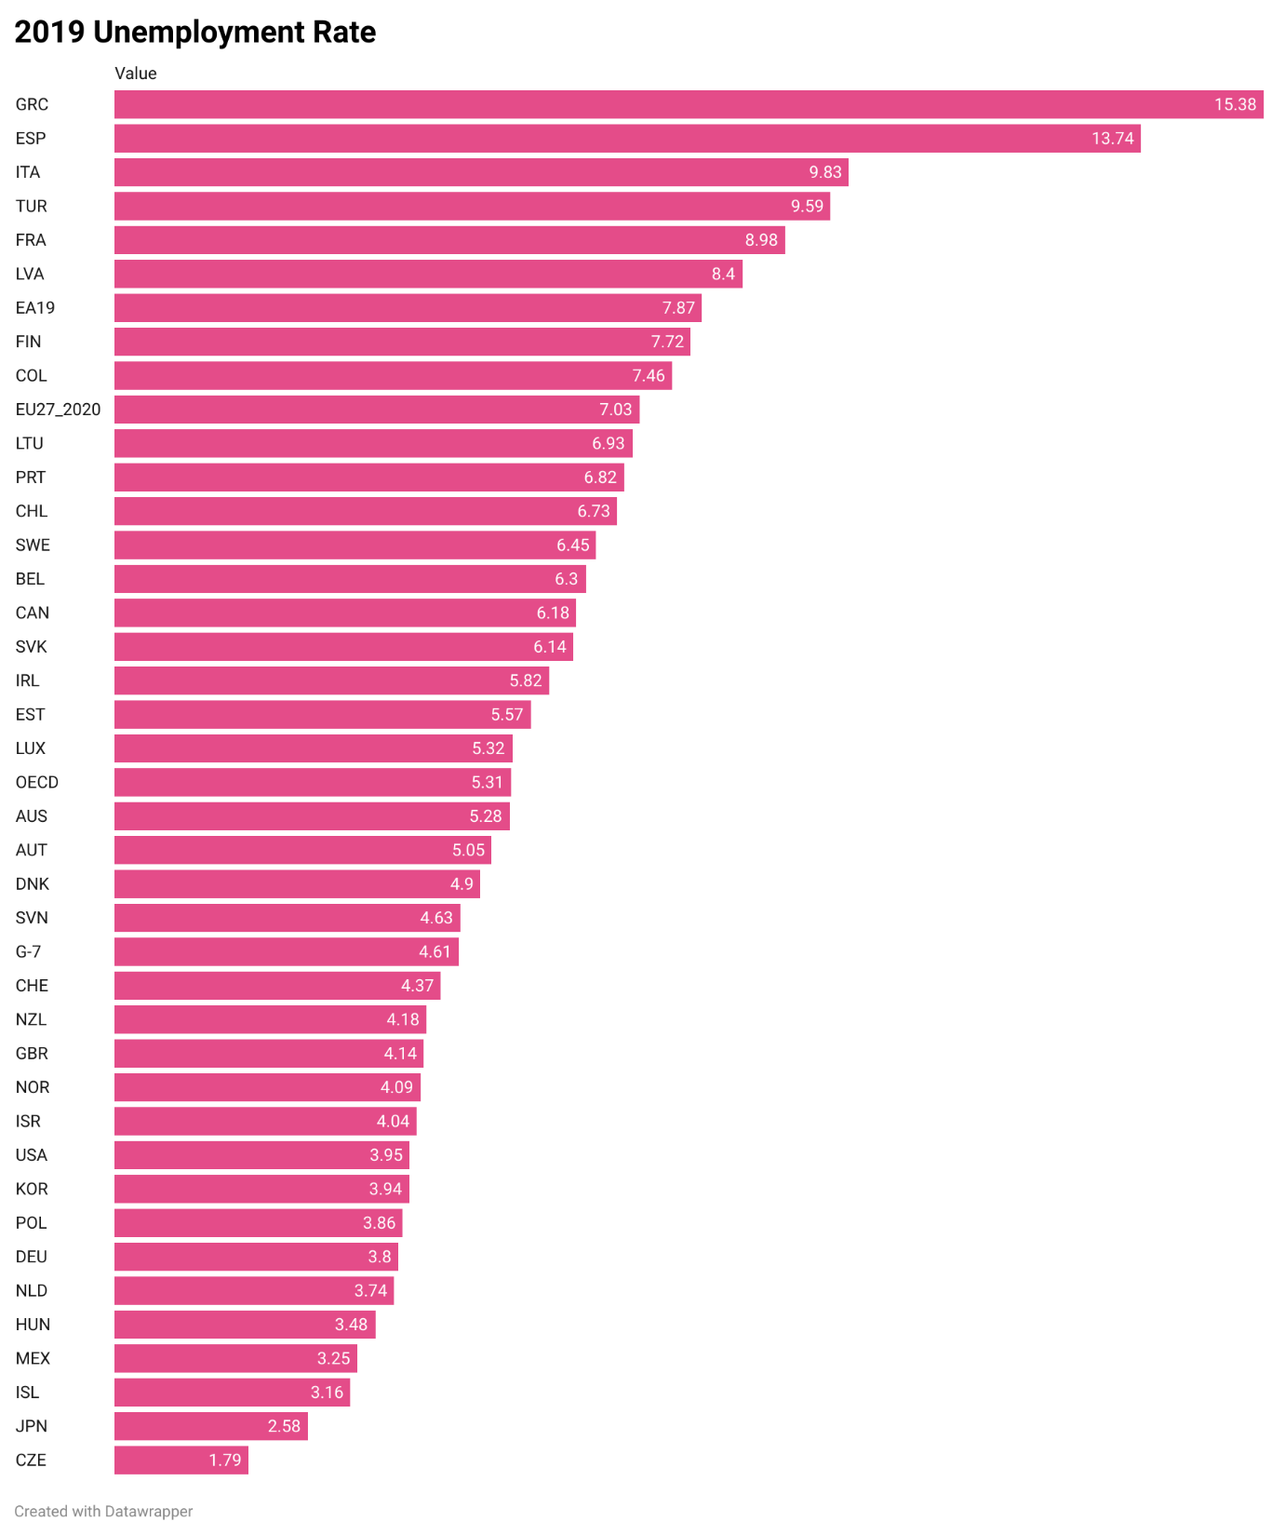
UNEMPLOYMENT RATES BEFORE AND AFTER COVID-19
You can see the increase in unemployment rates in 2018, the year Covid-19 did not enter our lives, and in 2019, when it entered our lives.

Slide 5
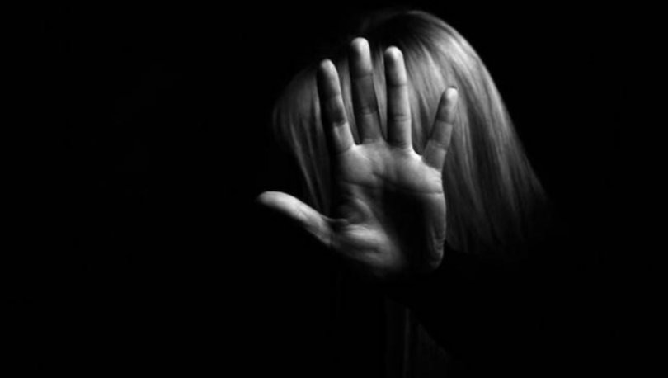
Covid-19 has also increased the rate of some problems that existed in our world before its emergence. In particular, its effect on problems arising from both economic and social reasons has increased visibly, one of these problems is undoubtedly violence against women.

Slide 6
Violence against women is an issue we still face, even though we are in the 21st century all over the world. According to a study conducted at Hacettepe University, it was revealed that 4 out of 10 women in Turkey have been exposed to violence or harassment at some point in their lives. According to a study by the World Health Organization, it has been determined that 1 in 3 women worldwide have experienced violence or harassment.

Slide 7
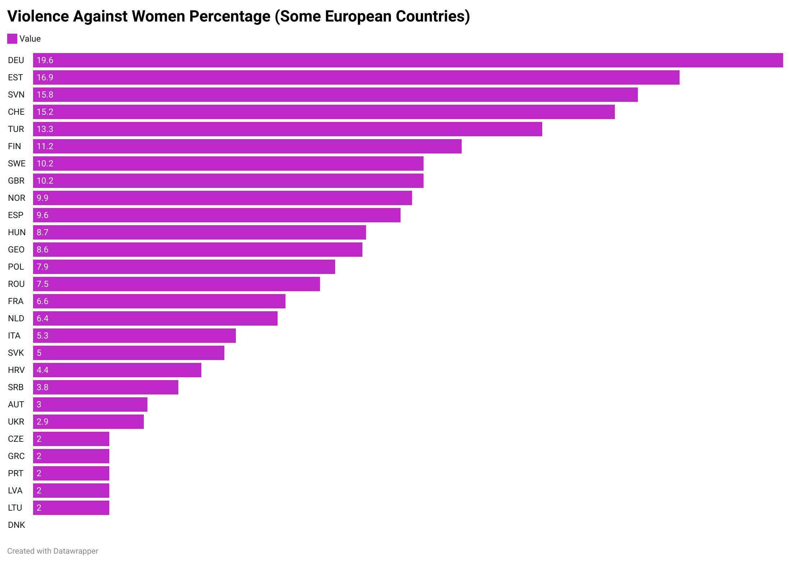
Percentage of vıolence agaınst women ın some europen countrıes (2019)

Slide 8
When we look at our country, a total of 474 women were killed by men in 2019, and when we look at 2020, 300 women were killed by men, while 171 women were found suspiciously dead. These numbers seem to be 34 more murders for 2019 and 31 more for 2020 than the number of murders in 2018, when there was no Covid-19. Although the number in 2018 was grave, we wouldn't be wrong if we cite the pandemic as one of the reasons for the grave increase in 2019, when the economy was in the worst situation, and in 2020, when the normalization process has just begun.

Slide 9
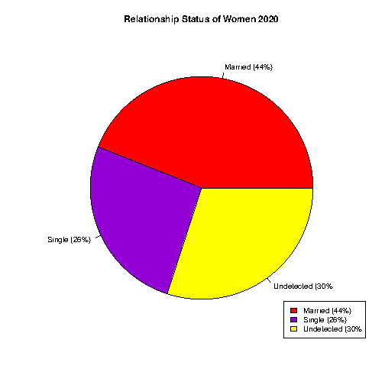
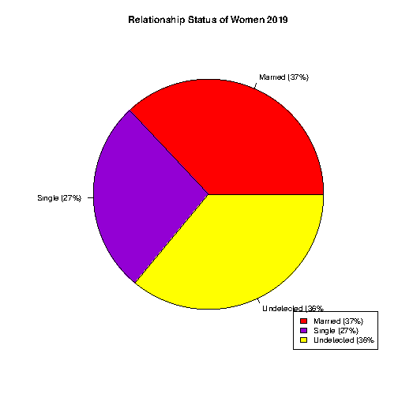
First, let's take a comparative look at some of the details of women’s murders in 2019 and 2020 over pie charts.
As we can see from the graph, while the majority of the women killed were married, we see that the murder rate of married women increased in 2020. In addition, it is thought that some of the women in an unidentified state are married to a religious marriage or are their lovers whom they have to hide from the society.

Slide 10
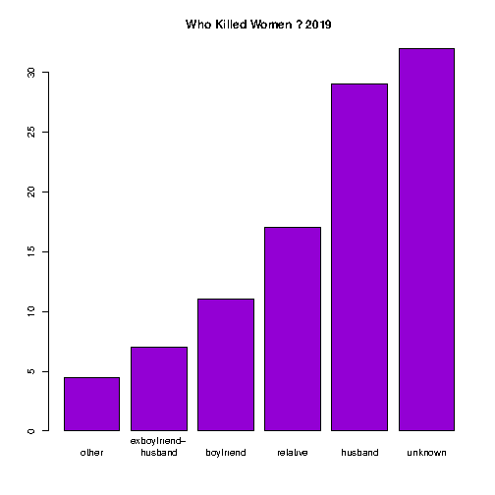
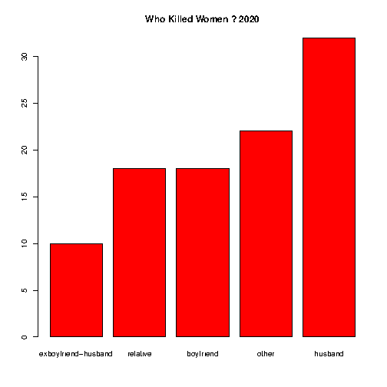
When we look at the data here, we see that most of the perpetrators of the murders in 2019 were committed by unidentified people, and in 2020, they were murdered by the people they were married to. (The other section includes people whom the women do not know or do not know but have no emotional ties to, and the relatives section includes people such as father, brother, cousin of those who killed women).

Slide 11
So what is the share of Covid-19 in these ?
At the beginning of the presentation, we talked about the collapse caused by Covid-19 in the economy and the economic depression it created in people, then we saw the women’s murders and by whom they were committed. In the first chart we saw how unemployment rates had increased, and in chart 4, from who killed women, the biggest difference between 2019 and 2020 was the increase in the rate of women being killed by their husbands. The fact that this increase was especially in the 2019-2020 periods, when the bans intensified in our country and the economic depression was felt more, shows how the economic depression caused by Covid-19, especially in patriarchal families, can lead to painful results.

Slide 12
In conclusion, by looking at these data, we examined some of the reasons why economic reasons have taken a big place in the murder of women in the last 2 years. Due to the unemployment and bad economy caused by Covid-19, we unfortunately concluded that women were murdered by the men they were with. However, no reason should and cannot legitimize the murder of women. We must unite as a society and the world to put an end to violence against women, and raise everyone's awareness.

