Slide 1
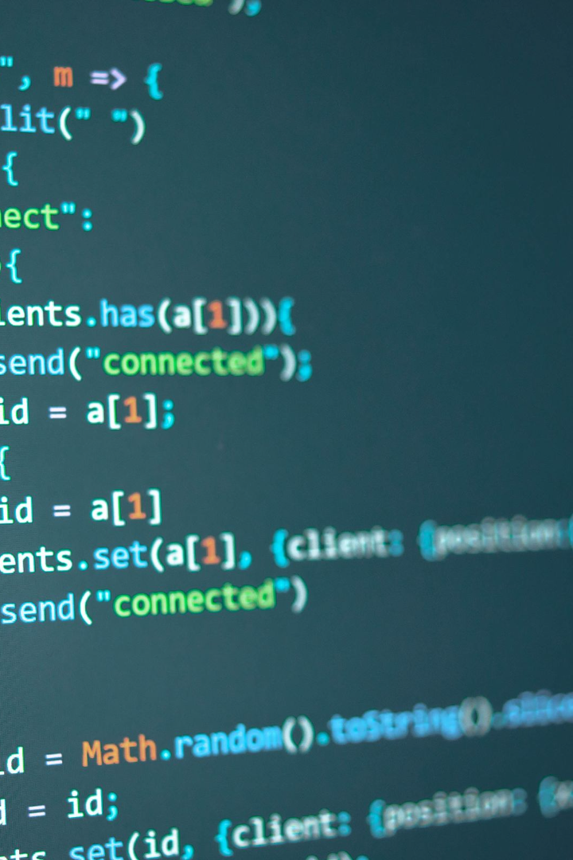
Introduction to TensorFlow Initialization, Indexing, Reshaping, and Hello World
The world of machine learning has opened exciting new doors for developers. This presentation will provide you with a beginner’s guide to initialization methods for Tensors, indexing a Tensor, reshaping a Tensor and coding a TensorFlow program.

Slide 2

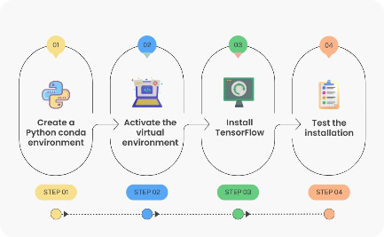

Installing TensorFlow
Get started with the installation of TensorFlow and explore the features it has to offer. In this section, we will cover the basics of how to install, use, and get the most out of this powerful machine learning platform.
Introduction to TensorFlow
Installing TensorFlow
Understanding Tensors
Get started with the installation process and start exploring the power of this tool.
Explore the importance of Tensors and how they work within TensorFlow.
Learn about the basics of TensorFlow and how it can help you develop machine learning models.

Slide 3

Initialization of Tensors
Initializing tensors is a crucial step in machine learning. In this section, we will explore different methods of tensor initialization and when to use them.
1
Why Tensor Initialization Matters
2
Different Initialization Methods
Tensor initialization is a crucial aspect in training machine learning models, especially neural networks. The choice of how you initialize the parameters (weights and biases) in your model can significantly impact the training process and the ultimate performance of the model.
Random
Zero

Slide 4
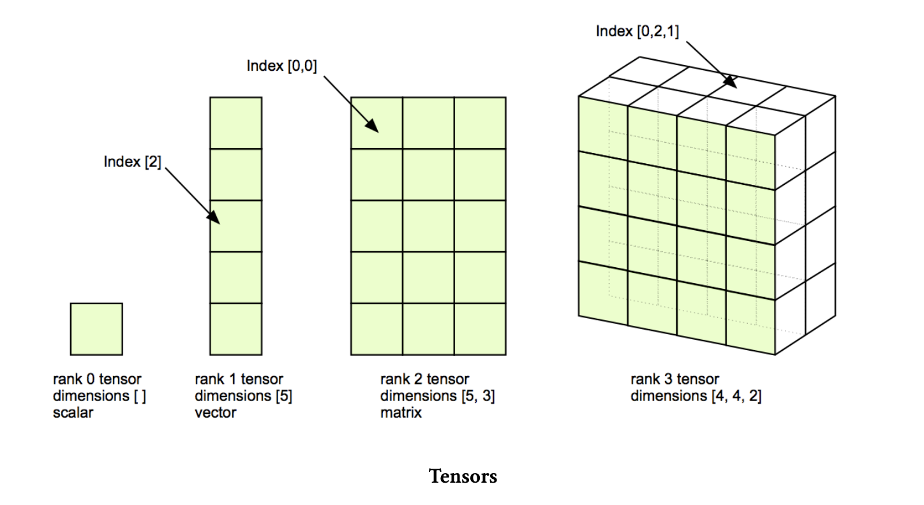

Slide 5

Indexing and Slicing a Tensor
Learn the key concepts of accessing, modifying, and slicing elements in a Tensor. This section will help you navigate your way through the Tensor structure.
1
Accessing Specific Elements
2
Indexing and Slicing
3
Modifying Tensor Elements

Slide 6
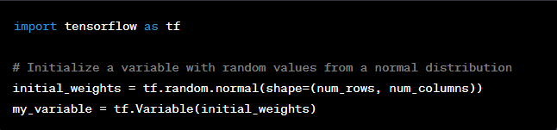
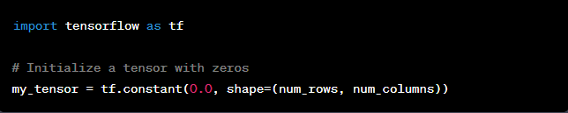
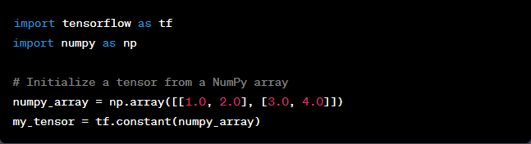
Accessing Specific Elements

Slide 7
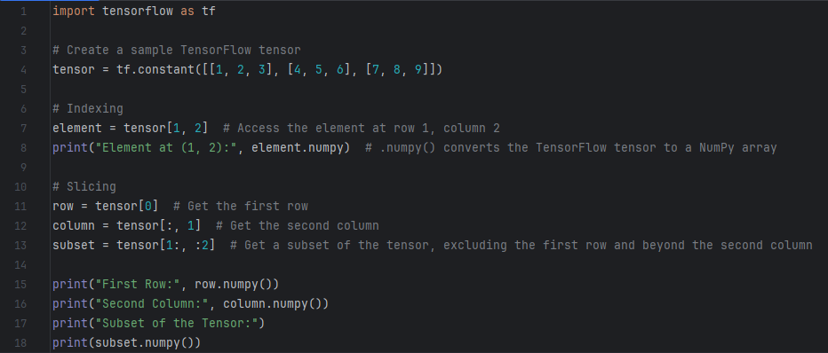
Indexing and Slicing

Slide 8
Reshaping a Tensor
Learn about the best practices and reasons for reshaping a Tensor to make the most out of your complex data. This section teaches you how you can change the shape of a Tensor.
Reasons for Reshaping Tensors
Changing the Shape of a Tensor
Reshaping Examples
Get hands-on experience with reshaping tensors through useful examples that demonstrate the power of this technique.
Understand the importance of reshaping a Tensor for better data visualization and easier comprehension of complex data structures.
Explore how to change the shape of a tensor using various techniques to fit different machine learning models.

Slide 9
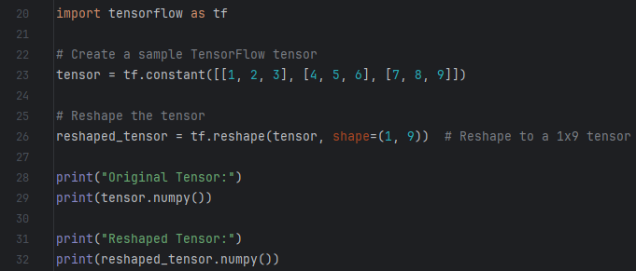
Reshaping

Slide 10

Writing Hello World in Tensorflow and Python
Get started with basic programming in TensorFlow. In this section, we will show you how to write a simple program in TensorFlow and run 'Hello World'.
1
Creating a Simple TensorFlow Program
Learn how to create a simple program in TensorFlow and how it can optimize your machine learning model.
2
Hello World in TensorFlow
Write your first TensorFlow program with 'Hello World'.
3
Running and Testing the Program
Test and run your program and prepare to explore more advanced programming in TensorFlow in the future.

Slide 11
Overview of the TensorFlow and Python Syntax
In this final section, we summarize what we have explored so far in terms of TensorFlow and Python syntax and conventions.
TensorFlow Syntax
Python Syntax
- Tensor initialization methods
- Variable initialization
- Accessing and slicing a Tensor
- Indexing and slicing in Python
- Reshaping a Tensor
- Reshaping arrays in Python

