Slide 1

Predictive Analysis

Slide 2
Goal
1. Get data from the database with the given credentials.
2. Perform Regression Analysis for the given data to identify how the money spent on Marketing, R&D, and Administration is affecting the company’s Profit. Predict the Profit for the below-given input features.
3. Visualize the data using Tableau /Power BI and derive insights about all the features provided and give your inputs/suggestions to the company.

Slide 3
Regression Analysis with Excel tool.
Equation of Model
Profit = (RD_Spend*0.8057) + (Administration*-0.0268) + (Marketing_Spend*0.0272) + 50122.1930

Slide 4
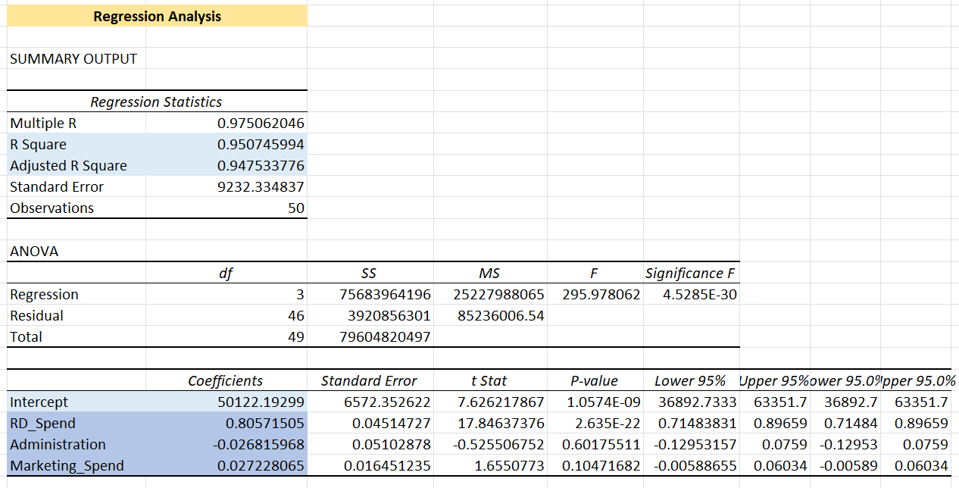

Slide 5
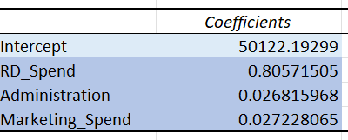
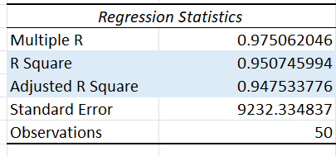
Intercept and Slope
Model Metrics

Slide 6
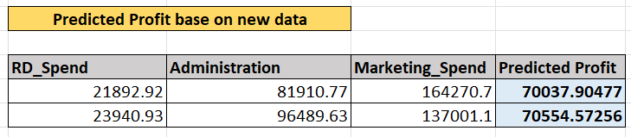
Prediction With Given data.

Slide 7
Visualise in Power BI tool.
With Interactive Matrix and Chart and table.

Slide 8
Overall Metrics.

Slide 9
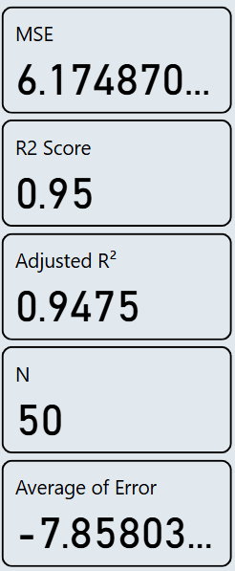
Model Performance Information.

Slide 10
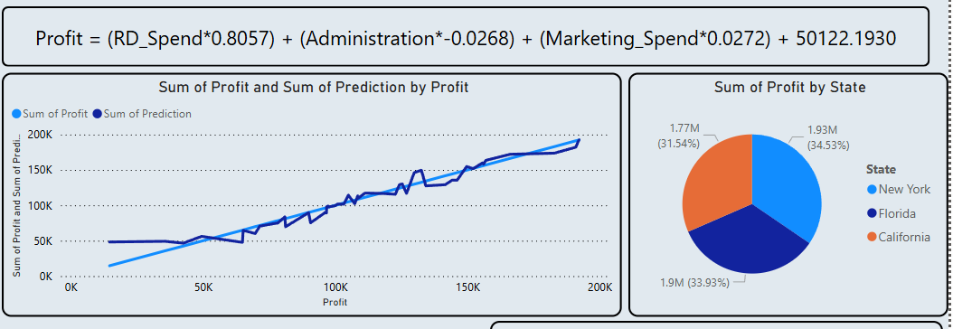
Equation,
Line chart for compare Actual and predicted Profit,
Bar chart for State wise contribution.

Slide 11
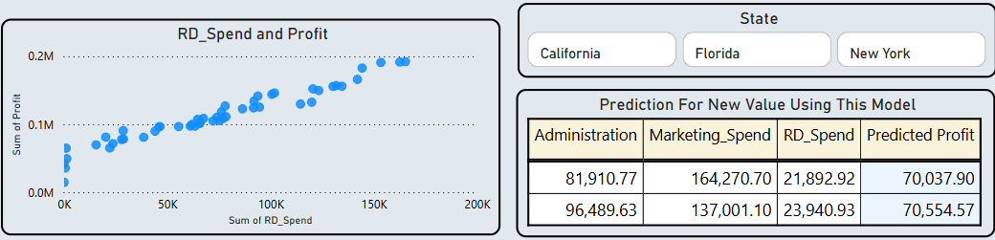
Slicer,
Scatter plot chart for compare two Features,
And Prediction show as table.

Slide 12
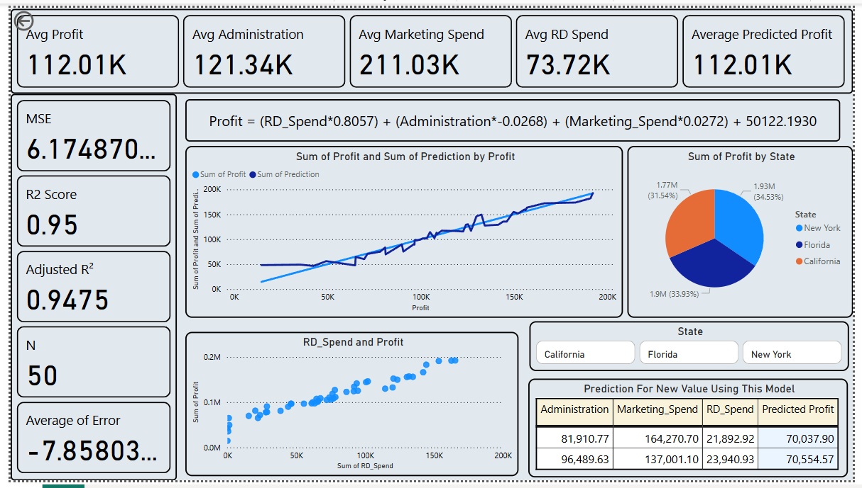

Slide 13
For Model Performance in Power BI
Write a DAX Query for Matrics:
1. MSE = POWER(AVERAGEX(Sheet1,(Sheet1[Profit]-Sheet1[Prediction])),2)
2. R2 Score = 1 - ([RSS]/[TSS]) RSS = SUMX(Sheet1,POWER(Sheet1[Profit]-Sheet1[Prediction],2))
TSS = SUMX(Sheet1,POWER(Sheet1[Profit]-AVERAGE(Sheet1[Profit]),2))
3. Adjusted R² = 1- (((1-[R2 Score])*([N]-1))/([N]-3-1))
4. N = COUNT(Sheet1[Profit])

Slide 14
Business Suggestions Based on Dashboard Insights
1. Increase Investment in R&D
R&D Spend has the highest positive impact on profit. Businesses should consider increasing their R&D budget to boost profitability.
2. Reevaluate Administration Costs
The negative coefficient for Administration suggests it may not be contributing positively to profit. Optimize or reduce administrative expenses.
3. Enhance Marketing Strategy
Marketing Spend has a small positive impact. Reevaluate the effectiveness of current marketing strategies and focus on high-ROI campaigns.
4. Focus on High-Performing States
New York contributes the highest portion of profit. Explore strategies to expand in similar high-performing regions.

