Slide 1

DOCKER
Internal Working

Slide 2
Say you want to build some Software
What all do you have to set up? Some of the following maybe :
Install the Runtime Environment for the executable
Set up Environment variables
Install and check all dependencies
Install and set up any services needed
Map and connect the ports for your Software API

Slide 3
Want to set it up somewhere else?
Try to repeat the process
It works on your machine, but doesn’t work here
Cry while trying to figure out what went wrong out of the several things that could have
What if there was a better way to go about this?

Slide 4
Introducing Containers
What if, you could package everything you software needed with it, and run it isolated from the system that it is on? That is the idea of containers.
A Container, from your Software’s perspective, is a entire computer, with all the dependencies, files, environment variables, ports, memory, etc. it needs.
From your (system’s) perspective, a container is just an area in the system which doesn’t know about the entire system, but using the same OS.
Just tell Docker what exactly your software needs, Docker saves this in an ‘Image’.
Voila! Now run a container using the Image, and your software runs the same everywhere.

Slide 5
Some Terminology
Related to Docker

Slide 6
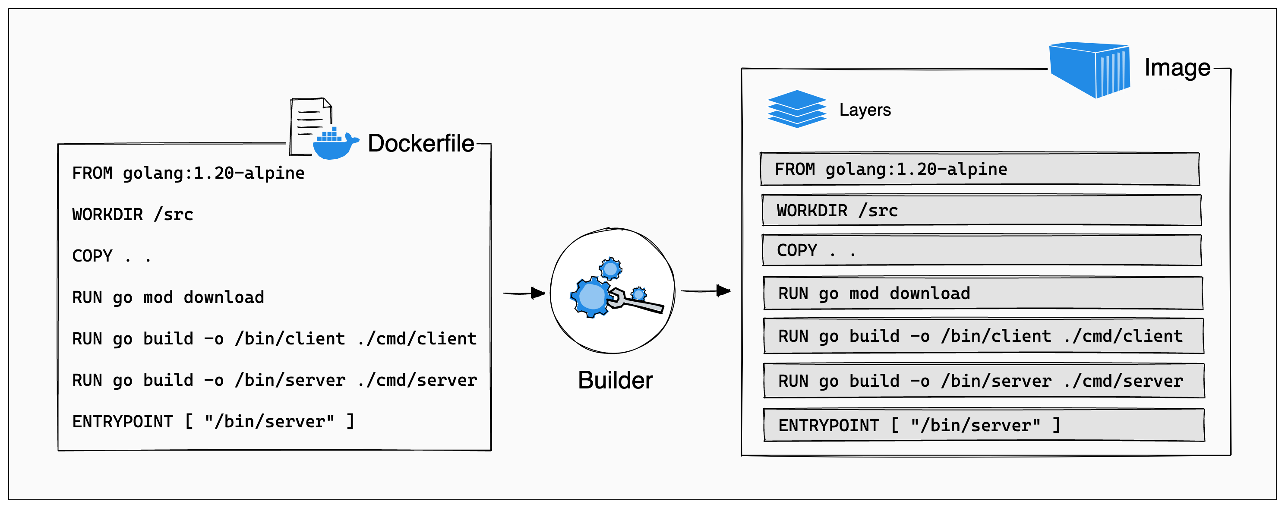
Image
Image is just the blueprint of a container. Docker builds Images layer by layer, using a Dockerfile. Multiple containers can be made from the same image.

Slide 7
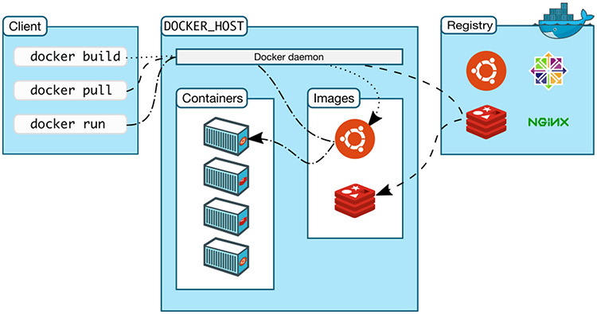
Docker Daemon and Client
Docker Client is the application that you interacts with, that takes input from the user. It then sends those to the Docker Daemon (dockerd).
The Docker Daemon is a background process that provides the actual functionality of Docker.

Slide 8
How are Containers made?
Features of the Linux Kernel

Slide 9
Processes
A running instance of some program is called a process.
The Kernel uses a scheduler to run hundreds of processes on limited number of processing units. It also decides how much resource to allocate to processes.
Processes have IDs (PIDs), can ask to create more processes, consume resources, and get information about the system.
The Operating System exposes primary memory to processes using Virtual Addresses, using which they can access only their memory.

Slide 10
Namespaces
Namespaces are a way to lie to processes about the System that they are on. The idea is that processes do not need, and shouldn’t have, access to everything on the system.
Using namespaces, you can restrict what resources processes can access, what information they know about the system, how they interact with other resources, etc.
There are several kinds of namespaces, used to control access to several things.

Slide 11
Types of Namespaces
UTS Namespace : Different Hostname
PID Namespace : Different Process IDs, independent of root PIDs
Net Namespace : Access to network resources, like ports
User Namespace : Maps users from one namespace to root namespace
Mount Namespace : Different Filesystem visible (like chroot())
IPC Namespace : Control how processes communicate with each other

Slide 12
Control Groups
Control Groups are used to group processes together, and control what and how much resources they can access.
For example, you can put PID 100 in one cgroup, PID 101 in another, assigning 10% of the CPU to each. Now even if PID 100 does something memory intensive, it would have to effect on PID 101.
Cgroups can also control access to network resources and secondary memory.

Slide 13
How is this related to a Container?
A Container is simply using all these namespaces and a Cgroup together, to group processes.
Cgroups are used to control resource allocation, while namespaces show it a different filesystem, different ports, hide other processes, so that you’re the process running within the container truly feels like it is running on its own computer.
Containers can be connected to each other using virtual ports. To the processes running on them, it is like connecting to another computer.

Slide 14
How does Docker achieve this?
Docker Runtime Ecosystem

Slide 15
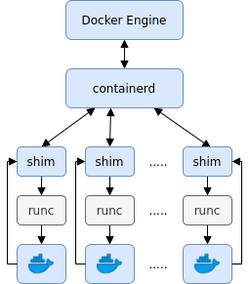
Docker is a collection of tools
The actual Docker engine provides more abstraction and better features, to make it easier for end users to create, manage, and deploy containers.
Actual low level features are delegated to other lower level programs. Dockerd doesn’t directly make syscalls.

Slide 16

CONTAINERD
Dockerd sends commands to containerd to manage containers.
It is a lower level runtime for containers.
Containerd manages the entire lifecycle of the container.
It provides features such as transferring Images, managing networks, etc,

Slide 17
RUNC
RUNC is the lowest level container runtime in Docker.
It is the program that actually accesses the low level features of the Kernel, using syscalls. It is the program that makes the calls to create namespaces and cgroups.
RUNC contains libcontainer, a library written in Go to manage containers.
Although RUNC creates and runs the containers, to allow for greater customizability by Docker, it exits after loading the container process.

Slide 18
CONTAINERD-SHIM
Containerd-shim is the software bridge between containerd and runc- containered loads containerd-shim, which as a daemon process loads runc, which loads the container process.
After runc exits, the containerd-shim daemon becomes the parent process of the container process. As such, it can reroute its standard iostreams to where Docker specifies. It can also report the exit code of the container after it stops.

