Slide 1
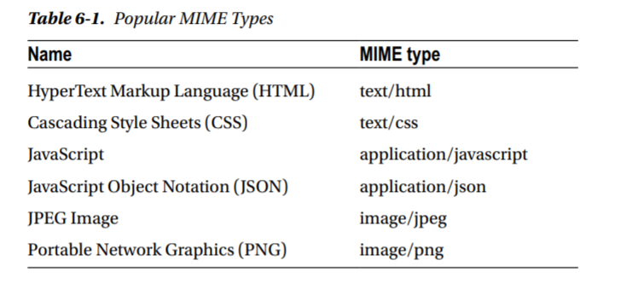

Slide 2
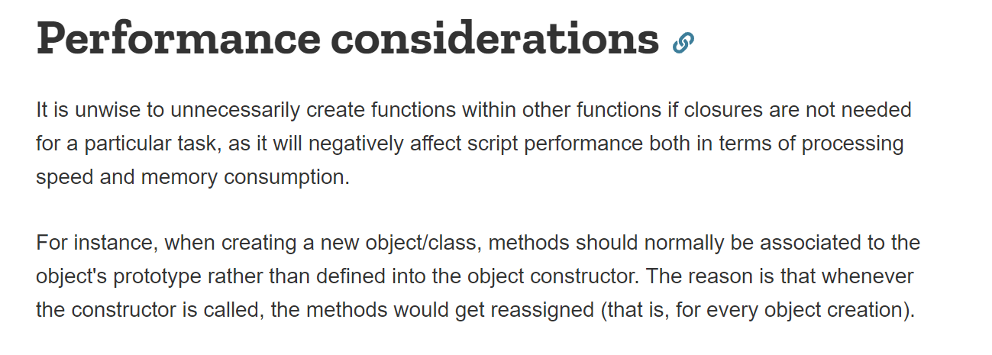

Slide 3
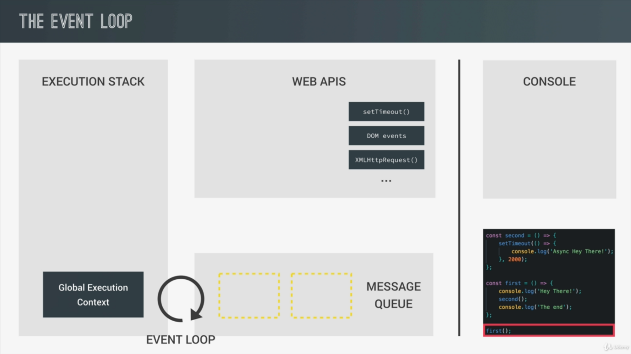

Slide 4
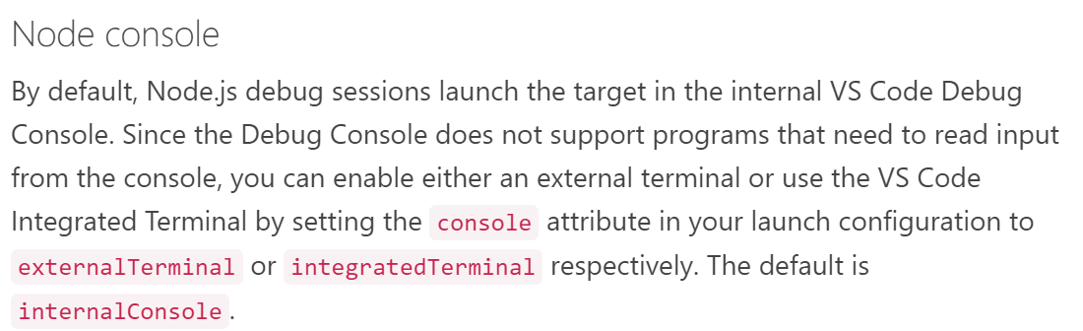

Slide 5
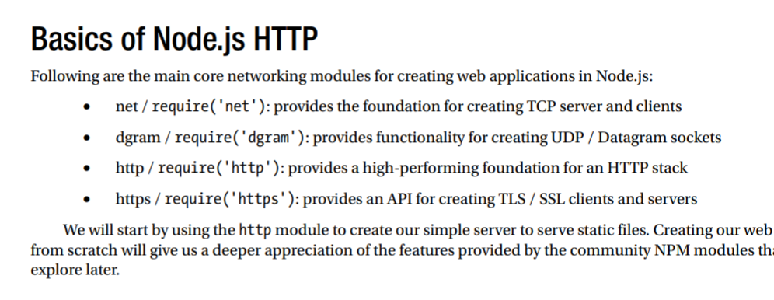

Slide 6
The user-agent is a line of text for identifying the browser you are using, its version number and some system details such as operating system, its version by the hosting web server. When a browser connects to a website, it will add the user-agent field inHTTP header for all the requests by default.

Slide 7


Slide 8
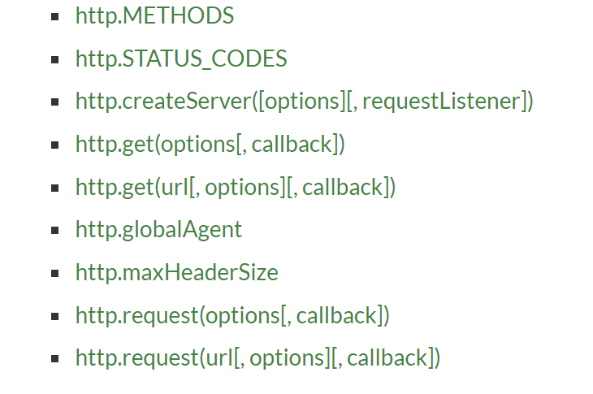
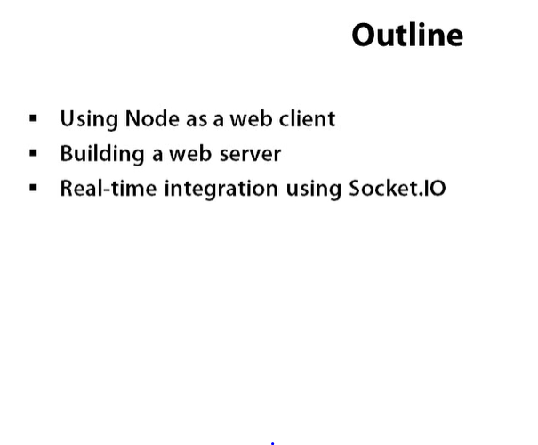

Slide 9
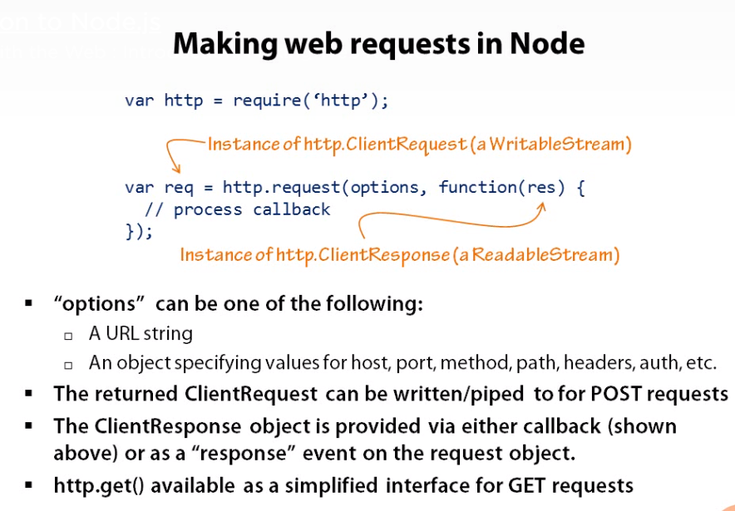

Slide 10
