Slide 1
Empirical Analysis of Union-Find Structures
John Sutton, Robert Morris, Nolan Schiek, Sawyer Blanchford

Slide 2
Motivation
Why Union-Find Matters
Union-Find tracks which items belong to the same group as the program runs
Essential for algorithms that build or analyze connected components
Appears in major areas:
  Kruskal's Minimum Spanning Tree Algorithm
  Image Labeling and Segmentation
  Percolation & Physics Simulations
  Network and Connectivity Analysis

Slide 3
Project Goal
Objective:
Compare two Union-Find implementations:
  List-Based Union-Find using linked lists
  Tree-Based Union-Find using parent pointers
    Includes enhancements like union-by-size, union-by-rank, and path compression
Goal:
Measure their empirical performance across multiple workloads and input sizes.

Slide 4
Union-Find: The Operations
The Three Basic Operations
MakeSet(x): creates a new group containing only x
Find(x): returns the "representative" or ID of the group x belongs to
Union(x, y): merges the two groups containing x and y
Correctness Requirements:
Representatives remain consistent
All nodes in a set eventually link to the same root/head

Slide 5
List-Based Union-Find
Representation:
  Each set stored as a linked list
  Weighted union:
    Move Smaller list -> Larger list
    find(x) = head[x] is O(1)
Expected Performance:
  Union(x, y) ≈ O(log(n)) amortized
  Total cost ≈ O(m + nlog(n))
Instrumentation:
  Parent pointer updates
  List movement counts

Slide 6
Tree-Based Union-Find
Representation:
  Parent pointer for each node
  Weighted union
  Path compression on finds
Expected Performance:
  O((n + m) α(n))
  α(n) ≤ 4 for all practical input sizes (inverse Ackermann)
  Effectively constant time
Instrumentation
  Parent pointer updates
  Maximum depth & depth distributions

Slide 7
Experiment Design
Different Workloads to Test the Structures
Random Workload (50% union / 50% find): Simulates average-case behavior
Random Workload (20% union / 80% find): Simulates more read-heavy scenarios
Inputs:
n ∈ {10k, 50k, 100k, 200k}
m ∈ {n, 5n, 10n}

Slide 8
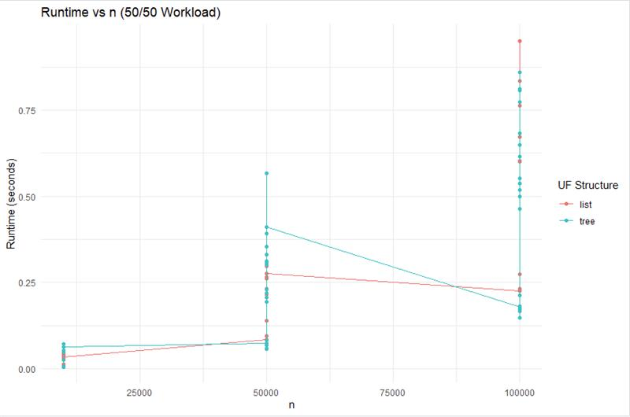
Runtime Results
Observations:
Tree-based UF stays nearly flat
List-based UF grows logarithmically
Gap widens as n increases

Slide 9
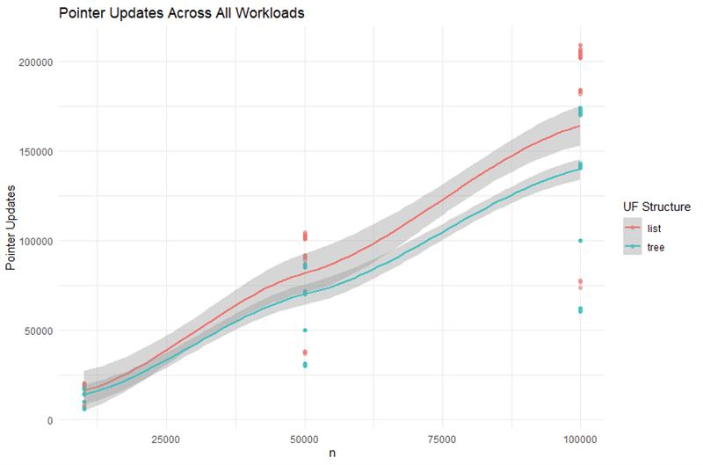
Pointer Update Results
Observations:
List-based pointer updates grow much faster
Tree-based updates remain small
Path compression eliminates repeated long walks

Slide 10
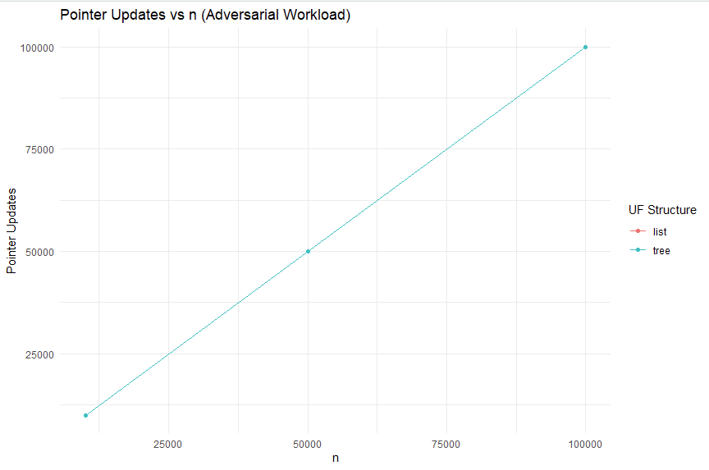
Adversarial Behavior
Adversarial Workload:
Sequential unions(0-1, 1-2, 2-3, …)
Forces deepest possible structure
Useful for exposing worst-case behavior
Results (Runtime):
List-Based UF becomes very slow
Tree-Based UF remains unaffected and fast
Path compression immediately flattens chains

Slide 11
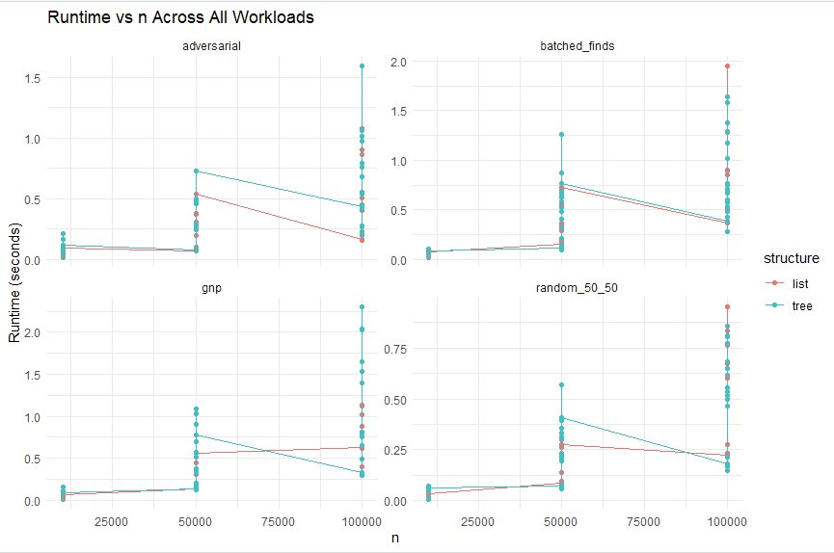
Application Benchmark: G(n, p)
Real-World Graph Workload:
Build connectivity structure in Erdős–Rényi G(n,p)
Perform random connectivity queries
Results:
Tree-based UF ≈ 2–3× faster
List-based UF slows noticeably as n increases
Both remain correct

Slide 12
Interpretation & Takeaways
What the experiments taught us
Tree-Based UF is effectively constant time under all tested workloadds
List-Based UF grows nearly exactly as theoretical analysis predicts
Path compression is the most important optimization
Union-by-rank vs union-by-size shows minimal differences
Empirical results line up extremely well with theory

Slide 13
Limitations & Future Work
Limitations:
Python overhead affects timings
No memory usage profiling
Adversarial pointer updates incomplete
Only one application benchmark tested
Future Work:
Implement different language versions
Add memory tracking
Evaluate more heuristics
Larger-scale experiments

Slide 14
Contributions & Questions
John Sutton – Produced graphs in R, interpreted results, prepared the final report and presentation.
Nolan Schiek – Interpreted results and findings, prepared the final report and presentation
Sawyer Blanchford - Produced code for experiments in Python, assisted in final report preparation
Robert Morris – Assisted in production of final report.

