Slide 1
Automatic Deceleration System
TEAM ALPHA
Basil Skaria
Eldhose K.A
Georgy M Rajan
Siddharth.S

Slide 2
Abstract
Traffic congestion is one of the major concerns in transportation sector. Increasing at a high pace, solutions and suggestions are introduced claiming lighter differences.
Productive changes in infrastructure of the modes of transport or any other related factors would currently have to develop at higher pace than that of the traffic.
A focus on controlling system brakes, aided by image recognition and data inheritance.
The vehicle a attached with a device that controls the system breaks based on the decision made by the image recogniser.

Slide 3
How the problem was identified
Inspired by the loading icon of Google Chrome (Ubuntu).
When a random vehicle signals a small sign of deceleration in a group of cars moving in circular motion, the car behind it slows by a small factor, the car behind that slows down with a greater value and this becomes a progression and eventually the car at the very back will be the slowest.
Translating this scenario to a straight chain of infinite length, the effect is similar.
This progressive deceleration causes traffic congestion!

Slide 4
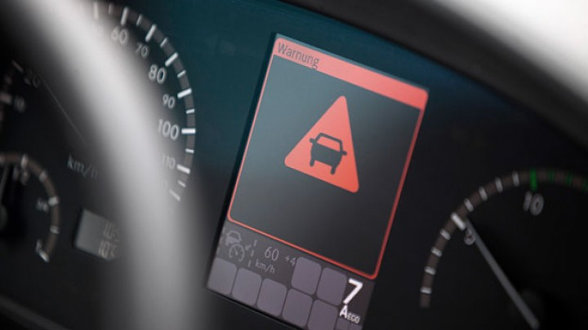
Strategy
Decelerate vehicle after Sign board detection.
Sign boards are considered as objects.
Triangle: Hazard , Circle: Notification.
Deceleration also takes place when Google maps shows speed limit of a particular road.
At Night, the deceleration is more sensitive to every sign board ( Hazard & Notification ).
Easily implemented on gearless vehicles, and method of engine braking is used for manual transmission vehicles.

Slide 5
Benefits
Less traffic is better than no traffic.
Gradual deceleration makes sure of efficient fuel usage.
Less Road Accidents

Slide 6
THANK YOU

