Slide 1

At.&T App
Avoid traffic.
&
Travel

Slide 2
Introduction
Traffic is increasing at a high pace and solutions are not catching up.
Solutions should be focussed on people’s mindset rather than improving the infrastructure and other related factors.
“At.&T” provides satisfactory solution and encourages people to switch over to lighter vehicles as it works on a reward based system.

Slide 3
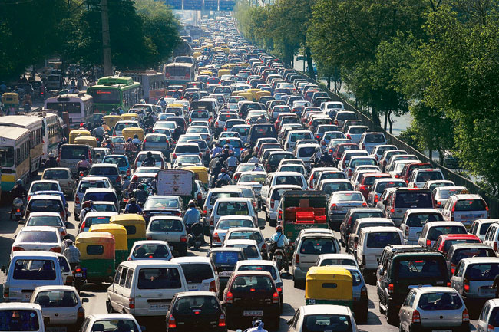
Traffic!...But how?
Luxury & Attitude
Improper Road Management
Less Usage of Public transport

Slide 4
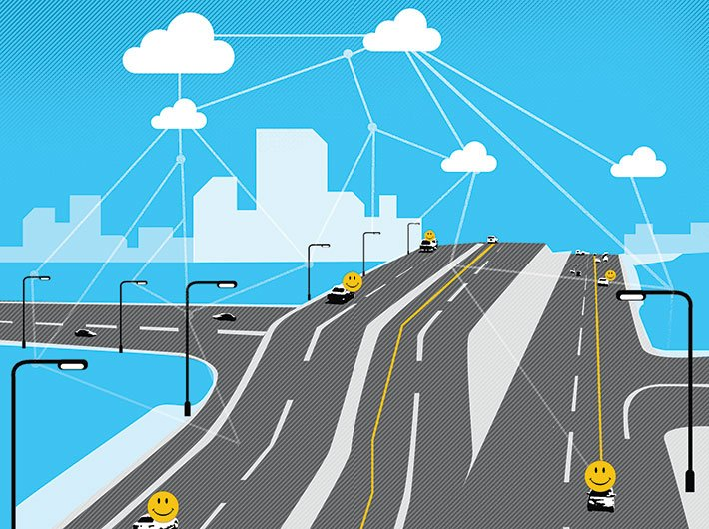
Solution
“At.&T” app
Works on Reward system
Centralized Monitoring

Slide 5
Features
Application is free but to avail offers, ioT package should be purchased
Centralized authority
Reward system
Smartphone independent device to be implemented soon

Slide 6
Working
In a family every person will be having the app installed on their smartphones.
The app monitors the no of persons travelling, route and vehicle.
The solution encourages only to use cars when more than 3 persons are travelling or if it is an unpleasant weather.
The monitoring activities takes place in the presence of the authority mentioned before.
If a person is picking up his/her family members, then he/she will broadcast a signal from the app to other member’s app.
Once they have been picked up, an acknowledgement signal will be issued to the authority.

Slide 7
Advantages
People using this app benefits credit points.
Decrease traffic because unwanted solo rides will be avoided.
Decrease fuel consumption.
Decrease pollution.
Decrease contribution to global warming.
Help solve crimes and monitor threats.

Slide 8
Disadvantages
Development is based on user’s attitude.
Limited internet access.

Slide 9
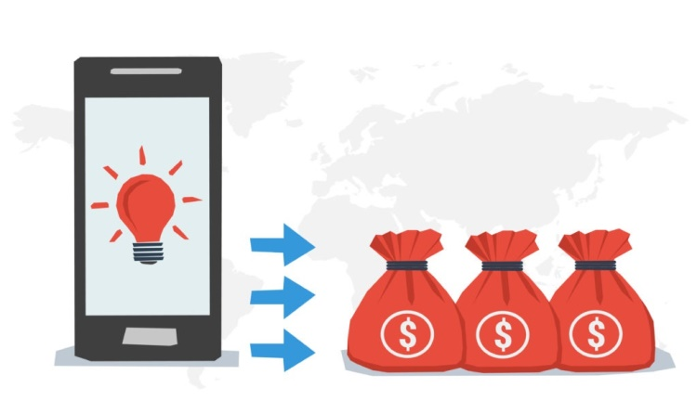
Monetizing Strategy
Each user who wishes to participate should invest a small fee.
Their investment grows as they dedicate themselves to save resources by following the simples suggestions the App provides.
The App can suggest Eco-products and other products which user can buy to increase their credits.

Slide 10
Thank You

