Slide 1
Team Alpha
Psychology Analysis

Slide 2
About us
We are Team Alpha. Our team consists of four members:
Basil Skaria
Georgy M Rajan
Siddharth S
Eldhose K A

Slide 3
Skills & expertise
User experience and User Interface
C,C++, Java,python, etc….
AI & Machine Learning
Formal Systems

Slide 4
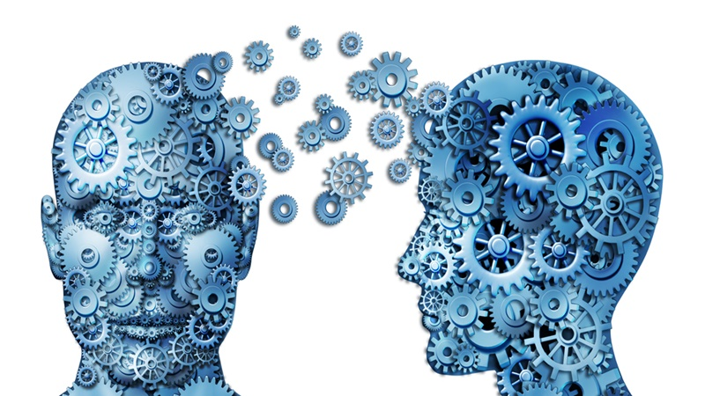
Psychology Assessment
A better way to manage and control ourselves.

Slide 5
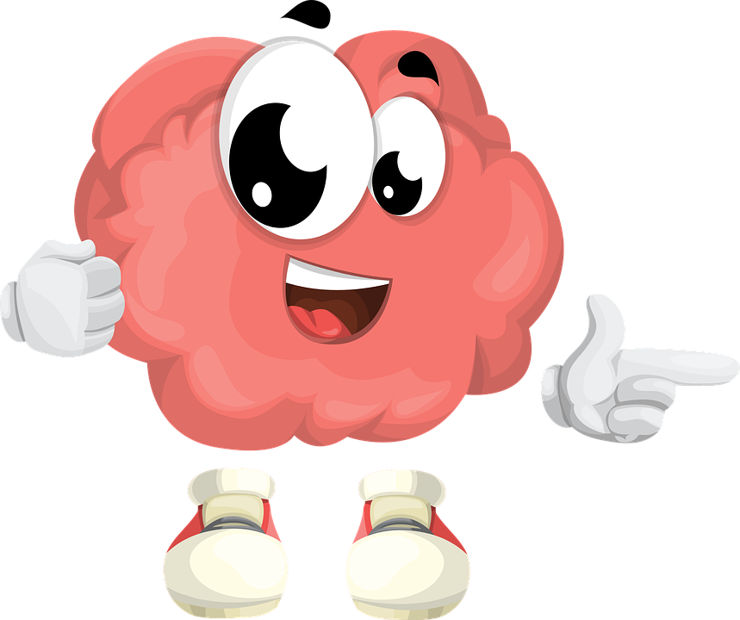
Why Psychology Assessment using Programming ?
The Human mind is one of the most complicated things that all great minds in the human history had come across and thus understanding it,its need and its patterns are another great challenge we face.
Traditionally we process and try to arrive at conclusions about how minds works from another mind and arrive at a state of complete hault because we can’t process that incredible junks of data to arrive at meaningful conclusions.

Slide 6
Data collection
Observe Body Language Cues
1. Pay Attention to Appearance
2. Notice Posture
3. Watch For Physical Movements
4. Real time Heart rate monitoring
5. Checking for excessive sweating
etc…..

Slide 7
Implementation
The videos and images of the person under study is to be collected and it is to be fed into an AI based

Slide 8
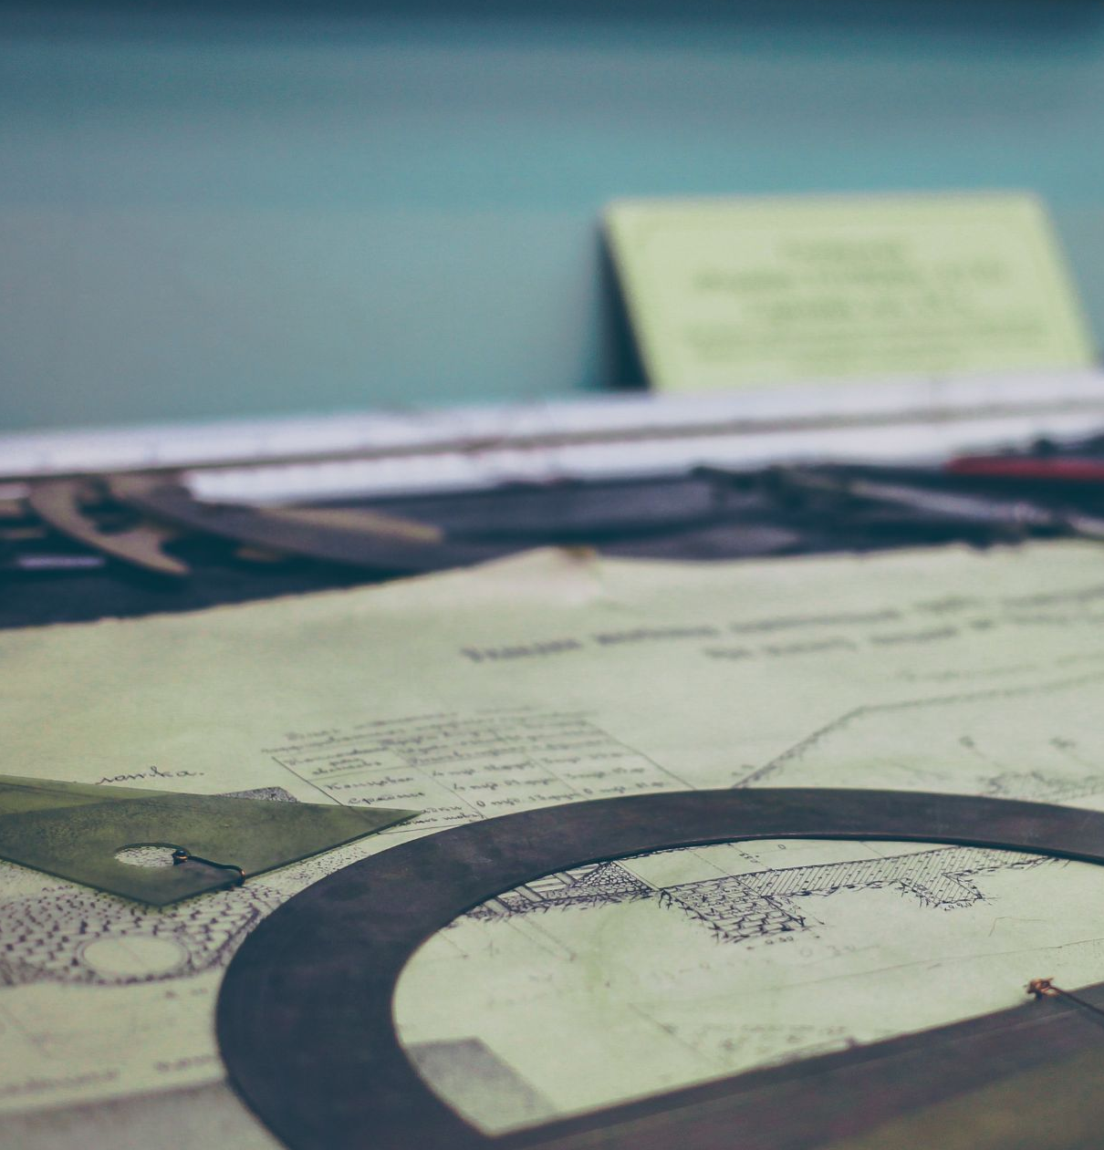




Slide 9

Contact
Your Name
no_reply@example.com
www.example.com

