Slide 1
EE219B
Logic Synthesis
R. K. Brayton
University of California
Berkeley
Spring 2000

Slide 2
Introduction
Motivation
Commercial success - used almost everywhere VLSI is done
But more general –
  Generally - discrete functions of discrete valued variables
Body of useful and general techniques
  can be applied to other areas

Slide 3
Applications
Foundation for
Combinational and sequential logic synthesis
Automatic test vector generation
Timing and false paths analysis
Formal verification
Asynchronous synthesis
Automata theory
Optimal clocking schemes
Hazard analysis
Power estimation
General combinatorial problems

Slide 4
Outline of Class
Class notes: (see class web page)
Introduction
  Logic functions and their representation
  Unate recursive paradigm,
  Two Level logic minimization (ESPRESSO)
  Quine McCluskey method
  Midterm
Multi-level logic synthesis
  Introduction (Boolean networks, factored forms)
  Division
  Simplification
    
  Testing
  Technology mapping
    Advanced technology mapping

Slide 5
Outline of Class
Multi-level logic synthesis (contd.)
  Delay analysis (true and false paths)
  Timing optimization
  Constant delay paradigm (sizing)
  midterm
Sequential logic synthesis
  Introduction (FSM networks)
  Retiming and resynthesis
  Asynchronous synthesis
  Node minimization?
  ** State minimization **
Final project presentations and report

Slide 6
The Boolean n-cube B^{n}
B = { 0,1}
B² = {0,1} X {0,1} = {00, 01, 10, 11}
B²
B¹
B⁰
B³
B⁴

Slide 7
Boolean Functions
f(x) : B^{n} B
B = {0, 1}, x = (x₁, x₂, …, x_{n})
x₁, x₂, … are variables
x₁, x₁, x₂, x₂, … are literals
each vertex of B^{n} is mapped to 0 or 1
the onset of f is {x|f(x)=1} =f ¹ = f ⁻¹(1)
the offset of f is {x|f(x)=0} =f ⁰ = f ⁻¹(0)
if f ¹ = B^{n}, f is the tautology, i.e. f ≡ 1
if f ⁰ = B^{n} (f ¹ = ∅), f is not satisfiable
if f(x) = g(x) for all x ∈B^{n}, then f and g are equivalent
We write simply f instead of f ¹

Slide 8
Literals
A literal is a variable or its negation
y, y
It represents a logic function
Literal x₁ represents the logic function f, where
f = {x| x₁ = 1}
f = x₁ f = x₁
x₁ x₁
Literal x₁ represents logic function g where
g = {x| x₁ = 0}

Slide 9
Boolean Formulas
Boolean formulas can be represented by formulas defined as catenations of
parentheses ( , )
literals x, y, z, x, y, z
Boolean operators + (OR), X (AND)
complementation, e.g. x + y
Examples
f = x₁ X x₂ + x₁ X x₂ = (x₁+x₂) X (x₁+x₂)
h = a + b X c = a X (b + c)
We usually replace X by catenation, e.g. a X b→ab

Slide 10
Logic functions
There are 2^{n} vertices in input space B^{n}
There are 2^{2n} distinct logic functions.
  Each subset of vertices is a distinct logic function:
f ⊆ B^{n}
111
000 1
001 0
010 1
011 0
100 ⇒ 1
101 0
110 1
111 0
x₃
“truth table”
000
x₂
x₁

Slide 11
Logic Functions
However, there are infinite number of logic formulas
  f = x + y
  = xy + xy + xy
  = xx + xy + y
  = (x + y)(x + y) + xy
Synthesis = Find the best formula (or “representation”)

Slide 12
Boolean Operations -
AND, OR, COMPLEMENT
f : B^{n} → B
g : B^{n} → B
AND - fg = h such that
  h = {x| f(x)=1 and g(x)=1}
OR - f + g = h such that
  h = {x| f(x)=1 or g(x)=1}
COMPLEMENT - f = h such that
  h = {x| f(x) = 0}

Slide 13
Cubes
The AND of a set of literal functions (“conjunction” of literals) is a cube
C = xy
is a cube
C = (x=1)(y=0)
z
y
x
x =1
y =0
xy

Slide 14
Cubes
If C ⊆ f, C a cube, then C is an implicant of f.
If C ⊆ B^{n}, and C has k literals, then |C| has
2^{n-k} vertices.
Example 1 C = x y ⊆ B³.
k = 2 , n = 3.
C = {100, 101}.
|C| = 2 = 2^{3-2.}
If k=n, the cube is a minterm.

Slide 15
Representation of
Boolean functions
The truth table of a function f : B^{n} → B is a tabulation of its value at each of the 2^{n} vertices of B^{n}.
For
  f = abcd + abcd + abcd + abcd + abcd + abcd + abcd + abcd
  the truth table is
  This is intractable for large n
  (but canonical)
  Canonical means that if two functions are the same, then the canonical representations of each are isomorphic.
abcd f
0 0000 0
1 0001 1
2 0010 0
3 0011 1
4 0100 0
5 0101 1
6 0110 0
7 0111 0
abcd f
8 1000 0
9 1001 1
10 1010 0
11 1011 1
12 1100 0
13 1101 1
14 1110 1
15 1111 1

Slide 16
Sum-of-Products Representation - SOP
A function can be represented by a sum of cubes (products):
f = ab + ac + bc
Since each cube is a product of literals, this is a “sum of products” representation
A SOP can be thought of as a set of cubes F
  F = {ab, ac, bc} = C
A set of cubes that represents f is called a cover of f. F={ab, ac, bc} is a cover of f = ab + ac + bc.

Slide 17
SOP
bc
Covers (SOP’s) can efficiently represent many logic functions (i.e. for many, there exist small covers).
Two-level minimization seeks the minimum size cover (least number of cubes)
= onset minterm
Note that each onset
minterm is “covered”
by at least one
of the cubes, and
covers no offset minterm.
ab
c
ac
b
a

Slide 18
Irredundant
Let F = {c₁, c₂, …, c_{k}} be a cover for f.
f = ∑_{i}^{k}₌₁ c_{i}
A cube c_{i}∈ F is irredundant if F\{c_{i}} ≠ f
Example 2: f = ab + ac + bc
bc
bc
Not covered
ab
ac
c
ac
b
F\{ab} ≠ f
a

Slide 19
Prime
A literal j of cube c_{i} ∈ F ( =f ) is prime if
(F \ {c_{i} }) ∪ {c’_{i} } ≠ f
where c’_{i} is c_{i} with literal j of c_{i} deleted.
A cube of F is prime if all its literals are prime.
Example 3
f = ab + ac + bc
c_{i} = ab; c’_{i} = a (literal b deleted)
F \ {c_{i} } ∪ {c’_{i} } = a + ac + bc
F=ac + bc + a =
F \{c_{i} } ∪ {c’_{i} }
bc
a
c
ac
b
Not equal to f since
offset vertex is covered
a

Slide 20
Prime and Irredundant Covers
Definition 1 A cover is prime (irredundant) if all its cubes are prime (irredundant).
Definition 2 A prime of f is essential (essential prime) if there is a minterm (essential vertex) in that prime but in no other prime.

Slide 21
Prime and Irredundant Covers
Example 4
f = abc + bd + cd is prime and irredundant.
abc is essential since abcd∈abc, but not in bd or cd or ad
Why is abcd not an essential vertex of abc?
What is an essential vertex of abc?
What other cube is essential? What prime is not essential?
abc
bd
c
b
a
d
cd

Slide 22
PLA’s - Multiple Output Boolean Functions
A PLA is a function f : B^{n} → B^{m} represented in SOP form:
f1
f2
f3
a
~b
c
d
a
b
~c
~d
n=4, m=3
a
~b
~c
d
a
~b
c
~d
a
~b
c
~d

Slide 23
PLA’s (contd)
Each distinct cube appears just once in the AND-plane, and can be shared by (multiple) outputs in the OR-plane, e.g., cube a~bc~d.
Extensions from single output to multiple output minimization theory are straightforward.
Multi-level logic can be viewed mathematically as a connection of single output functions.

Slide 24
Shannon (Boole) cofactors
Let f : B^{n} → B be a Boolean function, and x= (x₁, x₂, …, x_{n}) the variables in the support of f. The cofactor f_{a} of f by a literal a=x_{i} or a=x_{i} is
f_{xi} (x₁, x₂, …, x_{n}) = f (x₁, …, x_{i-1}, 1, x_{i+1},…, x_{n})
f_{xi} (x₁, x₂, …, x_{n}) = f (x₁, …, x_{i-1}, 0, x_{i+1},…, x_{n})

Slide 25
Shannon (Boole) Cofactor
The cofactor f_{C} of f by a cube C is just f with the fixed values indicated by the literals of C, e.g. if C=x_{i} x_{j}, then x_{i} =1, and x_{j} =0.
If C= x₁ x₄ x₆, f_{C} is just the function f restricted to the subspace where x₁ =x₆ =1 and x₄ =0.
As a function, f_{C} does not depend on x₁,x₄ or x₆
(However, we still consider f_{C} as a function of all n variables, it just happens to be independent of x₁,x₄ and x₆).
x₁f ≠ f_{x1}
Example: f= ac + a c , af = ac, f_{a}=c

Slide 26
Fundamental Theorem
Theorem 1 Let c be a cube and f a function. Then c ⊆ f ⇔ f_{c} ≡ 1.
Proof. We use the fact that xf_{x} = xf, and f_{x} is independent of x.
If: Suppose f_{c} ≡ 1. Then cf=f_{c}c=c. Thus,
c ⊆ f.
f
c

Slide 27
Proof (contd)
Only if. Assume c ⊆ f
Then c ⊆ cf = cf_{c}. But f_{c} is independent of literals l ∈ c. If f_{c} ≠1, then ∃ m ∈ B^{n}, f_{c}(m)=0.
Let m_{i}’=m_{i}, if x_{i}∉c and x_{i}∉c.
or if m_{i}=0, x_{i} ∈ c
or m_{i}=1, x_{i} ∈ c.
m_{i}’=m_{i} otherwise.
i.e. we make the literals of m’ agree with c, i.e. m’ ∈ c. But then f_{c}(m’) = f_{c}(m) = 0,
Hence, c(m’)=1
and f_{c}(m’) c(m’)= 0,
contradicting c ⊆ cf_{c}.
C=xz
m= 000
m’= 101
m’
m

Slide 28
End of Lecture 1

Slide 29
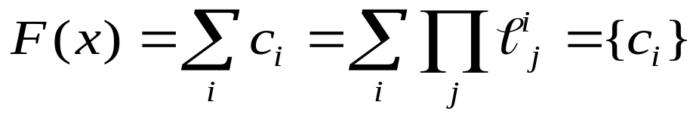
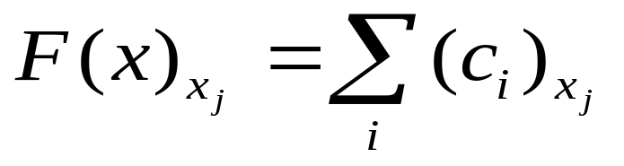
Cofactor of Covers
Definition 3 The cofactor of a cover F is the sum of the cofactors of each of the cubes of F.
Note: If F={c₁, c₂,…, c_{k}} is a cover of f, then F_{c}= {(c₁)_{c}, (c₂)_{c},…, (c_{k})_{c}} is a cover of f_{c}.
Suppose F(x) is a cover of f(x), i.e.
Then for 1≤j≤n,
is a cover of f_{xj}(x)

Slide 30
Definition 4 The cofactor Cx_{j} of a cube C
with respect to a literal x_{j} is
C if x_{j} and x_{j} do not appear in C
C\{x_{j}} if x_{j} appears positively in C, i.e. x_{j}∈C
∅ if x_{j} appears negatively in C, i.e. x_{j}∈C
Example 5
If C = x₁ x₄ x₆,
Cx₂ = C (x₂ and x₂ do not appear in C )
Cx₁ = x₄ x₆ (x₁ appears positively in C)
Cx₄ = ∅ (x₄ appears negatively in C)

Slide 31
Example 6
F = abc + bd + cd
F_{b} = ac + cd
(Just drop b everywhere and throw away cubes containing literal b)

Slide 32
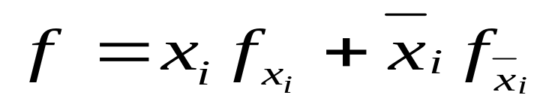
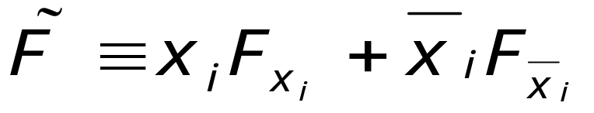
Shannon Expansion
f : B^{n} → B
Theorem 2
Theorem 3 F is a cover of f. Then
We say that f (F) is expanded about x_{i}. x_{i} is called the splitting variable.

Slide 33
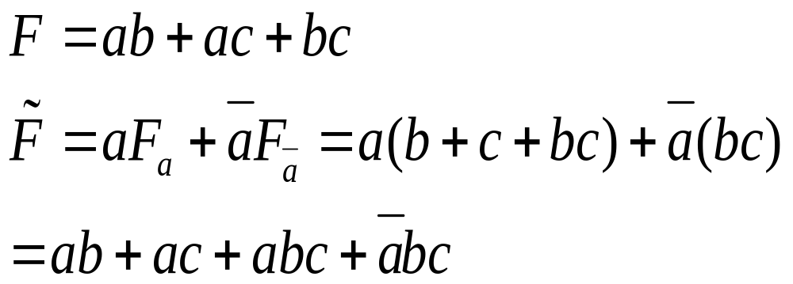
Example 7
=>
Cube bc got split into two cubes
bc
c
c
b
b
a
a

Slide 34
Cover Matrix
We sometimes use matrix notation to represent a cover:
Example 8 F = ac + cd =
a b c d a b c d
ac→ 1 2 1 2 or 1 - 1 -
cd→ 2 2 0 1 - - 0 1
Each row represents a cube. 1 means that the positive literal appears in the cube, 0 the negative. The 2 (or -) here represents that the variable does not appear in the cube. It also represents both 0 and 1 values.

Slide 35
Example 9
ac = 1 2 0 2 = {1, {0,1}, 0, {0,1}}
= {1000, 1100, 1001, 1101}
2 is sometimes called “input don’t care”, but this is confusing so we won’t use the term.

Slide 36
Incompletely Specified Functions
F = (f, d, r) : B^{n} → {0, 1, *}
where * represents “don’t care”. (Sometimes we use 2 in place of *)
f = onset function - f(x)=1 ↔ F(x)=1
r = offset function - r(x)=1 ↔ F(x)=0
d = don’t care function - d(x)=1 ↔ F(x)=*
(f,d,r) forms a partition of B^{n}. i.e.
f + d + r = B^{n}
fd = fr = dr = ∅ (pairwise disjoint)

Slide 37
A completely specified function g is a cover for F=(f,d,r) if
f⊆ g ⊆ f+d
(Thus gr = ∅). Thus, if x∈d (i.e. d(x)=1), then g(x) can be 0 or 1, but if x∈f, then g(x)=1 and if x∈r, then g(x)=0.
(We “don’t care” which value g has at x∈d)

Slide 38
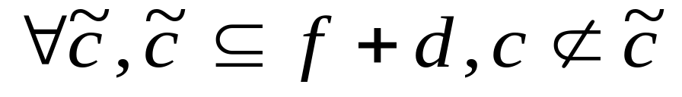
Primes of Incompletely Specified Functions
Definition 5 A cube c is prime of F=(f,d,r) if c⊆f+d (an implicant of f+d), and no other implicant (of f+d) contains c, i.e.
(i.e. it is simply a prime of f+d)
Definition 6 Cube c_{j} of cover F={c_{i}} is redundant if f⊆ F\{c_{j}}. Otherwise it is irredundant.
Note that c⊆f+d ↔ cr = ∅

Slide 39
Example:Logic Minimization
Consider F(a,b,c)=(f,d,r), where f={abc, abc, abc} and d ={abc, abc}, and the sequence of covers illustrated below:
F¹= abc + abc+ abc
Expand abc→a
on
off
F²= a+abc + abc
Don’t care
abc is redundant
a is prime
F³= a+abc
Expand abc → bc
F⁴= a+bc

Slide 40
Checking for Prime and Irredundant
Let G={c_{i}} be a cover of F=(f,d,r). Let D be a cover for d.
c_{i}⊆G is redundant iff
c_{i} ⊆(G\{c_{i}})∪D ≡ G^{i (1)}
(Since c_{i}⊆ G^{i} and f⊆G⊆f+d then c_{i} ⊆ c_{i}f+c_{i}d
and c_{i}f⊆ G\{c_{i}}. Thus f⊆ G\{c_{i}}.)
A literal l ∈ c_{i} is prime if (c_{i}\{ l }) ( = (c_{i})_{l} ) is not an implicant of F.
A cube c_{i} is a prime of F iff all literals l ∈ c_{i} are prime.
Literal l ∈ c_{i} is not prime ⇔ (c_{i})_{l} ⊆ f+d ⁽²⁾

Slide 41
Note: Both tests (1) and (2) can be checked by tautology:
(G^{i})_{ci} ≡ 1 (implies c_{i} redundant)
(F∪D)_{(ci)l} ≡ 1 (implies l not prime)

Slide 42
Example
F={abc, abc, abc}
D={ac}
R={ab,ac}
Expand abc → ab= (c_{i})_{l} = (abc)_{c}
Check ab ⊆ f+d ⇔ (f+d)_{ab} = 1
(f+d)_{ab} = c +c ≡ 1 OK
Expand ab → a. Check a ⊆ f+d
(f+d)_{a} = bc + bc +c ≡ 1 OK
F= a + abc + abc
Check if abc is redundant
abc ⊆ a+ abc + ac = F\{abc} ∪ D
(a+ abc + ac )_{abc} = 1 OK

Slide 43
Cover is now F = a + abc and D = ac
Check if abc is redundant
abc ⊆ a+ ac = F\{abc } ∪ D
(a+ ac )_{abc} =∅ NOT REDUNDANT

