Slide 1
Binary Recursion Tree
The recursive Shannon expansion corresponds to a binary recursion tree
Example:
Path π(v) to node v corresponds to cube c^{π(v)}
Example: c^{π(v)} = x₁ x₂ x₃
x
x₁
1
0
1
0
x₂
y
y
1
0
0
π(v)
1
0
1
x₃
1
0
v

Slide 2
Binary Recursion Tree
The root represents the original function f.
Each node v corresponds to f_{c}π(v).
If ever f_{c}π(v) = 1 or 0 we can terminate the tree and replace v by 1 or 0. Such a node v is a leaf.

Slide 3
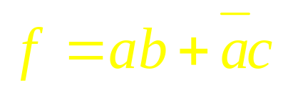
Example
Splitting variable
a
a
1
0
1
0
b
b
c
0
b
1
0
0
1
1
0
1
1
1
0
1
0
0
c
c
1
0
1
0

Slide 4
Implicit Enumeration -
Branch and Bound
Checking for tautology and many other theoretically intractable problems (co-NP complete) can be effectively solved using implicit enumeration:
use recursive Shannon expansion to explore B^{n.}
In (hopefully) large subspaces of B^{n}, prune the binary recursion tree by
  exploiting properties of the node function f_{c}π(v)
  exploiting heuristic bounding techniques
even though in the worst case the recursion tree may have 2^{n} nodes, in practice (in many cases), we typically encounter a linear number of nodes

Slide 5
Implicit Enumeration -
Branch and Bound
Thus we say that the 2^{n} min-terms of f have been implicitly enumerated
BDD’s (Binary Decision Diagrams) are alternate representations in which implicit enumeration is performed statically, and nodes with identical path cofactors are identified
(very important -- will discuss later!)

Slide 6
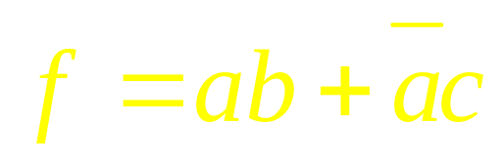
Example
Not a tautology. In testing for tautology, we look for a cube subspace c such that f_{c}=0. If we can find it then f is not the tautology.
a
1
0
b
b
f_{ab}
1
0
0
1
1
0
c
c
1
0
1
0

Slide 7
Can rule out complete cube subspace c’ if f_{c’}=1
Tautology can be proved by finding {c_{i}} such that Σ c_{i} = 1 and fc_{i} ≡ 1 for all c_{i}. We don’t need that c_{i} c_{j} =∅.
a
Means that f, in the subspace c’ = ac, is identically 1
1
0
b
C ‘
0
c
1
1
0
1
0
1
0

Slide 8
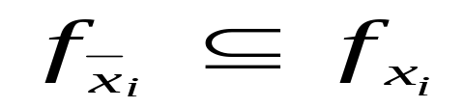
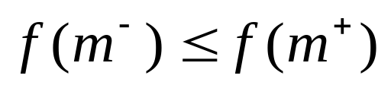
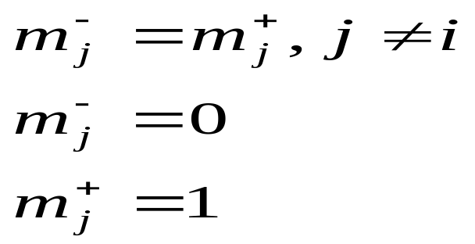
Definition 1 A function f : B^{n} → B is positive unate in variable x_{i} iff
This is equivalent to monotone increasing in x_{i}:
for all min-term pairs (m⁻, m⁺) where
For example, m⁻₃=1001, m⁺₃=1011(where i=3)

Slide 9
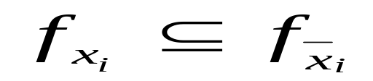
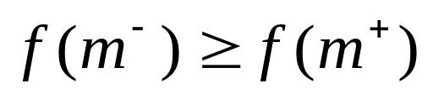
Similarly for
negative unate
monotone decreasing:
A function is unate in x_{i} if it is either positive unate or negative unate in x_{i}.
Definition 2 A function is unate if it is unate in each variable.
Definition 3 A cover f is positive unate in x_{i} iff ‾x_{i} ∉ c_{j} for all cubes c_{j}∈F

Slide 10
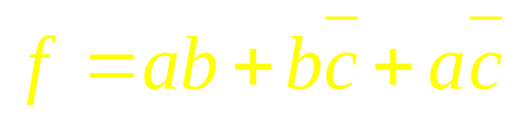
Example 1
m⁺
positive unate in a,b
negative unate in c
c
c
b
b
f(m⁻)=1 ≥ f(m⁺)=0
m⁻
a
a

Slide 11
The Unate Recursive Paradigm
In the EXPRESSO program, the key pruning technique is based on exploiting the properties of unate functions.
In particular, the splitting variable is chosen so that the functions at lower nodes of the recursion tree become unate.

Slide 12
Unate covers F have many extraordinary properties:
  If a cover F is minimal with respect to single-cube containment, all of its cubes are essential primes.
  In this case F is the unique minimum cube representation of its logic function.
  A unate cover represents the tautology iff it contains a cube with no literals, i.e. a single tautologous cube.
This type of implicit enumeration applies to many sub-problems (prime generation, reduction, complementation, etc.). Hence, we refer to it as the Unate Recursive Paradigm.

Slide 13
The Binate Select Heuristic
Tautology and other programs based on the unate recursive paradigm use a heuristic called BINATE_SELECT to choose the splitting variable in recursive Shannon expansion. The idea is for a given cover F, choose the variable which occurs, both positively and negatively, most often in the cubes of F.

Slide 14
The Binate Select Heuristic
Example 2 Unate and non-unate covers:
a b c d
G = ac+cd 1 2 1 2
2 2 1 0
a b c d
F = ac+cd+bcd 1 2 1 2
2 2 0 1
2 1 1 0
Choose c for splitting.
The binate variables of a cover are those with both 1’s and 0’s in the corresponding column.
In the unate recursive paradigm, the BINATE_SELECT heuristic chooses a (most) binate variable for splitting, which is thus eliminated from the sub-covers.
is unate
is not unate

Slide 15
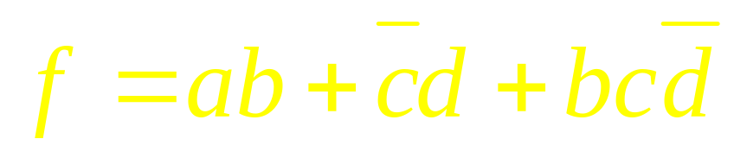
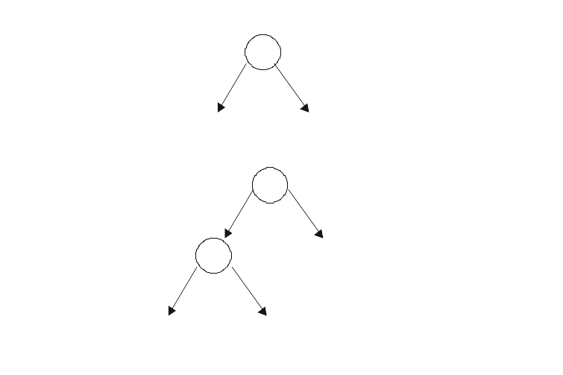
Examples
c
1
0
1 2 1 2
F=2 2 0 1
2 1 1 0
1222
2120
unate
2221
unate
F_{C}
F _{‾C}
c
1
0
12220
21201
22212
unate
1 2 1 2 0
F= 2 2 0 1 2
2 1 1 0 1
e
1
21202
unate
12222
unate

Slide 16
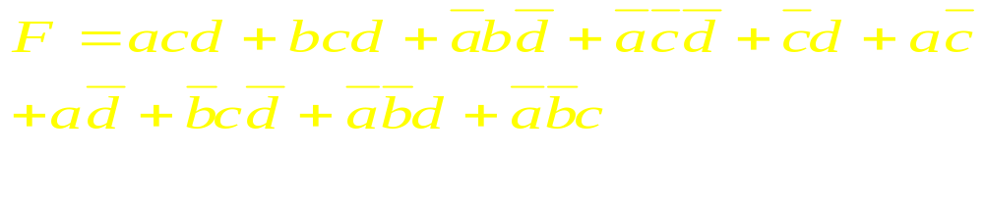
Tautology
Is F = 1? NOT EASY!!!
1211
2111
0120
0200
F= 2201 == 1?
1202
1220
2010
0021
0012

Slide 17
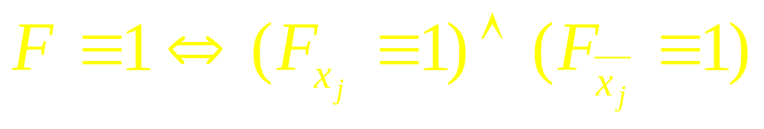
Two Useful Theorems
Theorem 1
Theorem 2 Let A be a unate cover matrix. Then A≡1 if and only if A has a row of all 2’s.
Proof:
If. A row of all 2’s is the tautology cube.
Only if. Assume no row of all 2’s. Without loss of generality, suppose function is positive unate. Then each row has at least one “1” in it. Consider the point (0,0,…,0). This is not contained in any row of A. Hence A≠1.

Slide 18
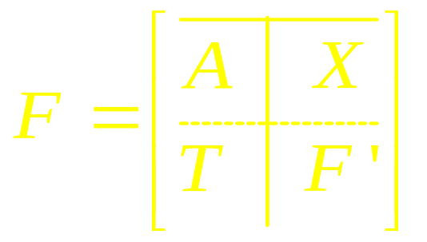
Unate Reduction of Tautology Checking
Let F(x) be a cover. Let (a,x’) be a partition of the variables x, and let
where
the columns of A correspond to variables a of x
T is a matrix of all 2’s.
Theorem 3 Assume A ≠1. Then F≡1 ⇔ F’≡1

Slide 19
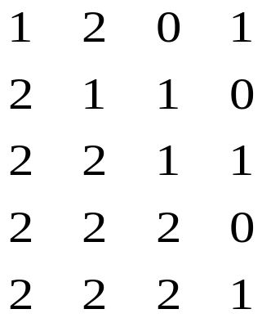
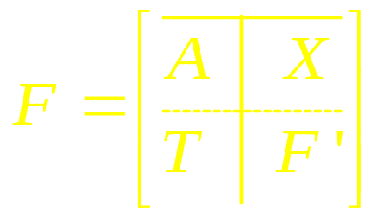
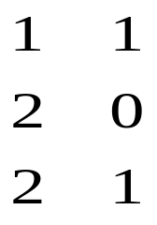
Example 3
=

Slide 20
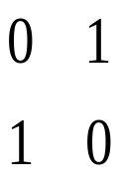
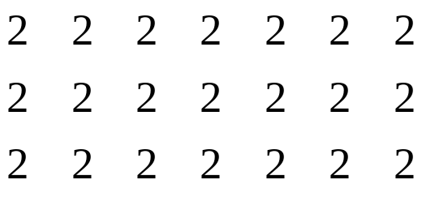
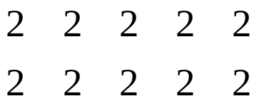
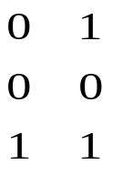
Unate Reduction
A₁
B₁
Result: Only have to look at D1 to test if this is a tautology.
Note: A₁, A₂ has no row of all 2’s. Hence is a unate cover. Hence (A₁, A₂)≠1
C₁
C₂
D₁
A₂
B₂

Slide 21
End of Lecture 2

Slide 22
Proof
A≠1
T=2’s
Theorem 1 Assume A ≠1. Then F≡1⇔F’≡1
Proof: [if]: Assume F’≡1. Then we can replace F’ by all 2’s. Then last row of F becomes a row of all 2’s, so tautology.

Slide 23
Proof (contd)
[Only if]: Assume F’ ≠1. Then there is a minterm m₂ such that F’(m₂)=0, i.e. m₂∉cube of F’. Similarly, m₁ exists where A(m₁)=0, i.e. m₁∉cube of A. Now the minterm (m₁,m₂) in the full space satisfies F(m₁,m₂)=0 since m₁m₂ ∉AX and m₁m₂∉TF’.
(a, x’) is any row of first part
a(m₁) ^ x’(m₂)=0 ^ x’(m₂)=0
(t,f’) is any row of the last part t(m₁) ^ f’(m₂)=t(m₁) ^ 0 = 0
So m₁m₂ is not in any cube of F.

Slide 24
Unate Reduction for Tautology
Procedure TAUTOLOGY(F, C)
// C is a cube returned if F ≠1. Then C
// contains a minterm m where F(m)=0
T ← SPECIAL_CASES(F)
if (T ≠-1) return T
F ← UNATE_REDUCTION(F)
if (F=∅) print C; return 0;
j ← BINATE_SELECT(F)
T← TAUTOLOGY(F_{xj} , C∪ {x_{j} }
if(T=0) print (C∪ {x_{j} }), return 0
T← TAUTOLOGY(F_{xj} , C ∪{x_{j} }
if(T=0) print (C∪ {x_{j} }), return 0
return 1
end

Slide 25
Unate Reduction for Tautology
Notes.
T=1(0) if F is a tautology (is empty), else T=-1
SPECIAL_CASES: (T=-1 unless)
T=1 : F contains a cube with no literals (all 2’s)
T=0 : F contains same literal in every cube
T=0 if number of minterms in onset is < 2^{n}

Slide 26
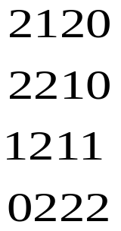

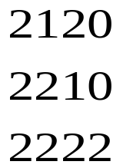
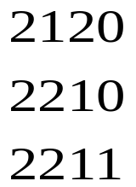
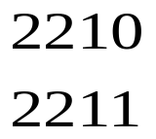
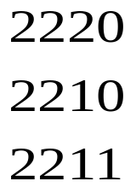


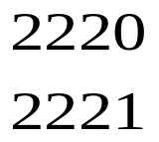
Unate reduction
No tautology(case 2)
~x1
x1
tautology(case 1)
~x2
x2
No tautology(case 2)
~x3
No tautology(case 2)
x3
x4
tautology(case 1)
~x4
tautology(case 1)

Slide 27
Unate Recursive Paradigm
Create cofactoring tree stopping at unate covers
  choose, at each node, the “most binate” variable for splitting
  recurse till no binate variable left (unate leaf)
“Operate” on the unate cover at each leaf to obtain the result for that leaf. Return the result
At each non-leaf node, merge (appropriately) the results of the two children.
Main Idea “Operation” on unate leaf is easy
Operations: complement, simplify,tautology,generate-primes,...
a
b
c
merge

Slide 28
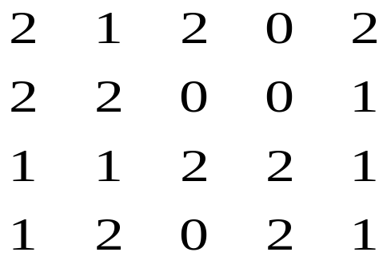
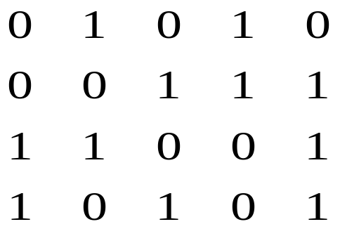
Operations on a Unate Cover:
Complement
Map cube matrix M into Boolean matrix B
a b c d e
= B
Thus non-2 1
2 0

Slide 29

Complement of a Unate Cover
Find all minimal column covers of B. (A column cover is a set of columns J such that for each row i, ∃j∈J such that B_{ij} = 1)
Example 4 {1,4} is a minimal column cover for
All rows “covered” by at least one 1.

Slide 30
Complement of a Unate Cover
For each minimal column cover create a cube with opposite column literal from M.
Example 5 {1,4} ad is a cube of f

Slide 31
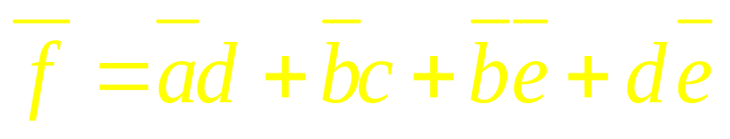
Complement of a Unate Cover
The set of all minimal column covers = cover of ‾f.
Example 6
{(1,4), (2,3), (2,5), (4,5)} is the set of all minimal covers. This translates into:

Slide 32
Unate Complement Theorem
Theorem 4 Let M be a unate cover of f. The set of cubes associated with the minimal column covers of B_{M} is a cube cover of‾f.
Proof. We first show that any such cube c generated is in the offset of f, by showing that the cube c is orthogonal (has empty intersection) with any cube of M. Note, the literals of c are the complemented literals of M. (Since M is a unate cover, the literals of M are just the union of the literals of each cube of M). For each cube m_{i}∈M, ∃j∈J such that B_{ij}=1. (J is the column cover associated with c). Thus, (m_{i})_{j}=x_{j}⇒ c_{j}= ‾x_{j} and (m_{i})_{j}= ‾x_{j} ⇒ c_{j}=x_{j}. Thus m_{i}c = ∅. Thus c ⊆ ‾f .

Slide 33
We now show that any minterm μ∈‾f is contained in some cube c generated. First μ must be orthogonal to each cube of M. So for each row of M, there is at least one literal of μ that conflicts with that row. The union of all columns (literals) where this happens is a column cover of B_{M}; hence this union contains at least one minimal cover and the associated cube contains μ.

Slide 34
Complement of a Unate Cover
The set of all minimal column covers = cover of ‾f.
Example 6
M=
{(1,4), (2,3), (2,5), (4,5)} is the set of all minimal covers. This translates into:
‾f =‾ad +‾bc +‾b‾e +d‾e
A minimal column cover is (1,4) ‾ad
‾ad f =b‾d +‾c‾d + abe +a‾c e
B_{M}

Slide 35
Consider min-term ‾abcd‾e ∈‾f . It conflicts in literals ‾a,c,d,‾e . Thus {1,3,4,5} is a column cover. It contains {1,4} and {4,5}. Thus
‾abcd‾e ∈‾ad∈ d‾e

Slide 36
Unate Covering
Definition 4 The problem, given a Boolean matrix B, find a minimum column cover, is called a unate covering problem.
The problem of unate complementation was our first example of the unate covering problem and we will see it often in this course.
Unate Covering Problem:
Given B, B_{ij}∈{0,1} find x, x_{i}∈{0,1} such that
Bx≥1
and Σ_{j} x_{j} is minimum.
Sometimes we want to minimize
Σ_{j} c_{j}x_{j}
where c_{j} is a cost associated with column j.

Slide 37
Quine-McCluskey Procedure
(Exact)
Given G’ and D (covers for F = (f,d,r) and d), find a minimum cover G of primes where:
f ⊆ G ⊆ f+d
(G is a prime cover of F )
Q-M Procedure
  1. Generate all the primes of F , {P_{j}} (i.e. primes of (f+d)=G’+D)
  2. Generate all the minterms of f=G’‾D, {m_{i}}
  3. Build Boolean matrix B where
  B_{ij} = 1 if m_{i}∈ P_{j}
  = 0 otherwise
  4. Solve the minimum column covering problem for B (unate covering problem)

Slide 38
Difficulty
Note: Can be
~ 2^{n} minterms
~ 3^{n}/n primes
Thus O(2^{n}) rows and O(3^{n}/n ) columns AND minimum covering problem is NP-complete. (Hence can probably be double exponential in size of input, i.e. difficulty is O(2^{3n})
primes
3^{n}/n
0
1
minterms
2^{n}
0
0
0
1

Slide 39
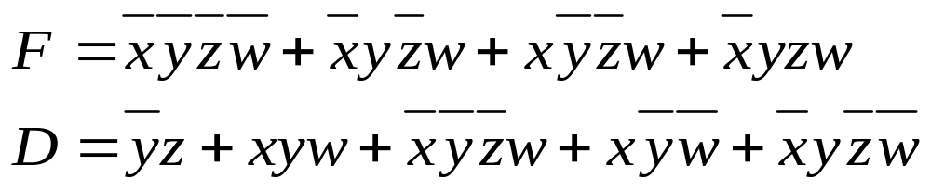
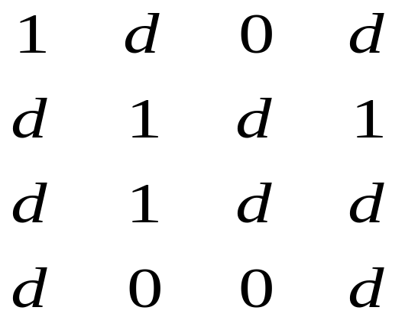
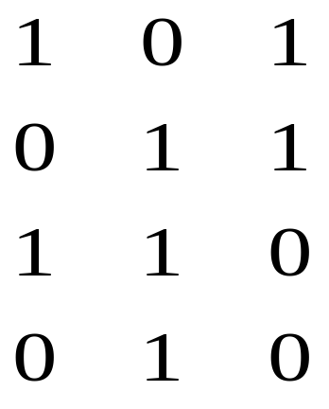
Example 8
Primes: ‾y + w + ‾x‾z
Covering Table
Solution: {1,2} ⇒ ‾y + w is minimum prime
cover. (also w+ ‾x‾z)
‾x‾z
‾x‾y
‾xy
xy
x‾y
y
‾z‾w
Karnaugh map
‾zw
w
zw
‾y
w
‾x‾z
z‾w
‾x‾y‾z‾w
‾xy‾zw
x‾y‾zw
‾xyzw

Slide 40
Covering Table
Primes of f+d
Definition 5 An essential prime is any prime that uniquely covers a minterm of f.
‾y
w
‾x‾z
‾x‾y‾z‾w
Minterms of f
‾xy‾zw
x‾y‾zw
Row singleton
(essential minterm)
‾xyzw
Essential prime

Slide 41
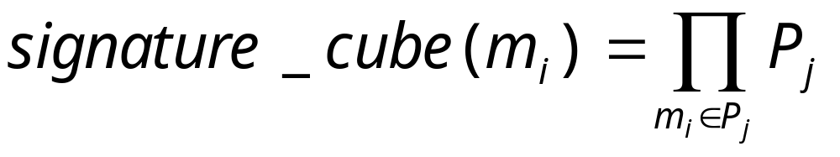
Covering Table
Row Equality: In practice, many rows are identical. That is there exist minterms that are contained in the same set of primes.
m₁ 0101101
m₂ 0101101
Any row can be associated with a cube -- called the signature cube.
e.g. m₁ ∪ m₂ ⊆ P₂P₄P₅P₇

Slide 42
Row and Column Dominance
Definition 6 A row i₁ whose set of primes is contained in the set of primes of row i₂ is said to dominate i_{2.}
Example 9
i₁ 011010
i₂ 011110
i₁ dominates i₂
We can remove row i₂ , because we have to choose a prime to cover i₁, and any such prime also covers i₂. So i₂ is automatically covered.

Slide 43
Row and Column Dominance
Definition 7 A column j₁ whose rows are a superset of another column j₂ is said to dominate j_{2.}
Example 10
j₁ dominates j₂
We can remove column j₂ since j₁ covers all those rows and more. We would never choose j₂ in a minimum cover since it can always be replaced by j₁.
j₁ j₂
1 0
0 0
1 1
0 0
1 1

Slide 44
Pruning the Covering Table
1. Remove all rows covered by essential primes (columns in row singletons). Put these primes in the cover G.
2. Group identical rows together and remove dominated rows.
3. Remove dominated columns. For equal columns, keep one prime to represent them.
4. Newly formed row singletons define n-ary essential primes.
5. Go to 1 if covering table decreased.
The resulting reduced covering table is called the cyclic core. This has to be solved (unate covering problem). A minimum solution is added to G - the set of n-ary essential primes. The resulting G is a minimum cover.

Slide 45
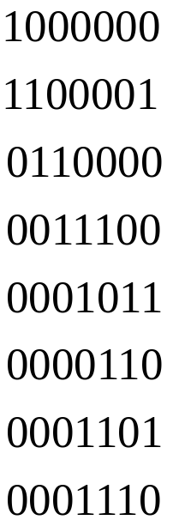
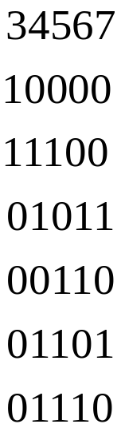
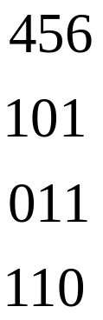
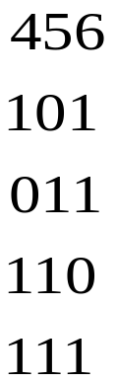
Example
Essential Prime and
Column Dominance
G=P1
n-ary Essential Prime
and
Column Dominance
G=P1 + P3
Cyclic
Core
Row dominance

Slide 46
Solving the Cyclic Core
Best known method (for unate covering) is branch and bound with some clever bounding heuristics.
Independent Set Heuristic:
Find a maximum set of “independent” rows I. Two rows B_{i1} ,B_{i2} are independent if ∃j such that B_{i1j} =B_{i1j}=1. (They have no column in common)
Example 11 Covering matrix B rearranged with independent sets first.
1
1
1
B=
1
0
Independent set = I
of rows
1
1
1
1
1
A
C

Slide 47
Lemma 1
|Solution of Covering| ≥ |I|
1
1
1
1
0
1
1
1
1
1
A
C

Slide 48
Heuristic
1
1
1
1
0
1
1
1
1
1
A
C
Let I={I₁, I₂, …, I_{k}} be the independent set of rows
choose j ∈ I_{i} which covers the most rows of A. Put j → J
eliminate all rows covered by column j
I ← I\{I_{i}}
go to 1 if |I| > 0
If B is empty, then done (in this case we have the guaranteed minimum solution - IMPORTANT)
If B is not empty, choose an independent set of B and go to 1
Can you think of some improved heuristics?

Slide 49
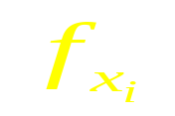


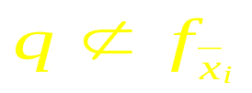
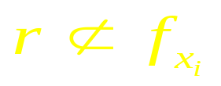
Generating Primes
We use the unate recursive paradigm. The following is how the merge step is done. (Assumption: we have just generated all primes of and .)
Theorem 5 p is a prime of f iff p is maximal among the set consisting of
P = x_{i}q, q is a prime of ,
P = x_{i}r, r is a prime of ,
P = qr, q is a prime of , r is a prime of

Slide 50
End of lecture 3

Slide 51
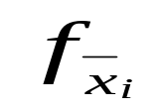

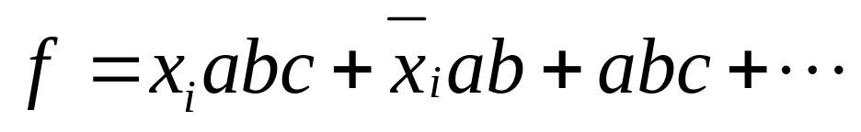
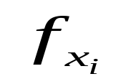
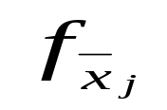
Generating Primes
Example 12 Assume q = abc is a prime of .
Form p=x_{i}abc. Suppose r=ab is a prime of .
Then is an implicant of f
Thus abc and x_{i}ab are implicants, so x_{i}abc is not prime.
Note: abc is prime because if not, ab ⊆ f_{x} (or ac or bc) contradicting abc prime of
Note: x_{i}ab is prime, since if not then either ab ⊆ f or x_{i}a ⊆ f . The first contradicts abc prime of and the second contradicts ab prime of

Slide 52
New Exact Methods
For 40 years, Q-M method remained basically unchanged. In 1992, two fundamentally new methods developed:
McGeer’s Method (McGeer, Sanghavi, et al)
  generate all essential signature cubes (ESC)
  (if c is a cube, σ( c ) is the intersection of all primes containing c; an essential signature cube is a maximal cube of {σ(m_{i})} where m_{i} is a minterm of the onset.)
  generate only those primes that contain an essential signature cube (ESP)
  form covering tables ESC vs ESP and solve. (This initial covering table is like the original with a single step of row and column dominance)
Note: Covering table is smaller, of size
|ESC| x |ESP|

Slide 53
New Exact Methods
Implicit Q-M based on BDD’s (Coudert and Madre, McGeer, Swamy, Brayton)
  form characteristic BDD of all primes
  form characteristic BDD of all minterms of f (F=(f,d,r))
  formulate row dominance and column dominance elimination as BDD operations
  iterate dominance and prime/minterm elimination until no further decrease
  generate covering table (cyclic core at this point) and solve

Slide 54
New Exact Methods
GREAT RESULTS!
In both cases, superior to ESPRESSO-EXACT (both in speed and in number of problems solved)
ESPRESSO has a suite of about 130 examples, of which ESPRESSO-EXACT can solve about 110. The others solve almost all of the 130.

