Slide 1
Timing Closure and the constant delay paradigm
Problem: (timing closure problem)
It has been difficult to get a circuit that meets delay requirements because of inaccuracies in delay models and wire load estimates.
Iteration between logic synthesis and layout does not converge
Solution: (sizing)
Get good circuit by logic synthesis
Lay it out and get good numbers on wire loads.
Size each gate to
  Meet timing constraints
  Use as little area as possible

Slide 2
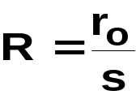



Timing Closure and the constant delay paradigm
Single buffer
delay model:
Assumptions:
Transistor modelled as an effective resistance inversely proportional to device width
  R = r₀/s
Discharge network modelled as a linear capacitance composed of constant part C_{L} and device dependent part, C_{p} = sc_{p}
Gate delay approximated by summing R_{i}C_{i} over all nodes where R_{i} represents the total resistance between node i and the output

Slide 3
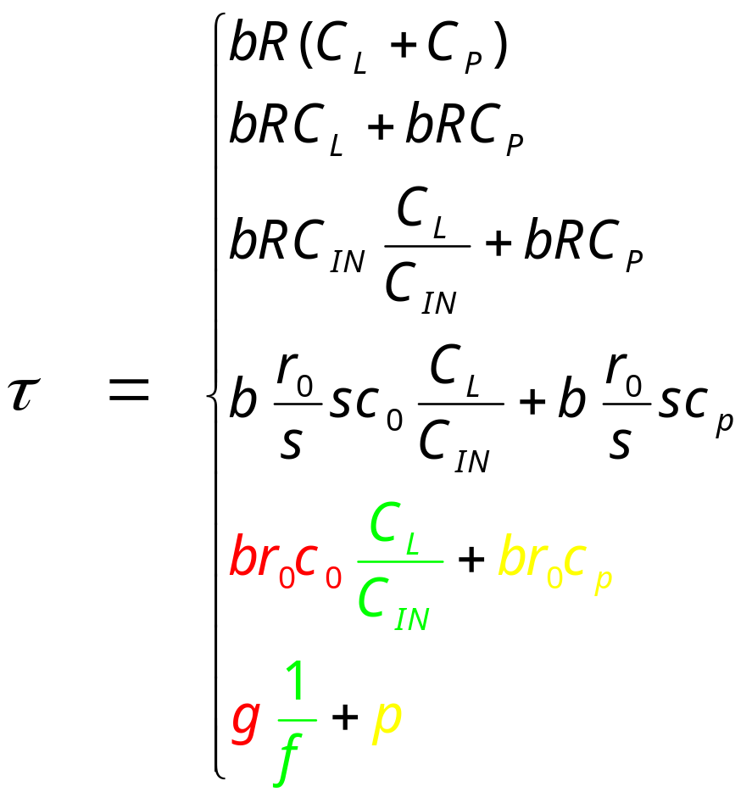
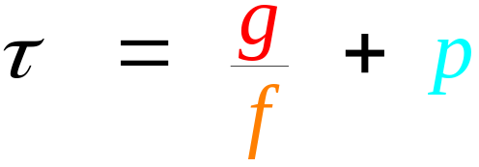
Buffer delay
buffer

Slide 4
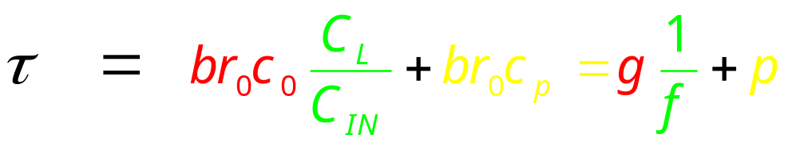
Sutherland delay equation
g = br₀c₀ - computing effort
  size independent
  depends on:
    function
    topology
    relative transistor dimensioning in the gate type
p = br₀c_{p} - inherent (parasitic) delay
  size independent
1/f = C_{L}/C_{IN} - restoring effort
g/f = effort delay

Slide 5
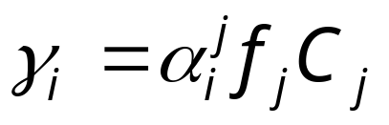
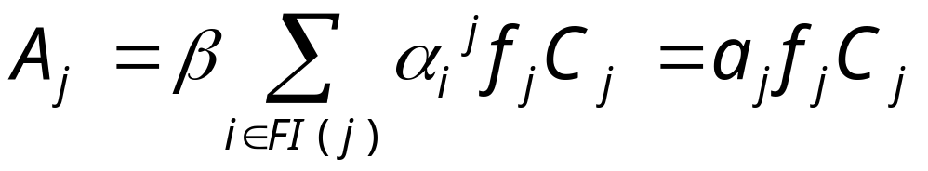
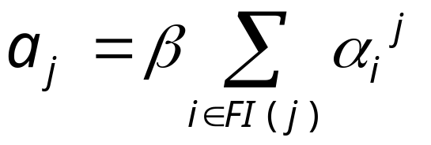
Capacitance and Area
All input capacitances scale linearly ( C_{in} = f_{j} C_{j} ) with the load
For input i, the input capacitance, _{i}, is proportional to f_{j} C_{j}
Assume that size of a gate is proportional to sum of its input capacitances
depends on the gate type of j
general
gate
₁
₂
gate
j
C
j
_{k}

Slide 6
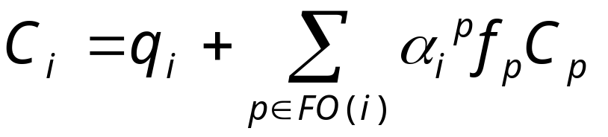
Capacitances in networks
j
C
j
output
capacitances
given
i
q_{i}
k
C
k
q_{i} - imposed
capacitances
(e.g. wire load)

Slide 7
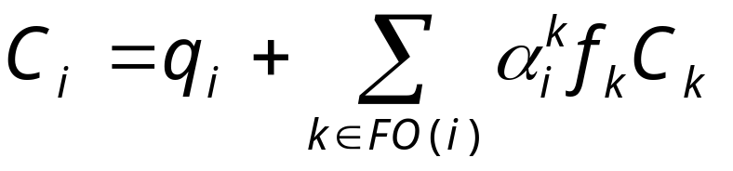
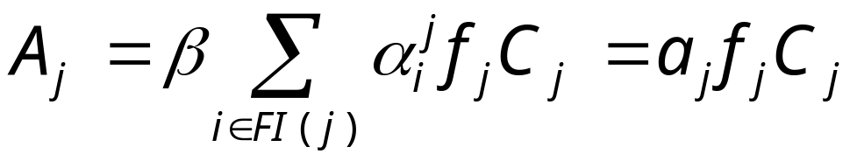
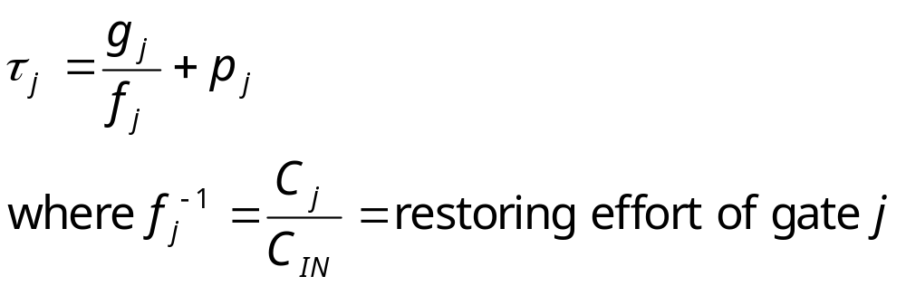
Equations

Slide 8
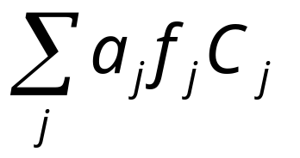
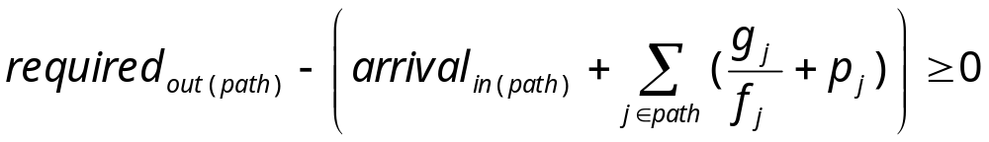
Problem
Find { f_{j} } (gate sizes) to minimize the total area:
while meeting delay requirements:
on all PI -> PO paths

Slide 9
Heuristic for distributing restoring efforts
Sutherland’s hypothesis of uniform restoring effort (1/f ) :
Given:
  a network with an equal number of gates on every path from PI to PO,
  a capacitance at every PO, and
  a driving capability at each PI,
the network is smallest (and meets delay constraints) when every stage on each PI -> PO path has the same restoring effort.

Slide 10
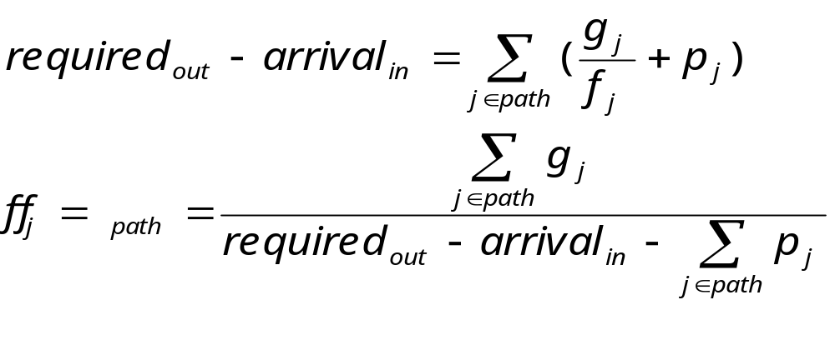
Heuristic solution
Assign delays to gates so that:
  slack on each gate’s output is 0
  restoring efforts are uniformly distributed to all gates as much as possible
Iteratively,
  find longest paths (in # gates).
  assign 0 slack and uniform restoring effort to path:

Slide 11
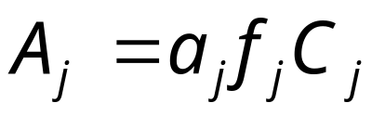
Solving for the C_{i} and A_{i}
Given:
{ q_{i} }
{ f_{k} } (just solved for)
C_{i} for each of the primary outputs
Find: C_{i} for all i
C_{i} can be computed in reverse topological order
Areas are

Slide 12
Constant delay synthesis
logic synthesis
  structures network for speed (technology independent)
  does load independent technology mapping
  inserts buffers (heuristically)
Layout
  wire loads are extracted
Delays on each gate are assigned to a constant by zero slack and uniform restoring effort heuristic
Gate areas change, but this does not perturb layout significantly
Yields better circuit properties
  smaller area
  lower power consumption
  timing closure (no need to iterate logic synthesis)
Library (continuous sizes?)
  method requires sizing to meet delays

Slide 13
Constant delay synthesis
Delay requirements are always met as long as they are not less that parasitic delay
Area will depend on delay requirements
  Area-delay tradeoff curve
Heuristic may not yield minimum area.
  Could solve the nonlinear program for minimizing area
What technology independent and dependent logic synthesis techniques lead to smaller areas?
  is the final area very sensitive to these?
The problem of timing closure is alleviated.
  fix delay first and then find area
  other way is (classical approach)
    guess at loads and synthesize to meet delays
    update loads and resynthesize etc.

