Slide 1
Node Minimization in Logic
Node minimization can be applied to
Combinational Logic
Sequential Logic
ω-automata (properties are specified)
In all cases, synthesis/optimization can be divided into:
deriving all the flexibility (allowed from at a node) from surround environment and specification
synthesizing/optimizing an implementable behavior

Slide 2
Sequential Synthesis
(Combinational logic and memory)
Computational Model
  Network of interacting FSM’s (possibly cyclic)
FSM
FSM
FSM
FSM
FSM’s (general node)
  Mealy or Moore
  Symbolic/multi-valued (v has values in {stop, go, caution} )
  nondeterministic
s₂
a/1
s₁
s₃
a/0
  several inputs and outputs per FSM node

Slide 3
FSM Specification
FSM’s can be given by a state transition graph (STG):
1-/11
-0/01
2
inputs x, v
outputs u,z
x,v/u,z
00/10
-1/10
-0/00
1
start
state
-1/01
1
3
01/10
or by a netlist of gates and latches (BLIF-MV format):
latches
Primary inputs
Primary outputs

Slide 4
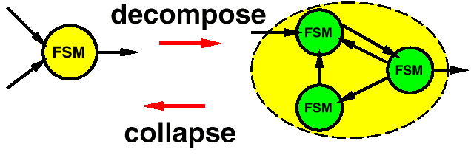
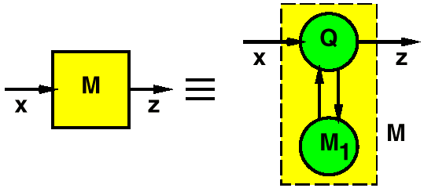
Sequential Synthesis
Decomposition/Collapsing
collapsing =
constructing
product
machine
“Boolean” Division:
Given two FSM’s M and M₁, find FSM Q (quotient) such that M₁ x Q = M. (What about M = M₁ x Q + R )?
Node Minimization
FSM
FSM

Slide 5
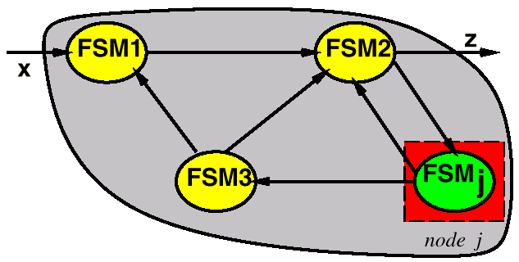
Node Minimization: Two Problems
Given: FSM Network and specification M : x → z
M
Problem 1: Summarize and represent all permissible (implementable) machines at node j : Want : S_{j} such that
M_{j} is permissible ⇔ M_{j} S_{j} (i.e. S_{j} “simulates” M_{j} )
Past (partial) results: “don’t care” sequences
  input (those that can’t occur)
    Kim and Newborn(1972)
    Devadas and Newton (1990)
    Somenzi (1991), Wang and Brayton (1993)
  output ( pairs that can’t be distinguished )
Problem 2: Find optimum M_{j} , such is that M_{j} S_{j} if and only if M_{j} permissible.

Slide 6
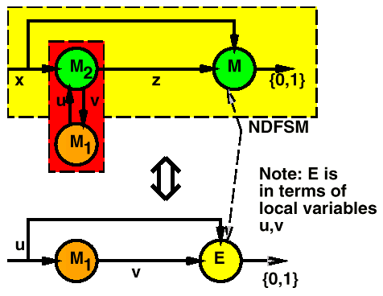
The E-Machine (Watanabe ICCAD ‘93)
Theorem:
  Given specification M : x → z (in general a NDFSM) and FSM’s M₁, M₂, there exists a NDFSM E (called the E-machine) such that
  FSM N is permissible at M₁ ⇔ N E
E summarizes the
Environment of M₁

Slide 7
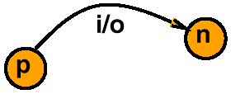
The E-Machine (Watanabe ICCAD ‘93)
E can be computed by a (complicated ) fixed point calculation.
NDFSM is represented using characteristic function of its transition relation: T (p,i,n,o ) = 1
Thus E summarizes all the permissible machines for M₁ (solution to Problem 1)

Slide 8
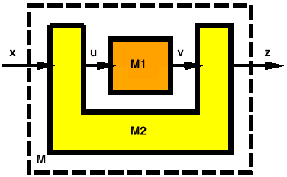
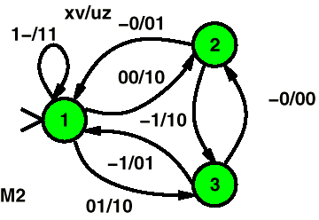
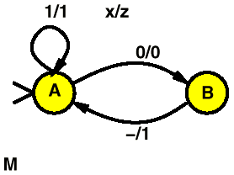
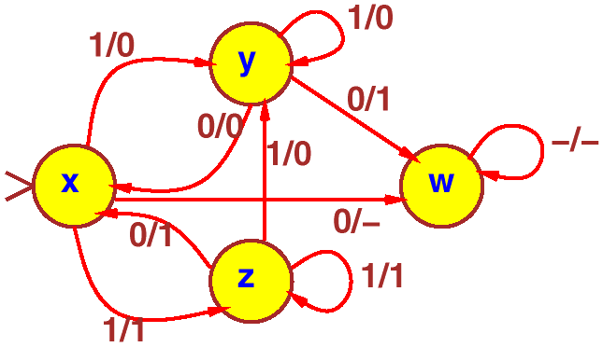
Example
given
given
M2:
M:
specification
u/v
E-machine
for location
M1:
Note: do not
need to know
what M1 is

Slide 9
E-machine Construction Using Logic S1S
S1S stands for “Second order logic with 1 Successor”
Example: (describing a relation between sequence X and sequence Y). If a 1 appears at any even clock tick in X , a 1 also appears in Y at that time.
Theorem: [Büchi 1961] A ∗-language L is definable in S1S if and only if L is regular
A language is regular ⇔ accepted by an automaton
S1S Φ
regular
language
L
automaton
A
FSM M

Slide 10
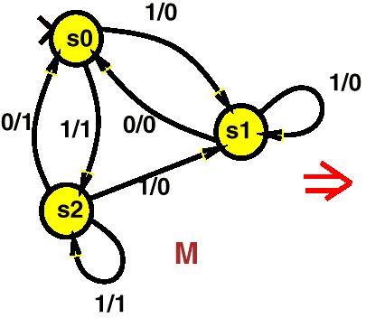
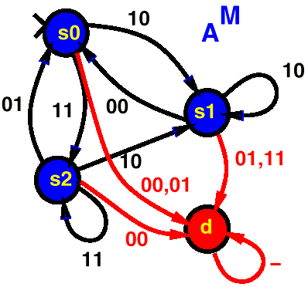
E-machine Construction Using Logic S1S
Every FSM M ⇒ automaton A^{M} obtained by
Accepting
state
Note: Every i/o is converted into io.
Unspecified inputs transition to dummy node

Slide 11
S1S - Definitions & Background
∗-Languages: Given finite set Σ
Σ*: set of all finite sequences over Σ (random sequences)
A ∗-language is a subset of Σ*
Notation:
lower case variable (x) takes value in Σ, upper case (X) in Σ*
Finite Automata (FA) ⎯ 5-tuple (Σ,S, s₀,T,A)
  Σ ⎯ finite set called alphabet
  S ⎯ finite set of states
  s₀ ∈ S ⎯ initial state
  T ⊂ S x Σ x S ⎯ transition relation
  A ⊂ S ⎯ accepting states
Deterministic FA:
(∀s)(∀x)[ |{t : (s,x,t) ∈ T }| ≤1];
otherwise non-deterministic

Slide 12
Definitions & Background - II
String X ∈ Σ* accepted by FA if there exists a sequence of states (a run) σ₀ σ₁ ... σ_{n} such that
  1. n = |X|,
  2. σ₀ = s₀, σ_{n} ∈ A, and
  3. (∀i )[(σ_{i} , X_{i}, σ_{i +1} ) ∈ T ]
Language of FA = set of strings accepted by it.
A ∗-language is regular if it can be constructed by { x ∈ Σ, ., +, ∗, (, ) }, e.g. (a(b+c)∗)∗.

Slide 13
Definitions & Background - II
Facts:
1. Language is regular ⇔ it is accepted by a DFA
(If a NDFA, convert to DFA by power set construction)
2. Class of regular languages is closed under
  Union, Intersection (product machine construction)
  Projection (eraser construction)
  Complementation (determinize with power set construction ⇒ trivial complementation - exchange accepting and nonaccepting states).

Slide 14
Introduction & Background - III
Logic S1S (second order theory of one successor):
Natural logic for sets of sequences.
  Formalism for describing properties of sequences;
  powerful mechanism for analysis and manipulation of sequential systems (makes available full power of logic)
Alphabet of S1S : {0,S,=,<,∈, ∧,¬,∃,x₁,x₂,…,X₁,X₂,…} (x_{i} ∈ Σ )
Syntax:
  Terms: 0 | x_{i} | St₁ where t₁ is a term.
  Examples: ⎯ 0, SS0, SSSSx₃.
  Atomic formulae: t₁ = t₂ | t₁ < t₂ | t₁ ∈ X_{k} where t₁, t₂ are terms, and X_{k} is a finite set of terms.
  Examples: ⎯ (0 < S0), (x₃ = SSSx₅), (Sx₇ ∈ X₂ )
  S1S formulas: φ ∧ ψ | (¬φ) | (∃x_{i} )φ | (∃X_{i} )φ where φ, ψ are S1S formulae (including atomic formulae).
  Examples: (0 < S0) ∧ (Sx₇ ∈ X₂), (∃X )(∃x )[(x ∈ X )(Sx ∈ X )].

Slide 15
Introduction & Background - III
S1S Semantics: Interpret over Σ* = ω = {0,1,2,…}.
Example 1: (Existence of least elements in non-empty subsets of ω )
ψ = (∀X )[(∃x )(x ∈ X ) →
    (∃y )((y ∈ X ) ∧ ¬((∃z)(z ∈ X ∧ (z < y ))))]
Example 2: (Defining subsets of ω which contain 5 whenever they contain 3.)
φ₀(X ) = (SSS0 ∈ X ) → (SSSSS0 ∈ X )
Example 3: (Defining the subset of even integers)
φ₁(X ) = (0 ∈ X ) ∧ ¬(S0 ∈ X ) ∧ (∀x )(x ∈ X ↔ SSx ∈ X )
Example 4: (Defining the relation: “every even number is X is in Y” )
φ₂(X,Y ) = (∀x )[(∀Z )(φ₁(Z ) ∧ x ∈ Z ) → (x ∈ X → x ∈ Y )]
Given a formula φ (X₁ ), the class of subsets of ω defined by φ (X₁ ) is {β ⊂ ω | φ (β) is true};
Generally, formulae φ (X₁,X₂,…,X_{n}) define subsets of ( {0,1}^{n} )*

Slide 16
Introduction & Background VI
1-1
Obervation: Finite subsets of ω ↔ sequences over {0,1}. For example {0,2,3} is represented by 1011.
We have to be careful about 0 sequences, e.g. to distinguish 00 from 000 etc. (Can do this by picking a length and extending each set to that length by putting 0’s at the end)
Thus, S1S formulae define ∗ -languages.
Theorem: [Büchi 1961] A ∗-language is definable in S1S if and only if it is regular.

Slide 17
Advantages of S1S:
Relationship between automata and S1S ⇒ formally, succinctly express behaviors as formulae in S1S. In particular,
  Automatic procedure for deriving automaton from formula.
  Rigorous and constructive proofs for synthesis procedures.

Slide 18
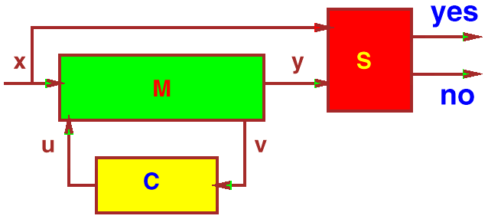
The E-MACHINE-I
Consider machines in configuration below. x, y observable inputs, outputs, L^{S} ⊂ (Σ_{X} x Σ_{Y})* is a regular specification, i.e. the set of all (x, y) sequences in L^{S}
((x₁,y₁),(x₂,y₂),…)
is accepted by some automaton S.

Slide 19
The E-MACHINE-I
Theorem: The set of all behaviors on u, v which will yield behavior on the inputs and outputs x, y compatible with the specification S (x,y) is given by the following S1S expression:
φ^{E} (V,U ) = (∀X,Y )[φ^{M} (X,U,Y,V ) → φ^{S} (X,Y )]
Proof: Convert each machine above to S1S expression. U,V,X,Y are sequences.

Slide 20
Constructing the E-Machine in Four Steps
φ^{E} (U,V ) = (∀X,Y )[φ^{M} (X,Y,U,V ) → φ^{S} (X,Y )]
= ¬(∃ X,Y )[φ^{M} (X,Y,U,V ) ∧ ¬ φ^{S} (X,Y )]
can be rewritten in terms of manipulating automata:
  E (u,v ) = ¬[∃(x,y )[M (x,y,u,v ) × ¬S (x, y )]]
We use the correspondence between automata and FSM’s. Each of the operations in S1S, ∧,¬,∃ corresponds to the automata constructions of product, complementation, and projection.

Slide 21
Constructing the E-Machine in 4 Steps
Implies 4-step construction for E-machine E (u,v ) = ¬[∃(x,y )[M (x,y,u,v ) × ¬S (x, y )]]
1. Complement the specification,
  S (x,y) →S (x,y)
2. Form the product machine,
  P (x,y,u,v ) = M(x,y,u,v ) ×S (x,y )
3. Existentially quantify out (erase) x,y from P,
  P (u,v ) = ∃(x,y )[P (x,y,u,v )]
4. Complement P,
  E (u,v ) = P (u,v )
~
~
~

Slide 22
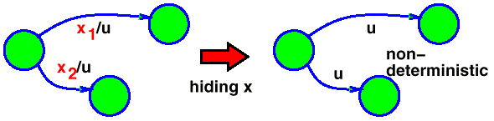
Comments on the Four Steps
1. S (x,y) →S (x,y)
  If specification is non-deterministic, this may be exponential in |S| (number of states); a subset construction is required to complement S.
2. P (x,y,u,v) = M (x,y,u,v ) ×S (x,y)
  Easy; just the usual product machine construction. Using BDD’s, just multiply the two transition relations.
3. P (u,v ) = ∃(x,y)[P (x,y,u,v )]
  Easy; existential quantification is simply a “hiding” of variables operation. In general quantifying variables leads to non-deterministic automata.
~

Slide 23
Comments on the Four Steps
~
4. E (u,v) = P (u,v)
  If P (u,v) is non-deterministic, then potentially exponential; we have to determinize with the subset construction. However, the resulting automaton E is deterministic, and hence a “pseudo-nondeterministic” FSM.
There are special cases (topologies), where the worst case behavior does not occur.
~
A pseudo-nondeterministic FSM is a nondeterministic FSM
but whose automaton is deterministic.

Slide 24
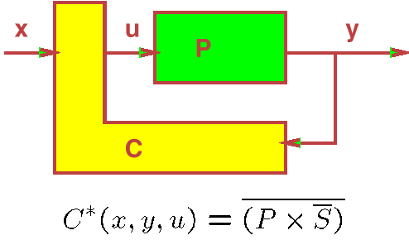
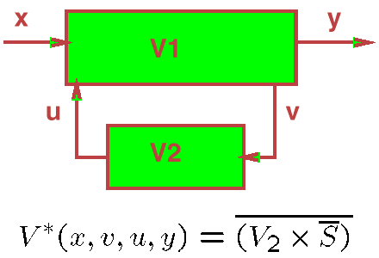
Applications of the E-MACHINE
Supervisory Control: Construct a controller C which controls a plant P so that it has a given behavior S.
Rectification/Engineering Change: Modify an original design so that it conforms to a new specification S.
Note: These constructions have no quantification,
  no introduction of non-determinism
  if S is deterministic, then construction is polynomial.

Slide 25
The E-MACHINE II
Cascade-I:
x
u
y
A1
A2
φ ^{A} 1∗(X,U ) = (∀Y )[φ ^{A} 2(U,Y ) → φ ^{S} (X,Y )]
φ ^{A} 2∗(U,Y ) = (∀X )[φ ^{A} 1(X,U ) → φ ^{S} (X,Y )]
Here, S (x,y) = (∃u)[A1(x,u) × A2(u,y)], i.e. the specification is the currrent implementation. In this case, the machine A₂* produced by the above construction is exactly that produced by the Kim and Newborn construction.

Slide 26
The E-MACHINE II
Cascade-II:
x
u
v
y
B1
B2
B3
φ ^{B}2∗(U,V ) = (∀X,Y )[φ^{B}1(X,U ) ∧ φ^{B}3(V,Y ) → φ^{S}(X,Y )]
2-way Cascade:
x
u
y
M1
M2
v
φ ^{M}1∗(X,V,U ) = (∀Y )[φ ^{M}2(V,U,Y ) → φ^{S}(X,Y )]
φ ^{M}2∗(U,V,Y ) = (∀X )[φ ^{M}1(X,V,U ) → φ^{S}(X,Y )]

Slide 27
Realizability
The set LE defined by φ^{E}(U,V ) is the set of all acceptable behaviors. In general, LE may not be realizable. This can happen in two ways.
1. There may be blocking input sequences V, i.e. sequences for which there is no output U such that (U,V ) ∈ LE.
2. A realization may not exist because of non-causality, viz the output may depend on future values of the input.
Example: suppose (1,0),(1,1),(1,1),...∈ L but
  (1,0),(1,1),(0,-),...∉ L
Thus, at the second step, the output can be 1 only if the next input is a 1.
~
~
~
~

Slide 28
Realizability
Definition 4: C is compatible with C * (C C *) provided that
(∀V,U )[φ ^{C}(V,U ) → φ ^{C*}(V,U )]
Realizability Problem: Given a regular L^{C*} ⊂ (Σ_{V} × Σ_{U})*, determine the existence of an implementable finite state machine C such that C C *.
This can be solved by calling the following algorithm.
~
~

Slide 29
Realizability Algorithm
        Mealy algorithm:
Realizable_States: (DFA D: (S_{D}, s₀, ∑_{V} × ∑_{U}, T_{D}, A_{D}))
{
S_{C} = S_{D}, T_{C} = T_{D}, A_{C} = A_{D};
while ( TRUE ) {
remove states s from S_{C}, T_{C}, A_{C} such that
¬ [(∀v )(∃u,t )[(s,v,u,t ) ∈ T_{C} ∧ (t ∈ A_{C} )]
if ( no states were removed )
break;
}
return SC, TC, AC;
}
Lemma 1: C * is realizable if and only if the set of states S_{C} remaining after convergence contains the initial state. Further, there exists an implementable machine (completely specified, deterministic) C, C C * if and only if C C ^{mealy}, where C ^{mealy} is C * restricted to the states S_{C} returned by the Mealy algorithm.
~
~
~

Slide 30
Moore Realizability
Sometimes we want to restrict to Moore machines to ensure that there are no combinational cycles.
        Moore algorithm:
Realizable_States: (DFA D: (S_{D}, s₀, ∑_{V} × ∑_{U}, T_{D}, A_{D}))
{
S_{C} = S_{D}, T_{C} = T_{D}, A_{C} = A_{D};
while( TRUE ) {
remove states s from S_{C}, T_{C}, A_{C} such that
¬ [(∀v )(∃u )(∀t )[(s,v,u,t ) ∈ T_{C} ⇒ (t ∈ A_{C})]
remove transitions s,v,u,t from T_{C} such that
¬ [(s,v,u,t ) ∈ T_{C} ⇒ (∀v )(∃t )(s,v,u,t ) ∈ T_{C} ]
if ( no states or transitions were removed )
break;
}
return SC, TC, AC;
}
~
~
~
~

Slide 31
End of lecture 23

Slide 32
Moore Realizability
Lemma 2: 1. C * is realizable as a Moore machine if and only if the set of states S_{C} remaining after the above Moore algorithm converges contains the initial state.
2. Further, there exists an implementable Moore machine (completely specified, deterministic), C, C C * if and only if C C ^{moore}, where C ^{moore} is C* restricted to the states S_{C} returned by the Moore algorithm.
However, even though there may not exist a Moore machine, there may exists a Mealy machine D C^{mealy} i.e. not all behaviors contained in C^{mealy} are Moore behaviors.
~
~
~

Slide 33
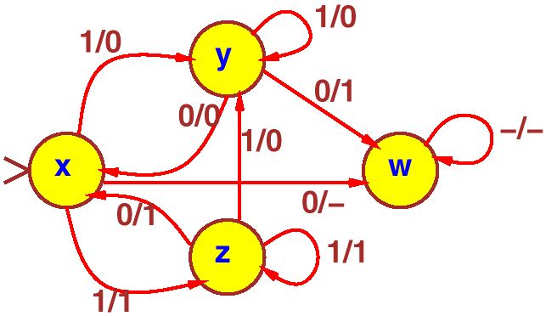
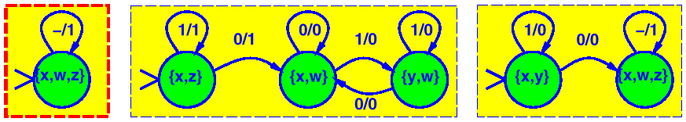
Problem 2 - Minimizing the node M1
Contained Behavior:
E-Machine:
Some contained behaviors: (deterministic FSM’s) contained in this:

Slide 34
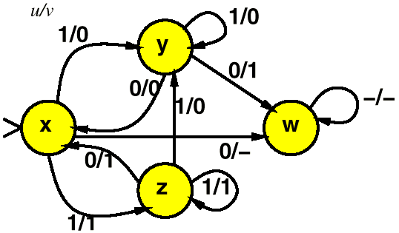
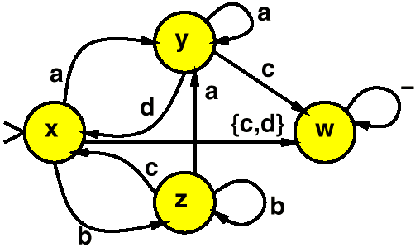
E-machine is Pseudo Nondeterministic
E-machine for M₁
u is the input
v is the output
Definition 5: E = (U,V,S,T,r ) is a pseudo NDFSM (PNDFSM) if ∀(s_{p},u,v) there exists at most one s_{n} ∈ S such that T(s_{p},u,v,s_{n} ) = 1, i.e. A ^{E} is deterministic.
Thus when viewed as an automaton, a PNDFSM is deterministic:
a=1/0
b=1/1
c=0/1
d=0/0
Deterministic Finite Automaton
(incompletely specified)

Slide 35
Node Minimization
One way to minimize a node in an FSM network is to “state minimize” the E-machine:
Find a minimum state machine contained in E- machine.
“State Minimization” Methods:
Exact and heuristic methods exist for this. These use the notion of compatible sets of states generalized from incompletely specified machines to PSNDFSM.
Watanabe - 1994 (exact and heuristic)
Damiani - 1994 (exact)
Kam and Villa - 1995 (exact method using implicit computation (BDDs) of compatibles).

Slide 36
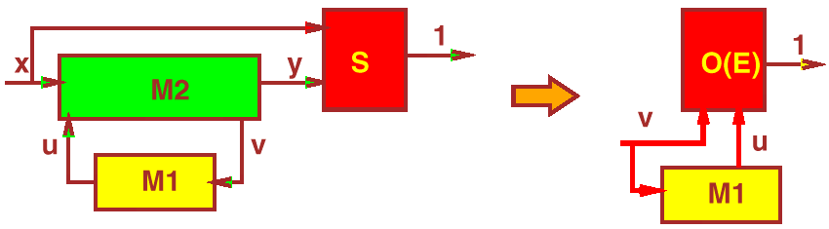
FSM Node Minimization via ATPG
(more practical)
where O (E ) is the observability FSM of the E-machine E.
O (E ) is a FSM obtained from E by converting each i /o pair to an input io, and completing it by adding a dummy state d, and an output, where output is 0 if io is a transition to d and 1 otherwise.

Slide 37
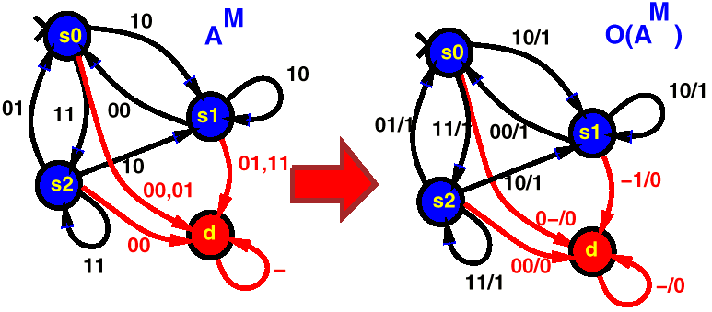
FSM Node Minimization via ATPG
Since O (E ) is a completely specified FSM, we can implement it as a netlist and use sequential redundancy removal on M1. [H.Y. Wang - 1995].

Slide 38

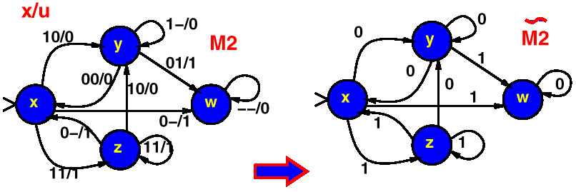
Using Sequential Input Don’t Cares
Before sequential ATPG is used we can transform the driving machine M2 by removing its inputs, simplifying and input determinizing (add new input(s) if machine is nondeterministic). Then sequential redundancy removal is used on the M1 part of the composed machine.

Slide 39
Summary - Sequential Synthesis
Node minimization
  know how to derive complete set of permissible behaviors (E- machine)
  E-machine is a complex computation (possibly doubly exponential) but some topologies are easier.
  exact and heuristic state minimizers for PNDFSM’s
  use of sequential ATPG for minimizing given network relative to E-machine
  limited right now to small machines
  need more examples and experiments on use of approximate methods.

Slide 40
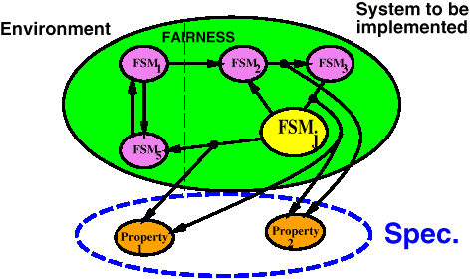
Design Verification and Refinement
Problem: We want to verify that a given design satisfies a set of desired properties.
Computational Model:
Network of NDFSM’s with fairness constraints. This models
  system to be synthesized
  its environment
Properties - expressed by either
  ω -automata or
  computational tree logic (CTL) with fairness constraints.

Slide 41
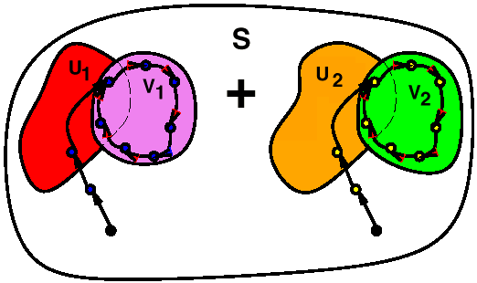
ω -Automata and Fairness Constraints
Rabin: fair (acceptable) path r = (s₀,s₁,s₂,…) is
Σ (F∞(U_{i} ) ∧ G∞(V_{i} ))
where
F∞(U_{i} ) ⇒ inf(r) ∩ U_{i} ≠ φ G∞(V_{i} )) ⇒ inf(r) ⊆ V_{i}
i
Rabin Automaton
With Rabin automata, one can express properties like
  infinitely often each time C requests service, eventually it gets access to service
- a liveness property
A Streett automaton is like a Rabin but with complementary fairness constraints:
Π (F∞(U_{i} ) ∧ G∞(V_{i} ))
i

Slide 42
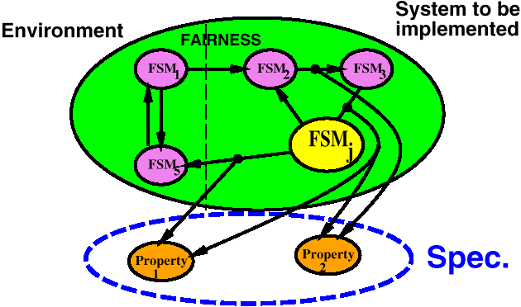
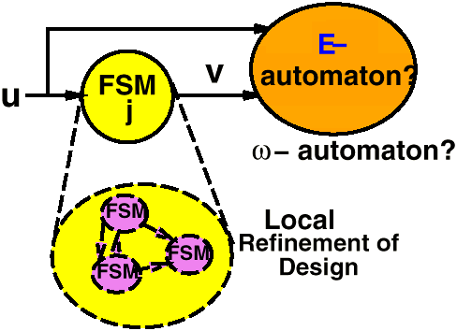
Verification and Refinement
Set of properties {P₁,P₂,…,P_{n} } acts like our system specification.
Problems:
1. Summarize complete set of behaviors allowed locally at a single node, FSM_{j}.
2. Refine (synthesize) a suitable implementation of FSM_{j} (if one exists).

Slide 43
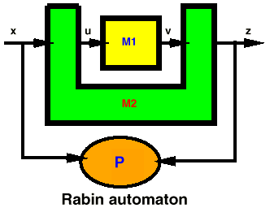
Generalized E-machine for Design Refinement
P is desired property expressed as an ω -automaton.
M2 is the rest of the system
Restated as S1S Expression on Infinite Strings:
Theorem 1: [Buchi (1960) ] A ω-language is expressible as an S1S expression if and only if it is ω-regular.
Thus E (u,v) = ∀(x,z)(M2(x,v,u,z ) ⇒ P (x,z ))
is an expression in S1S.
Thus operationally,
  E (u,v) = ∃(x,z )(M2 ×‾P )
exists. (It turns out that E (u,v ) is a Rabin automaton.)

Slide 44
Generalized E-machine Construction
E(u,v) = ∃(x,z )(M2 ×P )
1. Complement P. Generally, can express properties as deterministic Rabin automata (DR), so complementation into a deterministic Streett automata (DS), is easy.
2. Form M2 ×‾P. Easy since if M2 is Streett.
3. Form Q = ∃(x,z)(M2 ×‾P ). Easy, but Q generally becomes NS. (Hiding variables generally causes nondeterminism).
4. Complement Q. We can do this by
NS → DR.
The complexity is:
NS (n,f ) → DR (2 ^{n2 log(n2 )} )
where n is the number of states and f the number of fairness constraints (Saffra - 1988).
This has been implemented
(Tasiran & Hojati).
^{f}
^{f}

Slide 45
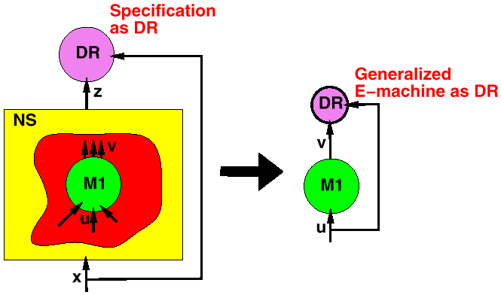
Summary - Design Refinment
In theory, we have a solution to the problem of finding all permissible behaviors when our initial specification is a set of properties.
(Note: the construction is hierarchical ).

Slide 46
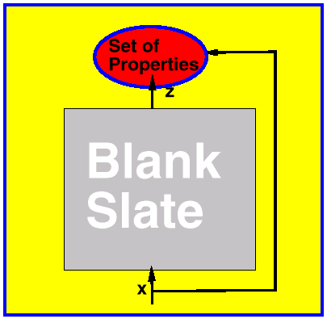
The Ultimate Synthesis Problem
Open Questions:
how to find a contained behavior in E-automaton, i.e. a completely specified deterministic FSM.
how to find a minimum contained behavior

Slide 47
Conclusions
Common theme: for synthesis of combinational, sequential, and ω-automata for the node minimization problem.
Problems of synthesis and verification are closely related in all three areas.
Common model: network of automata.

Slide 48
End of lecture 24 and this section

Slide 49
Outline
Quick review of combinational logic
Derivation of E-machine for sequential logic
Extension of E-machine to ω-automata

Slide 50
Combinational Logic:
Three Main Optimization Steps
All Heuristic
1. Decomposition/Collapsing
  factorization
  kerneling
  Boolean division
fj
collapsing
decomposition
2. Node Minimization
3. Technology Mapping

Slide 51
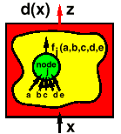
Combinational Logic:
Node Flexibility
Problem: Simplify logic function f_{j}
Boolean network
Don’t Cares: (summarize effect of rest of network on node j)
  EXDC - given external don’t cares
    d = (d₁(x), …, d_{m}(x))
  SDC_{j} - local input patterns that never occur
  ODC_{j} - primary input values for which f_{j} has no effect on primary outputs.

Slide 52
Combinational Logic: Node Flexibility
Theorem: g_{j} is permissible at node j iff
f_{j} δ_{j} ≤ g_{j} ≤ f_{j} + δ_{j}
where δ_{j} ≡ SDC_{j} + ODC_{j} + EXDC
Thus f_{j}, δ_{j} effectively summarize all functions permissible at node j.
Can represent this set by its characteristic function
O (x, y_{j}) = (f_{j} δ_{j} ⇒ y_{j}) ∧ ((f_{j} +δ_{j}) ⇒y_{j})
Node Minimization: Can use standard two-level minimizers to do node minimization.

Slide 53
Combination Logic: Multiple Output Functions
Network of Multiple Output Functions:
z₁,…,z_{m}
Boolean network but each node has multiple outputs
fj
N
x₁,…,x_{n}
What is the set of permissible functions for f_{j} at N ?
  Don’t care formulation does not work
  Boolean Relation: (completely specified)
  β : B^{n} → (2^{B})^{M}
  Compatible functions: A function g_{j} is compatible with a Boolean relation B (or contained in):
  g_{j} β ⇔ ∀x, g_{j} (x) ∈ β (x)
Can represent β as its characteristic (or observability) function:
O (x, z ) = 1 ⇔ z ∈ β (x )

Slide 54
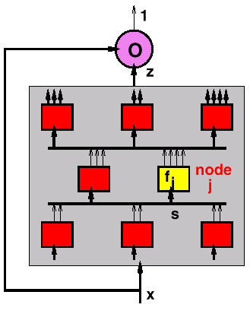
General Problem
Given a network of multiple-output functions and observability specification:

Slide 55
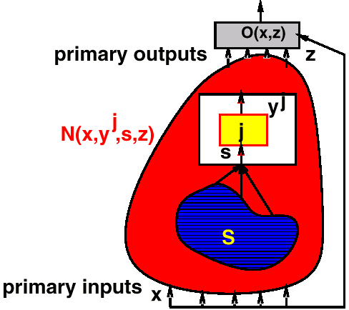
General Problem
Summarize all implementable functions at node j, i.e. derive O_{j} (s, y^{j}) such that:
f (s) is implementable at node j ⇔ f O_{j} (s, y^{j})
O_{j}(s, y^{j}) = ∀x,z[N(x,y^{j},s,z) ⇒ O(x,z)]

Slide 56
Node Minimization
Optimization Problem: Given O(s, y^{j}), find “best” f_{j} such that O(s, f(s)) ≡ 1
Boolean Relation Minimizers:
Exact - Somenzi (1989)
  Like Quine-McCluskey
  define prime implicants
  generate all primes
  solve covering (binate) problem
Heuristic - Watanabe (1991)
  Uses BDD’s to represent Boolean relation- iterates reduce, expand irredundant until no change.

Slide 57
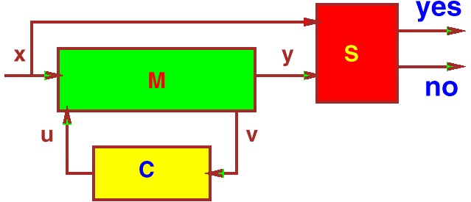
E-Machine Approximations
Definition 1 The strong satisfiability don’t care set for C is defined by the following formula:
φ^{SDC}0(V) = ¬(∃X,U,Y)φ^{M}(X,U,V,Y)
It is precisely the set of sequences over v which can never be generated, no matter what replacement is used for C.
~
~
~
~
~
~
C

Slide 58
E-Machine Approximations
This set gives a certain amount of flexibility in choosing implementations for C; namely any behavior in the machine C₀ defined below is acceptable.
φ^{C}0(V,U) = φ^{SDC}0(V) + φ^{C}(V,U)
or
C₀(v,u) = (∃x,v,y)[M(x,u,v,y)] × C(v,u)
It can be shown that C₀ is an ISFSM, and also that C₀ does not provide all the flexibility available in optimizing C.
C
_
~
~

Slide 59
More Approximations
Definition 2 The weak satisfiability don’t care set for C is given by the following expression:
φ^{SDC}0 (V ) = ¬(∃X,U,Y )φ^{M} (X,U,V,Y)
It is precisely the set of sequences over v which can never be generated in the product machine, M × C.
This set gives additional flexibility over SDC0C is choosing implementations for C ; namely any behavior in the machine C₁ defined below is acceptable.
φ^{C}1 (V,U ) = φ^{SDC}1(V ) + φ^{C} (V,U)
~
~
~
~
~
~
C
C

Slide 60
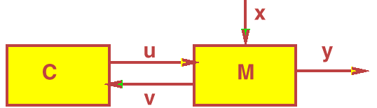
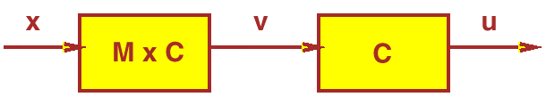
More Approximations
and corresponds to the input don’t care sequences of Wang when in configuration:
And is the Kim and Newborn flexibility when in configuration:
It can be shown that C₁ is an ISFSM, and also that C₁ does not provide all the flexibility available in optimizing C.

Slide 61
More Approximations
Definition 3 The strong observability equivalence relation for C is given by the following expression:
φ^{O}0(V) = (∀X,Y,U)[φ^{M}(X,U,V,Y) → φ^{M×C}(X,Y)]
It is precisely the set of sequences over v for which any output sequence over u is permissible.
Clearly, for input sequences which are never generated any output is acceptable, so φ^{SDC}1(V) ⊆ φ^{O}0(V).
This set gives additional flexibiltiy over SDC^{C}₁ in choosing implementations for C ; namely any behavior in the machine C₂ defined below is acceptable.
φ^{C2}(V,U ) = φ^{O}0(V ) + φ^{C}(U,V )]
It can be shown that C₂ is an ISFSM, and that C₂ does not provide all the flexibility available in optimizing C.
It can be proved that
φ^{C0} ⊆ φ^{C1} ⊆ φ^{C2}
~
~
~
~
~
~
~
~
C
C
C
C

