Slide 1
Retiming and Re-synthesis
Outline:
Retiming
Retiming and Resynthesis (RnR)
Resynthesis of Pipelines

Slide 2
Optimizing Sequential Circuits by Retiming Netlist of Gates
Netlist of gates and registers:
Various Goals:
  Reduce clock cycle time
  Reduce area
    Reduce number of latches
Inputs
Outputs

Slide 3
Retiming
Problem
  Pure combinational optimization can be myopic since relations across register boundaries are disregarded
Solutions
  Retiming: Move register(s) so that
    clock cycle decreases, or number of registers decreases and
    input-output behavior is preserved
  RnR: Combine retiming with combinational optimization techniques
    Move latches out of the way temporarily
    optimize larger blocks of combinational

Slide 4
Circuit Represetation
[Leiserson, Rose and Saxe (1983)]
Circuit representation: G(V,E,d,w)
  V ↔ set of gates
  E ↔ set of wires
  d(v) = delay of gate/vertex v, (d(v)≥0)
  w(e) = number of registers on edge e, (w(e)≥0)

Slide 5
Circuit Representation
Example: Correlator
+
7
0
Host
0
0
0
δ
δ
2
3
3
0
δ(x, y) = 1 if x=y
0 otherwise
Graph (Directed)
a
b
Circuit
Operation delay
δ 3
+ 7
Every cycle in Graph has at least one register i.e. no combinational loops.

Slide 6
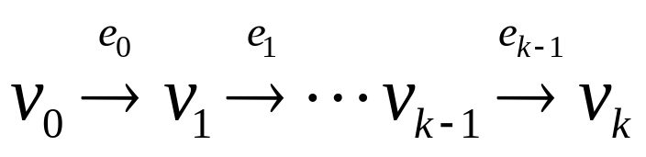
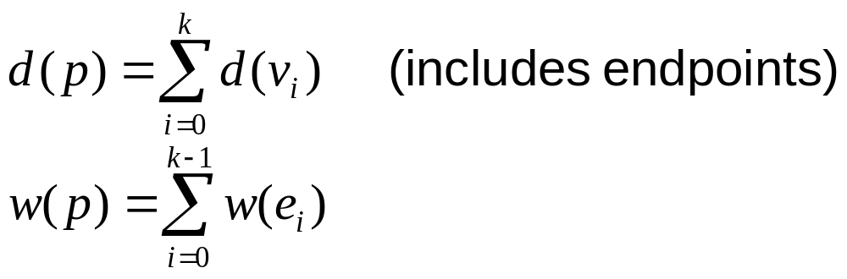
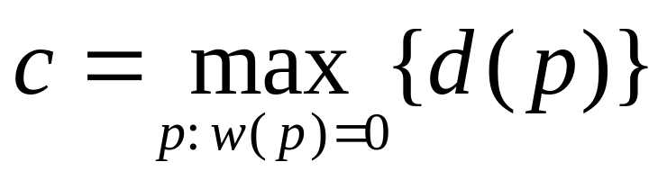
Preliminaries
For a path p :
Clock cycle
7
Path with
w(p)=0
0
0
0
0
2
3
3
0
For correlator c = 13

Slide 7
Basic Operation
Movement of registers from input to output of a gate or vice versa
Does not affect gate functionalities
A mathematical definition: retardation
  r: V → Z, an integer vertex labeling
  w_{r}(e) = w(e) + r(v) - r(u) for edge e = (u,v)
Retime by -1
Retime by 1

Slide 8
Basic Operation
Thus in the example, r(u) = -1, r(v) = -1 results in
7
7
0
0
0
1
0
0
0
1
v
u
v
u
2
1
3
3
3
0
3
0
For a path p: s→t, w_{r}(p) = w(p) + r(t) - r(s)
Retardation
  r: V→Z, an integer vertex labeling
  w_{r}(e) =w(e) + r(v) - r(u) for edge e= (u,v)
  A retiming r is legal if w_{r}(e) ≥ 0, ∀e∈E

Slide 9
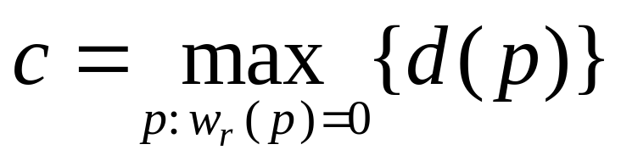
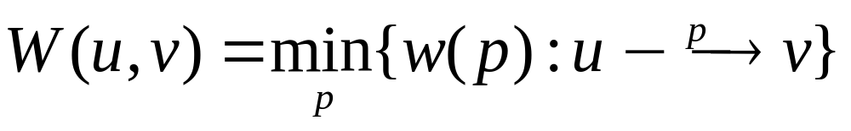
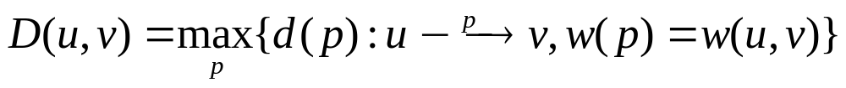
Retiming for minimum clock cycle
  Problem Statement: (minimum cycle time)
  Given G (V, E, d, w), find a legal retiming r so that
  is minimized
  Retiming: 2 important matrices
    Register weight matrix
    Delay matrix

Slide 10
Retiming for minimum clock cycle
W = register path
weight matrix
(minimum # latches
on all paths between
u and v)
D = path delay matrix
(maximum delay on
all paths between
u and v)
7
0
0
v0
0
0
2
3
3
V1
0
V2
W
V0 V1 V2 V3
D
V0 V1 V2 V3
V0
V1
V2
V3
0 2 2 2
0 0 0 0
0 2 0 0
0 2 2 0
0 3 6 13
13 3 6 13
10 13 3 10
7 10 13 7
V0
V1
V2
V3
c ≤ α ⇔ ∀p, if d(p) > α then w(p) ≥ 1

Slide 11
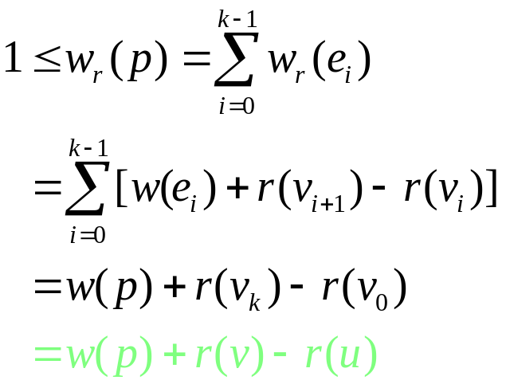
Conditions for Retiming
Assume that we are asked to check if a retiming exists for a clock cycle α
Legal retiming: w_{r}(e) ≥ 0 for all e. Hence
w_{r}(e) = w(e) = r(v) - r(u) ≥ 0 or
r (u) - r (v) ≤ w (e)
For all paths p: u → v such that d(p) ≥ α, we require w_{r}(p) ≥ 1
  Thus
Or take the least w(p) (tightest constraint) r(u)-r(v) ≤ W(u,v)-1
Note: this is independent of the path from u to v, so we just need to apply it to u, v such that D(u,v) > α

Slide 12
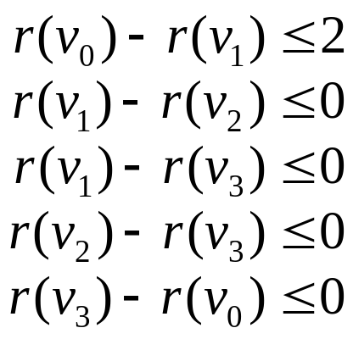
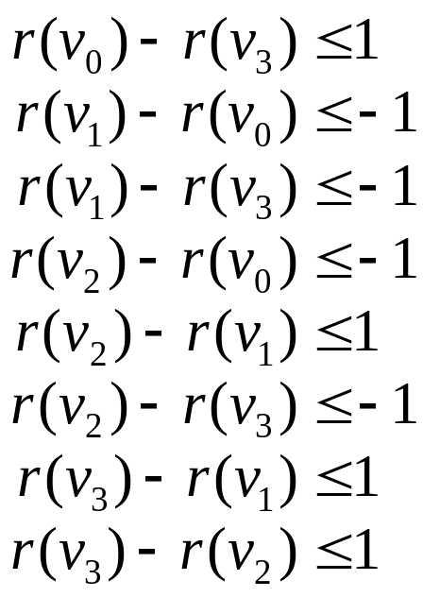
Solving the constraints
All constraints in difference-of-2-variable form
Related to shortest path problem
W
V0 V1 V2 V3
D
V0 V1 V2 V3
Correlator: α = 7
V0
V1
V2
V3
0 2 2 2
0 0 0 0
0 2 0 0
0 2 2 0
0 3 6 13
13 3 6 13
10 13 3 10
7 10 13 7
V0
V1
V2
V3
D>7:
r(u)-r(v)≤W(u,v)-1
Legal: r(u)-r(v)≤w(e)
7
0
0
v0
0
0
2
3
3
v1
0
V2

Slide 13
Solving the constraints
Do shortest path on constraint graph: (O(|V|³ )).
A solution exists if and only if there exists no negative weighted cycle.
D>7:
r(u)-r(v)≤W(u,v)-1
Legal: r(u)-r(v)≤w(e)
-1
0
-1
r(0)
2
r(1)
0
1
1
-1
1
0,-1
1
r(2)
0,-1
r(3)
-1
0
1
Constraint graph
A solution is r(v₀) = r(v₃) = 0, r(v₁) = r(v₂) = -1

Slide 14
Retiming
To find the minimum cycle time, do a binary search among the entries of the D matrix (0(⏐V⏐³ log⏐V⏐))
7
W
V0 V1 V2 V3
D
V0 V1 V2 V3
0
0
v0
0
0
V0
V1
V2
V3
0 2 2 2
0 0 0 0
0 2 0 0
0 2 2 0
0 3 6 13
13 3 6 13
10 13 3 10
7 10 13 7
V0
V1
V2
V3
2
3
3
v1
0
V2
Retimed correlator:
+
+
Retime
Host
Host
δ
δ
δ
δ
Clock cycle
= 3+3+7=13
Clock cycle = 7
a
b
a
b

Slide 15
Retiming: 2 more algorithms
1. Relaxation based:
  Repeatedly find critical path;
  retime vertex at end of path by +1 (O(⏐V⏐⏐E⏐log⏐V⏐))
2. Also, Mixed Integer Linear Program formulation
v
+1
Critical path
u

Slide 16
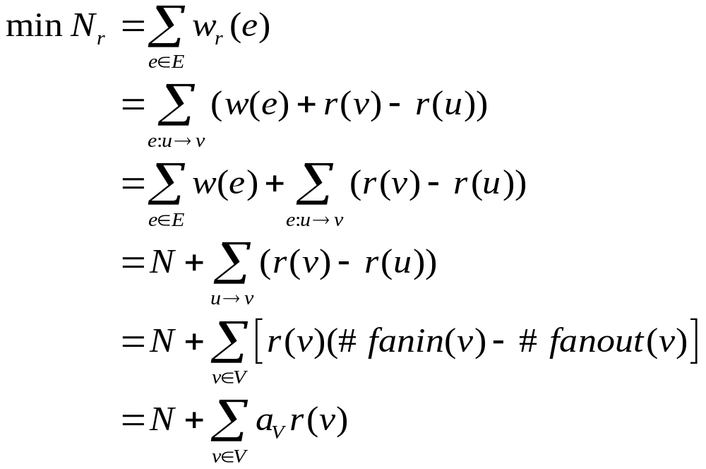
Retiming for minimum area
(minimum # latches)
Goal: minimize number of registers used
where a_{v} is a constant.

Slide 17
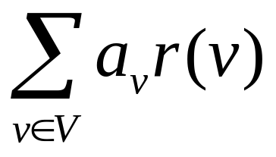
Minimum registers - formulation
Minimize:
Subject to: w_{r}(e) =w(e) + r(v) - r(u) ≥ 0
Reducible to a flow problem

Slide 18
Retiming and resynthesis: motivation
Goal: incorporate combinational optimization into sequential optimization
Naïve approach: carve out combinational regions, do optimization on each region. Only local gains made.
Can we do any better?
RnR: a new approach
Sentovich, Malik, Brayton andSangiovanni-Vincentelli (‘89)
3 step approach
    Move registers to boundary of circuit
    Optimize network
    Move registers back in an optimal way

Slide 19
RnR: circuit representation
Circuit representation: communication graph
  internal/peripheral edges
  edge-weight = register count
0
c
1
2
a
b
1
1
internal
peripheral
i
j

Slide 20
Extended Retiming
Move register to the periphery
Negative edge-weights permitted
A negative latch has the interpretation that it advances its output by 1 clock cycle instead of delaying it
-1
negative
latch
1

Slide 21
Peripheral Retiming
A retiming is called a peripheral retiming if it results in all internal edges having zero weight
Peripheral edges can have negative weight
β₂
β_{n}
β₁
β_{k}
α_{k}
All internal edge
weights are 0
peripheral
weights
α₁
α_{n}
α₂

Slide 22
Peripheral Retiming
A circuit that undergoes peripheral retiming followed by a legal retiming, i.e. one that results in all weights ≥ 0 is “functionally equivalent” to the original circuit
Functional equivalence: equivalence of finite state automata:
  But we have to be careful about the initial conditions and initializing sequences. The resulting circuit may only exhibit equivalence after an appropriate delay. See [Singhal et.al ICCAD 1995].
  This holds even for regular retiming

Slide 23
Peripheral Retiming - an example
2
0
c
c
Peripheral retiming
0
0
1
2
a
b
a
b
0
1
1
1
i
j
i
j
Not possible for all circuits:
0
a
0
c
0
o1
i
0
0
d
d
j
b
o2
0
1
0
0

Slide 24
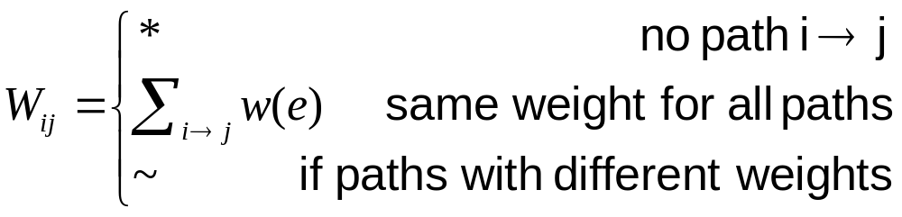
Path Weight Matrix (PWM)
Matrix W
  rows: inputs
  columns: outputs
o1
o2
o1 o2
I 1 *
j 0 ~
k * 0
a
1
b
1
i
j
k

Slide 25
PWM and Peripheral Retiming
Satisfiable path weight matrix:
  1. W_{ij} ≠ ~, ∀i, ∀j and
  2. ∃α_{i}, β_{j}, such that W_{ij}= α_{I} + β_{j} , ∀W_{ij} ≠ *
Peripheral retiming possible ⇔ matrix is satisfiable
  α_{i}, β_{j} specify registers on peripheral edge
  some α_{i}, β_{j} can be negative
Complexity: linear in size of communication graph

Slide 26
Path Weight Matrix - generation
o1 o2
I 1 *
j 0 ~
k * 0
From inputs to outputs:
  generate output columns of W.
Example:
[ * ~ 0 ]
[ 1 0 * ]
o1
o2
( [ * 0 * ]+1) & [ * 0 0 ]
= [ * 1 * ] & [ * 0 0 ]
= [ * ~ 0 ]
[ 1 0 * ]
([ 0 * * ]+1) & ([ * 0 * ]+0)
= [ 1 * * ] & [ * 0 * ]
= [ 1 0 * ]
([ * 0 * ]+0) & ([ * * 0 ]+0)
= [ * 0 * ] & [ * * 0 ]
= [ * 0 0 ]
a
1
b
1
i
j
k
Paths from inputs
to node
[ 0 * * ]
[ * 0 * ]
[ * * 0 ]

Slide 27
Computing α, β
Each constraint of the form α_{I} + β_{j} = W_{ij}
Procedure
  set α₁ = 0
  use first row to generate β‘s
  determine α‘s from β‘s
  check for consistency
Example:
o
0/2
c
1/0
2/0
a
b
o
i 2
j 3
α₁ = 0
α₂ = 1
β₁ = 2
1/0
1/1
i
j

Slide 28
Computing α,β
Example:
0
a
0
c
0
o1
i
0
0
d
d
j
b
o2
0
1
0
0
o1 o2
i 0 0
j 0 1
α1+ β1 = 0 α2+ β1 = 0
α1+ β2 = 0 α2+ β2 = 1
------------------------------
β1- β2 = 0 β1- β2 = -1
contradiction

Slide 29
Optimizing Acyclic Sequential Circuits
Acyclic circuits with satisfiable W
  Do peripheral retiming putting α_{i},β_{j} registers at the I/O
  Resynthesize interior
  Do a legal retiming (move registers in)
    May not always be possible
Acyclic circuits with unsatisfiable W
  Identify maximal sub-circuits with satisfiable W
  Cut connections
  Repeat previous procedure

Slide 30
Acyclic Sequential Circuits
cut
circuits
Note that both of the cut circuits can be peripherally retimed, unlike the original.

Slide 31
Optimizing Cyclic Sequential Circuits
Cyclic circuits
  Make circuit acyclic by breaking cycles
    Different feedback-cuts give different W’s
  Find sub-circuits with satisfiable W’s
  Repeat procedure

Slide 32
FSM Optimization
X
Y
OUT
A
B
X
X
Y
Y
Break feedback
OUT
B
A

Slide 33
FSM Optimization
Peripheral retiming
combinational
X
X
Y
Y
OUT
B
A
X
X
Resynthesize
Y
Y
OUT
B
A

Slide 34
FSM Optimization
Retime
X
X
Y
Y
OUT
X
B
A
Y
Reconnect
OUT
B
A

Slide 35
FSM Optimization
Original circuit
OUT
A
B
Resynthesized circuit
OUT
A
B

Slide 36
Resynthesis of Pipelines
Goal: Performance optimization of pipeline circuits
Example: Pipeline circuit C
O_{n}
O_{n}
C_{n}
I_{n}
C_{n}
n -1
I_{n}
Peripheral
Retiming
-(n -1)
O_{i}
O_{i}
C_{i}
I_{i}
C_{i}
I_{i}
i-1
Combinational
circuit
-(i-1)
O₁
O₁
C₁
I₁
C₁
I₁

Slide 37
Resynthesis of Pipelines
Parameters:
  A vector of arrival times for inputs
  R vector of required times for outputs
  c target clock cycle
  C circuit
Pipeline performance problem:
P_{P}(C_{P},c_{P},A_{P},R_{P})
Combinational performance problem:
P_{C}(C_{C},c_{C},A_{C},R_{C})

Slide 38
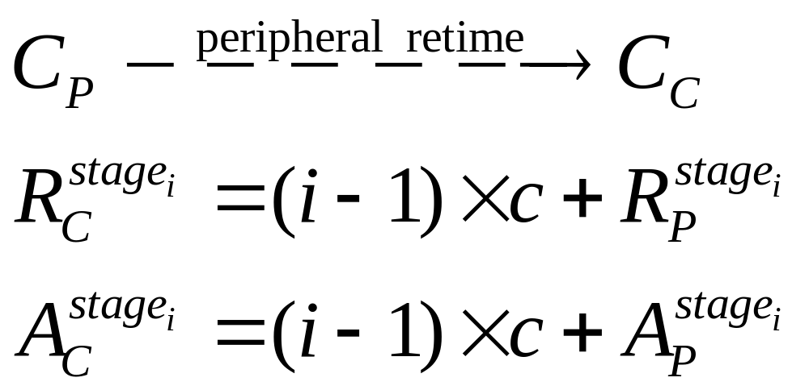
Resynthesis of Pipelines
Problem Transformation:
  Relax P_{P}(C_{P},c_{P},A_{P},R_{P}) to P ‘_{P}(C_{P},c_{p}+δ,A_{P},R_{P})
    where δ = largest possible single gate delay
  Convert: pipeline P ‘_{P} to combinational problem P ‘_{C}

Slide 39
Perfomance Synthesis of Pipeline
Arrival and Required Times for P ‘_{C} :
O_{n}
O_{n}
C_{n}
I_{n}
C_{n}
I_{n}
Peripheral
Retiming
(i-1)c+R_{i}
O_{i}
O_{i}
C_{i}
I_{i}
C_{i}
I_{i}
Combinational
circuit
(i-1)c+A_{i}
O₁
O₁
C₁
I₁
C₁
I₁
Theoretical Contribution:
  If P ‘_{C}(c_{p}+δ) has a solution then retiming yields a solution to P ‘_{P} (c_{p}+δ)
  If there is a solution to P_{P} (c_{p}) then peripheral retiming yields a solution to P ‘_{C} (c_{p}+δ)

