Slide 1
Verification of FSM Equivalence
Goal: Verify that two sequential circuit implementations always produce the same sequence of outputs given the same sequence of inputs.
i1
M1
out1
i1
M2
out2
Note: both machines are completely specified.
Does out1 = out2 for all possible input sequences?

Slide 2
FSM Equivalence of the Product Machine
M1xM2
M1
i
f
Form the product machine:
M(S,I,T,O,Init)
x = (x₁,x₂) present state
y = (y₁,y₂) next state
i = i₁ = i₂ input
Init(x) = (Init₁(x₁) x Init₂(x₂)) initial states
T(x,i,y) = T₁(x₁,i,y₁) • T2(x₂,i,y₂) transition relation
f(x,i) = (f₁(x₁,i) ≡ f₂(x₂,i)) single output
where ≡ denotes XNOR operation.
M2

Slide 3
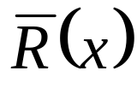
Implicit State Enumeration
The FSM’s are equivalent iff for all inputs, their outputs are identical on all reachable state pairs.
Let R be the set of all reachable state pairs.
Equivalence is verified by the following predicate:
∀(x,i) [(x∈ R) → f(x,i)]
Easy computation with BDDs. Simply compute
+ f(x,i)
and check if this is identically 1.

Slide 4
Implicit State Enumeration
The following fixed point algorithm computes the set of reachable state pairs R(x) of an FSM.
R₀(x) = Init(x)
R_{k+1}(x) = R_{k}(x) + [y → x] ∃x, i (R_{k}(x) • T(x,i,y))
where [y → x] represents substitution of x for y.
The iteration terminates when R_{k+1}(x) = R_{k}(x) and the least fixed point is reached.

Slide 5
Implicit FSM Traversal
Implicit enumeration of reached state set
  manipulates set of states directly in a BFS manner
  exponential speed-up over explicit enumeration methods (sometimes)
  exploits the fact that the number of states does not usually reflect system complexity
  implicit state enumeration may take a long time for sequentially deep circuits e.g. those with counters
one set of states
at a time:
one step

Slide 6
Finding Reachable States in an FSM
R₀ is the set of intial states
R₀

Slide 7
Finding Reachable States in an FSM
R₁ is the set of states reachable from the initial states in less than or equal to one steps.
R₁
R₀

Slide 8
Finding Reachable States in an FSM
R₂ is the set of states reachable from the initial states in less than or equal to two steps.
R₁
R₀
R₂

Slide 9
Finding Reachable States in an FSM
The fixed-point iteration terminates after finding R₄ = R₅.
The resultant set is the set of reachable states.
R₁
R₀
R₂
R₄=R₅

Slide 10
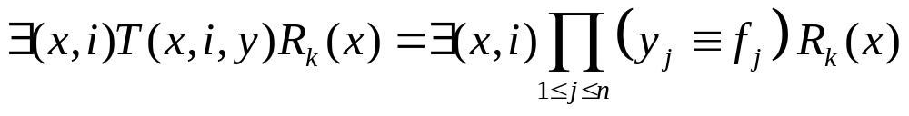
Partial Product Method
Do not need to compute the transition relation T(x,i,y) explicitly as a single monolithic BDD.
Can keep T(x,i,y) in product form (called “partitioned translation relation”):

Slide 11
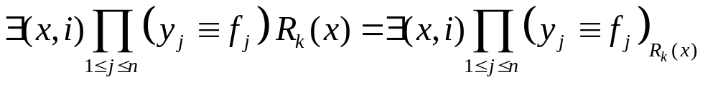
Partial Product Method Using Constrain
Can form the constrain with respect to R_{k}(x) of each (y_{j} ≡ f_{j}) before forming the final AND. This usually reduces the size of the final AND.
The final AND operation can be decomposed into a balanced binary tree of Boolean ANDs.
intermediate variables can be quantified out as soon as no other product depends on those variables.

Slide 12
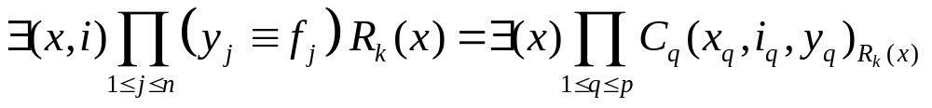
Using Constrain
Can pre-cluster groups of T_{j}(x_{j},i_{j},y_{j}) (defined as
(y_{j} ≡ f_{j}(x_{j},i_{j}))) together:
C_{j} = ∃i_{kj}(T_{j1},...,T_{jk})
where the i_{kj} that we can quantify out here are the ones that do not appear in any other T_{i}. Thus
Using constrain is a bad idea since (C_{j}(x_{j},i_{j},y_{j}))_{Rk(x)} may result in a BDD with more variables. (It is better to use RESTRICT).

Slide 13

Better Idea: Use Restrict
Linearly order (heuristically) the C_{j} and multiply from the right by R_{k}(x) one at a time, quantifying variables x_{q}, i_{q} as soon as possible (when they appear in no other terms).
R_{i+1} = R_{i}(x) + [y → x] ∃(x_{p},i_{p})C_{l1}(...(∃(x_{q},i_{q} ) C_{lq}P_{i}(x))...)
where P_{i}(x) = RESTRICT(R_{i}, ).
Note: here we do not care about any state in R_{i-1} since we have already found all successor states of these.
Computation done as a binary tree where quantification of x and i is done as soon as possible:
Quantify all remaining
variables that appear
in no other remaining
node.
C_{lq}P_{i}(x)

Slide 14
End of lecture 25

Slide 15
Restrict Operator
Restrict:
if f is independent of x_{i} then RESTRICT(f,c) is also.
it does not have the other nice properties of constrain.
Experiments show that restrict produces smaller BDDs.
function RESTRICT(f,c)
assert(c ≠ 0)
if (c = 1 or is_constant(f)) return f
else if (c_{x’i} = 0), return RESTRICT(f_{xi},c_{xi})
else if (c_{xi} = 0), return RESTRICT(f_{x’i},c_{x’i})
else if (f_{xi} = f_{x’i}), return RESTRICT(f_{xi}, c_{xi} + c_{x’i})
else return x_{i} RESTRICT(f_{xi},c_{xi}) +x’_{i} RESTRICT(f_{x’i},c_{x’i})

Slide 16
Recursive Image Method
(R_{i-1} is the set of currently reached states and g is the vector of next state functions)
The method uses CONSTRAIN: Let
g : B^{n} → B^{m}, g = [g₁, g₂, ..., g_{m}], and
c = characteristic function of R_{i-1} .
First step: use the CONSTRAIN operator to form
f = g_{c} = [(g₁)_{c}, (g₂)_{c}, ..., (g_{m})_{c}].
Second step: the range of f is determined. Let R(f) denote the range of the function f.
R_{i} = R(f)(y) = y₁R([f₂,...,f_{m}]_{f1}) + y’₁R([f₂,...,f_{m}]_{f’1})

Slide 17
Explicit FSM Traversal
Explicit enumeration:
process one state at a time
  for each state, next states are enumerated one by one
complexity depends on the number of states and the number of input values.
methods that enumerate the state space explicitly cannot handle FSM’s with a large number of states
one state
at a time
first
1
second
2
third
3
fourth
4

Slide 18
State enumeration
State traversal techniques are essential to:
  synthesis of sequential circuits
  verification of sequential circuits
Applications:
  sequential testing [Cho, Hachtel and Somenzi ITC ‘91]
  extraction of sequential don’t cares
  implementation verification:
    checking sequential equivalence [Coudert and Madre ICCAD ‘90]
    [Touati, Lin, Brayton and Sangiovanni ICCAD ‘90]
  design verification:
    checking language containment of ω-regular languages [Touati, Kurshan and Brayton 1991] [HSIS system ‘94]
    CTL model checking [Burch, Clarke, McMillan and Dill DAC ‘90] [SMV (CMU ‘91), VIS (Berkeley ‘96), MOCHA (Berkeley ‘98) systems]

Slide 19
End of this section

Slide 20
FSM Equivalence on the Product Machine
M1xM2
M1
i
f
M2

Slide 21
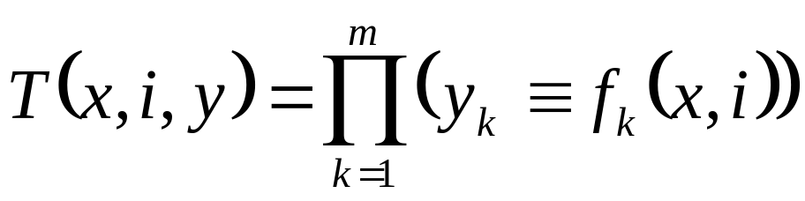
Transition and Output Relations
Let x be the present state, i the inputs, y the next state, and o the outputs.
Transition function vector: f(x,i) = [f₁(x,i), ..., f_{m}(x,i)]
Output relation:
O(x,i,o) = 1 ↔ output is o at state x and input i
Transition relation:
T(x,i,y) = 1 ↔ y = next state from state x on input i.
Note: transition relation can represent non-deterministic FSM but transition functions cannot.

Slide 22
Transition and Output Relations
(
)
m
(
(
)
)
T
x
,
i
,
y
=
∏
y
≡
f
x
,
i
k
k
k
=
1
y₁
f₁
≡
x
y₂
f₂
T(x,i,y)
y₃
≡
f₃
≡
i
y_{m}
f_{m}
Transition Relation
≡

Slide 23
Range, Domain, Image and Inverse Image
R(f) = range of f and D(f) = domain f(x) is a unique point
y ∈ R, but f⁻¹(y) is in general a set
The image of a function f(x) with respect to a domain constraint C(x) is denoted
Img (f, C) = {y | ∃x ∈ C : y = f(x)}.
In terms of relation T(x,i,y) and BDD operators:
Img (T, C)(y) = ∃x(C(x) • T(x,i,y)).
The inverse image of a function f(x) with respect to a domain constraint C(y) is denoted
Pre (f, C) = {x | ∃y ∈ C : y = f(x)}.
In terms of relation T(x,i,y) and BDD operators:
Pre (T, C)(x) = ∃ y(C(y) • T(x,i,y)).
Img (T,C) and Pre (T,C) are sets usually represented by BDD’s.

Slide 24
Generalized Cofactor
Recall:
  If c is a cube, the Shannon cofactor is the cover of the generalized cofactor cof(f,c), which is independent of variables of the cube c.
  There are many other functions which cover cof(f,c).
  Want: heuristic to select a representative function of cof(f,c) that has a small BDD representation.
  The constrain operator [Coudert ICCAD ‘90] is a representation of generalized cofactor which, in most cases, has a small BDD representation.
  When c is a cube, constrain operator gives the same result as the usual Shannon cofactor.

Slide 25
Constrain Operator
function constrain(f,c)
assert(c ≠ 0)
if (c = 1 or is_constant(f)) return f
else if (c_{x’i} = 0), return constrain(f_{xi},c_{xi})
else if (c_{xi} = 0), return constrain(f_{x’i},c_{x’i})
else return x_{i} constrain(f_{xi},c_{xi}) + x’_{i} constrain(f_{x’i},c_{x’i})
f
c
f_{c}
a
a
a
b
b
b
1
1
b
0
1
0
1
0
1
0
1

Slide 26
Properties of Constrain Operator
Following properties of the constrain operator make it very useful in implicit image computations. We denote constrain(f,c) by f_{c}.
  (g ο f)_{c} = g ο f_{c}
  In particular, (f + g)_{c} = f_{c} + g_{c} and (f’)_{c} = (f_{c})’.
  ∃x f(x,y) • c(x) = ∃x f_{c}(x,y)
  c is contained in f iff f_{c} is a tautology.
  If c is the characteristic function of a set A ⊆ B^{n}, then f_{c}(B^{n}) = f(A). i.e. R(f_{c}) = Img (f,A)
  Given F (f,d,r), f_{d’} usually has a smaller BDD representation than f.

Slide 27
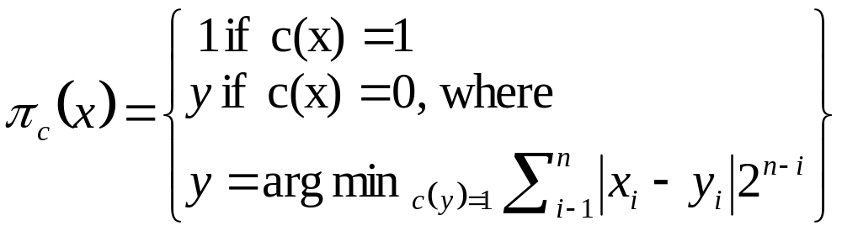
Constrain Operator: Another Perspective
Let c : Bn → B be a non-null Boolean function, and x₁ < x₂ < ... < x_{n} an ordering of its input variables. The mapping π_{c} is defined as follows:
π_{c} is a projection that maps a minterm x ∈ B^{n} to a minterm y in the ON-set of c, which has the closest distance to x, according to the distance metric d.
The particular metric used guarantees the uniqueness of y in the definition above.
Since π_{c} maps all points in B^{n} into the ON-set of c, then
f_{c}(x) = f(π_{c}(x)). If f = (f₁,...,f_{m}), then f_{c} = ((f₁)_{c},...,(f_{m})_{c}).

Slide 28
Fixed Point Iteration via Predicate Transformers
Let (p,q) be two predicates on a finite set S. Let F be a predicate transformer, i.e. F(p) = r where r is a new predicate on S. Suppose F is monotone:
p ⊂ q → F(p) ⊂ F(q)
We associate a sequence {p_{i}} as follows:
p₀ = 0
p_{i+1} = F(p_{i})
p∞ = p_{i} if p_{i+1} = p_{i}
p∞ is called the least fixed point of the predicate transformer F.
Note that p_{i} ⊆ p_{i+1}, since 0 ⊆ F(p₀) → F(0) ⊆ F(F(0)).
Since S is finite (p_{i})_{i≥0} converges after a finite number of iterations.

Slide 29
Fixed Point Iteration via Predicate Transformers
If p₀ = S, the corresponding iteration gives the greatest fixed point of F.
All sets can be represented by BDD’s, and the predicate transformer F(p_{i}) can be computed using BDD operations.

