Slide 1
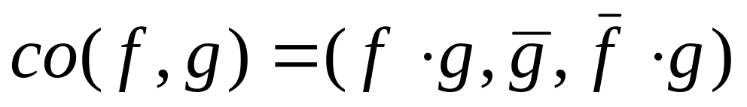
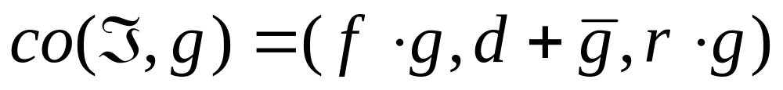
Generalized Cofactor
Definition 1 Let f, g be completely specified functions. The generalized cofactor of f with respect to g is the incompletely specified function:
Definition 2 Let ℑ = (f, d, r) and g be given. Then

Slide 2
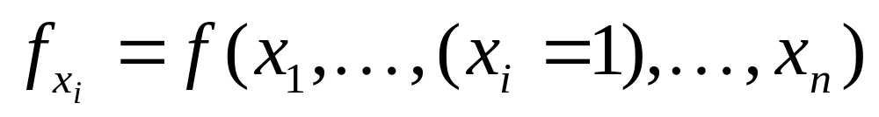
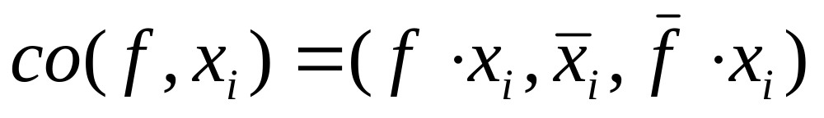
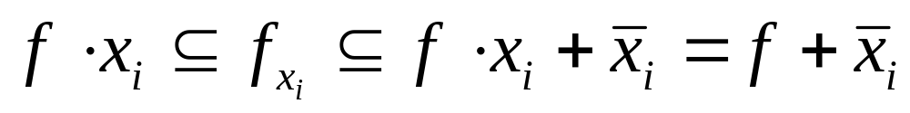
Relation with Shannon Cofactor
Let g=x_{i} . Shannon cofactor is
Generalized cofactor with respect to g=x_{i} is
Note that
In fact f_{xi} is the unique cover of co(f, x_{i} ) independent of the variable x_{i} .

Slide 3


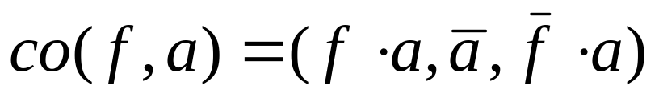
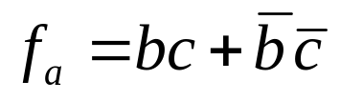
Shannon Cofactor
on
off
Don’t care

Slide 4





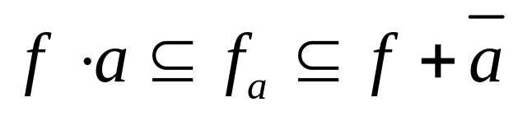
Shannon Cofactor (Cont.)
So

Slide 5
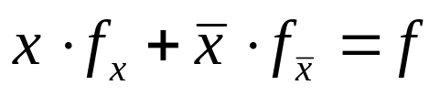

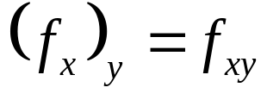

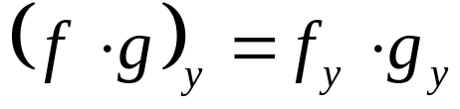

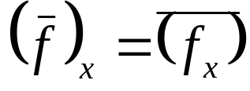
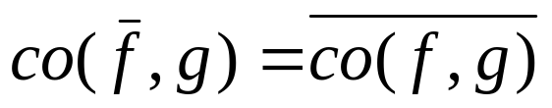
Properties of Generalized Cofactor co(f,g)
Shannon Cofactor
Generalized Cofactor
We will get back to use of generalized cofactor later

Slide 6
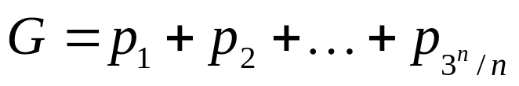
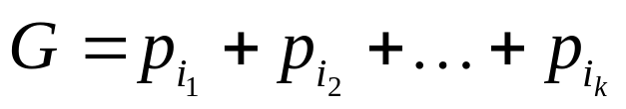
Quine-McCluskey Summary
Q-M:
1. Generate cover of all primes
2. Make G irredundant (in optimum way)
Note: Q-M is exact i.e. it gives an exact minimum
Heuristic Methods:
Generate (somehow) a cover of ℑ using some of the primes
Make G irredundant (maybe not optimumly)
Keep best result - try again (i.e. go to 1)

Slide 7
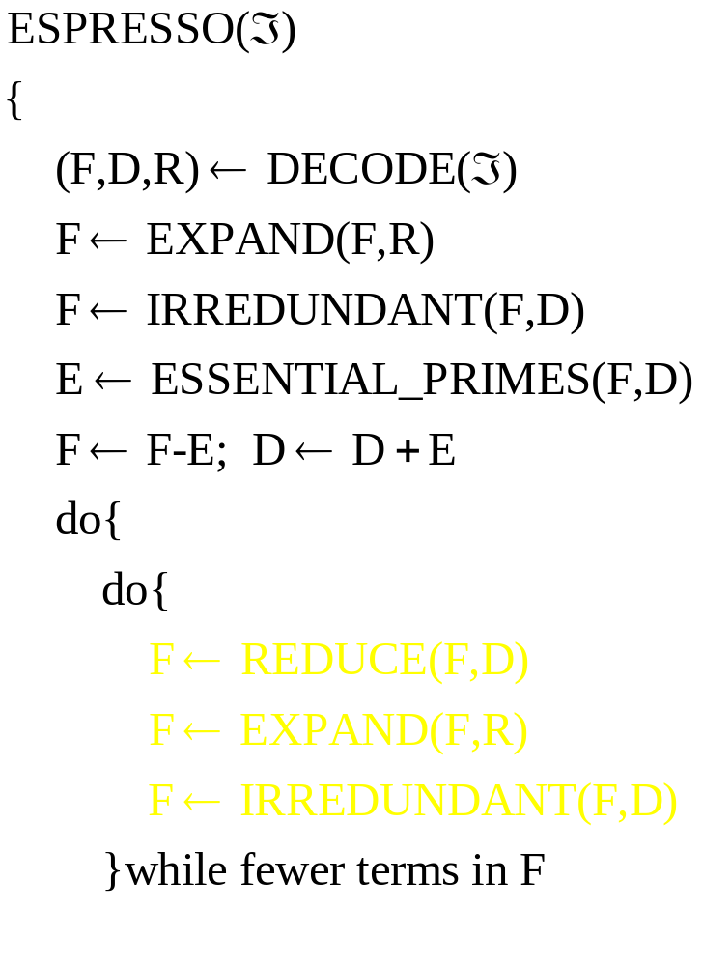
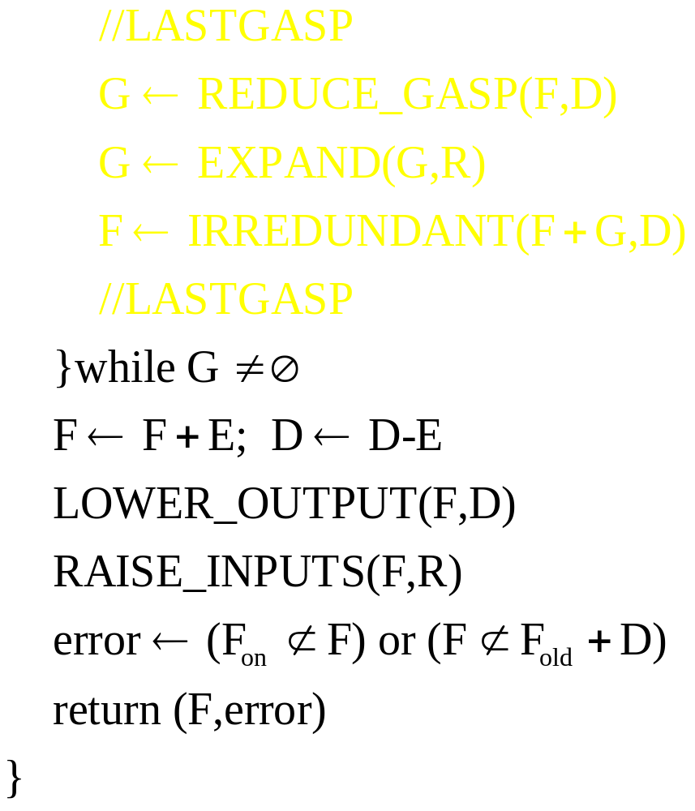
ESPRESSO - Heuristic Two-Level Minimization

Slide 8




ESPRESSO Illustrated

Slide 9
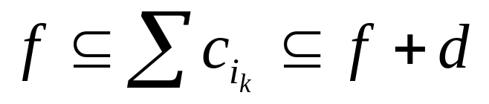
IRREDUNDANT
Problem:
Given a cover of cubes {c_{i}}, find a minimum subset {ci_{k}} that is also a cover, i.e.
Idea 1:
We are going to create a function g(y) and a new set of variables y_{i}, one for each cube c_{i}. A minterm in the y-space will indicate a subset of the cubes {c_{i}}.
Example 1:
y=011010 = {c₂,c₃,c₅}

Slide 10
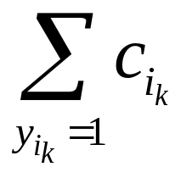
IRREDUNDANT
Idea 2:
Create g(y) so that it is the function such that:
g(y) = 1 ⇔ is a cover
i.e. if g(y^{k}) = 1 if and only if {c_{i} | y^{k}_{i} =1} is a cover.
Note: g(y) is positive unate (monotone increasing) in all its variables.

Slide 11


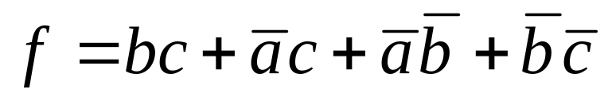

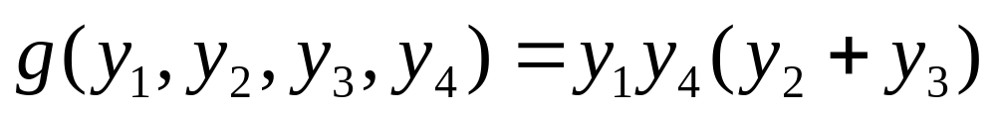

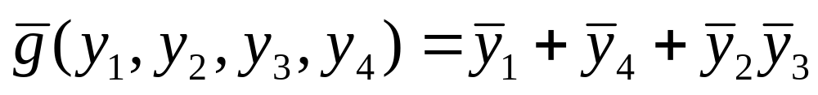
Example
Example 2:
Note:
We are after a minimum subset of cubes. Thus we want: the largest prime of g (least literals).
Consider g : it is monotone decreasing in y, e.g.

Slide 12

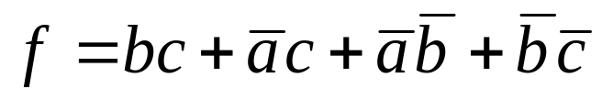
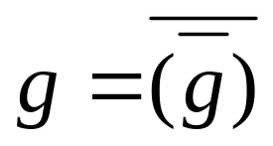
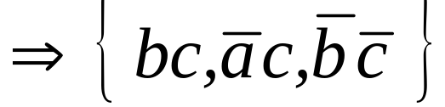
Example
Create a Boolean matrix for g:
Recall a minimal column cover of B is a prime of
We want a minimum cover of B
Example 3: {1,2,4} ⇒ y₁ y₂ y₄ (cubes 1,2,4)

Slide 13
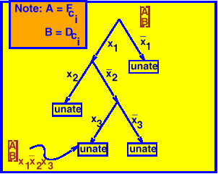
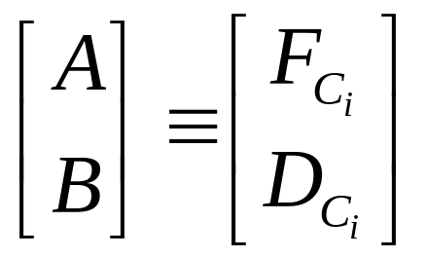
Deriving g(y)
Modify tautology algorithm:
F = cover of ℑ=(f,d,r)
D = cover of d
Pick a cube c_{i} ∈ F.
(Note: c_{i} ⊆ F ⇔ F_{ci} ≡ 1)
Do the following for each cube c_{i} ⊆ F :

Slide 14
Deriving g(y)
1. All leaves must be tautologies
2. G’ means how can we make it not the tautology. We must exactly delete all rows of all 2’s that are not part of D
3. Each row came from some row of A/B
4. Each row of A is associated with some cube of F.
5. Each cube of B associated with some cube of D ( we don’t need to know which, and we can’t delete its rows).
6. Rows that must be deleted are written as a cube, e.g. y₁y₂y₇ ⇒ delete rows 1,3,7 of F.

Slide 15
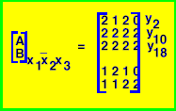
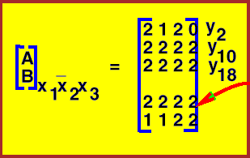
Deriving g(y)
Example 4: Suppose unate leaf is in subspace x₁x’₂x₃ :
Thus we write down: y₁₀ y₁₈ (actually, y_{i} must be one of y_{10 ,} y₁₈). Thus, F is not a cover if we leave out cubes c₁₀ , c₁₈.
Unate leaf
Note: If row of all 2’s in don’t cares,
then there is no way not to have tautology at that leaf.
Row of all 2’s
in don’t cares

Slide 16
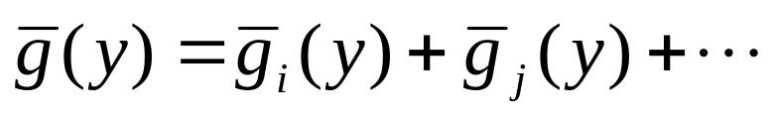
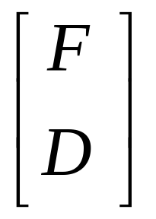
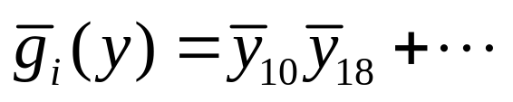




Deriving g(y)
c_{i}
c_{j}
x₁
x₂
x₃

Slide 17
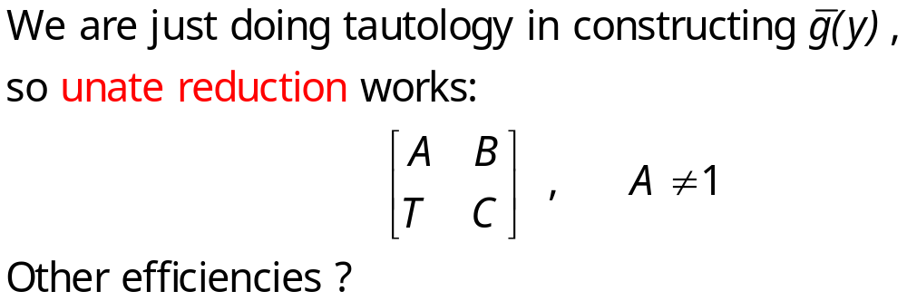
Summary
Convert g(y) into a Boolean matrix B (note that g(y) is unate). Then find a minimum cover of B. For example, if y₁y₃y₁₈ is a minimum cover, then the set of cubes:
{c₁ , c₃ , c₁₈ }
is a minimum sub cover of { c_{i} | i=1,…,k}. (Recall that a minimal cover of B is a prime of g(y), and g(y) gives all possible sub-covers of F).
Note:

Slide 18
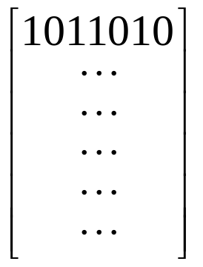
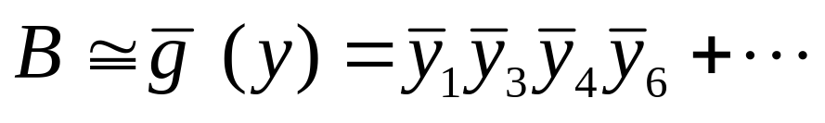
Back to Q-M
All primes
B = Minterms of f
We want a maximum prime of g(y).
Note: A row of B says if we leave out primes
{p₁ , p₃ , p₄ , p₆ }
we cease to have a cover.
So basically, the only difference between Q-M and IRREDUNDANT is that for the latter, we just constructed a ‾g(y) where we did not consider all primes, but only those in some cover: F = {c₁ , c₃ ,…, c_{k} }

Slide 19

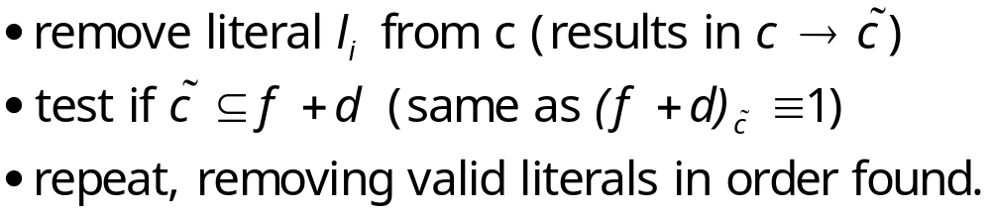
EXPAND
Problem: Take a cube c and make it prime by removing literals.
a). Greedy way: (uses D and not R)

Slide 20
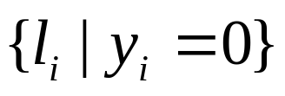
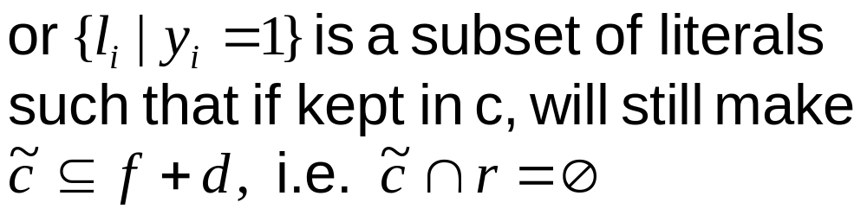
EXPAND
b). Better way: (uses R and not D)
Want to see all possible ways to remove maximal subset of literals.
Idea: Create a function g(y) such that g(y)=1 iff literals:
can be removed.

Slide 21
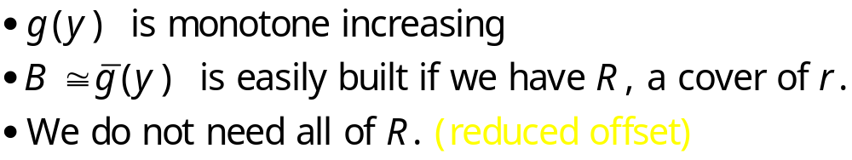
Main Idea of EXPAND
Outline:
Expand one cube, c_{i} , at a time
Build “blocking” matrix B = B ^{ci}
See which other cubes c_{j} can be feasibly covered using B.
Choose expansion (literals to be removed) to cover most other c_{j} .
Note:

Slide 22

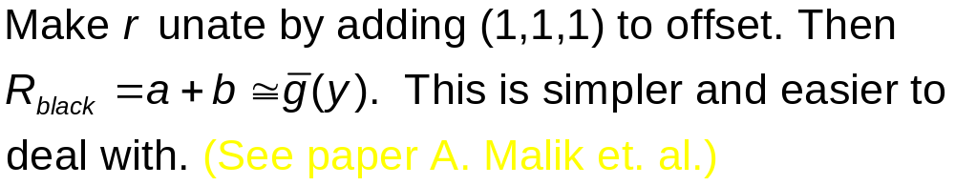
Reduced offset
on
off
Don’t care

Slide 23
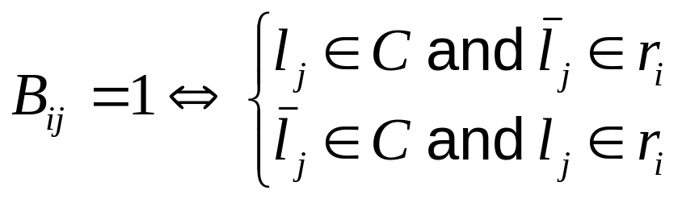
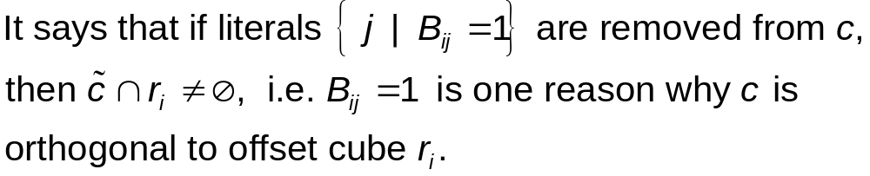
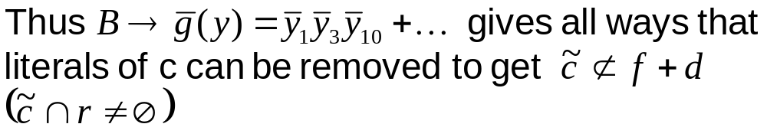
Blocking Matrix B (for cube C)
Given R = {r_{i} }, a cover of r. [ ℑ = (f,d,r) ]
What does row i of B say?

Slide 24
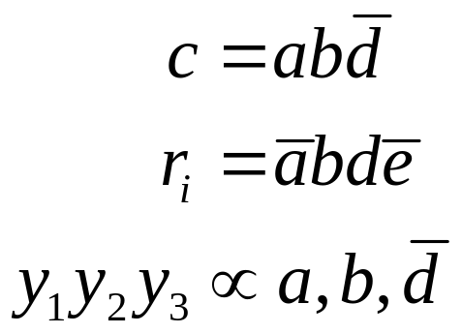
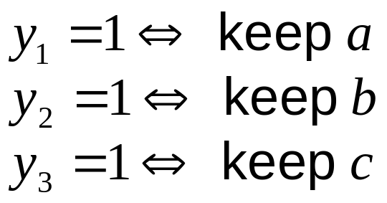
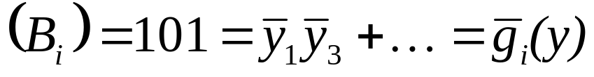


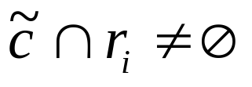

EXPAND example
Suppose g(y)=1,
If y₁ = 1, we keep literal a in cube c.
B_{i} means do not keep literals 1 and 3 of c. (implies that subsequent is not an implicant). If literals 1, 3 are removed we get . But :
so obviously b is not an implicant.

Slide 25
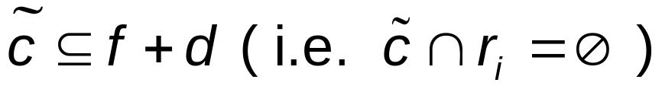




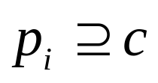

EXPAND continued
Thus all minimal column covers ( ≅ g(y) ) of B are the minimal subsets of literals of c that must be kept to ensure that
Thus each minimal column cover is a prime p that covers c, i.e. p ⊇ c.

Slide 26
End of lecture 4

Slide 27





Expanding c_{i}
F = { c_{i} }, ℑ = (f,d,r) f ⊆ F ⊆ f+d
Q: Why do we want to expand c_{i} ?
A: To cover some other c_{j} ‘s.
Q: Can we cover c_{j} ?
A: If and only if (SCC = “smallest cube containing” also called “supercube” )
equivalent to:
equivalent to:
literals ”conflicting” between c_{i}, c_{j} can be removed and still have an implicant

Slide 28

Expanding c_{i}
Can check SCC(c_{i}, c_{j}) with blocking matrix:
c_{i} = 12012
c_{j} = 12120
implies that literals 3 and 4 must be removed for to cover c_{j} . Check if column 3, 4 of B can be removed without causing a row of all 0’s.

Slide 29
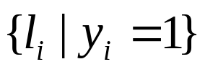





Covering function
The objective of EXPAND is to expand c_{i} to cover as many cubes c_{j} as possible. The blocking function g(y)=1 whenever the subset of literals
yields a cube . (Note that ).
We now build the covering function,h , such that:
h(y) = 1
whenever the cube covers another cube c_{j} ⊆ F.
Note: h(y) is easy to build.
Thus a minterm m ∈ g(y) h(y) is such that it gives
( g(m) =1 ) and covers at least one cube (h(m) =1). In fact every cube is covered. We seek m which results in the most cubes covered.

Slide 30

Covering function
Thus define h(y) by a set of cubes where d_{k} = k^{th} cube is:
(Thus each d_{k} gives minimal expansion to cover c_{k} )
Thus d_{k} ≠ ∅ if cube c_{k} can be feasibly covered by expanding cube c_{i}. d_{k} says which literals we have leave out to minimally cover c_{k} . Thus h(y) is defined by h(y) = d₁ + d₂ +… + d_{|F|-1} (one for each cube of F, except c_{i}. It is monotone decreasing).

Slide 31


Covering function
We want m ∈ g(y)h(y) contained in a maximum number of d_{k} ‘s.
In the Espresso, we build a Boolean covering matrix C (note that h(y) is unate negative) representing h(y) and solve this problem with greedy heuristics.
Note:

Slide 32

Covering function
Want set of columns such that if eliminated from B and C results in no empty rows of B and a maximum of empty rows in C.
Note:
a 1 in C can be interpreted as a reason why does not cover c_{j} .

Slide 33
Endgame
What do we do if h(y) ≡ 0 ?
Some things to try:
generate largest prime covering c_{i}
cover most care points of another cube c_{k}
coordinate two or more cube expansions, i.e. try to cover another cube by a combination of several other cube expansions
So far we have not come up with a really satisfactory endgame. This could be important in many hard problems, since it is often the case that h(y) ≡ 0 .

Slide 34


REDUCE
Problem: Given a cover F and c ∈ F, find the smallest cube c ⊆ c such that
F\{ c } + { c }
is still a cover. c is called the maximally reduced cube of c.
REDUCE is
order dependent
on
off
Don’t care

Slide 35


REDUCE Example
Example 5:
Two orders:
REDUCE is order dependent !

Slide 36

REDUCE Algorithm

Slide 37

REDUCE
Main Idea: Make a prime not a prime but still maintain cover:
{c₁ ,…, c_{i},…, c_{k}} → {c₁ ,…,c_{i},c_{i+1} ,…,c_{k} }
But
Get out of a local minimum (prime and irredundant is local minimum)
Then have nonprimes, so can expand again in different directions. (Since EXPAND is “smart”, it may know best direction)

Slide 38
REDUCE
F = {c₁ ,c₂, …,c_{k}}
F (i) = (F + D) \ { c_{i} }
= {c₁ ,c₂,…,c_{i-1},c_{i+1},…, c_{k}}
Reduced cube:
c _{i} = smallest cube containing (c_{i} ∩‾F(i) )
Note that c_{i} ∩‾F(i) is the set of points uniquely covered by c_{i} (and not by any other c_{j} or D).
Thus, c_{i} is the smallest cube containing the minterms of c_{i} which are not in F(i).

Slide 39




REDUCE
on
off
Don’t care
SCC == “supercube”
SCCC = “smallest cube containing complement”

Slide 40








Efficient Algorithm for SCCC
Unate Recursive Paradigm:
select most binate variable
cofactor
until unate leaf
What is SCCC (unate cover) ?
Note that for a cube c with at least 2 literals, SCCC(c) is the universe:
unate
So SCCC(cube) = 22222

Slide 41

SCCC
SCCC (U) = γ
Claim: if unate cover has row of
  all 2’s except one 0, then complement is in x _{i} , i.e. γ_{i} = 1
  all 2’s except one 1, complement is in x _{i}, i.e. γ_{i} = 0
otherwise in both subspaces, i.e. γ_{i} = 2
Finally
Implies that only need to look at 1-literal cubes.

Slide 42

SCCC Example
Example1:
Note: 0101 and 0001 are both in‾f . So SCCC could not have literal b or ‾b in it.
Example2:
Note that columns 1 and 5 are essential: they must be in every minimal cover. So ‾U = x₁x₅(...). Hence SCCC(U) = x₁x₅

Slide 43


SCCC Example
Proof. (sketch):
The marked columns contain both 0’s and 1’s. But every prime of‾U contains literals x₁ , x₅

Slide 44

SCCC
Thus
Thus unate leaf is easy !

Slide 45



Merging
We need to produce
If c₁ ∧ c₂ ≠ ∅, then points in both x_{i} and‾x_{j}, so
( SCC(x_{i}c₁ +‾x_{i}c₂) )_{i} = 2
If l_{j}∉c₁ , or l_{j}∉c₂ , then both x_{j} and‾x_{j} points exit, hence γ_{i} =2.
Also if l_{j}∈c₁ and ‾l_{j}∈c₂ , then γ_{i} =2.

Slide 46


ESPRESSO - Heuristic Two-Level Minimization

Slide 47


LASTGASP
Reduce is order dependent:
Expand can’t do anything with the reduction produced by REDUCE 2.
Maximal Reduce:
i.e. we reduce all cubes as if each were the first one.
Note:
{c₁^{M} ,c₂^{M} ,...} is not a cover.

Slide 48



LASTGASP
Now expand use EXPAND, but try to cover only c_{j}^{M}‘s. (Note here we call EXPAND(G,R), where G = {c₁^{M} ,c₂^{M} ,…, c_{k}^{M}} ) If a covering is possible, take the resulting prime:
and add to F:
Since F is a cover, so is . Now make irredundant (using IRREDUNDANT).
What about “supergasp” ?
Main Idea: Generally, think of ways to throw in a few more primes and then use IRREDUNDANT. If generate all primes, then just Quine-McCluskey

Slide 49





Goldberg Variation
Property of LASTGASP:
Let F^{i} = maximal reduction of F^{i} ∈ F. LASTGASP searches for maximally reduced cubes F^{i} and F^{k} such that
F^{ik} ≡ supercube( F^{i}, F^{k})
is an implicant of ℑ. It then produces a new prime (which is not in F) which covers supercube( F^{i}, F^{k}).
However, this does not guarantee that the size of F decreases by at least one on the next IRREDUNDANT.
EXAMPLE:

Slide 50
Goldberg Theorem
Theorem 1:
Let A^{ik} = (f∩ F^{i}∩ F^{k} ) - { F\ {F^{i},F^{k}} }
= ( F^{i}∩ F^{k} ) - { D+F\ {F^{i},F^{k}} }
(i.e. A^{ik} is the set of ON-set minterms covered by F^{i}∩ F^{k} and not intersected with any other cube from F.)
Then both F^{i} and F^{k} can be replaced by a prime P^{ik} ⊇ supercube( F^{i}, F^{k}) if and only if:
P^{ik} ⊇ A^{ik}
Thus for a reduction by at least one in the size of the cover, we need a prime with the property
P^{ik} ⊇ supercube( F^{i}, F^{k}) ∪ A^{ik}
An algorithm based on this was proposed by E. Goldberg of the Byelorussion Academy of Sciences, Institue of Engineering Cybernetics in Minsk, FSU (now at Cadence Berkeley Labs). He reported it was less expensive than SUPER_GASP and more effective than LASTGASP.

