Slide 1
Multi-Valued Logic
Up to now…two-valued synthesis
  Binary variables take only values {0, 1}
Multi-Valued synthesis
  Multi-valued variable X_{i} can take on values P_{i} = {0,…,|P_{i}|-1} (integers - but no ordering implied)
  Symbolic variables take values from symbolic set, e.g. state: {s₀,s₁,…,s_{n}} or
  X: {a,b,c}.

Slide 2
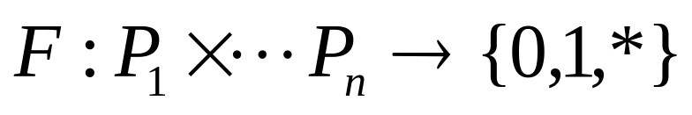
Multi-Valued Logic
Formally:
(sometimes called an mv-function).
Problem:
find the minimum (SOP) form for an incompletely-specified function of this kind
Big News:
Nothing (much) changes

Slide 3
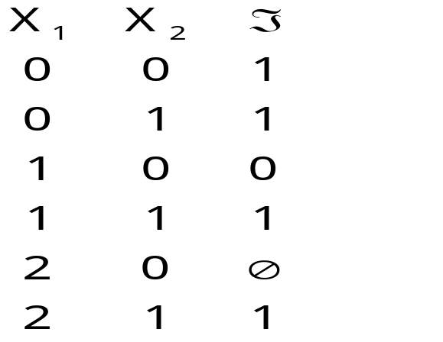
Example “Truth Table”
P₁={0,1,2}, P₂={0,1}
Here “2” means the value 2 and not {0,1}
  f(0,0) = 1 f(2,1) = 1
  f(1,0) = 0 f(2,0) = * unspecified
  (don’t cares)

Slide 4



MV Function
on
off
Don’t care

Slide 5
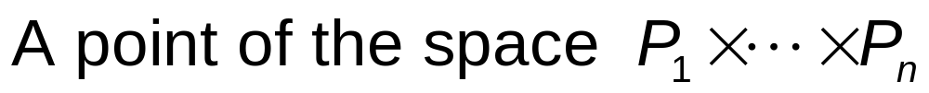
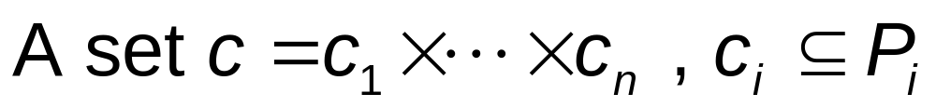
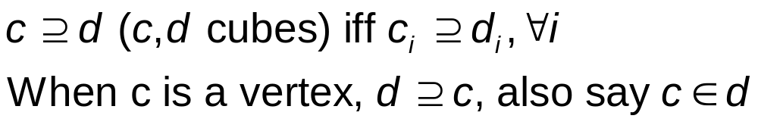
Terminology
Vertex:
Cube:
Containment:
Implicant:

Slide 6
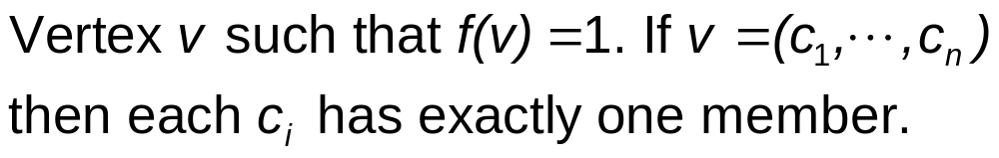
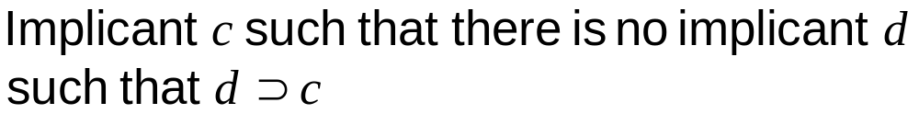
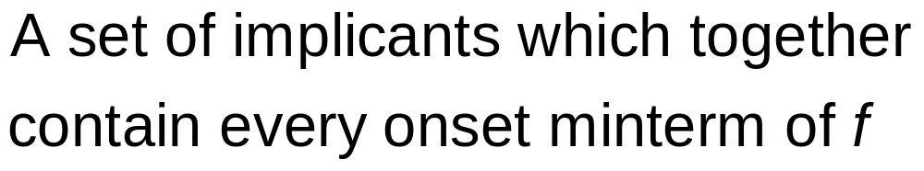
Terminology
Onset minterm:
Prime Implicant:
Cover of F :

Slide 7
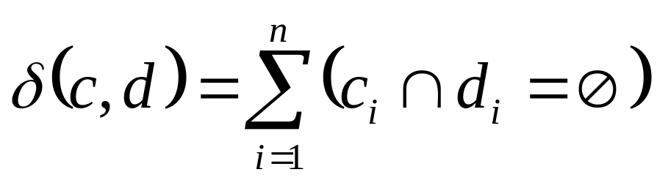
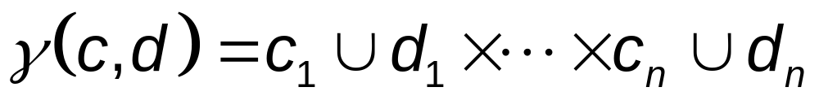
Terminology
Prime Cover of F :
Distance of cubes c,d :
Supercube of c,d :
Note: All these definitions are exactly as they were in the binary case.

Slide 8
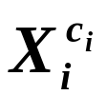
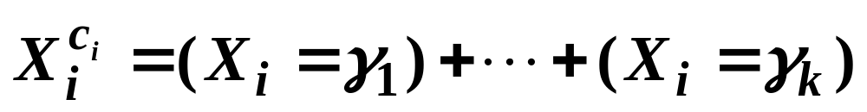
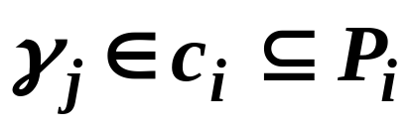

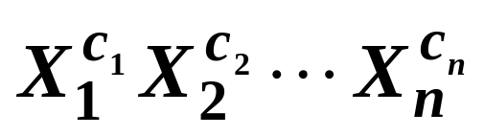
Notation-MV Literals
Definition - A multi-valued literal is a
binary logic function of the form
where
Definition - A cube can
be written as the product of MV-literals:

Slide 9
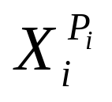
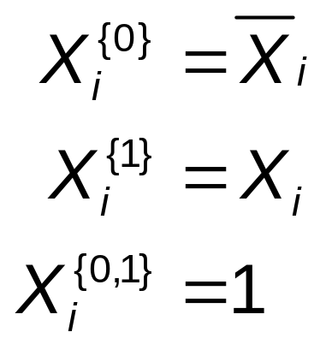
Notation-MV Literals
If c_{i}=P_{i} we may omit from the expression (since =1)
Note analogy to two-valued case:
Actually, multi-valued notation is superior to old (binary).

Slide 10
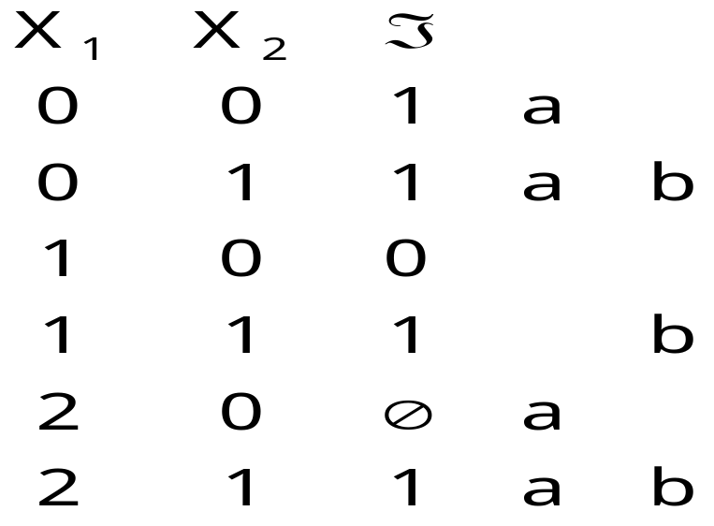
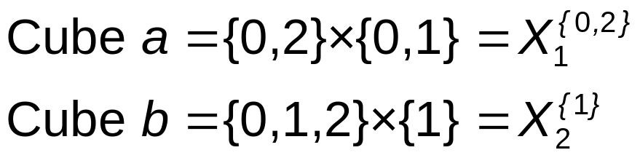
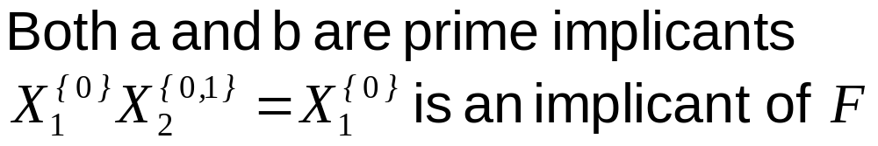
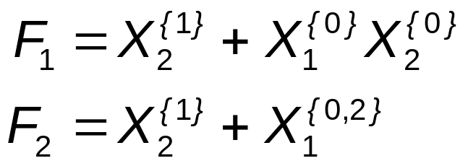
Example
Can form rows marked a (b) as a single mv-cube implicant
The following are cube covers of F. F₂ is a prime cover

Slide 11
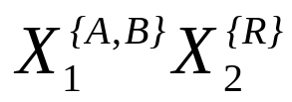
Positional Notation
Example: cube
P₁={A,B,C,D}, P₂={R,S} (Symbolic)
A B C D R S
Cube: 1 1 0 0 1 0
A cube does not depend on variable X_{i} if it has all 1’s in the set of columns associated with X_{i} .
Each of the columns of a variable is called a part of that variable. There is one part for each value a variable can take.
Extension of Espresso notation

Slide 12
Positional Notation
Extension of Espresso notation
(value=0) (value=1)
0 1 ← 1
1 0 ← 0
1 1 ← 2
Example:
X₁ X₂ X₃
             
       
       
       
      

Slide 13
End of lecture 5

Slide 14
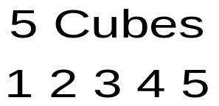
Positional Notation
X₁ X₂ X₃
      
      
       
       
      

Slide 15
Minimization Problem for Multi-Valued Logic
Given: a cover F of ℑ and a cover D of the don’t-care set d,
Find: A minimum sum-of-products form for ℑ
Same problem as for two-valued
Generate primes of (f+d)
Generate covering table
Solve the covering table (unate covering problem)
Same algorithms as for two-valued (except for small details).

Slide 16
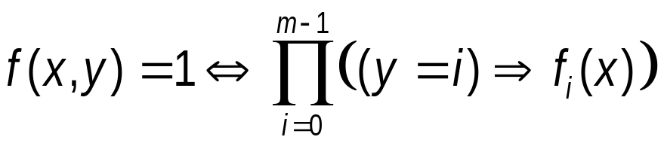
Applications of Multi-Valued Logic
Theorem (Hong): minimizing a two-valued (n input) × (m output) logic function g is equivalent to minimizing a single binary-output MV-logic function:
f : {0,1} × {0,1} × ... × {0,…,m-1} → {0,1}
Proof( sketch):
Let g = {f₀,…,f_{m-1}} be the multiple output function. Consider the characteristic function f of the multiple output function, (defined on (n+1) variables with the last one, y, being multi-valued on {0,1,…,m-1} ) :

Slide 17
Applications of Multi-Valued Logic
Note: an implicant of g (the multi-output function) is a cube c in the x-space where each output is turned on only if f_{i}(c)=1. Any output not turned on means no information (not offset), since the each output is the OR of all of its input cubes.
X f₁ f₂ f₃ f₄ f₅ f₆
g
x-cube 0 1 0 1 1 0

Slide 18
Other Applications: Encoding Problems
Other Applications:
Input Encoding problem
  bit-grouped PLA structure
Output encoding problem?
  output phase optimization?
State encoding problem
  Minimize symbolically to get constraints on a posssible binary encoding
  solve constraints to derive binary code
  Re-minimize binary problem
  Implement in binary

Slide 19
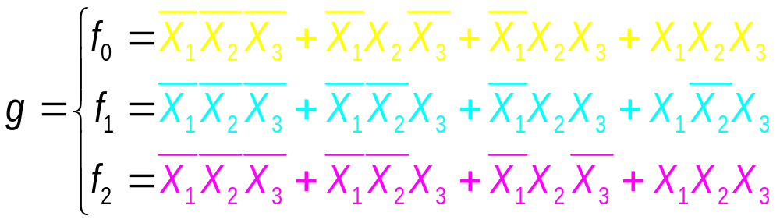
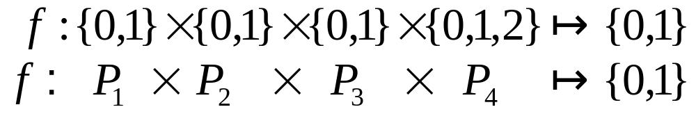
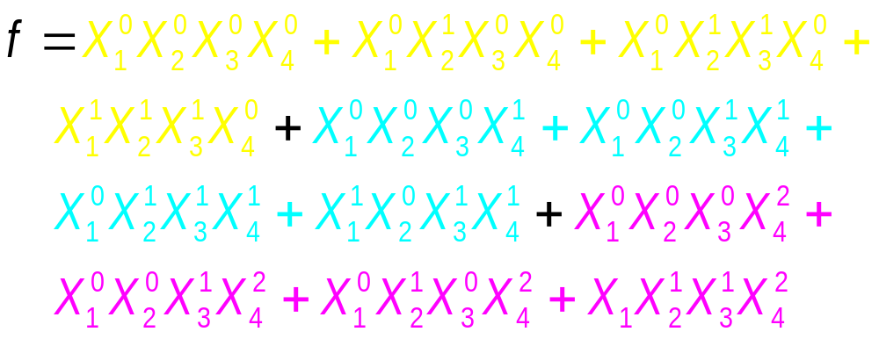
Multi-Valued Minimization Example

Slide 20
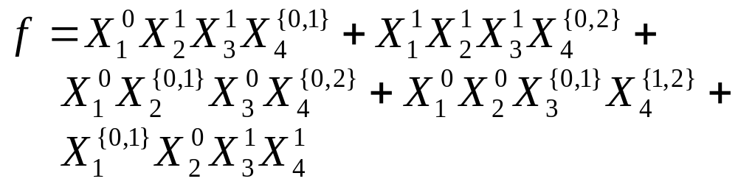
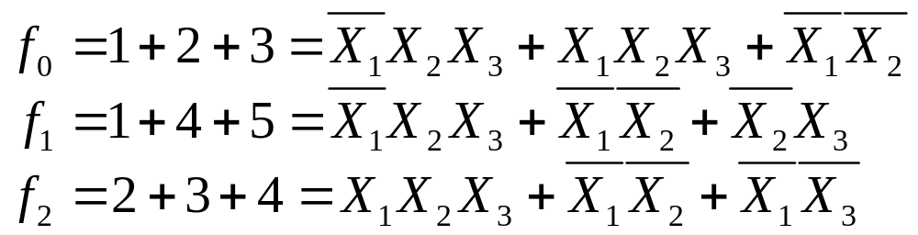
Example - after minimization
Prime and irredundant SOP of f:
(five cubes 1+2+3+4+5)
Equivalent to:

Slide 21



Example - after minimization
f₀ f₁ f₂
Note: is not a prime of f₀, but is a prime of f. Similarly for .

Slide 22
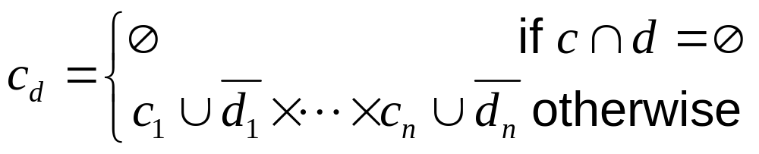
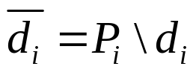
Shannon Cofactor
Cofactor of cube c with respect to cube d (c_{d})
Note:
Note: this agrees with “standard” cofactor in the case of two-valued
  Hint: check cases on d_{i}, c_{i}, e.g. if d_{i}=c_{i}=1 (i.e. x_{i} in d and c) , then (c_{d})_{i} = c_{i} ∪‾d_{i} = 2 = {0,1}
Rationale: Only care about value of c on subspace given by d. ( d is don’t care)

Slide 23
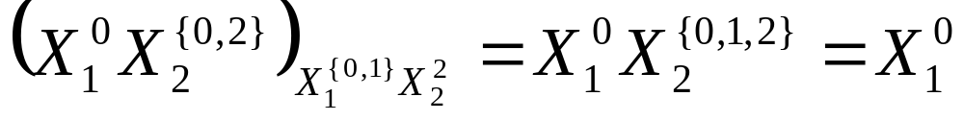

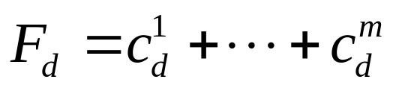
Shannon Cofactor - Example
Example: space is {0,1} × {0,1,2}
Cofactor of cover with respect to cube d is
Note: Cofactor of a cover with respect to another cover is not defined.

Slide 24
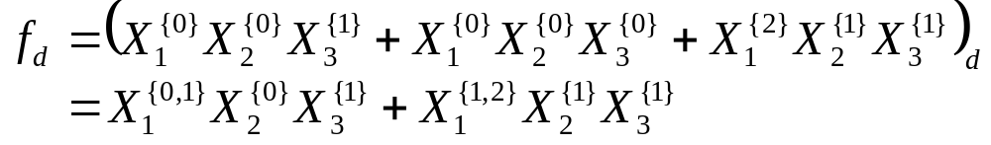


Shannon Cofactor-Example
F = (f,r) and cube d = X₁^{{0,2}}
Co(F,d)
f_{d}
F
d
Consider the generalized cofactor:
Co(F,d) = (fd,‾d, rd)
Note: We keep all the onset (not in‾d ) and project the care onset fd to‾d. Also, as in the binary case, but

Slide 25
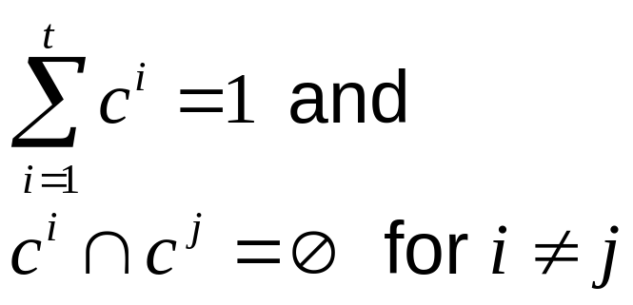
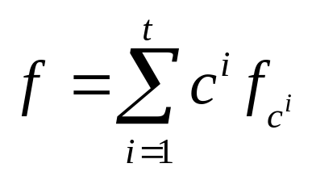
Shannon Cofactor Expansion Theorem (General Case)
Theorem: Let f be any function and {c¹, …, c^{t}} any set of cubes which partition the input space:
Then

Slide 26
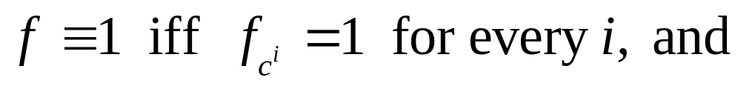
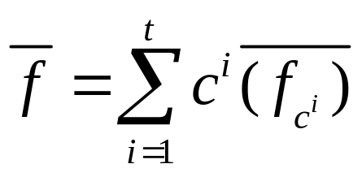
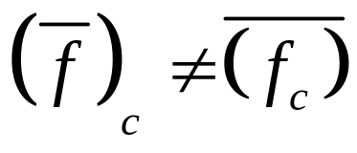
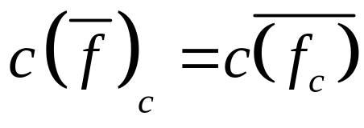
Shannon Cofactor Expansion Theorem (General Case)
We immediately have:
i.e. most Shannon cofactor results continue to hold. However, note , but

Slide 27
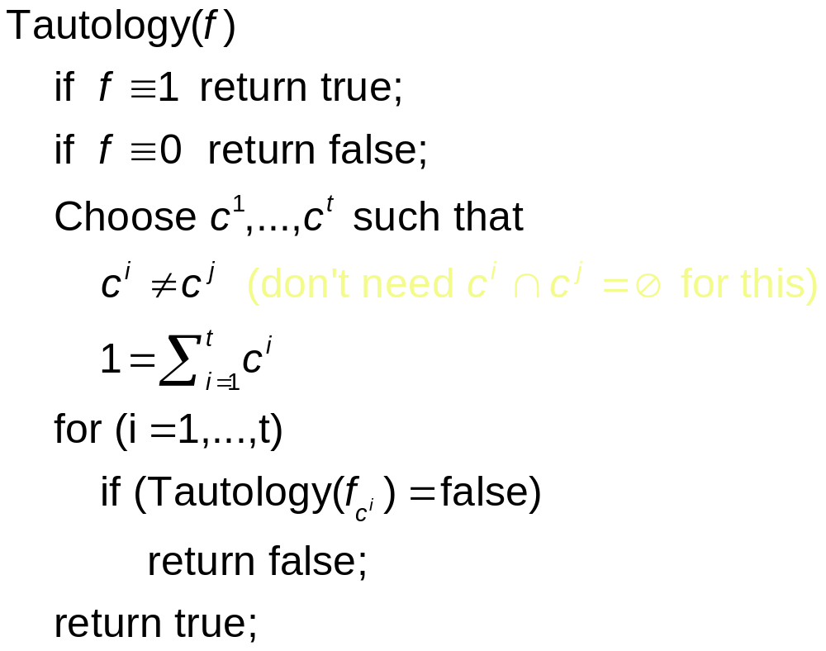
Recursive Paradigm: Multi-Valued Version

Slide 28
Recursive Paradigm: MV version
Still Open:
Unate leaves (what does unateness mean?)
Splitting choice (i.e. which { c^{i} })
Unate Reduction

Slide 29
Unateness: Multi-Valued
Definition 1: f is said to be weakly unate in X_{i} if there exists some value j, such that changing X_{i} from value = j to something else, does not cause f to decrease.
Analog to unateness in two-valued case set j=0 and get monotone increasing; set j=1 and get monotone decreasing
In general: detecting unateness is hard (obviously)
Special case: unate cover

Slide 30
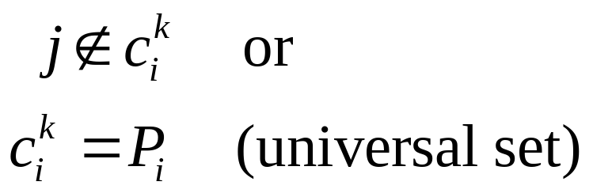
Weakly-Unate Cover
Definition 2: A cover F= c¹ +…+ c^{t} is said to be weakly unate in X_{i} iff there is some j such that, for each cube c^{k}, either:
(monotone increasing from
value j in variable X_{i})
j (X_{i})
    
    
     
    
    
    

Slide 31
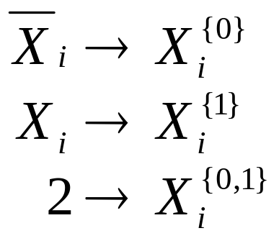
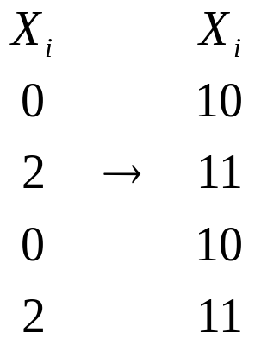
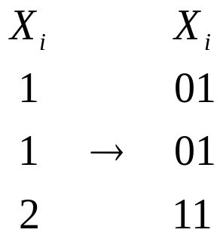
Weakly-Unate Cover
Analogy to two-value:
Rewrite (binary to MV)
Example
Here j=1 i.e. monotone increasing from j=1 (monotone decreasing in X_{i} )
Here j=0 i.e. monotone increasing from j=0 (monotone increasing in X_{i} )

Slide 32
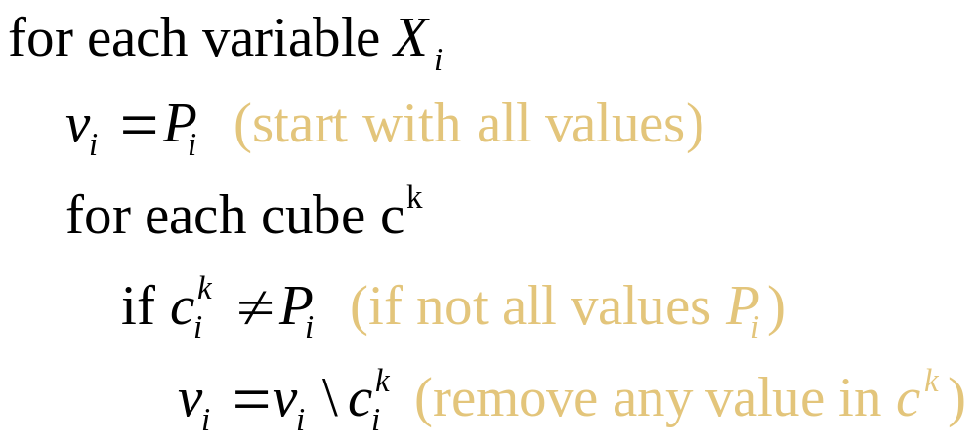
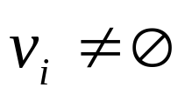
Weakly-Unate Cover
Easy to detect:
Unate variables are those for which
(Just looking for a column with all 0’s, except for rows of all 1’s)

Slide 33
Weakly-Unate Cover
1. throw out rows of all 1’s
2. Look for column of all 0’s
j (X_{i})
c₁ 01010
c₂ 00100
. ...
. 01..
c_{t-1} 11111
c_{t} 11111

Slide 34
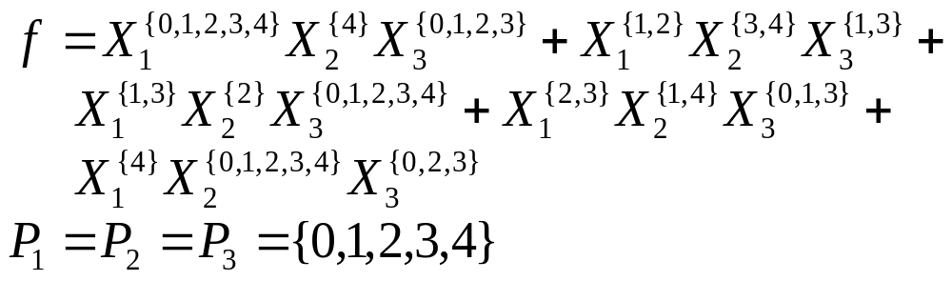
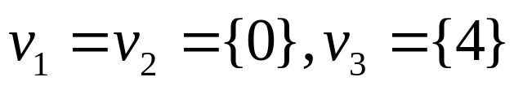
Example
F is weakly-unate in every variable.
X₁ X₂ X₃
c₁     
c₂     
c₃     
c₄     
c₅     

Slide 35
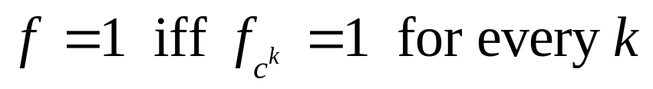
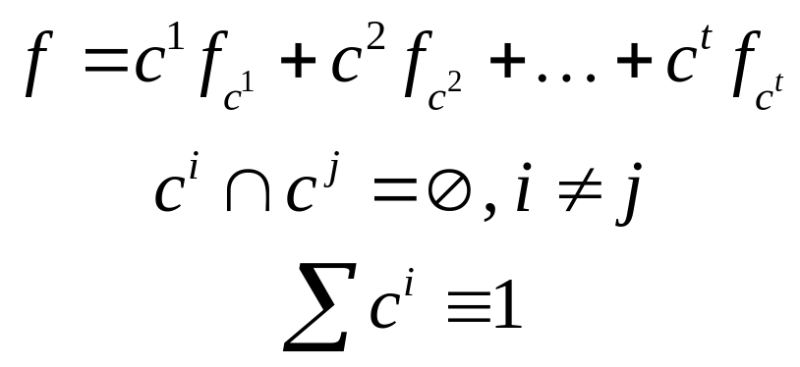
Application to Tautology
Theorem 1: Let {c¹, …, c^{t}} be a cube partition as in Shannon expansion theorem. Then:
Proof: follows two-valued case exactly.
(1)

Slide 36



Monotone Theorem
Theorem 2: Let f be weakly unate in variable x_{i} from value j. Then:
Analogous to for monotone increasing (from 0).
(2)
Proof:

Slide 37

Monotone Theorem

Slide 38


Weakly Unate Reduction Theorem
Theorem 3: (unate reduction) f is weakly-unate in X_{i}, and the “unate value” is j. Then f = 1 iff
Proof:

Slide 39

Weakly Unate Reduction Theorem

Slide 40



Tautology for Weakly Unate Cover
Definition 3: Cover c¹ + … + c^{t} is weakly-unate iff it is weakly-unate in all variables.
Theorem 4 : c¹+ …+c^{t} weakly-unate then c¹+ …+c^{t} =1 iff c^{j}=1 for some cube j.
Proof. Follows from reduction theorem.
Thus for weakly unate cover, can tell immediately.
Vertex 1000 0100 0100 not covered.

Slide 41



Reduction in One Step
c exactly as in two-valued algorithm
c is cube of unate variables, e.g.
then A_{c}=0. Hence f_{c}=(T B).

Slide 42

Revised Tautology
Left open: how to split?
i.e. how to choose c¹, …, c^{t} where c^{i} ∩ c^{j} = ∅, and ∑c^{i} =1.

Slide 43




Methods of Splitting
“Split by value”
  Gets rid of variable X_{i} in a single step.

Slide 44



Methods of Splitting
“Split by parts”
q, s partition P_{i} (e.g. q={0,1}, s={2,3}
  May get to unate leaves (somewhat) more quickly
  More freedom to choose good partitions -don’t need to entirely eliminate variable X_{i} at a node before splitting on X_{k}.
  In practice, “split by parts” is used

Slide 45

Choice of Splitting Variable
Cover F = γ¹ +…+ γ^{|F|}
Goal: get to weakly unate leaves as fast as possible
Definition 4: Active value of variable X_{i}:
(Any value k of X_{i} with all 1’s in column is not active)
Choose variable with most active values
(Note: all inactive values can be equivalently grouped into one value.)

Slide 46


Choice of Splitting Variable
Tie breaks (|F| is number of cubes)
  Variables i maximizing
  (“Smallest” variable = most 0’s in columns)
  Variables minimizing
  (least “2’s”)

Slide 47




Choice of Partition
Cover F=c¹+…+ c^{t}, variable X_{i}
Goal: Like to find partition q, s of P_{i} such that:
is minimized.
Hard problem! Use heuristic
“Fast to compute” more important than quality...
Heuristic:
m active values in X_{i}
q gets first m/2 active values, s the rest
This reduces the number of active values on each side by half
s not active
q not active

Slide 48
End of lecture 6

Slide 49
Strongly Unate Functions
Weakly-unate good enough for tautology based algorithms, but…
F weakly-unate ¬ ⇒ F_{c} weakly-unate
Example: F is weakly unate cover.
X₁ X₂ X₃ X₃
10 11 11 111
F = 11 10 10 100
11 11 10 010
c = 11 11 10 110
10 11 11 111
F_{c} = 11 10 11 101
11 11 11 011
F_{c} is not weakly unate in X₃. (But in this example, f_{c} is!)
(However, I think this also holds for f and f_{c} as well
i.e. f can be weakly unate
in a variable but f_{c} may not be).

Slide 50

Strongly Unate Functions
F weakly-unate does not imply every prime of f essential.
Example: f = { p1,p2,p3,p4,p5 }
p1,…, p5 are all primes.
  P1 essential
  p2 nonessential
  p3 essential
  p4 nonessential
  p5 essential
Weakly unate in all variables
A column of all 1’s indicates a value that is not active.
p1 11111 00001 11110
p2 01100 00011 01010
p3 01010 00100 11111
p4 00110 01001 11010
p5 00001 11111 10110

Slide 51
Strongly Unate Functions
f weakly-unate does not imply ‾f weakly-unate.
All these are primes.
Need stronger condition...
00110 01000 00101
11111 00001 00001
00001 11110 01001
‾f = 01100 00010 10101
11000 11000 11111
10110 10100 11111
10010 10010 11111

Slide 52

Stongly Unate functions
Definition 5: f is strongly-unate in X_{i} iff there is some total order < on P_{i} such that, for j<k in P_{i}
Thus “increasing” X_{i} (from value j to value k, if j<k) doesn’t decrease f.
Example: strongly unate cover (order is from left to right i.e. 1<2<3 on all variables)
Can detect strongly unate cover by the existence of a value order for each P_{i}, where the 0’s are on the left for all cubes.
111 011 1111
f = 011 001 1111
001 111 0011

Slide 53
Strongly Unate Functions: Propositions
f strongly-unate ⇒ f weakly-unate
f strongly-unate ⇒‾f strongly-unate
f strongly-unate ⇒ f_{c} strongly-unate
f strongly-unate ⇒ every prime of f essential..
But:
Weakly-unate applies to a cover more often
  easier to compute
  good enough for tautology based algorithms
Strongly unate not used in two-level logic minimization algorithms (so far).

Slide 54
Exact Minimization
Use basic logic synthesis algorithm
Generate all primes
Form covering table
Solve covering table
Steps (2)-(3) are same as in binary case

Slide 55

Prime Generation
Theorem 5 (Prime merging) Let f be any function,
l, r be any cubes such that l∩r=∅ and l+r=1.
Then the primes of f are the maximal cubes among:
  the primes of lf_{l} = l ∩ primes of f_{l}, and
  the primes of rf_{r} = r ∩ primes of f_{r}, and
  the cubes of c^{l}Θc^{r} where c^{l} ∈ primes of lf_{l} and c^{r} ∈ primes of rf_{r}.
(Θ stands for consensus)
Note: this easily specializes to binary theorem when all values are binary.
How do we get all the primes at a leaf? (see Rudell paper)
Note: if c and d are distance 2, then result is ∅

Slide 56
Heuristic Minimization
Use Espresso-II
Irredundant, Reduce, Lastgasp
(Unchanged because tautology based)
Essential Primes essentially unchanged
(minor technical differences in expression)
Expand
Minor difference from Espresso-II
Can’t use blocking matrix B^{c} when expanding cube c.
  May be able to expand c_{i} even if column j is in a minimal column cover of B^{c}.

Slide 57

Heuristic Minimization
Expand example:
Consider the case j∉c_{i}, j∉r_{i}^{k} for each cube k of the offset, j can be added to c_{i} even when i is in a minimal column cover of B^{c}. Adding j to c_{i} leaves c_{i} ∩ r_{i}^{k} = ∅ unchanged.
This implies that B^{c}_{ki} = 1 because c_{i} ∩ r_{i}^{k} = ∅ . But we still may be expand to change to
...X_{i} ...
   ⇒
  
     

Slide 58



Multi-value EXPAND
We build the blocking function g(y) using the cover of the offset R = { r¹ +…+ r^{|R|} }. To expand cube c, let variable y^{k}_{j} denote that in positional notation, the expanded cube has a 1 in value k of variable x_{j} . Then intersects r^{i} if
Hence, intersects the offset is given by the function
Note: this is monotone increasing in y

Slide 59


Multi-value EXPAND
Its complement g(y) (monotone decreasing) gives all legitimate expansions of c. A prime of g gives a prime expansion of c.
Note: g is a binary function, and is unate. It is convenient to obtain‾g(y) in SOP form by complementing (twice)
using our unate complementer.

Slide 60
Conclusions
Adding multi-valued permits
  minimizing multiple-output functions,
  solving encoding problems, and
  other applications which are naturally multi-valued.
Minimization fundamentals basically unchanged
Details changed in
  Consensus
  All-prime generation (minor)
  Unateness (2 kinds now - largest change)
  Essential primes (to accommodate consensus)
  Expand (blocking matrix no longer an efficiency gain)
Most details in paper by Rudell and Sangiovanni on MV optimization.

