Slide 1
ROBDD’s
represents a logic function by a graph (DAG). (many logic functions can be represented compactly - usually better than SOP’s)
canonical form (important) (only canonical if an ordering of the variables is given)
many logic operations can be performed efficiently on BDD’s (usually linear in size of result - tautology and complement are constant time)
size of BDD critically dependent on variable ordering

Slide 2
ROBDD’s
Directed acyclic graph (DAG)
one root node, two terminals 0, 1
each node, two children, and a variable
Shannon co-factoring tree, except reduced and ordered (ROBDD)
Reduced:
  any node with two identical children is removed
  two nodes with isomorphic BDD’s are merged
Ordered:
  Co-factoring variables (splitting variables) always follow the same order
        x_{i1} < x_{i2} < x_{i3} < … < x_{in}

Slide 3
Example
root
node
f = ab+a’c+bc’d
a
a
1
c+bd
b
c+bd
c
b
b
0
c+d
d+b
d
c
c
c
d
b
b
d
0
1
0
1
Two different orderings, same function.

Slide 4
Efficient Implementation of BDD’s
(Reference: Brace, Rudell, Bryant - DAC 1990)
Hash-Table: hash-fcn(key) = value
hash value
of key
collision
chain

Slide 5
Efficient Implementation of BDD’s
Strong canonical form: A “unique-id” is associated (through a hash table) uniquely with each element in a set.
With BDD’s the set is the set of all logic functions. A BDD node is a function. Thus each function has a unique-id in memory.
BDD is a compressed Shannon co-factoring tree.
f
v
0
1
f_{v}
f_{v}

Slide 6
ROBDD
Ordered BDD (OBDD) Input variables are ordered - each path from root to sink visits nodes with labels (variables) in ascending order.
ordered
order = a,c,b
a
not
ordered
a
c
c
b
c
b
c
b
0
1
0
1
Reduced Ordered BDD - reduction rules:
  if the two children of a node are the same, the node is eliminated: f = cf + c’f
  if two nodes have isomorphic graphs, they are replaced by one of them
These two rules make it so that each node represents a distinct logic function.

Slide 7
Theorem
Theorem 1 (Bryant - 1986)
ROBDD’s are canonical
Thus two functions are the same iff their ROBDD’s are equivalent graphs (isomorphic). Of course must use same order for variables.

Slide 8
Function is Given by Tracing
All Paths to 1
F = b’+a’c’ = ab’+a’cb’+a’c’ all paths to the 1 node
a
f
0
f_{a} = cb’+c’
1
c
1
f_{a}= b’
0
b
0
1
0
1
Notes:
By tracing paths to the 1 node, we get a cover of pairwise disjoint cubes.
The power of the BDD representation is that it does not explicitly enumerate all paths; rather it represents paths by a graph whose size is measures by its nodes and not paths.
A DAG can represent an exponential number of paths with a linear number of nodes.
Each node is given by its Shannon representation:
    f = af_{a} + ‾af_{a}

Slide 9
Implementation
Variables are totally ordered: If v < w then v occurs “higher” up in the ROBDD (call it BDD from now on).
Definition 1: Top variable of a function f is a variable associated with its root node.
Example: f = ab + a’bc + a’bc’. Order is (a < b < c).
      f_{a} = b, f_{‾a} = b
f
b is top variable of f
a
f
b
reduced
f does not depend on a,
since f_{a} = f_{‾a} .
Each node is written as a triple: f = (v,g,h) where g = f_{v} and h = f_{‾v} . We read this triple as:
    f = if v then g else h = ite (v,g,h) = vg+v ’ h
b
0
1
0
1
v is top variable of f
f
f
v
v
1
0
mux
0
1
g
h
g
h

Slide 10


ITE Operator
 operator can implement any two variable logic function. There are 16 such functions corresponding to all subsets of vertices of B ²:
Table Subset Expression Equivalent Form
0000 0 0 0
0001 AND(f, g) fg ite(f, g, 0)
0010 f > g f‾g ite(f,‾g, 0)
0011 f f f
0100 f < g ‾fg ite(f, 0, g)
0101 g g g
0110 XOR(f, g) f ⊕ g ite(f,‾g, g)
0111 OR(f, g) f + g ite(f, 1, g)
1000 NOR(f, g) f + g ite(f, 0,‾g)
1001 XNOR(f, g) f ⊕ g ite(f, g,‾g)
1010 NOT(g) ‾g ite(g, 0, 1)
1011 f ≥ g f + ‾g ite(f, 1, ‾g)
1100 NOT(f) ‾f ite(f, 0, 1)
1101 f ≤ g ‾f + g ite(f, g, 1)
1110 NAND(f, g) fg ite(f, ‾g, 1)
1111 1 1 1

Slide 11
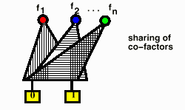
Unique Table - Hash Table
hash value
of key
collision
chain
Before a node (v, g, h ) is added to BDD data base, it is looked up in the “unique-table”. If it is there, then existing pointer to node is used to represent the logic function. Otherwise, a new node is added to the unique-table and the new pointer returned.
Thus a strong canonical form is maintained. The node for f = (v, g, h ) exists iff(v, g, h ) is in the unique-table. There is only one pointer for (v, g, h ) and that is the address to the unique-table entry.
Unique-table allows single multi-rooted DAG to represent all users’ functions:

Slide 12
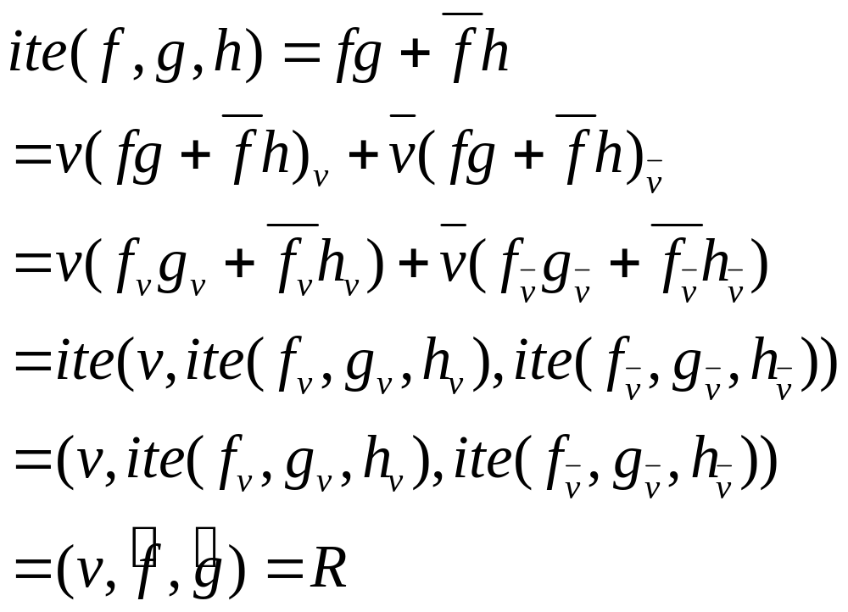
Recursive Formulation of ITE
v = top-most variable among the three BDD’s f, g, h

Slide 13
Recursive Formulation of ITE
Terminal cases: (0, g, f ) = (1, f, g) = f
ite (f, g, g) = g
ite(f, g, h)
if(terminal case) {
return result;
} else if(computed-table has entry (f, g, h )) {
return result;
} else {
let v be the top variable of (f, g, h );
f <- ite(f_{v} , g_{v} , h_{v} );
g <- ite(f_{‾v} , g_{‾v} , h_{‾v} );
if( f equals g ) return g;
R <- find_or_add_unique_table(v, f, g );
insert_computed_table( {f, g, h }, R);
return R; } }
The “insert_computed_table” is a cache table where ite results are cached.

Slide 14
Example
F
G
H
I
a
a
b
0
a
0
1
0
1
0
1
D
1
J
B
C
c
d
C
d
1
b
0
1
1
0
1
0
1
0
1
0
D
1
0
1
0
1
0
0
F,G,H,I,J,B,C,D
are pointers
I = ite (F, G, H)
= (a, ite (F_{a} , G_{a} , H_{a} ), ite (F_{‾a} , G_{‾a} , H_{‾a} ))
= (a, ite (1, C , H ), ite(B, 0, H ))
= (a, C, (b , ite (B_{b} , 0_{b} , H_{b} ), ite (B_{‾b} , 0_{‾b} , H_{‾b} ))
= (a, C, (b , ite (1, 0, 1), ite (0, 0, D)))
= (a, C, (b , 0, D))
= (a, C, J)
Check: F = a + b
        G = ac
        H = b + d
    ite(F, G, H) = (a + b)(ac) +‾a‾b(b + d)
    = ac + ‾a‾bd

Slide 15
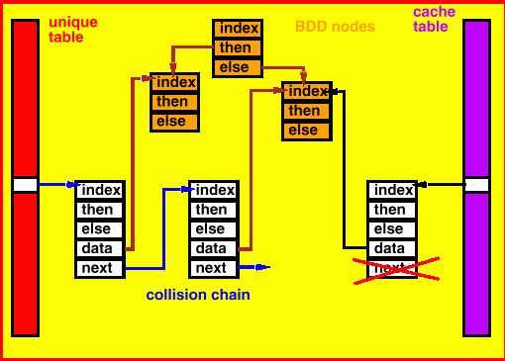
Computed Table
Keep a record of (F, G, H ) triplets already computed by the  operator in a hash-based cache ( “cache” table). This means that the collision chain is not used (if collision, old entry thrown away ).
The above structure is wasteful since the BDD nodes and collision chain can be merged.

Slide 16
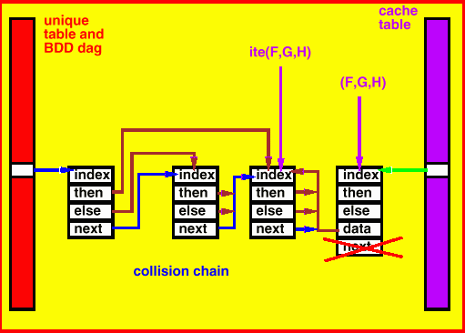
Better Implementation

Slide 17
Extension - Complement Edges
G
‾G
two different
DAGs
0
1
0
1
Can combine by making complement edges
G
‾G
only one DAG
using complement
pointer
0
1

Slide 18
Extension - Complement Edges
To maintain strong canonical form, need to resolve 4 equivalences:
V
V
V
V
V
V
V
V
Solution: Always choose one on left, i.e. the “then” leg must have no complement edge.

Slide 19
Ambiguities in Cache Table
Standard Triples: ite(F, F, G ) ⇒ ite(F, 1, G )
ite(F, G, F ) ⇒ ite(F, G, 0 )
    ite(F, G,‾F ) ⇒ ite(F, G, 1 )
    ite(F,‾F, G ) ⇒ ite(F, 0, G )
To resolve equivalences: ite(F, 1, G ) ≡ ite(G, 1, F )
ite(F, 0, G ) ≡ ite(‾G, 1,‾F )
ite(F, G, 0 ) ≡ ite(G, F, 0 )
ite(F, G, 1 ) ≡ ite(‾G,‾F, 1 )
ite(F, G,‾G ) ≡ ite(G, F,‾F )
  1. First argument is chosen with smallest top variable.
  2. Break ties with smallest address pointer.
Triples:
ite(F, G, H ) ≡ ite (‾F, H, G ) ≡ ite (F, ‾G,‾H) ≡ ite (‾F, ‾H, G)
Choose the one such that the first and second argument of ite should not be complement edges(I.e. the first one above).

Slide 20
Tautology Checking
Tautology returns 0, 1, or NC (not constant).
  ITE_constant(F, G, H ) {
  if(trivial case) {
  return result (0,1, or NC);
  } else if (cache table has entry for (F, G, H )) {
  return result;
  } else {
  let v be the top variable of F, G, H ;
  R ← ITE_constant(F_{v}, G_{v}, H_{v} );
  if(R = NC) {
  insert_cache_table({F, G, H }, NC);
  return NC;
  }
  E ← ITE_constant(F_{‾v} , G_{‾v} , H_{‾v} );
  if( R ≠ E) {
  insert_cache_table({F, G, H }, NC);
  return NC;
  }
  insert_cache_table({F, G, H }, E);
  return E;
  } }
Note: in computing ITE_constant, we set up a temporary cache-table for storing results of the ITE_constant operator. When done, we can throw away this table if we like.

Slide 21
Compose
Compose is an important operation for building the BDD of a circuit.
  Compose(F, v, G ) : F(v, x) → F( G(x), x)
Means substitute v = G(x)
  Compose(F, v, G) { (in F replace v with G )
  if(top_var(F) > v ) return F;
  (because F does not depend on v)
  if(top_var(F) = v ) return ITE(G, F₁, F₀ );
  R ← compose(F₁ , v, G );
  E ← compose(F₀ , v, G );
  return ITE(top_var(F), R, E);
  (note that we call ITE on this rather than
  returning (top_var(F), R, E). Why? ) }
Notes:
1. F₁ is the 1-child of F, F₀ the 0-child.
2. G , R, E are not functions of v .
3. If top_var of F is v, then ite (G , R, E ) does the replacement of v by G.

Slide 22
End of lecture 7

Slide 23
Multivalued Decision Diagrams(MDD’s) “BDD’s” for MV-functions
There is an equivalent theory (canonical etc.) for MDD’s:
v
P_{v} = (0,1,2,3,4)
0
1
4
2
3
Typically, we encode the multi-valued variable with log₂(|P_{v}|) binary variables and use unused codes as “don’t cares” in a particular way:
MDD package in VIS
Encode in binary
Use regular (optimized) BDD
  Package
Interface keeps track of
  encoding
4
1
3
0
2

Slide 24
Sets and Graphs:
With MDDs we can represent and manipulate general sets and graphs.
  Set: ⇒ characteristic function of set
  ≡ ((f (v ) = 1) ⇔ (v ∈S ⊆ P_{v}))
  Graph: (set of edges) ⇒ ((f (x, y ) = 1) ⇔ (x, y )
  is an edge in graph where x and y are multi-valued variables representing nodes in the graph.

Slide 25
Zero Suppressed BDD’s - ZBDD’s
ZBDD’s were invented by Minato to efficiently represent sparse sets. They have turned out to be extremely useful in implicit methods for representing primes (which usually are a sparse subset of all cubes).
Different reduction rules:
BDD: eliminate all nodes where then edge and else edge point to the same node.
ZBDD: eliminate all nodes where the then node points to 0. Connect incoming edges to else node.
For both: share equivalent nodes.
ZBDD:
BDD:
0
1
0
1
0
0
1
0
1
0
1
0
1

Slide 26
Canonicity
Theorem 2 (Minato) ZBDD’s are canonical given a variable ordering and the support set.
Example:
x₁
x₃
x₃
x₂
x₁
1
0
1
x₂
1
BDD
ZBDD if
support is
x₁, x₂
1
0
ZBDD if
support is
x₁, x₂, x₃
x₃
x₁
x₂
1
1
0
ZBDD if
support is
x₁, x₂ , x₃
BDD

