Slide 1
Multi-Level Logic Synthesis Introduction
Outline
Representation
  Networks
  Nodes
Technology Independent Optimization
Technology Dependent Optimization

Slide 2
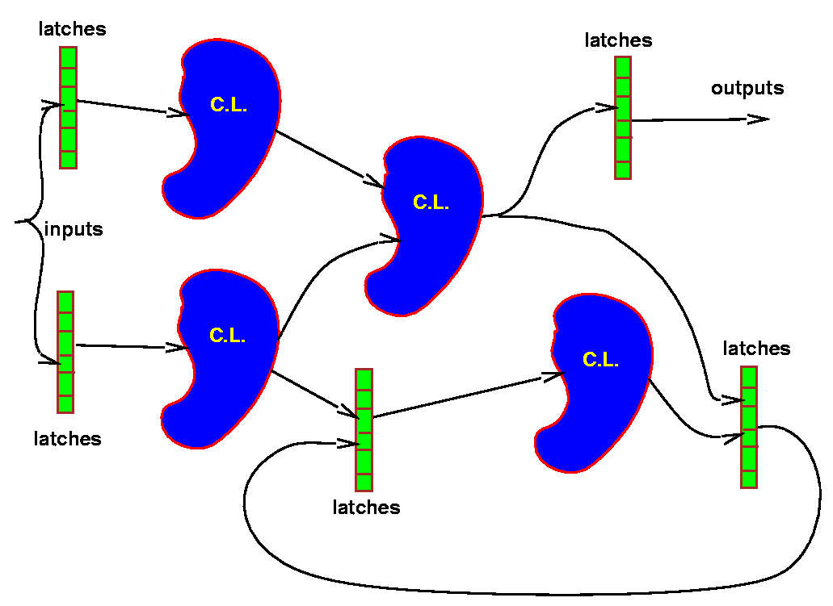
Structured System
(combinational logic, memory, I/O)
Combinational optimization
Sequential optimization

Slide 3
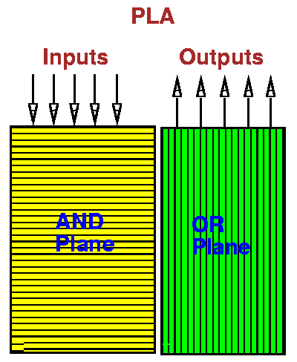
Two-Level (PLA) vs. Multi-Level
PLA
control logic
constrained layout
highly automatic
technology independent
multi-valued logic
slower?
input, output, state encoding
Multi-level
all logic
general
automatic
partially technology independent
coming
can be high speed
some results

Slide 4
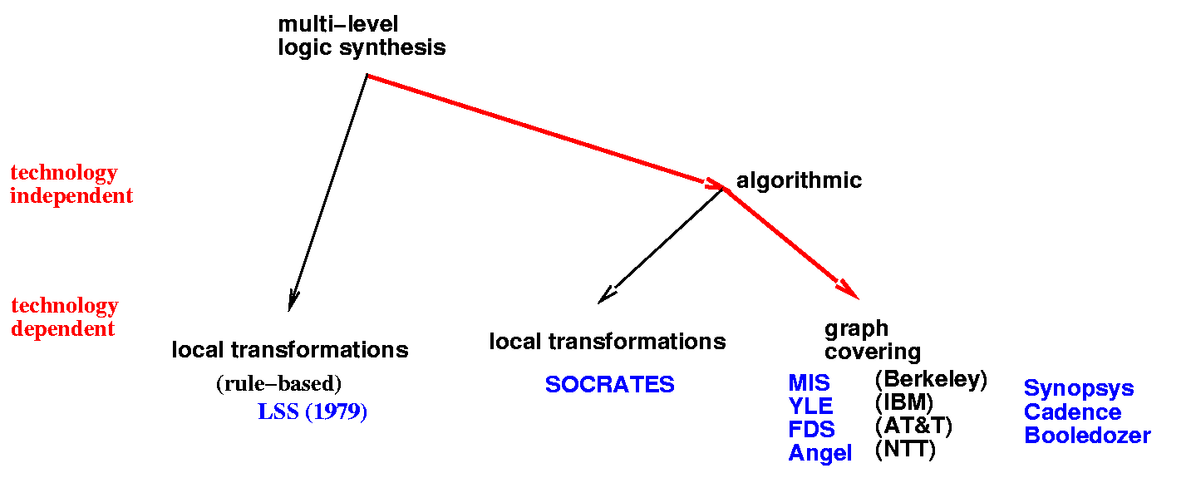
Early Approaches to Multi-Level
Algorithmic Approach
continues along lines of ESPRESSO and two-level minimization
spectrum of speed/quality trade-off algorithms
encourages development of understanding and theory

Slide 5
Optimization Cost Criteria
The accepted optimization criteria for multi-level logic are to minimize some function of:
  Area occupied by the logic gates and interconnect (approximated by literals = transistors in technology independent optimization)
  Critical path delay of the longest path through the logic
  Degree of testability of the circuit, measured in terms of the percentage of faults covered by a specified set of test vectors for an approximate fault model (e.g. single or multiple stuck-at faults)
  Power consumed by the logic gates
  Noise Immunity
  Wireability
while simultaneously satisfying upper or lower bound constraints placed on these physical quantities

Slide 6
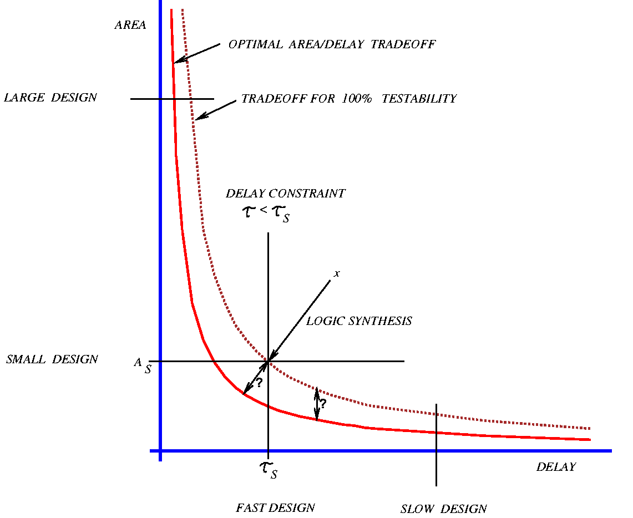
Optimization Cost Criteria

Slide 7
Multi-Level is Natural for High Level Synthesis
Example w=ab+ab’
If w, then z=cd+a’d’ ; u=cd+a’d’+e(f+b)
else z=e(f+b) ; u=(cd+a’d’)e(f+b)
A:
w=ab+ab’
z=w(cd+a’d’ )+w’e(f+b)
u=w(cd+a’d’+e(f+b))+w’((cd+a’d’)e(f+b))
B:
w=ab+ab’
t=cd+a’d’
s=e(f+b)
z=wt+w’s
u=w(t+s)+w’ts

Slide 8
Network Representation
In implementing multi-level logic our first aim is to establish a structure on which to develop a theory and algorithms
  independent of technology on which manipulations can be made, and
  optimization progress can be well estimated.
This leads to two abstractions:
  Boolean network
  Factored forms

Slide 9
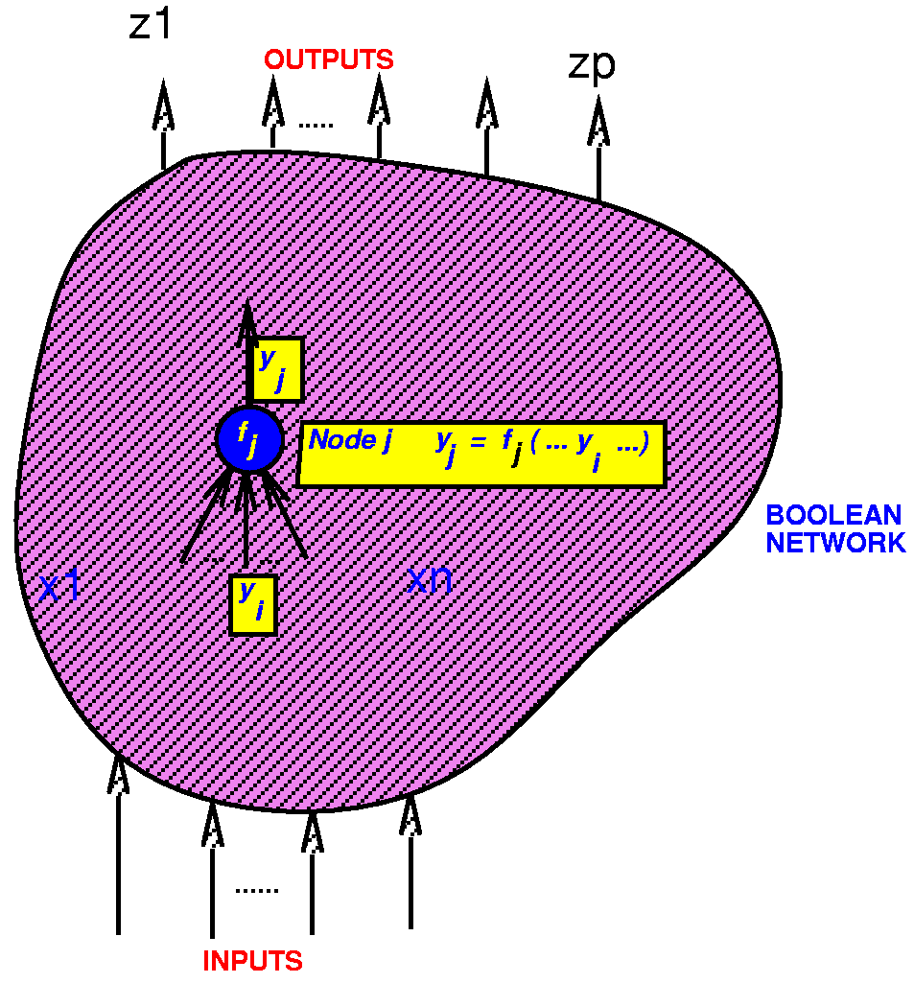
Network Representation
Boolean network:
  directed acyclic graph (DAG)
  node logic function representation f_{j}(x,y)
  node variable y_{j}: y_{j}= f_{j}(x,y)
  edge (i,j) if f_{j} depends explicitly on y_{i}
Inputs x = (x₁, x₂,…,x_{n} )
Outputs z = (z₁, z₂,…,z_{p} )
External don’t cares d₁(x), d₂(x) ,…, d_{p}(x)

Slide 10
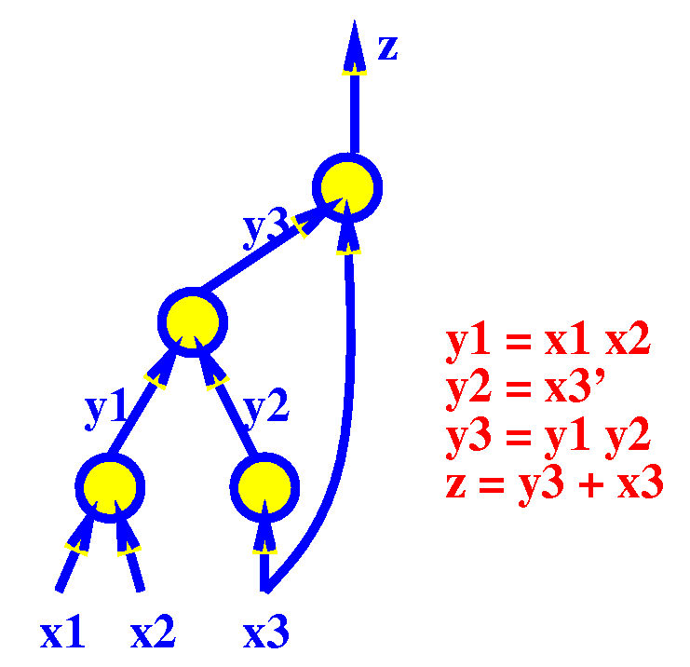
Network Representation
Boolean network:

Slide 11
Node Representation
Some choices:
Merged view (technology and network merged)
Separated view
  technology dependent
  technology independent
    node representation
      general node
      generic node
      discrete node

Slide 12
Node Representation
Separated, technology independent view, general node:
  each node can be a representation of an arbitrary logic function
  representation and implementation are the same
  a theory is easier to develop since there are no arbitrary restrictions dependent on technology
  SIS uses this approach (includes all others as special cases, except for multiple output nodes)
Choices of function representation for separated, technology independent view:
  sum of products form
  factored form
  binary decision diagram

Slide 13
Sum of Products (SOP)
Example:
abc’+a’bd+b’d’+b’e’f (sum of cubes)
Advantages:
  easy to manipulate and minimize
  many algorithms available (e.g. AND, OR, TAUTOLOGY)
  two-level theory applies
Disadvantages:
  Not representative of logic complexity. For example f=ad+ae+bd+be+cd+ce f’=a’b’c’+d’e’
  These differ in their implementation by an inverter.
  hence not easy to estimate logic; difficult to estimate progress during logic manipulation

Slide 14
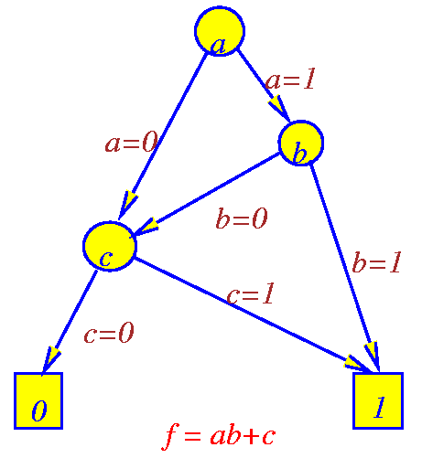
Reduced Ordered BDDs
  like factored form, represents both function and complement
  like network of muxes, but restricted since controlled by primary input variables
    not really a good estimator for implementation complexity
  given an ordering, reduced BDD is canonical, hence a good replacement for truth tables
  for a good ordering, BDDs remain reasonably small for complicated functions (e.g. not multipliers)
  manipulations are well defined and efficient
  true support (dependency) is displayed

Slide 15
Factored Forms
Example: (ad+b’c)(c+d’(e+ac’))+(d+e)fg
Advantages
  good representative of logic complexity f=ad+ae+bd+be+cd+ce f’=a’b’c’+d’e’ ⇒ f=(a+b+c)(d+e)
  in many designs (e.g. complex gate CMOS) the implementation of a function corresponds directly to its factored form
  good estimator of logic implementation complexity
  doesn’t blow up easily
Disadvantages
  not as many algorithms available for manipulation
  hence usually just convert into SOP before manipulation

Slide 16
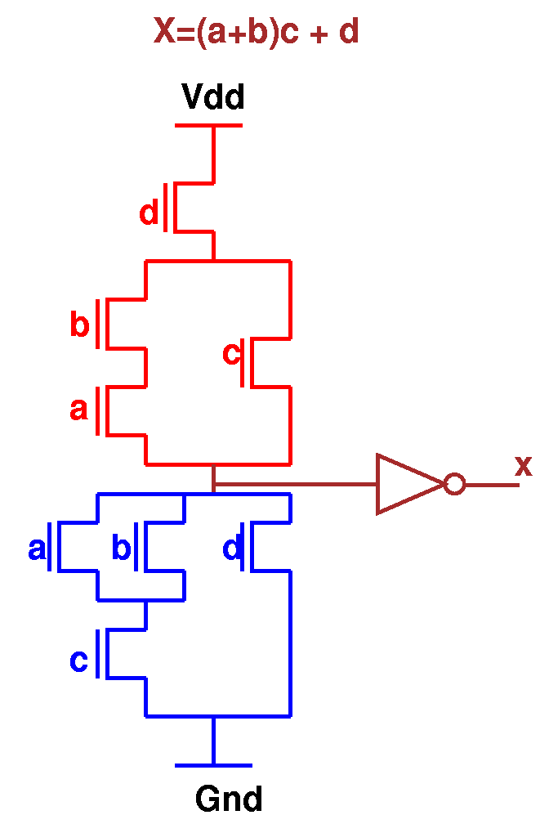
Factored Forms
Note:
literal count ∝ transistor count ∝ area
(however, area also depends on wiring)

Slide 17
Factored Forms
Definition 1: f is an algebraic expression if f is a set of cubes (SOP), such that no single cube contains another (minimal with respect to single cube containment)
  Example: a+ab is not an algebraic expression (factoring gives a(1+b) )
Definition 2: the product of two expressions f and g is a set defined by fg = {cd | c ∈ f and d ∈ g and cd ≠ 0}
  Example: (a+b)(c+d+a’)=ac+ad+bc+bd+a’b
Definition 3: fg is an algebraic product if f and g are algebraic expressions and have disjoint support (that is, they have no input variables in common)
  Example: (a+b)(c+d)=ac+ad+bc+bd is an algebraic product

Slide 18
Factored Forms
Definition 4: a factored form can be defined recursively by the following rules. A factored form is either a product or sum where:
  a product is either a single literal or product of factored forms
  a sum is either a single literal or sum of factored forms
A factored form is a parenthesized algebraic expression.
In effect a factored form is a product of sums of products … or a sum of products of sums …
Any logic function can be represented by a factored form, and any factored form is a representation of some logic function.

Slide 19
Factored Forma
Examples of factored forms:
x y’ abc’ a+b’c ((a’+b)cd+e)(a+b’)+e’
(a+b)’c is not a factored form since complementation is not allowed, except on literals.
Three equivalent factored forms (factored forms are not unique):
ab+c(a+b) bc+a(b+c) ac+b(a+c)

Slide 20
Factored Forms
Definition 5: The factorization value of an algebraic factorization F=G₁G₂+R is defined to be
fact_val(F,G₂) = lits(F)-( lits(G₁)+lits(G₂)+lits(R) )
= (|G₁|-1) lits(G₂) + (|G₂|-1) lits(G₁)
assuming G₁, G₂ and R are algebraic expressions. Where |H| is the number of cubes in the SOP form of H.
Example: The algebraic expression F = ae+af+ag+bce+bcf+bcg+bde+bdf+bdg
can be expressed in the form F = (a+b(c+d))(e+f+g), which requires 7 literals, rather than 24.
If G₁=(a+bc+bd) and G₂=(e+f+g), then R=∅. fact_val(F,G₂) = 2×3+2×5=16.
The factored form above saves 17 literals, not 16. The extra literal comes from recursively applying the formula to the factored form of G₁.

Slide 21
Factored Forms
  Factored forms are more compact representations of logic functions than the traditional sum of products form.
  For example,
  (a+b)(c+d(e+f(g+h+i+j) when represented as a SOP form is
  ac+ade+adfg+adfh+adfi+adfj+bc+bde+bdfg+ bdfh+bdfi+bdfj
  Of course, every SOP is a factored form but it may not be a good factorization.

Slide 22
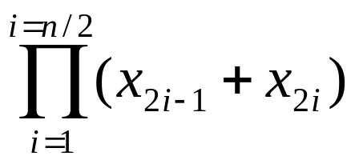
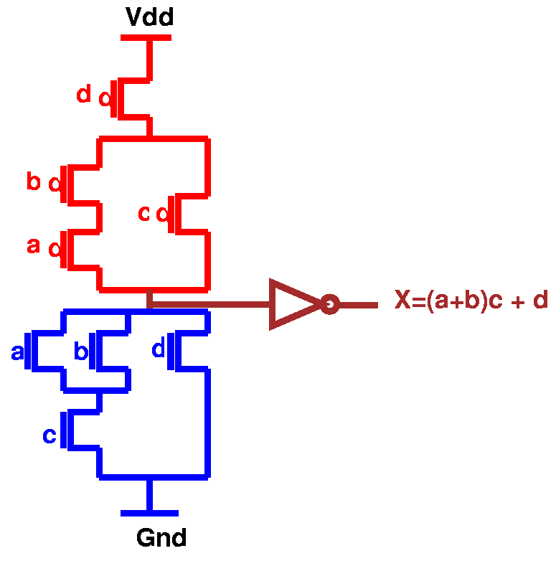
Factored Forms
When measured in terms of number of inputs, there are functions whose size is exponential in sum of products representation, but polynomial in factored form.
Example: Achilles’ heel function
There are n literals in the factored form and (n/2)×2^{n/2} literals in the SOP form.
Factored forms are useful in estimating area and delay in a multi-level synthesis and optimization system.
In many design styles (e.g. complex gate CMOS design) the implementation of a function corresponds directly to its factored form.

Slide 23
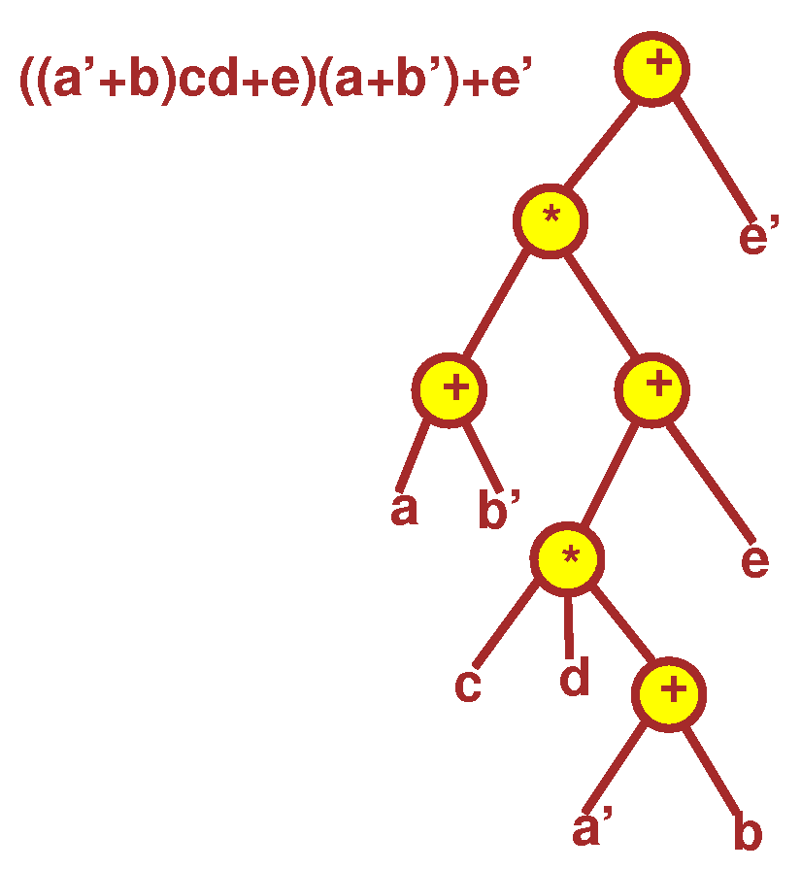
Factored Forms
Factored forms cam be graphically represented as labeled trees, called factoring trees, in which each internal node including the root is labeled with either + or ×, and each leaf has a label of either a variable or its complement.
Example: factoring tree of ((a’+b)cd+e)(a+b’)+e’

Slide 24
Factored Forms
The size of a factored form F (denoted ρ(F )) is the number of literals in the factored form.
Example: ρ(( a+b)ca’) = 4 ρ((a+b+cd)(a’+b’)) = 6
A factored form is optimal if no other factored form (for that function) has less literals.
A factored form is positive unate in x, if x appears in F, but x’ does not. A factored form is negative unate in x, if x’ appears in F, but x does not.
F is unate in x if it is either positive or negative unate in x, otherwise F is binate in x.
Example:
(a+b’)c+a’ is positive unate in c, negative unate in b, and binate in a.

Slide 25
Cofactor of Factored Forms
The cofactor of a factored form F, with respect a literal x₁ (or x₁’ ), is the factored form F_{x1}= F_{x1=1}(x) (or F_{x1’}=F_{x1=0}(x) ) obtained by
  replacing all occurrences of x₁ by 1, and x₁’ by 0
  simplifying the factored form using the Boolean algebra identities
  1y=y 1+y=1 0y=0 0+y=y
  after constant propagation (all constants are removed), part of the factored form may appear as G + G. In general, G is another factored form, and the G’s may have different factored forms.

Slide 26
Cofactor of Factored Forms
The cofactor of a factored form F, with respect to a cube c, is a factored form F_{C} obtained by successively cofactoring F with each literal in c.
Example: F = (x+y’+z)(x’u+z’y’(v+u’)) and c = vz’. Then
F_{z’} = (x+y’)(x’u+y’(v+u’))
F_{z’ v} = (x+y’)(x’u+y’)

Slide 27
Factored Forms
SOPs forms are used as the internal representation of logic functions in most multi-level logic optimization systems.
Advantages
  good algorithms for manipulating them are available
Disadvantages
  performance is unpredictable - they may accidentally generate a function whose SOP form is too large
  factoring algorithms have to be used constantly to provide an estimate for the size of the Boolean network, and the time spent on factoring may become significant
Possible solution
  avoid SOP representation by using factored forms as the internal representation
  this is not practical unless we know how to perform logic operations directly on factored forms without converting to SOP forms
  extensions to factored forms of the most common logic operations have been partially provided, but more research is needed

Slide 28
Manipulation of Boolean Networks
Basic Techniques:
  structural operations (change topology)
    algebraic
    Boolean
  node simplification (change node functions)
    don’t cares
    node minimization

Slide 29
End of lecture 8

Slide 30
Structural Operations
Restructuring Problem: Given initial network, find best network.
Example: f₁ = abcd+abce+ab’cd’+ab’c’d’+a’c+cdf+abc’d’e’+ab’c’df’
f₂ = bdg+b’dfg+b’d’g+bd’eg
minimizing,
f₁ = bcd+bce+b’d’+a’c+cdf+abc’d’e’+ab’c’df’
f₂ = bdg+dfg+b’d’g+d’eg
factoring,
f₁ = c(b(d+e)+b’(d’+f)+a’)+ac’(bd’e’+b’df’)
f₂ = g(d(b+f)+d’(b’+e))
decompose,
f₁ = c(x+a’)+ac’x’
f₂ = gx
x = d(b+f)+d’(b’+e)
Two problems:
    find good common subfunctions
    effect the division

Slide 31
Structural Operations
Basic Operations:
1. Decomposition (single function)
f = abc+abd+a’c’d’+b’c’d’
⇓
f = xy+x’y’ x = ab y = c+d
2. Extraction (multiple functions)
f = (az+bz’)cd+e g = (az+bz’)e’ h = cde
⇓
f = xy+e g = xe’ h = ye x = az+bz’ y = cd
3. Factoring (series-parallel decomposition)
f = ac+ad+bc+bd+e
⇓
f = (a+b)(c+d)+e

Slide 32
Structural Operations
4. Substitution
g = a+b f = a+bc
⇓
f = g(a+b)
5. Collapsing (also called elimination)
f = ga+g’b g = c+d
⇓
f = ac+ad+bc’d’ g = c+d
Note: “division” plays a key role in all of these

Slide 33
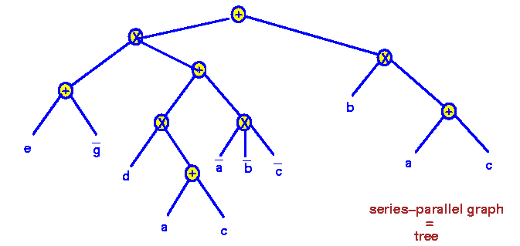
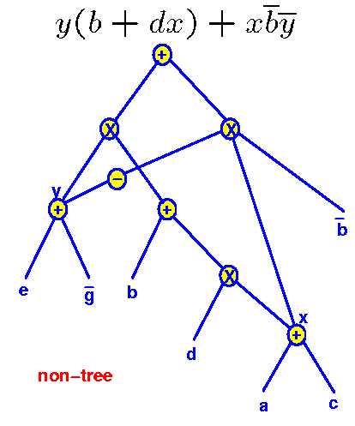
Factoring vs. Decomposition
Factoring f=(e+g’)(d(a+c)+a’b’c’)+b(a+c)
Decomposition: y(b+dx)+xb’y’
Note: this is similar to BDD collapsing of common nodes and using negative pointers. But not canonical, so don’t have perfect identification of common nodes.
tree
DAG

Slide 34
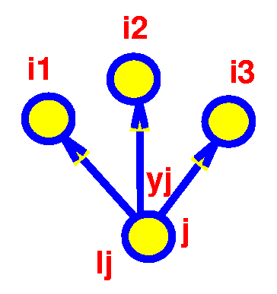
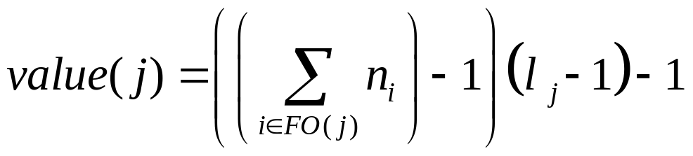
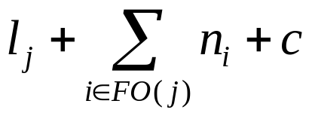
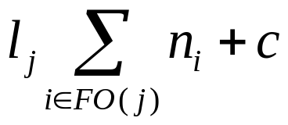
Value of a Node and Elimination
where
n_{i} = number of times literals y_{j} and y_{j}’ occur in factored form f_{i}
l_{j} = number of literals in factored f_{j}
with factoring
without factoring
value = (without factoring) - (with factoring)
Can treat y_{j} and y_{j}’ the same since ρ( F_{j} ) = ρ( F_{j}’ ).

Slide 35
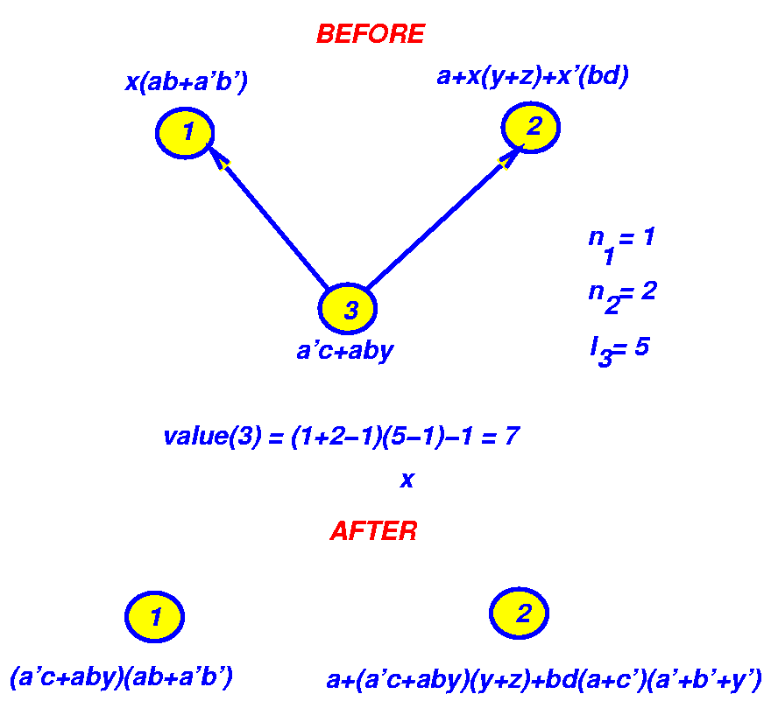
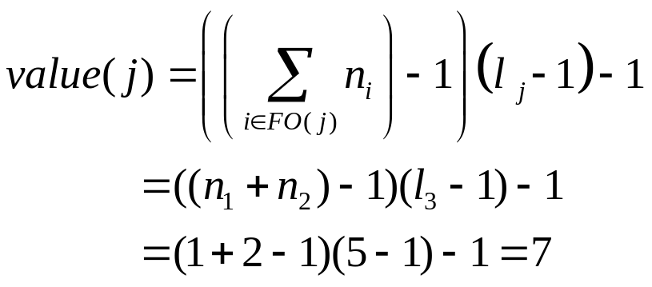
Value of a Node and Elimination
Literals before = 5+7+5 = 17
Literals after = 9+15 = 24
---
7
x
Difference after - before = value = 7
But we may not have the same value if we were to eliminate, simplify and then re-factor.

Slide 36
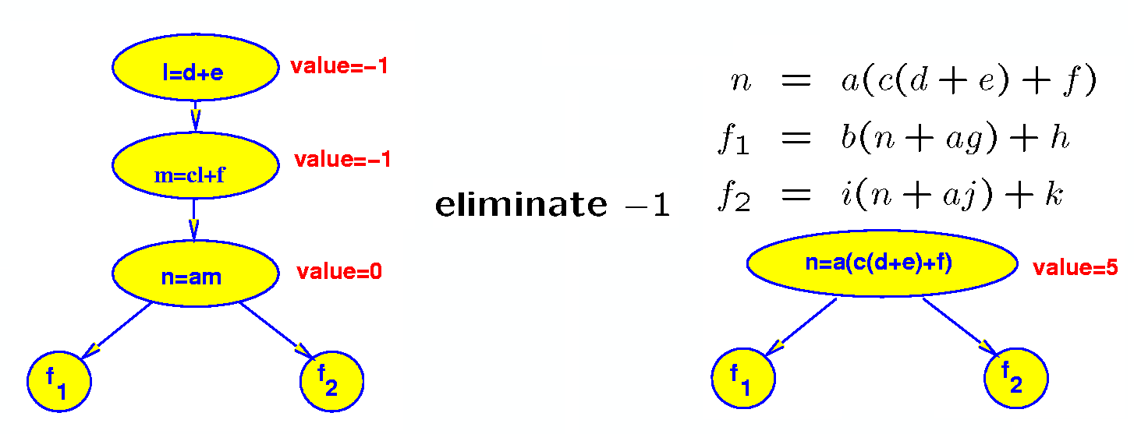
Value of a Node and Elimination
Note: value of a node can change during
elimination

Slide 37
Extra Slides Beyond This Point

Slide 38
Node Representation
Merged view (estimators are more accurate, but slower and more constrained):
  each node is a valid “gate” chosen from a library of gates to be used in the final implementation)
  representation and implementation are the same
Separated view (less accurate estimators, faster, more general - lends itself to theory)
  two representations allowed
  technology independent, without any connection to the final implementation
  technology dependent which only uses valid “gates” (in the cell library or meeting some criteria)
  in the separated, technology independent view, there are several choices

Slide 39
Node Representation
Separated, technology independent view, discrete node:
  a node can be one of a small set of logic functions, such as AND, OR, NOT, DECODE, and ADD
  multiple output nodes are also allowed
  used mostly in rule based systems
  complex blocks of logic can be manipulated as a single unit
  theory for such networks is more difficult
Choices of function representation for separated, technology independent view:
  sum of products form
  factored form
  binary decision diagram

Slide 40
Factored Forms
Sum of products forms are used as the internal representation of logic functions in most multi-level logic optimization systems.
Advantages
  good algorithms for manipulating them are available
Disadvantages
  performance is unpredictable - they may accidentally generate a function whose SOP form is too large
  factoring algorithms have to be used constantly to provide an estimate for the size of the Boolean network, and the time spent on factoring may become significant
Possible solution
  avoid SOP representation by using factored forms as the internal representation
  this is not practical unless we know how to perform logic operations directly on factored forms without converting to SOP forms
  extensions to factored forms of the most common logic operations have been partially provided, but more research is needed

Slide 41
Optimum Factored Forms
Definition 6: Let f be a completely specified Boolean function, and ρ(f) is the minimum number of literals in any factored form of f.
Recall ρ(F) is the number of literals of a factored form F.
Definition 7: Let sup(f) be the true variable support of f, i.e. the set of variables f depends on. Two functions f and g are orthogonal, f g, if sup(f)∩sup(g)=∅.

Slide 42
Optimum Factored Forms
Lemma 1: Let f=g+h such that g h, then ρ(f)=ρ(g)+ρ(h).
Proof:
Let F, G and H be the optimum factored forms of f, g and h. Since G+H is a factored form, ρ(F)≤ρ(G+H).
Let c be a minterm, on sup(g), of g’. Since g and h have disjoint support, we have f_{c}=(g+h)_{c}=g_{c}+h_{c}=0+h_{c}=h_{c}=h.
Similarly, if d is a minterm of h’, f_{d}=g.
Because ρ(h)=ρ(f_{c})≤ρ(F_{c}) and ρ(g)=ρ(f_{d})≤ρ(F_{d}),
ρ(h)+ρ(g)≤ρ(F_{c})+ρ(F_{d}).
Let m (n) be the number of literals in F that are from sup(g) (sup(h)). When computing F_{c} (F_{d}), we replace all the literals from sup(g) (sup(h)) by the appropriate values and simplify the factored form by eliminating all the constants and possibly some literals from sup(g) (sup(h)) by using the Boolean identities. Hence ρ(F_{c})≤n and ρ(F_{d}) ≤m. Since ρ(F)=m+n, ρ(F_{c})+ρ(F_{d})≤m+n=ρ(F).
We have ρ(f)≤ρ(g+h)≤ρ(F_{c})+ρ(F_{d})≤ρ(F) ⇒ ρ(f)=ρ(F).

Slide 43
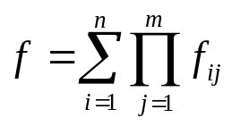
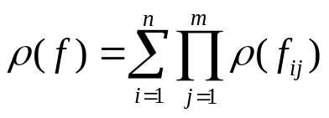
Optimum Factored Forms
Note, the previous result does not imply that all minimum literal factored forms of f are sums of the minimum literal factored forms of g and h.
Corollary 1: Let f=gh such that g h, then ρ(f)=ρ(g)+ρ(h).
Proof:
Let F’ denote the factored form obtained using DeMorgan’s law. Then ρ(F)=ρ(F’), and therefore ρ(f)=ρ(f’). From the above lemma, we have ρ(f)=ρ(f’)=ρ(g’+h’)=ρ(g’)+ρ(h’)=ρ(g)+ρ(h).
Theorem 1: Let such that f_{ij} f_{kl}, ∀ i≠j or k≠l, then
.
Proof:
Use induction on m and then n, and lemma 1 and corollary 1.

Slide 44
Optimum Factored Forms
Definition 8: For an incompletely specified function (f,d), if no optimum factored form of (f,d) can contain variable x, then x is said to be redundant.
Lemma 2: If F covers (f,d), then F_{c} covers (f_{c},d_{c}) for any cube c.
Proof:
Easy induction on the number of variables in c.
Theorem 2: Let (f,d+e) be an incompletely specified function such that sup(f+d)∩sup(e)=∅. Then, variables in sup(e) are redundant, which implies ρ(f,d+e)=ρ(f,d).
Proof:
Let F be any optimum factored form of (f,d+e). Assume e≠1, and let c be a minterm, on sup(e), of e’. By lemma 2, F_{c} covers (f_{c},d_{c}+e_{c}). But f_{c}=f, d_{c}=d and e_{c}=0. So, F_{c} also covers (f,d). Since F is optimum, and ρ(F_{c})≤ρ(F), we must have ρ(f_{c})=ρ(f), which implies that sup(F)∩sup(c)=sup(F)∩sup(e)=∅. Thus sup(e) variables are redundant.

Slide 45
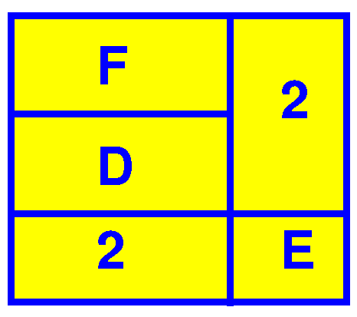
Optimum Factored Forms
The above theorem can be interpreted by the figure. If F, D and E are represented as sum of products expressions, in a positional cube notation, and the matrix has the structure indicated in the figure, then the set of cubes in E can be removed from the don,t care set without affecting the final result.

Slide 46
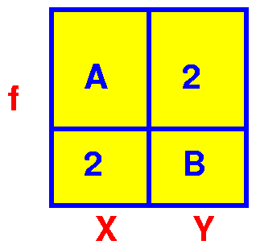
Optimum Factored Forms
A natural question to ask at this point is, “is E unique?” If yes, how do we find it? The following theorem answers the questions.
Theorem 3: Let f be a Boolean function, if there is a sum of product representation whose cube matrix has the structure as indicated in the figure, where the support of A and B are X and Y respectively, then no prime p contains variables from both X and Y.
Thus we just need to take the don’t care set and get a prime representation for it. If it has the above structure, then D and E are displayed.

Slide 47
Optimum Factored Forms
Proof:
Let p be a prime of f=A(x)+B(y). Suppose p contains variables from both X and Y. Let p=p_{x}p_{y} where p_{x} and p_{y} are parts of p containing only variables from X and Y respectively. Since p⊆f, then
A_{px}(x)+B_{py}(y)≡1
If A_{px}(x)≡1 then p_{x} ⊆A⊆f contradicting that p is prime. Hence B_{py}(y)≡1. But this implies p_{y} ⊆B⊆f contradicting that p is prime. Thus, p must contain variables either entirely from X or entirely from Y.

Slide 48
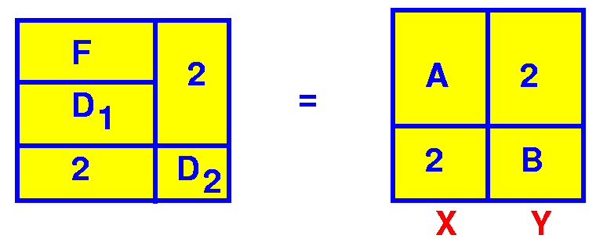
Optimum Factored Forms
Not only does theorem 3 show the uniqueness of the partition (if we make all cubes prime), it also indicates a procedure for obtaining it.
Given an incompletely specified function (F,D):
  expand all cubes of F+D to primes,
  build a cube matrix M,
  partition M into blocks of disjoint supports,
  remove from M each block of the partition that is contained entirely in D.

