Slide 1
Node Minimization
Problem:
  Given a Boolean network, optimize it by minimizing each node as much as possible.
Note:
  The initial network structure is given. Typically applied after the global optimization, i.e. division and resubstitution.
  We minimize the function associated with each node.
  What do we mean by minimizing the node “as much as possible”?

Slide 2
Functions Implementable at a Node
In a Boolean network, we may represent a node using the primary inputs {x₁,.. x_{n}} plus the intermediate variables {y₁,.. y_{m}}, as long as the network is acyclic.
DEFINITION 1: A function g_{j} , whose variables are a subset of {x₁,.. x_{n}, y₁,.. y_{m}}, is implementable at a node j if
  the variables of g_{j} do not intersect with TFO_{j}
  the replacement of the function associated with j by g_{j} does not change the functionality of the network.

Slide 3
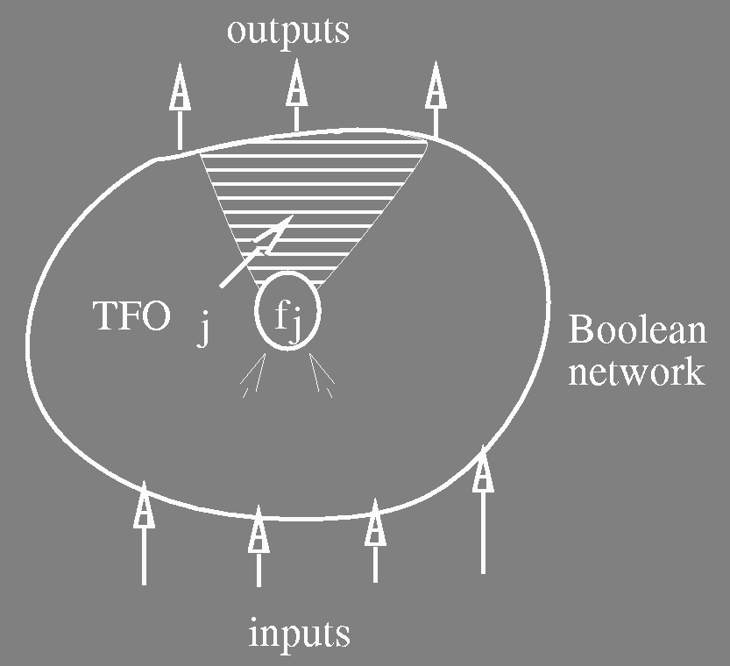
Functions Implementable at a Node
The set of implementable functions at j provides the solution space of the local optimization at node j.
TFO_{j} = {node i s.t. i = j or ∃ path from j to i}

Slide 4
Prime and Irredundant Boolean Network
Consider a sum­of­products expression F_{j} associated with a node j.
Definition 2: F_{j} is prime (in multi­level sense) if for all cubes c ∈  F_{j}, no literal of c can be removed without changing the functionality of the network.
Definition 3: F_{j} is irredundant if for all cubes c ∈ F_{j}, the removal of c from F_{j} changes the functionality of the network.

Slide 5

Prime and Irredundant Boolean Network
Definition 4: A Boolean
network is prime and
irredundant if F_{j} is prime
and irredundant for all j.
Theorem 1: A network is 100% testable for single stuck­at faults (s­a­0 or s­a­1) iff it is prime and irredundant.

Slide 6
Local Optimization
Goals:
Given a Boolean network,
  make the network prime and irredundant.
  for a given node of the network, find a least-cost sum­of­products expression among the implementable functions at the node.
Note:
  Goal 2 implies the goal 1,
  But we want more than just 100% testability. There are many expressions that are prime and irredundant, just like in two-level minimization. We seek the best.

Slide 7
Local Optimization
Key Ingredient ­ Network Don't Cares:
External don't cares ­XDC_{k} , k=1,…,p, - set of minterms of the primary inputs given for each primary output
Internal don't cares ­ derived from the network structure
  Satisfiability ­ SDC
  Observability ­ ODC

Slide 8
SDC
Recall:
We may represent a node using the primary inputs plus the intermediate variables.
  The Boolean space is B^{n+m} .
However, the intermediate variables are dependent on the primary inputs.
Thus not all the minterms of B^{n+m} can occur.

Slide 9

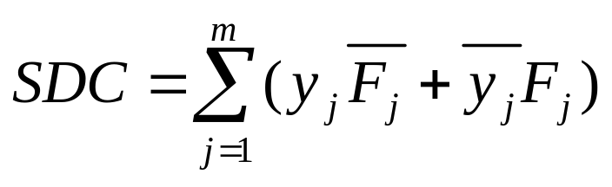
SDC
  Example:
  y₁ = F₁ = ‾x₁
y_{j} = F_{j} = y₁x₂
  Since y₁ = ‾x₁, y₁ ⊕‾x₁ never occurs.
  Thus we may include these points to represent F_{j} ⇒ Don't Cares
  SDC = (y₁ ⊕‾x₁)+(y_{j}⊕ y₁x₂)
  In general,
  Note: SDC ⊆ B^{n+m}

Slide 10


ODC
y_{j} = ‾x₁ x₂ + x₁‾x₃
z_{k} = x₁ x₂ + y_{j}‾x₂ + (y_{j} x₃)
Any minterm of x₁ x₂ + x₂ x₃ + x₂ x₃ determines z_{k} independent of y_{j} .
The ODC of y_{j} for z_{k} is the set of minterms of the primary inputs for which the value of y_{j} is not observable at z_{k}
This means that the two Boolean networks,
  one with y_{j} forced to 0 and
  one with y_{j} forced to 1
compute the same value for z_{k} when x ∈ ODC_{jk}

Slide 11
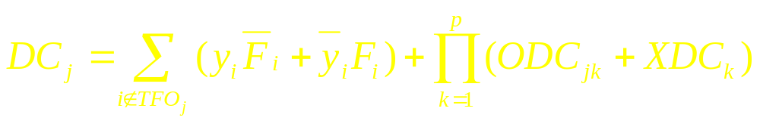
Don't Cares for Node j
Define the don't care sets DC_{j} for a node j as
ODC and SDC
illustrated:
outputs
ODC
F_{j}
Boolean
network
S
C
D
inputs

Slide 12
Main Theorem
THEOREM 2: The function F_{j} = (F_{j}-DC_{j}, DC_{j}, F_{j}+DC_{j}) is the complete set of implementable functions at node j
COROLLARY 3: F_{j} is prime and irredundant (in the multi-level sense) iff it is prime and irredundant cover of F_{j}
A least­cost expression at node j can be obtained by minimizing F_{j}.
A prime and irredundant Boolean network can be obtained by using only 2­level logic minimization for each node j with the don't care DC_{j} .
Note: If F_{j} is changed, then DC_{i} may change for some other node i in the network.

Slide 13
End of lecture 11

Slide 14
Local Optimization ­ Practical Questions
How to compute the don't care set at a node?
  XDC is given, SDC is easy,
  but how about ODC?
    This don't care set may be too large. A good subset?
How to minimize the function with the don't care?
  Complement may be too large?
  #Literals v.s. #Cubes?

Slide 15
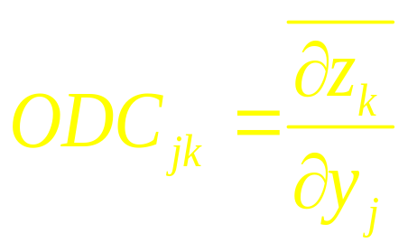
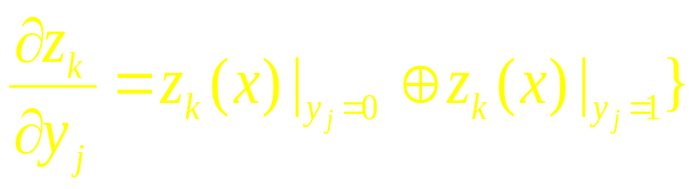
ODC Computation
z_{k}
g₁
g_{q}
g₂
y_{j}
x₁
x₂
x_{n}
Denote
where

Slide 16

ODC Computation
z_{k}
In general,
g₁
g_{q}
g₂
y_{j}
x₁
x₂
x_{n}

Slide 17
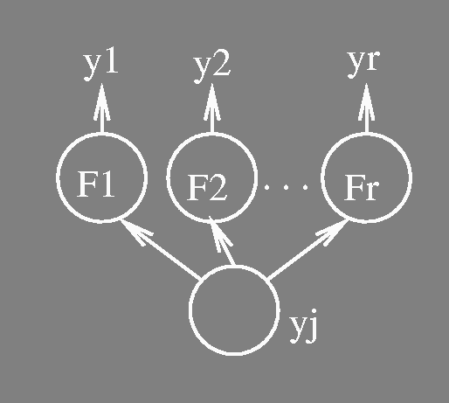


ODC Computation
Conjecture:
This conjecture is true if there is no reconvergent fanout in TFO_{j}.
With reconvergence, the conjecture can be incorrect in two ways:
  it does not compute the complete ODC. (can have correct results but conservative)
  it contains care points. (leads to incorrect answer)

Slide 18
Transduction (Muroga-197x)
Definition: Given a node j, a permissible function at j is a function of the primary inputs implementable at j.
The original transduction computes a set of permissible functions for a NOR gate in an all NOR­gate network.
  MSPF (Maximum Set of Permissible Functions)
  CSPF (Compatible Set of Permissible Functions)
  Both of these are just incompletely specified functions, i.e. functions with don’t cares.
Definition: We denote by g_{j} the function f_{j} expressed in terms of the primary inputs.
  g_{j}(x) is called the global function of j.

Slide 19
Transduction ­ CSPF
MSPF:
  is expensive to compute.
  if the function of j is changed, the MSPF for some other node i in the network may change.
CSPF:
  Consider a set of incompletely specified functions {f_{j}^{C}} for a set of nodes J such that a simultaneous replacement of the functions at all nodes j∈J each by an arbitrary cover of f_{j}^{C} does not change the functionality of the network.
  f_{j}^{C} is called a CSPF at j. The set {f_{j}^{C}} is called a compatible set of permissible functions (CSPFs).

Slide 20
Transduction ­ CSPF
Note:
CSPFs are defined for a set of nodes.
We don't need to recompute CSPF's if the function of other nodes in the set are changed according to their CSPFs
  The CSPFs can be used independently.
Any CSPF at a node is a subset of the MSPF at the node
External don’t cares (XDC) must be compatible

Slide 21
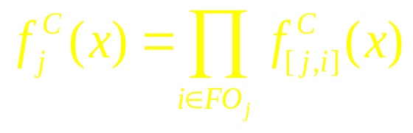
Transduction ­ CSPF
Key Ideas:
Compute CSPF for one node at a time.
  from the primary outputs to the primary inputs
If (f₁^{C} ,…, f_{j-1}^{C} ) have been computed, compute f_{j}^{C} so that simultaneous replacement of the functions at the nodes preceding j by functions in (f₁^{C} ,…, f_{j-1}^{C} ) is valid.
  put more don’t cares to those processed earlier
Compute CSPFs for edges so that
Note:
  CSPFs are dependent on the orderings of nodes/edges.

Slide 22

CSPF's for Edges
Assume CSPF f_{i}^{C} for a node i
is given.
Ordering of Edges: y₁ < y₂ < … < y_{r}
  put more don't cares on the edges processed earlier.
  only for NOR gates
0 if f_{i}^{C}(x) = 1
f_{[j,i]}^{C}(x) = 1 if f_{i}^{C}(x) = 0 and for all y_{k} > y_{j}: g_{k}(x) = 0 and
g_{j}(x) = 1
* (don’t care) otherwise

Slide 23

Transduction ­ CSPF
Example: y₁ < y₂ < y₃
y_{i} = [1 0 0 0 0 0 0 0] output
y₁ = [0 0 0 0 1 1 1 1]
y₂ = [0 0 1 1 0 0 1 1]
y₃ = [0 1 0 1 0 1 0 1]
f_{[1,i]}^{C} = [0 * * * 1 * * *]
f_{[2,i]}^{C} = [0 * 1 * * * 1 *]
f_{[3,i]}^{C} = [0 1 * 1 * 1 * 1]
Note: we just make the last 1 stay 1 and all others *.
Note: CSPF for [1; i] has the most don't cares among the three input edges.
global
functions
of inputs
i
edge CSPFs

Slide 24
CSPF Computation
Compute the global functions g for all the nodes.
For each primary output z_{k} ,
f_{zk}^{C}(x)= * if x∈XDC_{k}
f_{zk}^{C}(x)= g_{zk}(x) otherwise
For each node j in a topological order from the outputs,
  compute f_{j}^{C} = Π_{i∈FOj}f_{[j,i]}^{C}(x)
  compute CSPF for each fanin
  edge of j, i.e. f _{[k,j]}^{C}
[j,i]
j
[k,j]

Slide 25
Generalization of CSPF's
A Boolean network where a node function is arbitrary (not just NOR gates).
Based on the same idea as Transduction
  process one node at a time in a topological order from the primary outputs.
  compute a compatible don't care set for an edge, CODC_{[j,i]}
  intersect for all the fanout edges to compute a compatible don't care set for a node.
  CODC_{j}= Π_{i∈Foj} CODC_{[j,i]}^{C}
  Put more don't cares on nodes/edges processed earlier.

Slide 26

Compatible Don't Cares at Edges
Ordering of edges: y₁ < y₂ < … < y_{r}
Assume no don't care at a node i.
A compatible don't care for an edge [j,i] is a function of CODC_{[j,i]}(y) : B^{r} →B
Note: it is a function of the local inputs (y₁ , y₂ ,… ,y_{r}). It is 1 at m ∈ B^{r} if m is assigned to be don’t care for the input line [j,i].

Slide 27
Compatible Don't Cares at Edges
Property on {CODC_{[1,i]},…,CODC_{[r,i]}}
For all m∈B^{r}, the value of y_{i} does not change by arbitrarily flipping the values of { y_{j}∈FI_{i} | CODC_{[j,i]}(m) = 1 }
y_{i}
no change
m is held fixed, but value
on y_{j} can be arbitrary
if CODC_{[j,i]}(m) is don’t care
i
k
j
CODC_{[k,i]}(m)=1
CODC_{[j,i]}(m)=1

Slide 28
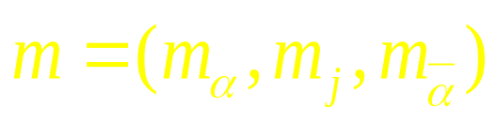
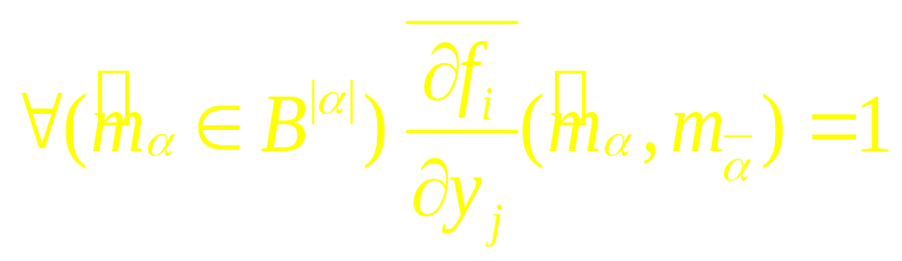
Compatible Don't Cares at Edges
Given {CODC_{[1,i]},…,CODC_{[j-1,i]}}
compute CODC_{[j,i]} (m) = 1 iff the
the value of y_{i} remains insensitive
to y_{j} under arbitrarily flipping of
the values of those y_{k} in the set:
α = { k∈FI_{i} | y_{k} < y_{j}, CODC_{[k,i]}(m) = 1 }
Equivalently, CODC_{[j,i]}(m) = 1 iff for

Slide 29


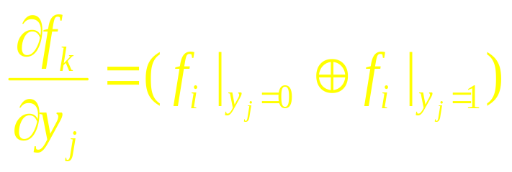
Compatible Don't Cares at Edges
(here ) Thus we are arbitrarily flipping the m_{α} part. In some sense is enough to keep f_{i} insensitive to the value of y_{j}.
is called the Boolean difference of f_{i} with respect to y_{j} and is all conditions when f_{i} is sensitive to the value of y_{j}.
  this is a function of FI_{i}, but not y_{j}.

Slide 30
Compatible Don't Cares at a Node
Compatible don't care at a node j, CODC_{j}, can also be expressed as a function of the primary inputs.
if j is a primary output, CODC_{j} = XDC_{j}
otherwise,
  represent CODC_{[j,i]} by the primary inputs for each fanout edge [j,i].
  CODC_{j}= Π_{i∈FOj}(CODC_{i}+CODC_{[j,i]})
THEOREM 7:
The set of incompletely specified functions with the CODCs computed above for all the nodes provides a set of CSPFs for an arbitrary Boolean network.

Slide 31

Easier Computations of CODC Subset
On page 46 of the paper by H. Savoj, an easier method for computing a CODC subset on each fanin y_{k}of a function f is:
where CODC_{f} is the compatible don’t care already computed for node f, and where f has its inputs y₁, y₂ ,…, y_{r} in that order.
The notation for the operator, C_{y}f = f_{y} f_{‾y} , is used here.

Slide 32
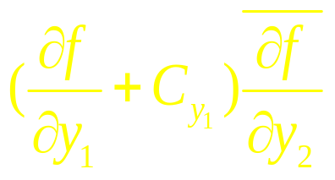

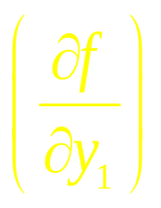
Easier Computations of CODC Subset
The interpretation of the term for CODC_{y2}
is that: of the minterms m∈B^{r} where f is insensitive to y₂,
we allow m to be a don’t care of y₂ if
  either m is not a don’t care for the y₁ input or
  no matter what value is chosen for y₁, (C_{y1}), f is still insensitive to y₂ under m (f is insensitive at m for both values of y₂ )

Slide 33
Computing Don't Cares using BDD's
Handles arbitrary Boolean networks.
  MSPF's for general case
  The complete set of implementable functions for a given node
    incorporating SDC's

Slide 34

The Set of Implementable Functions
Problem:
Given a node j and a set of variables
S ⊆ { x₁, …, x_{n}, y₁, …, y_{m} }\TFO_{j},
Find the set of all implementable functions for j, where the inputvariables of each function is a subset of S.

Slide 35
The Set of Implementable Functions
Note:
SDC's are subsumed.
(S = {x₁, …, x_{n}} ) ⇒ MSPF
(S = { x₁, …, x_{n}, y₁, …, y_{m} }\TFO_{j}) ⇒ the complete set of implementable functions at j.

Slide 36
The Set of Implementable Functions
Definitions:
g_{S} : B^{n} → B^{|S|} ­ the global functions of S;
the i^{th} function of g_{S} is the global function of the i^{th} variable of S.
g_{Z} : B^{n} → { 0, 1, * }^{p} ­ the global functions of the primary outputs plus XDC
z^{M} : B^{n+1} → B^{p} ­ the functions of the primary outputs expressed by the primary inputs and y_{j}
  for the node function of each primary output, recursively substitute each fanin by its node function, unless the fanin is either a primary input or y_{j}
j
S

Slide 37
The Maximal Set of Implementable Functions
Given S: Consider a Boolean relation
F_{j}^{M}(s,y_{j}) : B^{|S|}×B → B s.t.
∀x∈B^{n} : (s = g_{S}(x)) ⇒ z^{M}(x, y_{j}) ∈ g_{Z}(x)
  Note: F_{j}^{M} represents an
  incompletely specified function of s,
  i.e. if an s is associated with both y_{j} = 1 and y_{j} = 0 then y_{j} = * (don't care for that s)
Theorem 8: The set of functions given by F_{j}^{M} is the set of all implementable functions at j (as functions of the variables of S.)
  Proof. Easy.
j

Slide 38
BDD Computation for F_{j}^{M}(s,y_{j})
F_{j}^{M}(s,y_{j}) is a relation ­ a one to many map from s→y_{j}
F_{j}^{M}(s,y_{j}) ≡ 1 iff
∀x∈B^{n} : (s = g_{S}(x)) ⇒ z^{M}(x,y_{j})∈g_{Z}(x)
Universal Quantification:
For a function h : B^{r}→B of variables V={v₁,v₂,..,v_{r}} and V_{k} ={v₁,v₂,..,v_{k}} ⊆ V, the universal quantification of h by V_{k} is the function h_{k} of the variables V\V_{k} ( = V_{r- k} ) s.t.
h_{k}(V_{r-k}) = 1 iff ∀(V_{k}∈B^{k} ) h(V_{k}, V_{r-k})=1.
This is written as ∀_{Vk} h(v) of C_{Vk} h(v).

Slide 39
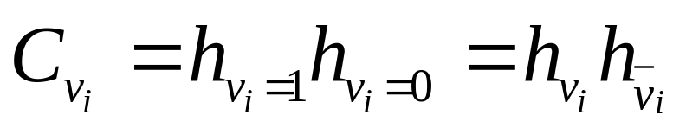
BDD Computation for F_{j}^{M} (s,y_{j})
h_{k}(V_{r-k}) = 1 iff ∀(V_{k}∈B^{k} ) h(V_{k}, V_{r-k})=1.
h_{k} is computed by successive cofactors of h by V_{h}.
h_{k}(V_{r-k})=C_{v1}(C_{v2}(...C_{vk}(h)..))
where the operator
The computation can be done easily using BDD's.
Thus F_{j}^{M} can be computed and represented using BDD's.

Slide 40

The Set of Implementable Functions
Remarks:
The BDD for F_{j}^{M} may be large.
Typically, S is set to FI_{j} plus those variables whose fanins are a subset of FI_{j}.
  In processing y₂ we use y₃ since its support is a subset of the support of y₂.
called the subset support filter.
corresponds to Boolean re-substitution since F_{j}^{M} is a function of y₃.

Slide 41
Summary of Computation of Don't Cares
XDC is given, SDC is easy to compute.
Transduction
  NOR­gate networks
  MSPF, CSPF (permissible functions of PI only)
Extension of CSPF's (CODCs) for general networks
  can be expensive to compute, not maximal
  implementable functions of PI and y.
Direct computation using BDD's
  the complete set of implementable functions
  SDC's are also subsumed.
Subset of don't cares
  TFI_{j} and the nodes whose support are a subset of the fanins of j.

Slide 42
End of lecture 12

Slide 43
Minimizing Local Functions
Once an incompletely specified function (ISF) is derived, we minimize it.
1. Minimize the number of literals
  Minimum literal() in the slides for Boolean division
2. The off­set of the function may be too large.
  Reduced offset minimization (built into ESPRESSO in SIS)
  Tautology­based minimization
If all else fails, use ATPG techniques to remove redundancies.

Slide 44

Reduced Offset
Idea: In expanding any single cube, only part of the off­set is useful. This part is called the reduced offset for that cube.
Example:
In expanding the cube
a b c the point abc is
of no use. Therefore
during this expansion
abc might as well be put
in the offset. Then the offset which was ab + ab + bc becomes a + b. The reduced offset is always unate. The trick is to derive the reduced offset for a particular cube without computing the offset.

Slide 45
Tautology­based Two­Level Minimization
In this, two­level minimization is done without using the offset. Offset is used for blocking the expansion of a cube too far. The other method of expansion is based on tautology.
Example:
In expanding a cube c = abeg to aeg we can test if aeg ⊆ f +d. This can be done by testing (f +d)_{aeg} ≡ 1 i.e. is (f + d) _{aeg} a tautology?

Slide 46

ATPG
Multi­Level Tautology:
Idea:
Use testing methods. (ATPG is a highly developed technology). If we can prove that a fault is untestable, then the untestable signal can be set to a constant.
This is like expansion in .

Slide 47
Removing Redundancies
Redundancy removal:
do random testing to locate easy tests
apply new ATPG methods to prove testability of remaining faults. (if non-testable for s-a-1, set to 1 etc.)
Reduction (redundancy addition) is the reverse of this. It is done to make something else untestable. There is a close analogy with reduction in espresso. Here also reduction is used to move away from a local minimum.
&
reduction = add an input
d
a
c
b
used in transduction (Muroga)
global flow (Bermen and Trevellan)
redundancy addition and removal (Marek-Sadowska et. al.)

Slide 48
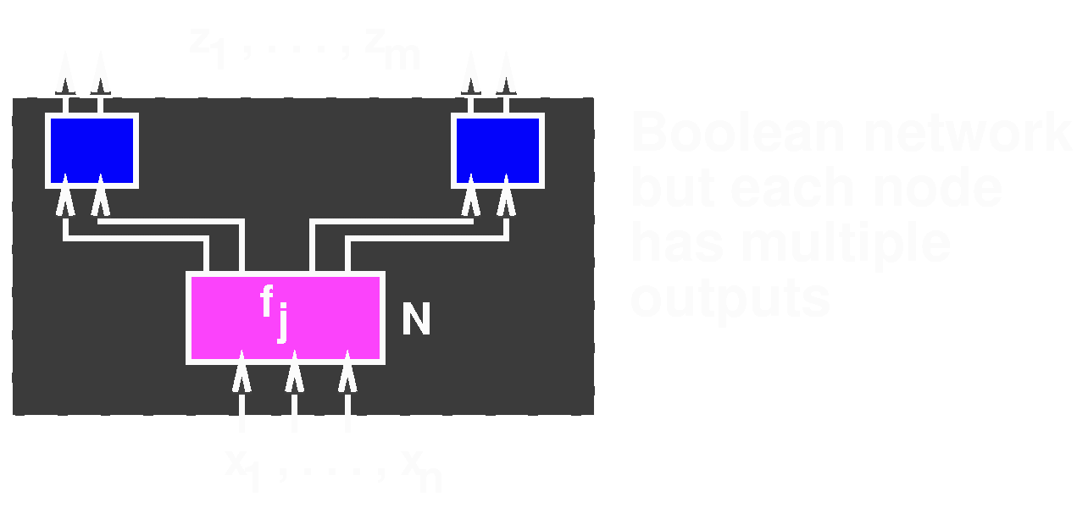
Multiple Output Functions
Network of Multiple Output Functions:
What is the set of implementable functions for f_{j} at N?
  Don't care formulation does not work
  Boolean Relation: (completely specified)
B : B^{n}→2^{Bm}
(one to many mapping)

Slide 49
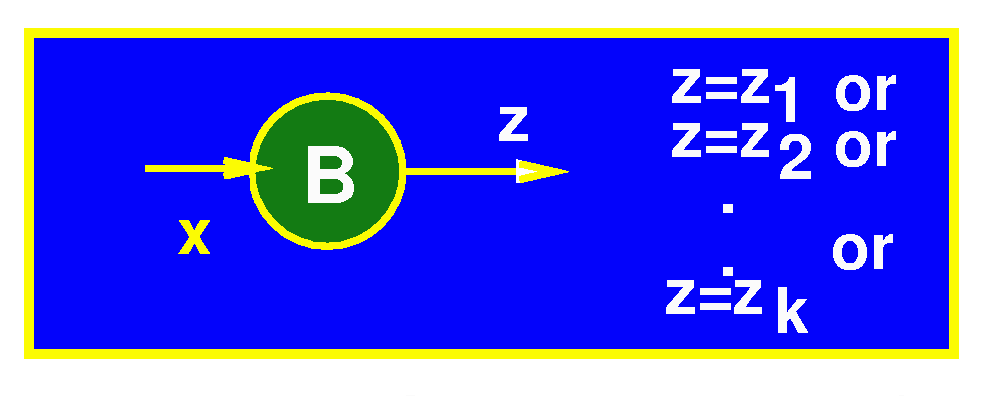
Multiple Output Functions
Implementable functions: A function g_{j} is an implementation (cover) of a Boolean relation B (g_{j}  B ) (or contained in) iff:
∀x, g_{j}(x)∈B (x)

Slide 50
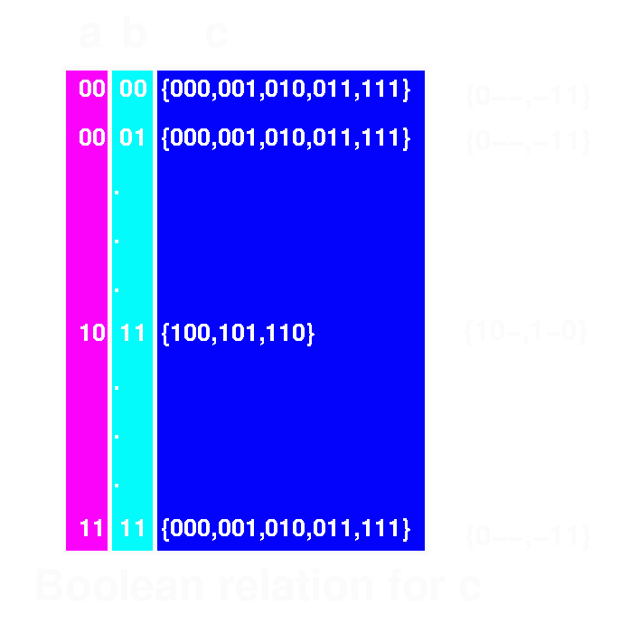
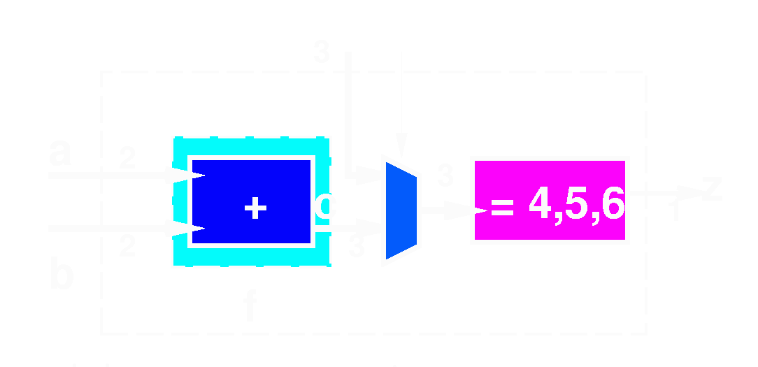
Example: Boolean Relation
Adder followed by
comparator
Want: f  B
One solution:
f = 000 if a + b ≠ 4,5,6
f = 100 if a + b = 4,5,6
This can’t be expressed
with don’t cares

Slide 51
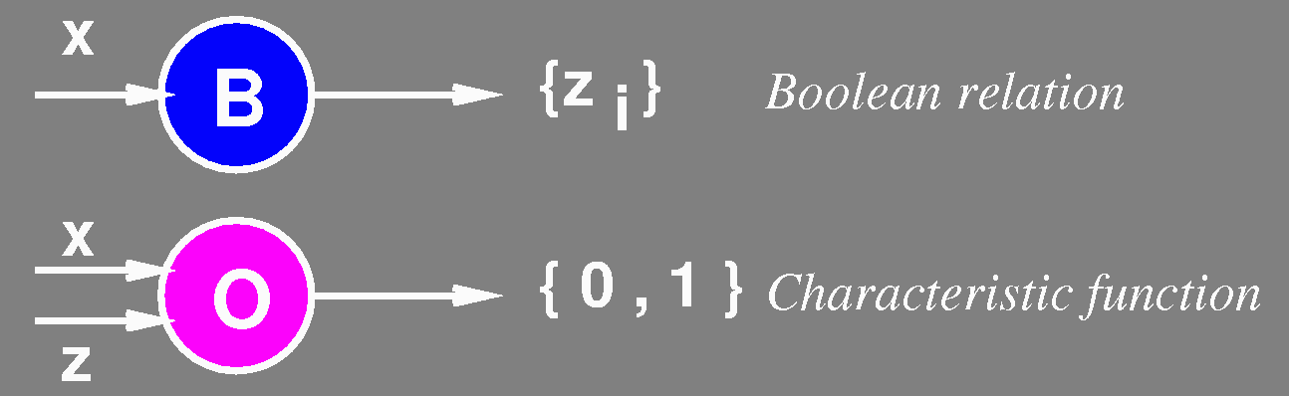
Representing Boolean Relations
Observability Function:
O = characteristic function of Boolean relation  B .
O (x,z) = 1 ⇔ z∈B (x)

Slide 52
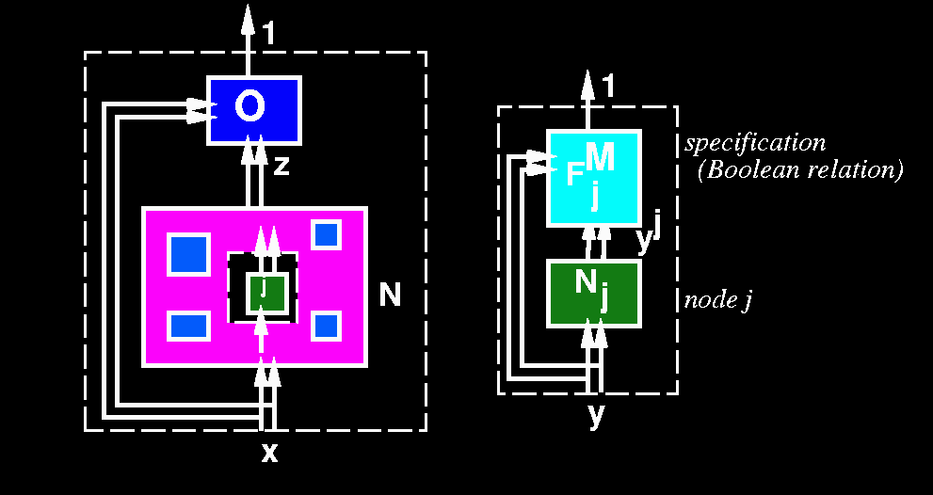
Representing Boolean Relations
Observability Network:
network of multiple output nodes
  same computational model
  hierarchical formulation
N_{j}

Slide 53
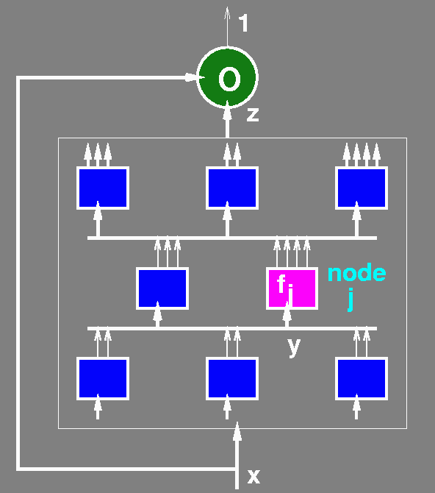
General Problem
Given network of multiple­output functions and observability specification:
Summarize all implementable
functions at node j, i.e. derive
F_{j}^{M}(y,y^{j} ) such that:
  f is implementable at node j
  ⇔ f  F_{j}^{M}(y,y^{j} )
  {Cerny ­ 1976,
  Savoj - thesis 1992, IWLS'93 }
Optimization Problem:
Find best f_{j} : f_{j}  F_{j}^{M}(y,y^{j} )

Slide 54
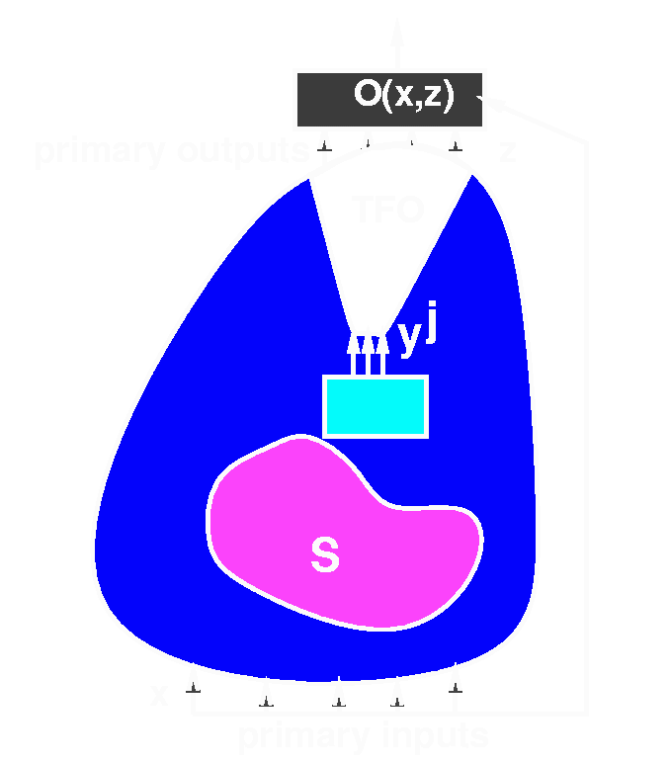
Deriving the Maximum Flexibility
Given S:
Consider a Boolean relation F_{j}^{M} : B^{|S|}×B^{k}→B
F_{j}^{M}( s, y^{j}) =
∀x { ( s = g_{S}(x)) ⇒ ∀z [ ( z = z^{M}(x, y^{j}) ) ⇒ O (x,z)] }
Note: z^{M}(x, y^{j}) represents the mapping given by the current circuit between x, y^{j} and the outputs z.

Slide 55
Deriving the Maximum Flexibility
Theorem: The set of functions given by f  F_{j}^{M} is the set of all implementable multi­output functions at node j (expressed as functions whose support is in S.)
Note: O can be treated as just another node in the Boolean network.
  even if we start with an initial Boolean relation specification, and a network of single output nodes, we can use the standard methods (e.g. full_simplify in SIS) for optimization.
Note:
∀x { ( s = g_{S}(x)) ⇒ ∀z [ ( z = z^{M}(x, y^{j}) ) ⇒ O (x,z)] }
Can be computed by standard BDD operations

Slide 56
Boolean Relation Minimizers:
Find best f_{j} : f_{j}  F_{j}^{M}(y,y^{j} )
Exact ­ Somenzi (1989),
Like Quine­McCluskey:
  define prime implicants
  generate all primes
  solve covering (binate) problem
Heuristic ­ Watanabe (1991)
Like ESPRESSO:
  iterates reduce, expand, irredundant until no change.
  Uses BDD's to represent Boolean relations

Slide 57
The End

Slide 58
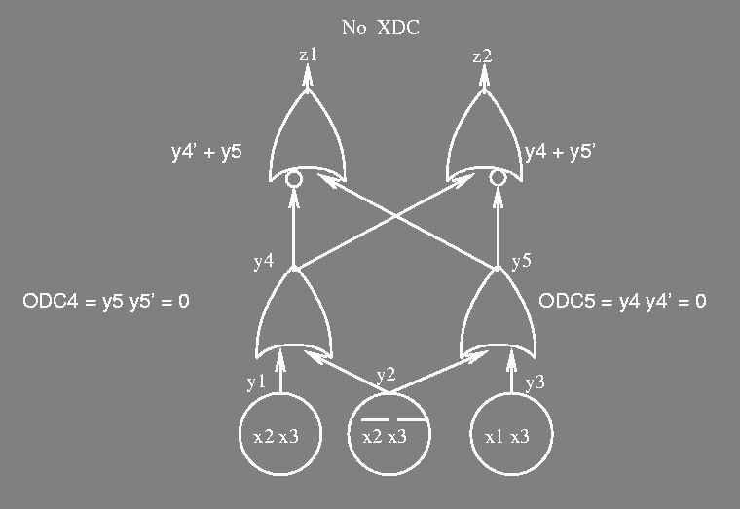
Incorrectness with Reconvergent Fanouts
Example 1
The correct ODC₂=x₁x₂+x₁x₂+x₃
(F₄|_{y2=0}‾⊕F₄|_{y2=1}+ODC₄)(F₅|_{y2=0}‾⊕F₅|_{y2=1}+ODC₅) =y₁y₃=x₁x₂x₃

Slide 59

Incorrectness with Reconvergent Fanouts
Example 2
The correct ODC₁=x₁+x₄
(F₂|_{y1=0}‾⊕F₂|_{y1=1}+ODC₂)(F₃|_{y1=0}‾⊕F₃|_{y1=1}+ODC₃) =(x₁+y₃)(x₄+y₂)=x₁+x₂+x₃+x₄

Slide 60
ODC Computation
Transduction
  ODC's for NOR­gate Networks
  Interesting Subset of ODC's
Extension of Transduction for General Networks
Direct Computations using BDD's

Slide 61
Transduction ­ MSPF
THEOREM 5 Given a NOR­gate network η, let η~ be the network obtained by replacing the node j by an OR gate. Let z_{k}~ be the k­th primary output of η~.
f_{j}^{M}= g_{j}(x) if ∃k:x∉XDC_{k} and z_{k}(x)≠z_{k}~(x)
f_{j}^{M}= * otherwise
  * designates don’t care points.
Note: the OR gate just complements the output of f_{j}.
Expensive to compute z_{k}~'s.
Can do better in case of no reconvergence.

Slide 62

MSPF for No Reconvergence
Define the MSPF for an edge [j,i]:
0 if f_{i}^{M}(x)=1
f_{[j,i]}^{M}(x)= 1 if f_{i}^{M}(x)=0 and ∀l∈FI_{i}, l≠j:gl(x)=0
* otherwise

Slide 63
MSPF for No Reconvergence
Define the MSPF for an edge [j,i]:
0 if f_{i}^{M}(x)=1
f_{[j,i]}^{M}(x)= 1 if f_{i}^{M}(x)=0 and ∀l∈FI_{i}, l≠j:gl(x)=0
* otherwise

Slide 64
MSPF for No Reconvergence
THEOREM 6: Suppose ∩_{i∈FOj}TFO_{i}=φ
Then f_{j}^{M}(x)=Π_{i∈FOj}f_{[j,i]}^{M}(x)

Slide 65
Generalization of CSPF's
The proposed procedure have two drawbacks.
CODC for an edge is expensive to compute. (exponential in # of fanins)
  some heuristics have been proposed.
The set of CODC_{j} s computed for the nodes is not maximal compatible, i.e. there might exist a function of the primary inputs for some node j s.t.
  1. the function cannot be obtained by ODC_{j}^{C} and
  2. the function can be added as a permissible function without destroying the property of the compatibility.

Slide 66

Non­Maximality of ODC^{C}
ODC C computed at a node may not be maximally compatible.
Example:
  ODC_{[2,3]}^{C}= ODC_{[2,4]}^{C}=φ
  ODC₂^{C}=φ
  However, we can put either 1 or 0 at y₂.
  therefore, ODC₂^{C} should be 1.

Slide 67

Compatible Set of Functions
T : a set of nodes s.t.
TFO_{j}-{j}⊆T and
T∩(TFI_{j}∪{j})=φ
  suppose a set of functions
  {f_{i}^{C}|i∈T} is given. f_{i}^{C} is
  an incompletely specified
  function of FI
find f_{j}^{C} compatible with
{f_{i}^{C}|i∈T}
  f_{j}^{C} is a maximal set of functions of FI_{j} compatible with all the combinations of the completely specified functions given by {f_{i}^{C}|i∈T}
Note: f_{j}^{C} is expressed by its fanins, rather than the primary inputs.

Slide 68
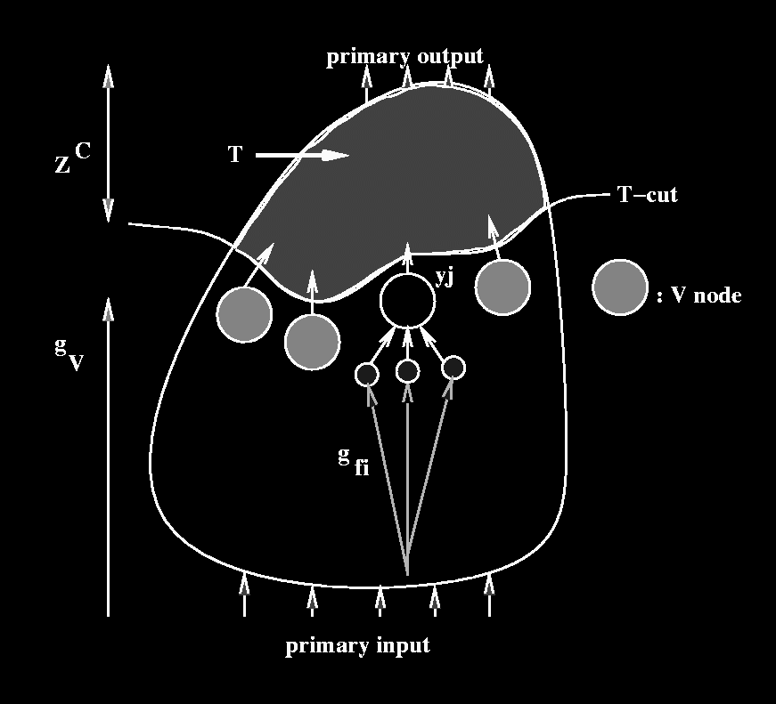
Compatible Set of Functions
V : the set of nodes
except j adjacent to
T­cut V={l|l∉T, l≠j,
and ∃i∈T:i∈FO_{l}}
g_{V}:B^{n}→B^{|V|} - the
global functions at
the V nodes.
g_{fi}:B^{n}→B^{|FIj|} - the
global functions at
the FI_{j} nodes.

Slide 69
Compatible Set of Functions
Z^{C}: B^{|V|+1}×B^{|Z|}→B a relation on the functionality of T (relation between V∪{y_{j}} and the primary outputs)
  Z^{C}((v,y_{j}),z)=1 iff there exists a set of completely specified functions at T given by {f_{i}^{C}|i∈T} with which z appears at the primary outputs by setting (v,y_{j}) at V and y_{j}.

Slide 70
Compatible Set of Functions
Consider a Boolean
relation F_{j}^{C}:B^{|FIj|}×B→B
s.t. F_{j}^{C}(y,y_{j})≡1 iff
(1) y=g_{fi}(x) and
∀(x,z)∈B^{n}×B^{p} : (2) Z^{C}((g_{V}(x),y_{j}),z)=1⇒z∈g_{Z}(x)
  Note: F_{j}^{C}(y,y_{j}) gives a relation (incompletely specified function) between y and y_{j}.
THEOREM 9 F_{j}^{C} is a maximal set of functions of FI_{j} compatible with {f_{i}^{C}|i∈T}

Slide 71
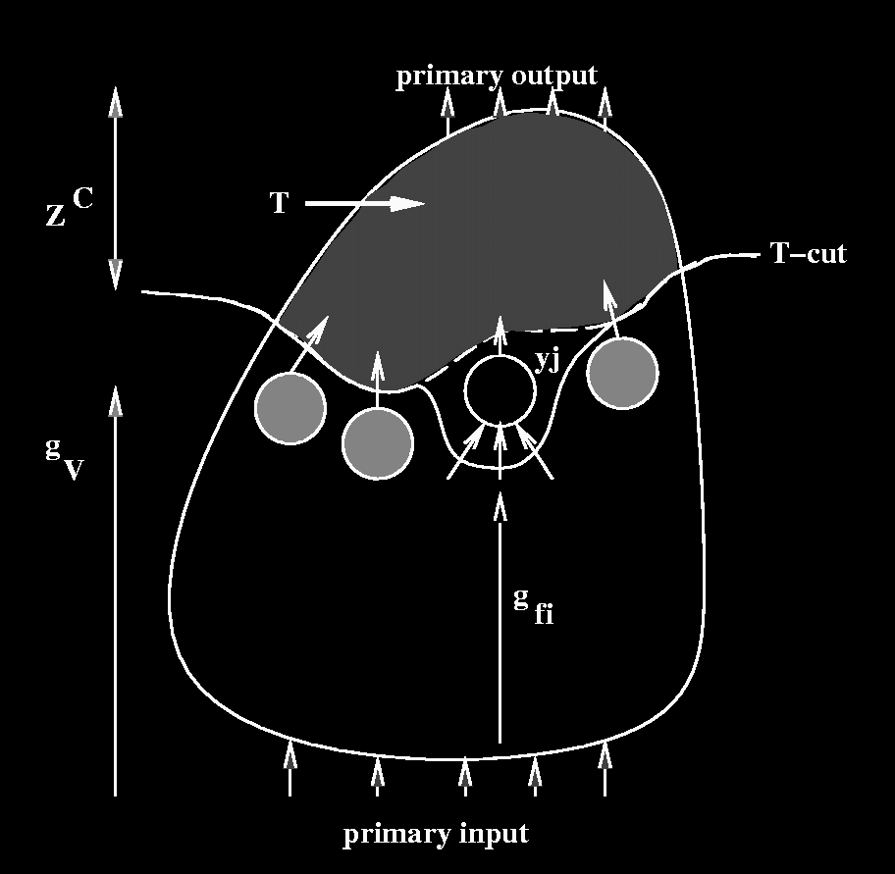
Compatible Set of Functions
Once F_{j}^{C} is computed,
T­cut is updated,
and y_{j} is put in T.
The nodes in FI_{j} are
now adjacent to the cut.
Z^{C} is updated.
The new Z^{C} is a relation between V∪FI_{j} and the primary outputs.
The new Z^{C}((v,y),z)=1 iff
∃y_{j}:Z^{C} ((v,y_{j}),z)=1 and F_{j}^{C}(y,y_{j})=1

Slide 72
BDD Computation for F_{j}^{C} and Z^{C}
F_{j}^{C}(y,y_{j}) = 1 iff
(1) y=g_{fi}(x) and
∀(x,z)∈B^{n}×B^{P}: (2) Z^{C}((g_{V}(x),y_{j}),z)=1⇒z∈g_{Z}(x)
The new Z^{C}((v,y),z)=1 iff
∃y_{j}: Z^{C}((v,y_{j}),z)=1 and F_{j}^{C}(y,y_{j}) = 1

Slide 73
BDD Computation for F_{j}^{C} and Z^{C}
Existential Quantification
For a function h:B^{r}→B of variables V={v₁,..,v_{r}} and V_{k}={v₁,..,v_{k}}⊆V, the existential quantification of h by V_{k} is the function h_{k} of the variables V-V_{k} s.t. h_{k}(v_{r-k})=1 iff ∃v_{k}∈B^{k}:h(v_{k},v_{r-k})=1.
h_{k}(v_{r-k})=S_{v1}(S_{v2}(... S_{vk}(h)..))
where S_{vi}(h)=h|_{vi=0}+ h|_{vi=1}

Slide 74
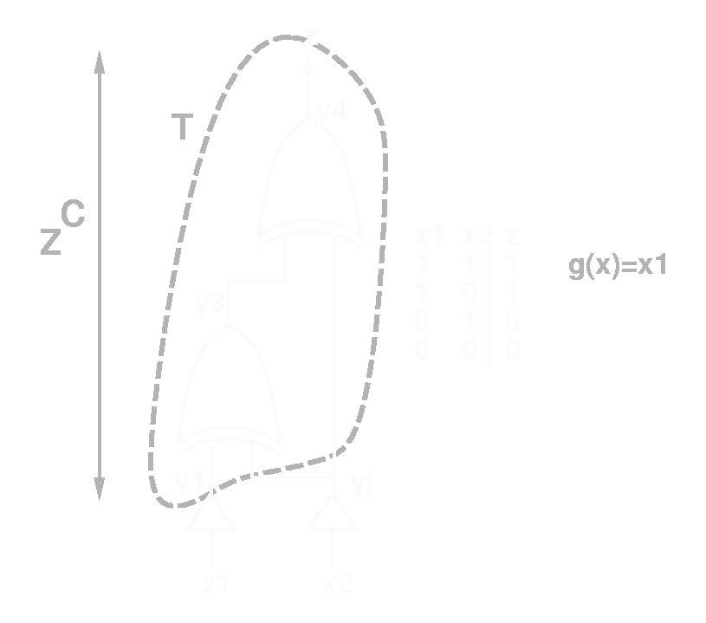
Compatible Set of Functions
Example
T_{C}={y₄,y₃}
V={y₁}
f₄^{C}=y_{j}⊕y₃
f₃^{C}=y₁⊕y_{j}
g_{V}=x₁
g_{fi}=x₂
g_{Z}=x₁
Z^{C}=y₁‾⊕ z
Thus
F_{j}^{C}(x₂,y_{j})=∀_{{x1,z}}((x₂=g_{fi})^(Z^{C}((g_{v}(x),y_{j}),z))⇒(z=g_{Z}(x)))
=C_{{x1,z}}((x₂‾⊕g_{fi})(x₁⊕z) ⇒(z‾⊕x₁)) = 1

