Slide 1
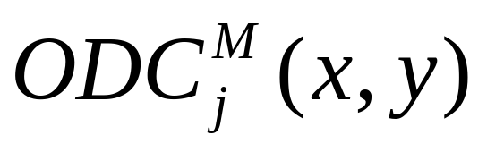
Using Don’t Cares -  command
Major command in SIS - uses SDC, ODC, XDC
Key Questions: How do we represent XDC to a network? How do we relate ODC + XDC to a node representation where ODC is some subset of

Slide 2

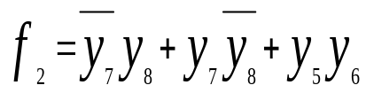
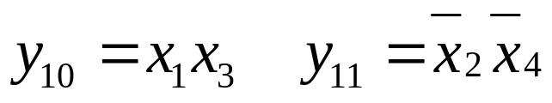

XDC
z
=
y
y
10
11
z (output)
y₁₂
or
separate
DC network
y₂
y₉
y₁
y₁₀
y₁₁
y₅
y₆
y₃
y₄
y₇
y₈
x₁
x₃
x₂
x₄
x₁
x₂
x₃
x₄
x₁
x₃
x₂
x₄
multi-level
Boolean network
for z

Slide 3

XDC is held in separate network, called the DC network. Described in BLIF by
.begin dc
...
.end dc
XDC and ODC are related only through x₁, x₂, x₃, x₄, the primary inputs.

Slide 4
Mapping to Local Space
How can ODC + XDC be used for optimizing the representation of a node, y_{j}?
y_{j}
y_{l}
y_{r}
x₁
x₂
x_{n}

Slide 5
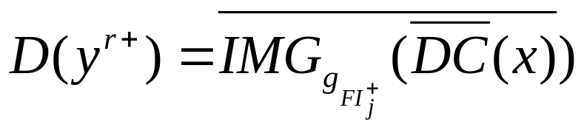
Mapping to Local Space
Definitions:
  The local space B^{r} of node j is the Boolean space of all the fanins of node j (plus maybe some other variables chosen selectively).
  A don’t care set D(y^{r+}) computed in local space (+) is called a local don’t care set.
Solution:
  Map DC(x) = (ODC+XDC)(x) to local space of the node to find local don’t cares, i.e. we will compute

Slide 6
Computing Local Don’t Cares
The computation is done in two steps:
y_{j}
y_{l}
y_{r}
x₁
x₂
x_{n}
1. Find DC(x) in terms of primary inputs.
2. Find D, the local don’t care set, by image computation
and complementation.

Slide 7
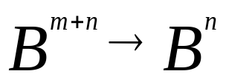
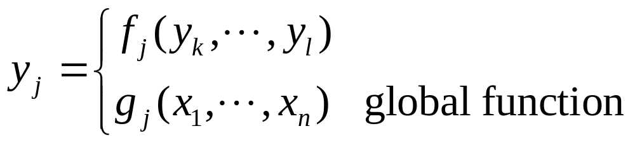
Map to Primary Input (PI) Space
y_{j}
y_{l}
y_{r}
x₁
x₂
x_{n}

Slide 8

Map to Primary Input (PI) Space
Computation done with Binary Decision Diagrams
  Build BDD’s representing global functions at each node in both the primary network and the don’t care network, g_{j}(x₁,...,x_{n}) - use BDD_compose or better, BDD_substitute.
  Replace all the intermediate variables in (ODC+XDC) with their global BDD
    Since we will be using the method of computing the compatible don’t cares by the “local cube method”, in general, this will be a set of cubes expressed in (x,y)
  Use BDD’s to substitute for y in the above (using BDD_substitute)
~
h
(
x
,
y
)
=
(
ODC
+
XDC
)(
x
,
y
)
→
h
(
x
)
=
DC(x)

Slide 9
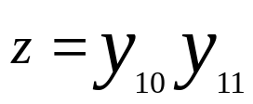
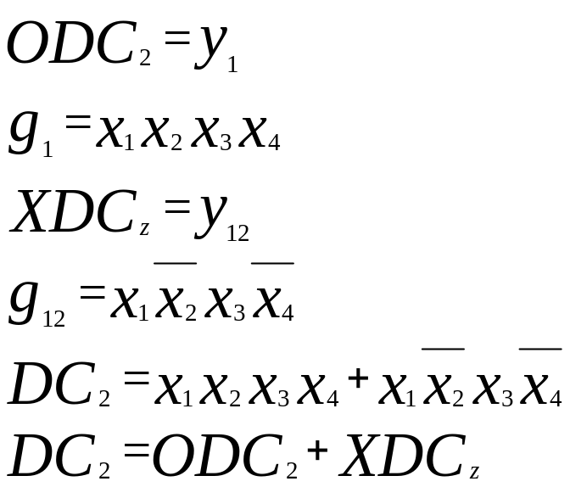
Example
XDC
z (output)
y₁₂
or
separate
DC network
y₉
or
y₁
&
y₂
y₁₀
y₁₁
&
y₅
y₆
xnor
y₃
y₄
&
&
y₇
y₈
x₁
x₃
x₂
x₄
x₁
x₂
x₃
x₄
x₁
x₃
x₂
x₄
multi-level
network
for z

Slide 10
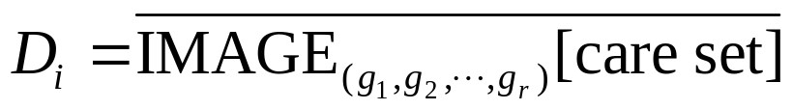
Image Computation
image of care
set under
mapping y₁,...,y_{r}
local
space
y_{j}
B^{r}
y_{l}
y_{r}
g_{l}
g_{r}
D_{i}
image
B^{n}
x₁
x₂
x_{n}
DC_{i}=XDC_{i}+ODC_{i}
care set
Local don’t cares are the set of minterms in the local space of y_{i} that cannot be reached under any input combination in the care set of y_{i}.
Local don’t Care Set:
i.e. those patterns of (y₁,...,y_{r}) that never appear as images of input cares.

Slide 11
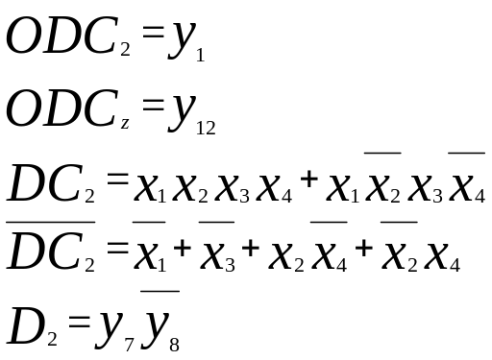
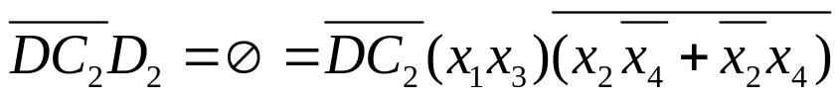

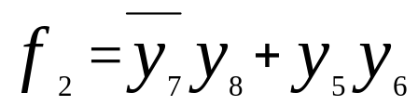
Example
XDC
z (output)
y₁₂
or
separate
DC network
y₉
or
y₁
y₂
y₁₀
y₁₁
&
&
y₅
y₆
xnor
y₃
&
y₄
&
y₇
y₈
x₁
x₃
x₂
x₄
x₁
x₂
x₃
x₄
x₁
x₃
x₂
x₄
multi-level network for z
Note that D₂ is given in this space y₅, y₆, y₇, y₈. Thus in the space 2210 never occurs.
Can check that
Using , f₂ can be simplified to

Slide 12

 Algorithm
Visit node in topological reverse order i.e. from outputs. This gives rise to a total ordering of all nodes. Edge ordering is inherited from node ordering, i.e. [i,j] < [k,j] if i < k.
Compute compatible ODC_{i} by “modified flipping” method.
  compatibility done in SOP form
  with intermediate y variables.
BDD’s built to get this don’t care set in terms of primary inputs (DC_{i})
Image computation techniques used to find local don’t cares D_{i} at each node.
( XDC_{i} + ODC_{i} )(x,y) → DC_{i}(x) → D_{i}( y ^{r} )
where ODC_{i} is a compatible don’t care at node i.
f
y₁
y_{k}

Slide 13
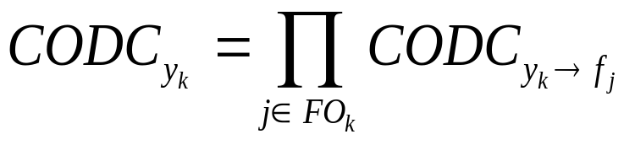
Easier Computation of CODC Subset
The Savoj method, an easy way for computing a CODC subset on each input of a function f, is:
where CODC_{f} is the compatible don’t cares already computed for node f, and where f has its inputs y₁,y₂,... in that order.

Slide 14
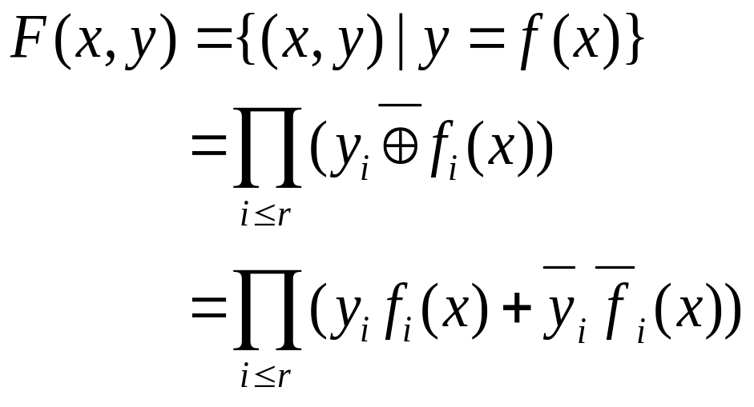
Image Computation: two methods
Transition Relation Method
f : B^{n} → B^{r} ⇒ F : B^{n} x B^{r} → B
F is the characteristic function of f.

Slide 15
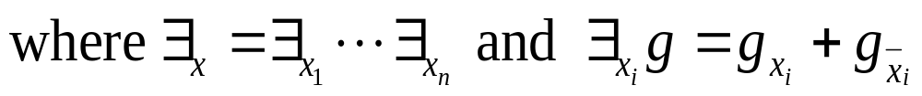
Transition Relation Method
Image of set A under f
f(A) = ∃_{x}(F(x,y)A(x))
The existential quantification ∃_{x} is also called “smoothing” and denoted sometimes by S_{x}.
Note: The result is a BDD representing the image, i.e. f(A) is a BDD with the property that
BDD(y) = 1 ⇔ ∃x such that f(x) = y and x ∈ A.
f
A
f(A)
x
y

Slide 16
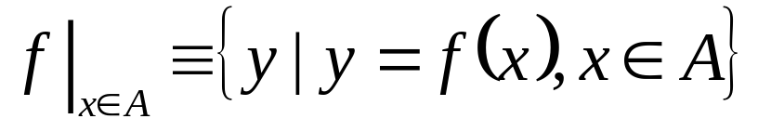
Recursive Image Computation
Problem: Given f : B^{n} → B^{r} and A(x) ⊆ B^{n}
Compute:
Step 1: compute CONSTRAIN (f,A(x)) ≡ f_{A(x)}
f and A are represented by BDD’s. CONSTRAIN is a built-in BDD operation. It is related to generalized cofactor with the don’t cares used in a particular way to make
1. the BDD smaller and
2. an image computation into a range computation.
Step 2: compute range of f_{A(x)}.
f_{A(x)} : B^{n} → B^{r}

Slide 17
Recursive Image Computation
Property of CONSTRAIN (f,A) ≡ f_{A(x)}:
(f_{A(x)})|_{x∈B}^{n} = f|_{x∈A}
i.e. range = image
f
A
f_{A}
f(A)
range of f_{A}(B^{n})
B^{n}
B^{r}
range of f(B^{n})

Slide 18
End of lecture 13

Slide 19



Recursive Image Computation
Divide and conquer
1.
B^{n}
B^{r} = (y₁,...,y_{r})
This is called input cofactoring

Slide 20
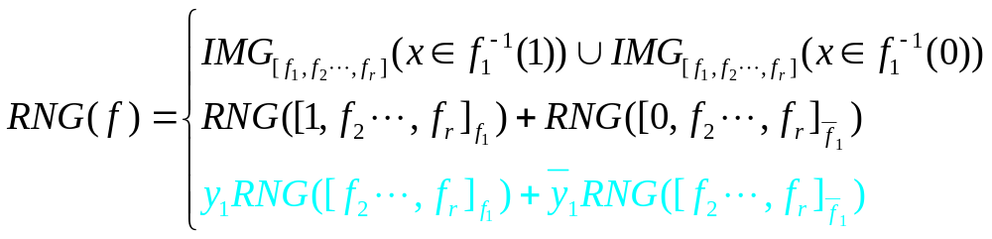
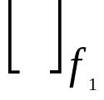
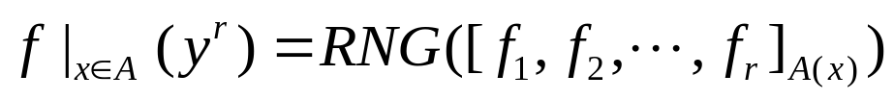
Recursive Image Computation
Divide and conquer
2.
where here refers to the CONSTRAIN operator.
(This is called output cofactoring). Thus
Notes: This is a recursive call. Could use 1. or 2 at any point.
The input is a set of BDD’s and the output can be either a set of cubes or a BDD.

Slide 21
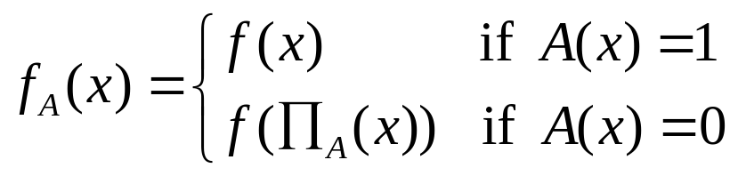
 illustrated
f
A
0
0
X
X
Idea: Map subspace (say cube c in B^{n}) which is entirely in DC
(i.e. A(c) ≡ 0) into nearest non-don’t care subspace
(i.e. A ≠ 0).
where _{A}(x) (projection) is the “nearest” point in B^{n} such that A = 1 there.

Slide 22

XDC
outputs
f_{j}
m intermediate
nodes
Don’t
Care
network
inputs ∈ B^{n}
Express ODC in terms of variables in B^{n+m}

Slide 23


Express ODC in terms of variables in B^{n+m}
B^{n}
B^{n+m}
B^{r}
ODC+XDC
DC
D
compose
cares
cares
image
computation
Minimize f_{j}
don’t care = D
f_{j}
local
space B^{r}
Question: Where is the SDC coming in and playing a roll?

