Slide 1
SPFDs - A new method for specifying flexibility
Sets of Pairs of Functions to be Distinguished
From the paper:
“A new Method to Express Functional Permissibilities for LUT Based FPGAs and Its Applications ”
by S. Yamashita, H. Sawada, and A. Nagoya, NTT Communications Science Lab., Kyoto, Japan ICCAD’96
BUT: this paper is more about a new kind of “don’t cares”, rather than about application to FPGAs

Slide 2
Methods for Expressing Sets of Functions
Don’t Cares (=> incompletely specified functions (ISFs))
  Satisfiability DCs
  Observability DCs
  XDCs
ATPG Redundancy Removal
Boolean Relations
Sets of Boolean Relations
SPFDs. (Actually, they are sets of ISFs).

Slide 3
ODCs and SPFDs
ODCs:
  Different ways to compute them
    Full method (difficult)
    Subsets
      Compatible Sets of Permissible functions (CSPFs)
        (Easier to compute)
      Compatible observability don’t cares (CODCs)
        see Savoj thesis - generalization of CSPFs
  CSPFs and CODCs
    have advantage that they can be computed fast - from outputs to inputs
    are independent

Slide 4
ODCs and SPFDs
SPFDs:
like CSPFs/CODCs
  can be computed fast from outputs to inputs
  are independent
but more powerful and
not a subset of DCs (they are a sets of ISFs)

Slide 5
ISFs
Usually we deal with binary ISFs.
  They can be represented as complete bipartite graphs on minterms.
  Vertices are minterms. Set of vertices may be subset of all minterms
  An edge means that we need to build a function that distinguishes (i.e. has different values) the two minterms on the edge.
onset
offset
A connected bipartite graph has only two colorings, one the onset
and the other the offset and vice versa (onset, offset)

Slide 6
Building F
We start with a complete bipartite graph (ISF) for F. This gives a set of minterms that must be distinguished.
F
y¹
y⁴
y₁
y₂
y₃
y²
y⁵
y³
g₁
g₂
g₃
x
Y space is (y₁,y₂,y₃).
Each y^{i} is a minterm in Y

Slide 7
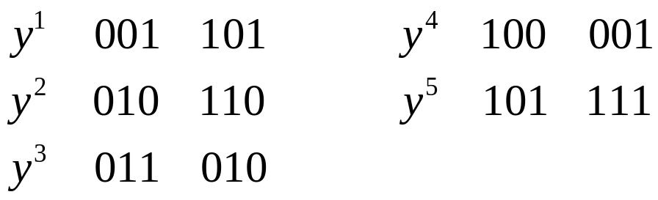
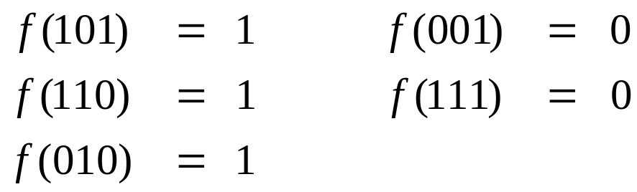
Building F
y¹
Suppose that the inputs to F are
y = (g₁(x), g₂(x), g₃(x)).
As long as {y¹, y², y³} are encoded differently from {y⁴, y⁵} by g(x), there exists a function F which implements the ISF.
y⁴
y²
y⁵
y³
old
new
old
new
New F:

Slide 8
Distributing the job
y¹
y⁴
y²
y⁵
y³
We can distribute the “encoding” job separately to the input wires.
Note: as long as each edge is distinguished by one of the inputs, this is sufficient for a new encoding.
input 1
input 2
input 3
y¹
y⁴
y²
y⁴
y¹
y⁵
y²
y³
y³
y⁵
y⁵
y⁴

Slide 9
Input Graphs
Each of the edges on the input graphs means that the input signal g_{i}(x) has to have a different value for the two nodes.
Note: the graphs are bipartite, but not complete and may be disconnected. In the above case, each graph has 4 different legal colorings.
input 1
input 2
input 3
y¹
y⁴
y²
y⁴
y¹
y⁵
y²
y³
y³
y⁵
y⁵
y⁴

Slide 10
Assigning Values
Now we can assign values to the graphs (color the graphs).
Thus, for example
y¹=1*1, y²=00*, y³=*10, y⁴=011, y⁵=100
input 1
input 2
input 3
y¹
y⁴
y²
y⁴
y¹
y⁵
y²
y³
y³
y⁵
y⁵
y⁴

Slide 11
Assigning Values
Note that y¹, y², y³, y⁴, y⁵ are all distinctly encoded in this case. But, in general, that is not necessary,
e.g. could have y¹ y² y³ all encoded with the same value.
The original ISF can be implemented with either encoding
F(y¹) = F(y²) = F(y³) = 1 and F(y⁴) = F(y⁵) = 0
Now just call ESPRESSO to get a minimized F.
y¹
y²
y³
y⁴
y⁵
input 2
y²
y⁴
input 1
y³
y¹
y⁵
y⁴
y²
input 3
y⁵
y¹
y⁵
y³
y⁴
input 1
input 2
input 3
y¹
y⁴
y²
y⁴
y¹
y⁵
y²
y³
y³
y⁵
y⁵
y⁴

Slide 12
SPFDs
Now we generalize this because
  we can
  it is more powerful
    (can be applied to multiple outputs and multiple valued variables)
  it improves understanding
Definition 1: A SPFD F(y) on domain Y is an undirected graph (V,E) where each v∈V is associated with a minterm
m = (y₁,...,y_{k}) ∈ Y
y¹
y²
y³
y⁶
y⁴
y⁵

Slide 13
Implements
Definition 2: A function f(y) implements F(y) = (V,E) iff f(y) is a valid coloring of F, i.e.
(y¹, y²) ∈ E iff f(y¹) ≠ f(y²),
Three Colorings
Must have at least 3 colors since
the chromatic number of graph is 3

Slide 14
Compatible
Definition 3: A mapping y(x) = (y₁(x),...,y_{k}(x)) is F(z)-compatible if
∀((z^{i},z^{j}) ∈ F(z)) y(X(z^{i})) ∩ y(X(z^{j})) = 0
where X(z^{i}) = { x | z(x) = z^{i} }.
Boolean Network
Z-space
Y-space
g
x-space (primary inputs)
F(z)
z^{i}
z^{j}
Z-space
z(x)
z(x)
Primary
Input
Space
X(z^{i})
X(z^{j})
y(x)
y(x)
Y-space

Slide 15
Re-implementing a Function
Theorem 1: If y(x) is F(z)-compatible, then there exists a function g(y) which implements F(z).
Proof.
Translate SPFD F(z) into F(y). Thus for each (z^{i}, z^{j}) ∈ F(z)), put an edge for every pair (y^{k}, y^{l}) where y^{k} ∈ y(X(z^{i})) and y^{l} ∈ y(X(z^{j})). Since y(X(z^{i})) ∩ y(X(z^{j})) = 0, there is no self edge in F(y). Hence a coloring exists.
F(z)
z^{i}
z^{j}
Z-space
z(x)
z(x)
Primary
Input
Space
X(z^{i})
X(z^{j})
y(x)
y(x)
Y-space

Slide 16
Re-implementing a Function
Color F(y) and implement the corresponding ISF by some function g(y).
Each y(X(z^{i})) creates an equivalence class which can all be colored with the same color, (but different colors can be used if preferred.)

Slide 17
Re-implementing the Inputs to a Function
We want to build new functions y’(x) at the inputs to G.
Boolean Network
Z-space
Y-space
G
x-space (primary inputs)

Slide 18
Re-implementing the Inputs to a Function
For new functions y’(x), just need for each edge in F(y), at least one input that has different values for the two minterms of the vertices of the edge
Theorem 2: y’(x) is F(z)-compatible if
∀(z^{i},z^{j})∈F, ∃k, ∀((x^{i},x^{j}) ∈ (X(z^{i}),X(z^{j}))), y’_{k}(x^{i}) ≠ y’_{k}(x^{j})
Proof. Since y’_{k}(x^{i}) ≠ y’_{k}(x^{j}), then y’(x^{i}) ≠ y’(x^{j}).
Hence y’(X(z^{i})) ∩ y’(X(z^{j})) = 0.

Slide 19
Re-using Old Topology
Note: up to now we could have assigned any edge of the node SPFD to any of the inputs
An efficient way of building a new mapping y’(x) is to use part of the old implementation.
Boolean Network
Z-space
Y-space
G
w¹
w²
w³
x-space (primary inputs)

Slide 20
Re-using Old Topology
Construct SPFDs {F₁(y),...,F_{r}(y)} (for each local input) such that
F_{k} (y) = { (y^{i},y^{j}) ∈ F(y) only if }
  i.e. the k^{th} input currently distinguishes (y^{i},y^{j}) for all those x which map to y^{i}, or to y^{j}
∀(y^{i},y^{j}) ∈ F(y), ∃k, (y^{i},y^{j}) ∈ F_{k}(y)
  i.e. each edge is assigned to one of the inputs
y
i
≠
y
j
k
k

Slide 21
Efficient Re-implementation
Theorem 3: Suppose the current implementation of the global functions at y, y(x), are implemented with sets of intermediate variables w = (w¹,...,w^{r}),
i.e. y(x) = (f₁(w¹(x)),...,f_{r}(w^{r}(x))).
Then for each k, any coloring of F_{k} (y) can be implemented with some function f’_{k} (w^{k}(x)).
(i.e. the new fanins of G can be implemented with the same inputs w¹,...,w^{r} as the old fanins)
Thus a new set of input functions y’(x) can be obtained as
y’ = (f’₁(w¹(x)),...,(f’_{r}(w^{r}(x)))
i.e. a set of functions of the current intermediate inputs to f₁,...,f_{r}.
Y-space
G
…
w¹
w²
w^{r}

Slide 22
End of lecture 15

Slide 23
Efficient Re-implementation
Proof. Consider F_{k}(y) for some input k. The current f_{k} implements F_{k}(y) since for (y^{i},y^{j}) ∈ F_{k}, f_{k}(y^{i}) ≠ f_{k}(y^{j}), i.e.
f_{k}(X(y^{i})) ∩ f_{k}(X(y^{j})) = 0
Thus for all x^{i} ∈ X(y^{i}), x^{j} ∈ X(y^{j}), we must have
w^{k}(x^{i}) ≠ w^{k}(x^{j}). Otherwise, f_{k}(w^{k}(x^{i})) = f_{k}(w^{k}(x^{j})) contradicting that f_{k}(y^{i}) ≠ f_{k}(y^{j}). Since w^{k} distinguishes x^{i} from x^{j} (i.e. the information is available at the inputs of node k), functions f’_{k}(w^{k}) exist which distinguish x^{i} and x^{j}.

Slide 24
How Do We Use This
Boolean Network
z-space
y-space
G
x-space (primary inputs)
Note: since y(x) is F(z)-compatible, then so is
y⁺ = (y(x),y_{k+1}(x)).
Theorem 4: Wire y₁ can be removed if and only if
(y₂,...,y_{k+1}) is F(z)-compatible.

Slide 25
Conclusions and future
SPFDs offer greater choice in implementing a circuit
  Can change both a node and its inputs
  An SPFD can be colored in many ways
New way to obtain Boolean divisors
Implementation using MDDs in progress
Implementation using SAT in progress
Useful for DSM for rewiring for noise avoidance or better layout
Can be used to define “don’t care wires”

Slide 26
Ruggedizing SPFD computation
Currently done using BDDs
  Works for medium sized circuits
Have developed a method using SAT
  Implementation almost done
Image computation:
which minterms in Z
are mapped into which
minterms in Y?
Z-space
SPFD(Z)
SPFD(Y)
Y-space
z -> y
if exists x such that
f_{Z}(x) = z and f_{Y}(x) = y
Primary inputs X

Slide 27
MV-SPFDs and Wire Removal
An MV-SPFD represents the information content of a wire in a network.
  the MV-SPFD of each fanin to a node, gives the information that it must provide.
The sum total of the information content of a node’s fanin wires must cover the information required of the output of the node.
We determine a minimal subset of fanins at each node which cover the required information by solving a covering problem.

Slide 28
Wire Removal and Wire Substitution
Wire removal: suppose
SPFD_{out} ⊆ SPFD_{in3}  SPFD_{in4}  SPFD_{in5}
Then, can remove in1 and in2
SPFD_{out}
Wire substitution: suppose
SPFD_{in4} ⊆ SPFD_{in6}
Then, can replace in4 by in6
SPFD_{in1}
Important:
Because wires are
changed, the internal
logic of a block may
change.
SPFD_{in5}
SPFD_{in2}
SPFD_{in4}
SPFD_{in3}

Slide 29
Don’t Care Wires
Each input pin σ will have a set of sources, S_{σ} (among which we can choose any one).
Each source ω (driver of a wire) distinguishes a set of pairs of minterms (SPFD) in the primary input space
Wire ω is assigned as a candidate source for input pin σ if:
SPFD_{σ} ⊆ SPFD_{ω}

Slide 30
Compatible sets of don’t care wires
Want to be able to select one source from each set S_{σ} independent of the selection made from any other set S_{σ}’ (compatible set of candidate sets of sources)
Theorem: A set of sets {S} of candidate wires is compatible if
  it can never produce a cyclic network
  for each wire ω  S SPFD_{σ} ⊆ SPFD_{ω}

Slide 31
Choosing best subset of wires
AWC: alternate wire choice problem
  Given: a point placement of pins and a set of candidate wires for each input pin
  Find: a selection of wires for each input pin that minimizes the total half-perimeters of the nets’ bounding boxes.
(The problem is NP-complete)

Slide 32
Placement using don’t care wires
Current placement by Mincut/Annealing or by a Force Directed Method:
  wire choices considered in move to determine cost of move
    use semi-greedy AWC algorithm during each placement move

Slide 33
Experiments – total wire length
(placement, no routing)
Initial PLA netlist
Alternate wires (13.5%)
Max Alternates (15%)
Wire removal
and Re-synthesis
Place
Place
6.6%
Place
10.2%
Place
0%
Wire choices
8.5%
Notes: 13.5% -> 15% in alternate wires results in 6.6% -> 10.2% improvement in wire length
Re-synthesis
Place
Wire removal
13.7%
Place
Wire removal
Wire removal currently does
not use placement information
14.4%
Place
? %

Slide 34
Wireplanning before decomposition
Primary outputs: information required (in terms of PIs)
?
?
?
Function inside block only needs to provide the information required of its fanouts
?
?
?
?
A block logic function exists iff the information at the inputs covers the information required at the output
?
?
?
Information
Arrives - PIs

Slide 35
Information Flow Theorem
Theorem: A set of logic functions exists for the blocks if and only if there exists a path from input I_{k} to output O_{j} whenever O_{j} depends on I_{k}.
?
?
?
Open question: How
do you make the
assignment of SPFD
edges so that the
resulting logic in the
blocks is as simple as
possible?
?
?
?
?
?
?

