Slide 1
DDoS Attack Detection
Comparative Analysis of ML and Deep Learning Models
January 2026

Slide 2
Problem Statement
What is DDoS?
Key Challenges
Exhausts target resources (bandwidth, CPU)
Makes services unavailable to users
Modern attacks are multi-vector campaigns
Traditional IDS often fail
Class Imbalance
176:1 ratio between classes
High Dimensionality
88 original features
Real-Time Constraints
Low latency required

Slide 3
Dataset: CICDDoS2019
431,320
Total Samples
52
Features
12
Classes
176.9x
Imbalance
Attack Categories:
Reflection/Amplification:
DNS, LDAP, MSSQL, NTP, NetBIOS, SNMP,
Portmap, TFTP
Flood Attacks:
Syn, UDP, UDPLag + Benign traffic

Slide 4
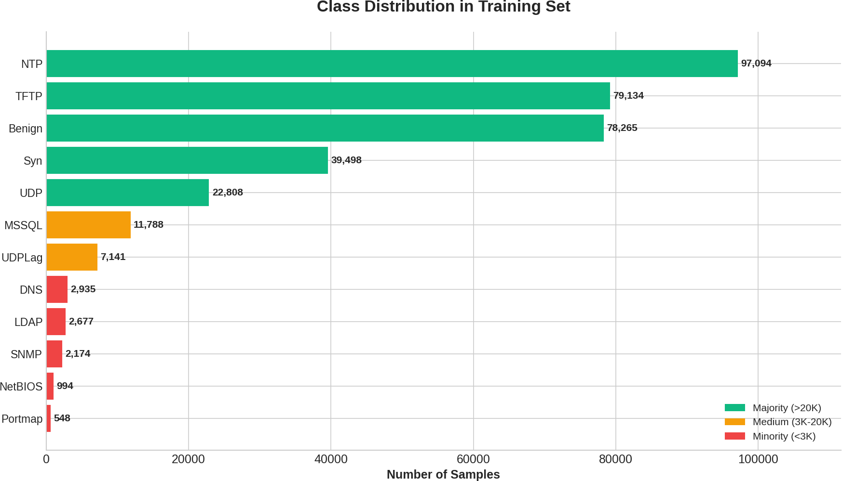
Class Distribution

Slide 5
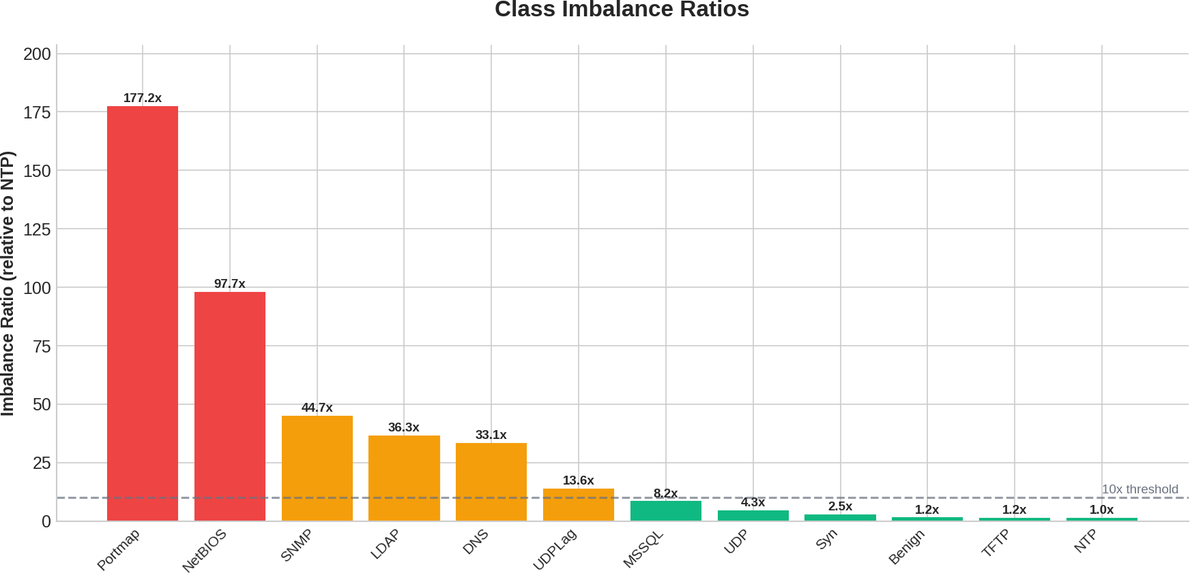
The Class Imbalance Challenge

Slide 6
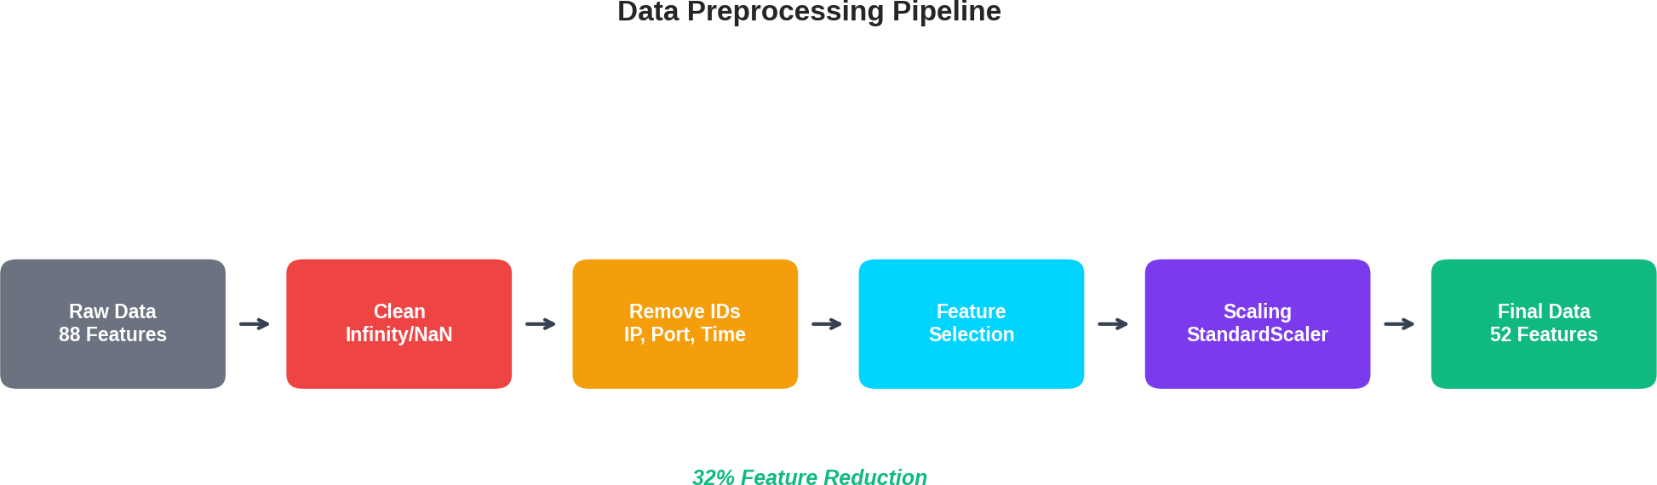
Data Preprocessing Pipeline
Feature Selection Techniques:
Variance Thresholding – Remove zero-variance features Correlation Analysis – Remove features with r > 0.95 Random Forest Importance – Rank and select top features

Slide 7
Models Evaluated
Category
Models
Type
Logistic Regression, KNN XGBoost, LightGBM, CatBoost
Linear / Instance Ensemble Trees
Baseline
Gradient Boost- ing
Deep Learning
Ensemble
MLP, DCN, Transformer, CVAE Stacking, Voting
Neural Networks Meta-learners
10 models evaluated across 4 paradigms

Slide 8
Gradient Boosting: XGBoost
Key Features
Configuration
Regularized objective (L1 + L2) Scalable tree-boosting system Handles sparse data efficiently Built-in cross-validation
n estimators: 100
max depth: 6
learning rate: 0.1
min child weight: 3
Best Single Model
97.89% Accuracy
State-of-the-art for structured tabular data

Slide 9
Traditional ML: Random Forest + PCA
PCA Preprocessing Configuration
Reduced to 15 principal components
Retained 96% of variance Faster training & inference Reduced overfitting risk
max depth: 15
Balanced complexity vs performance Deeper trees caused overfitting Ensemble of decision trees
Best Overall Model
97.95% Accuracy — 0.8268 Macro F1
Highest accuracy AND best minority class performance

Slide 10
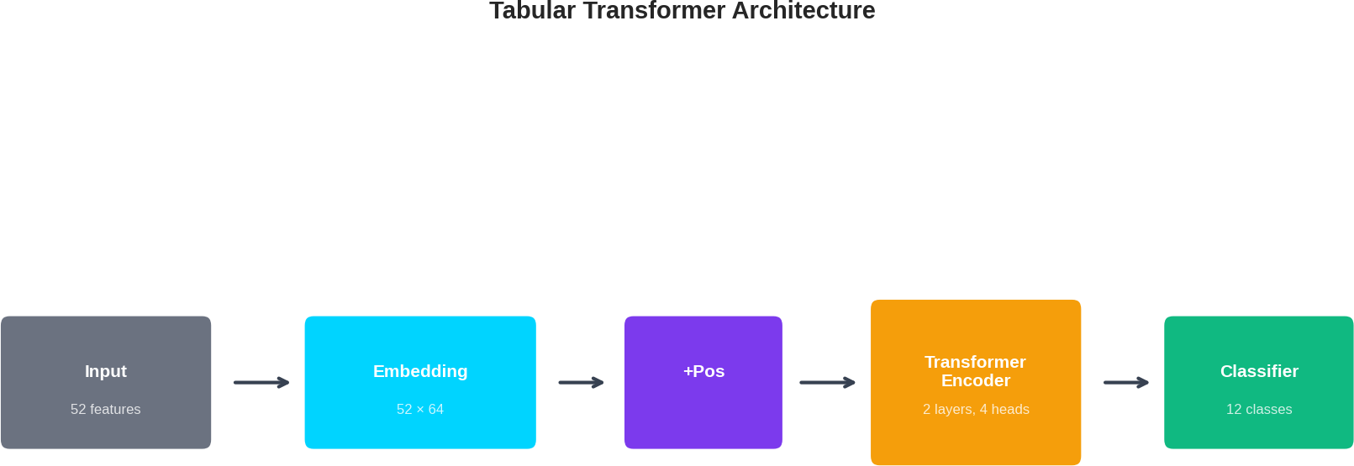
Tabular Transformer
Self-Attention: Each feature attends to ALL other features Multi-Head (4 heads): Learns different relationship patterns Result: 96.64% accuracy, 0.7376 Macro F1

Slide 11
Ensemble Methods
Voting-Based
10 Base Models
Hard Voting: Majority vote Weighted Voting: By accuracy/F1 Top-K Voting: Best 5 models only
Gradient Boosting
LightGBM, XGBoost, CatBoost
Neural Networks
MLP, DCN, Transformer
Traditional ML
KNN, Logistic Reg., AdaBoost, RF
Stacking (Meta-Learning)
Base models make predictions Meta-learner combines them 5-fold stratified CV

Slide 12
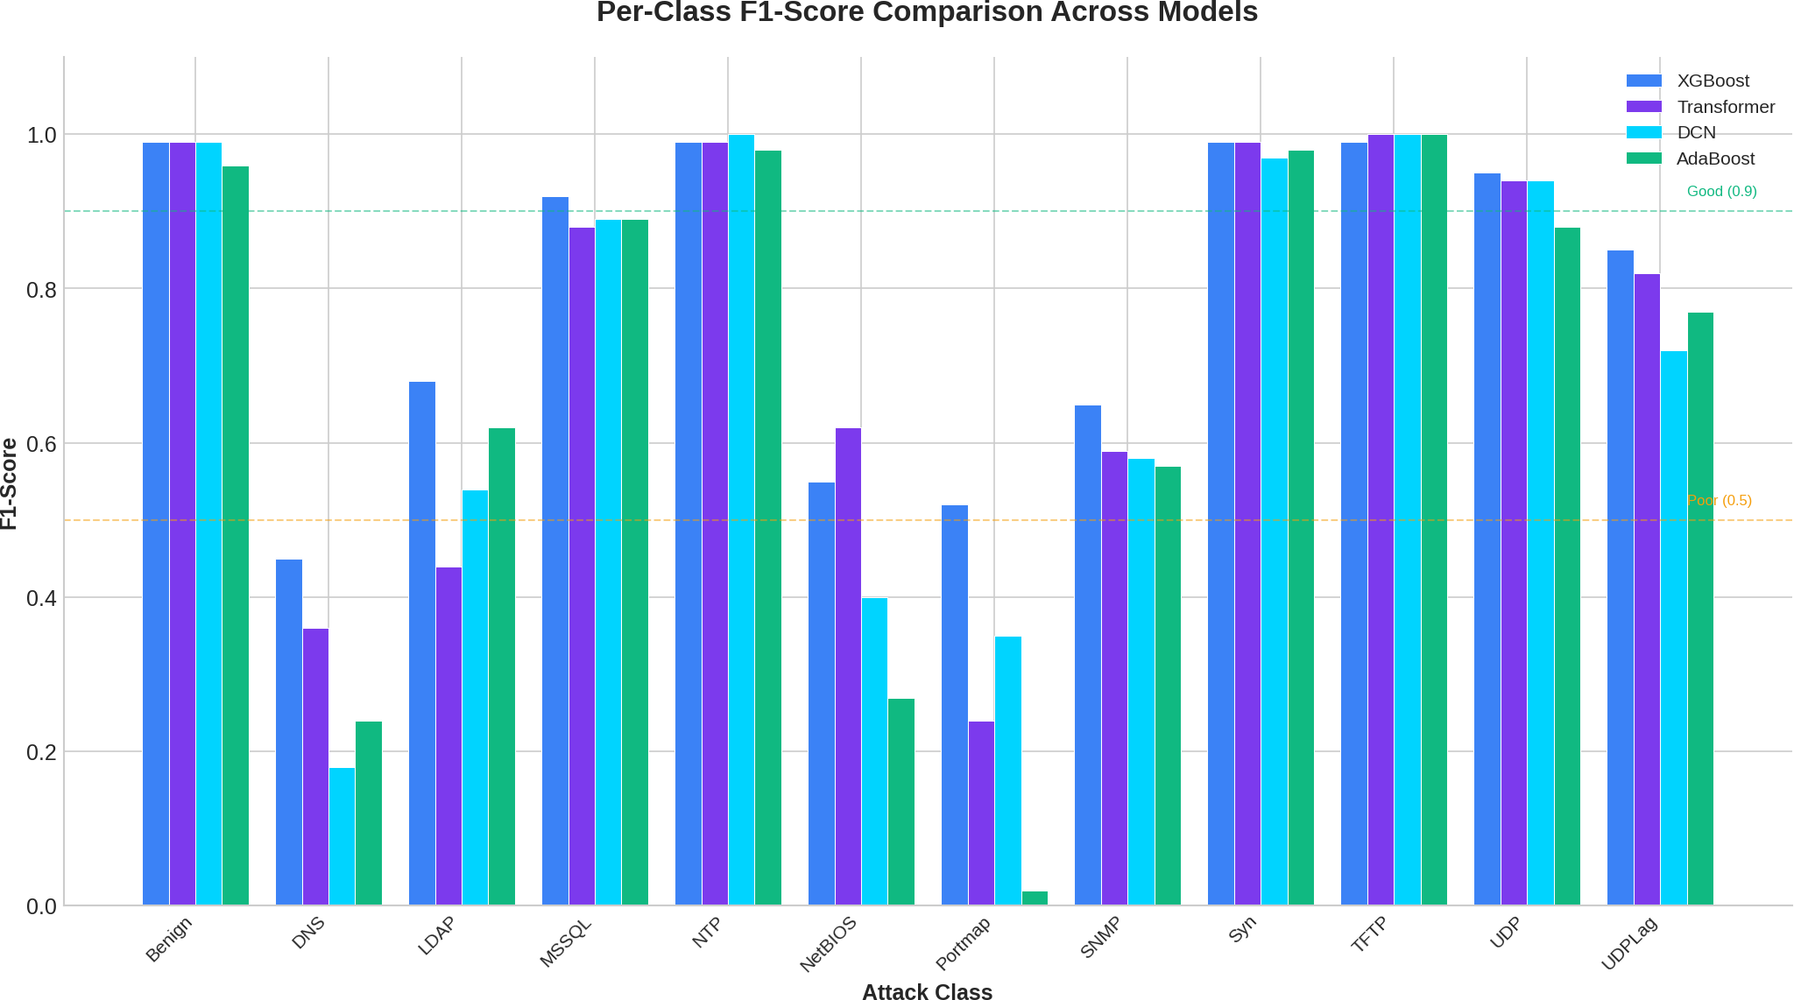
Per-Class F1-Score Comparison

Slide 13
Ensemble Results
Method | Accuracy | F1 (Weighted)
Stacking (GB) | 97.81% | 0.9773
Stacking (RF) | 97.72% | 0.9766
Stacking (MLP) | 97.54% | 0.9746
Top-5 Voting | 97.53% | 0.9745
Weighted Voting | 97.38% | 0.9730
Hard Voting | 97.33% | 0.9726

Slide 14
Summary: All Model Results
Model | Accuracy | Precision | Recall | F1 (Macro)
Random Forest + PCA | 97.95% | 0.8173 | 0.8486 | 0.8268
XGBoost | 97.89% | – | – | –
MLP | 97.27% | – | – | –
KNN | 97.15% | – | – | –
CVAE | 96.84% | 0.7140 | 0.7403 | 0.7103
CatBoost | 96.71% | – | – | 0.7472
Tabular Transformer | 96.64% | 0.7266 | 0.7709 | 0.7376
DCN | 96.28% | 0.7095 | 0.7539 | 0.7120
Logistic Regression | 94.87% | 0.6697 | 0.7327 | 0.6834
AdaBoost | 94.73% | 0.6824 | 0.7360 | 0.6810
LightGBM | 93.08% | 0.5920 | 0.6088 | 0.5878
Best Accuracy: RF+PCA (97.95%)
Best Macro F1: RF+PCA (0.8268)

Slide 15
Summary: Performance by Class Category
Majority Classes (Benign, NTP, Syn, TFTP)
Samples: >10,000
— F1 > 0.96 for all models
Deep learning achieved near-perfect scores (>0.99)
Moderate Classes (MSSQL, UDP, UDPLag)
Samples: 1,000–10,000
— F1 between 0.72–0.94
DCN & Transformer particularly effective
Minority Classes (DNS, LDAP, NetBIOS, Portmap, SNMP)
Samples: <1,000
— F1 varies widely
Challenging despite weighted loss functions
Primary Challenge
176:1 class imbalance – Minority class detection remains the bottleneck

